Slide 1
TO DO
Section L
Tale of the Peacock

Slide 2
EVIDENCE OF EVOLUTION
Key Concept
  Darwin argued that living things have been evolving on earth for millions of years. Evidence for this process could be found in…

Slide 3
EVIDENCE FOR EVOLUTION
Fossil Record
Geographic Distribution
  Adaptive Radiation
Similarities in Early Development
Genetic Evidence
Comparative Morphology
  Homologous structures
  Analogous structures
  Vestigial organs

Slide 4
EVIDENCE FOR EVOLUTION
Fossil Record
Darwin saw fossils as a record of the history of life on Earth.
By comparing fossils from older rock layers with fossils from younger layers, scientists could document that life on Earth has changed over time.

Slide 5
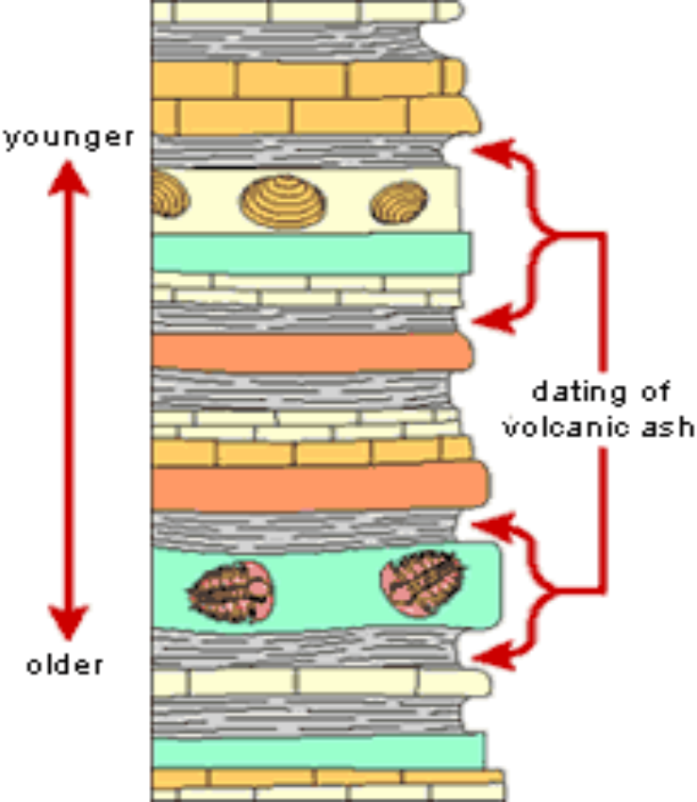
EVIDENCE FOR EVOLUTION
Fossil Record:
Through the examination of sedimentary rock strata (layers), fossils have been used to trace the history of modern life.

Slide 6
EVIDENCE FOR EVOLUTION
Fossil Record
The fossil record provides snapshots of the past that, when assembled, illustrate a panorama of evolutionary change over the past four billion years.
The picture may be smudged in places and may have bits missing, but fossil evidence clearly shows that life is old and has changed over time.

Slide 7
EVIDENCE FOR EVOLUTION
Fossil Record
In rocks more than 1 billion years old, only fossils of single-celled organisms are found.
In rocks that are about 550 million years old, fossils of simple, multicellular animals can be found.
At 500 million years ago, ancient fish without jawbones surface.
At 400 million years ago, fish with jaws are found.

Slide 8
EVIDENCE FOR EVOLUTION
At 350 million years ago, amphibians appear.
At 300 million years ago, reptiles appear.
At 230 million years ago, mammals appear.
At 150 million years ago, birds appear.
As the rocks become more and more recent, the fossils look increasingly like the animals we observe today.

Slide 9
EVIDENCE FOR EVOLUTION
Earth is billions of years old.
Fossils in different layers of rock (sedimentary rock strata) showed evidence of gradual change over time.

Slide 10
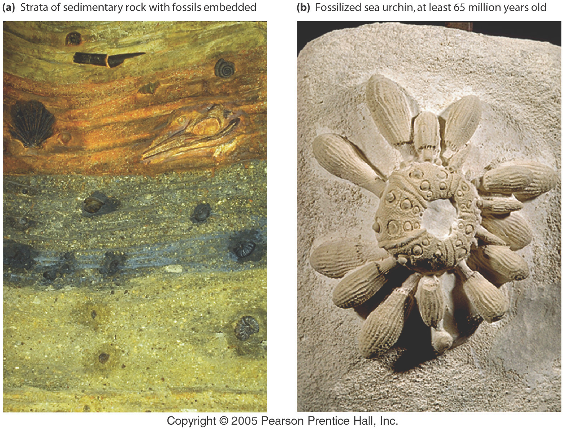
Evidence for Evolution – The Fossil Record

Slide 11
SECTION M
Dating the Fossil Record
You have received nine rock samples from a paleontologist in California. Your job is to arrange the samples in order from oldest to youngest according to their fossil content and to determine their relative age using the process of relative dating. Results from absolute dating methods will not be available from a laboratory for several weeks, and the paleontologist needs the information immediately. You know form previous work that the rocks in sample 2 are the oldest.

Slide 12
SECTION M
Dating the Fossil Record
You know form previous work that the rocks in sample 2 are the oldest.
In your teams, arrange the fossil cards from oldest to youngest. Begin with sample 2 because you know this sample is the oldest. You may need to try several different arrangements to get the cards in order. After an organism becomes extinct, it does not appear in younger rocks.

Slide 13
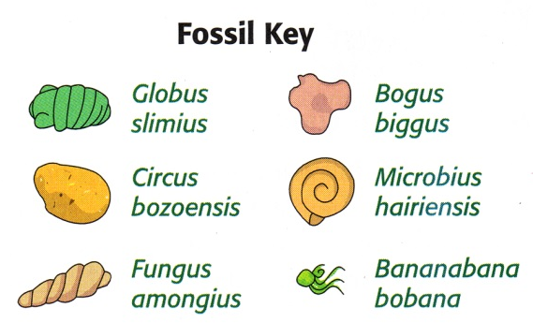
SECTION M
Dating the Fossil Record

Slide 14
SECTION M
Record the samples in order from oldest to youngest in the first column.
Indicate which fossils are found in the sample.
You are planning on preparing a timeline for the paleontologist in California.
But when the results, shown here, come in from the geology lab, you discover that the dates have been separated from the appropriate rock samples.

Slide 15
SECTION M
Absolute dating is very expensive and you can’t have it done again.
You have already determined the relative ages of the samples.
All you have to do is arrange the dates from oldest to youngest.
Add these dates to your table: Fossil Ages- 28.5 mya, 30.2 mya, 18.3 mya, 17.6 mya, 26.3 mya, 14.2 mya, 23.1 mya, 15.5 mya, 19.5 mya

Slide 16
SECTION M
Order of Samples | Species found in sample | Age of sample (in millions of years)
2 | G. slimius | 30.2 mya

