Slide 1
GENETIC EVIDENCE
REMEMBER:
Darwin had no concept of genetics.
•Therefore, genetic tests subject evolution to a whole new set of possible falsifications
How does it do?

Slide 2
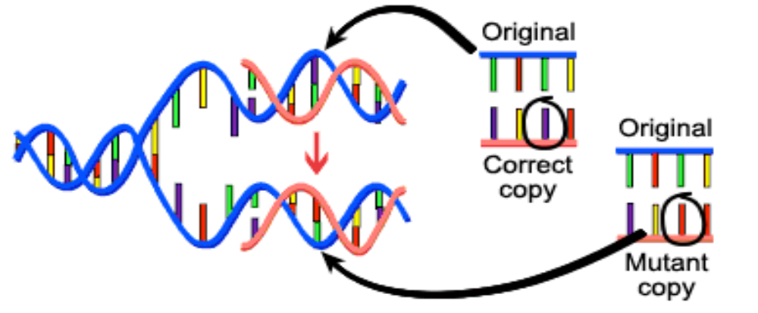
GENETIC EVIDENCE
Mutations happen gradually.
therefore, common descent predicts that related organisms will have related amino acid sequences and base sequences even if not functionally required.

Slide 3
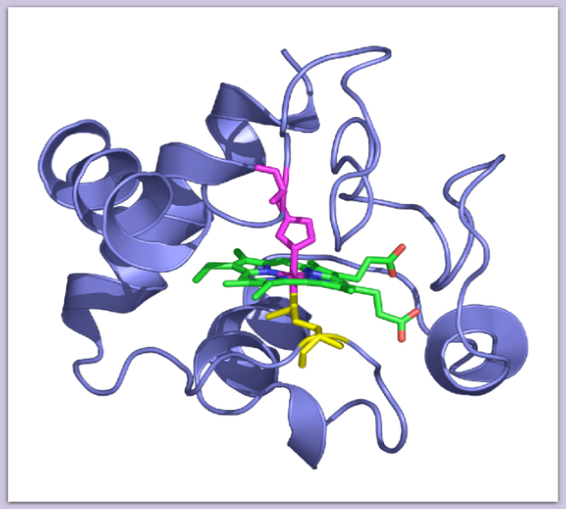
GENETIC EVIDENCE
Ubiquitous Proteins: Perform same function for all organisms
Example: Cytochrome C
  Used in oxygen transport
  Functionally, no reason to be similar

Slide 4
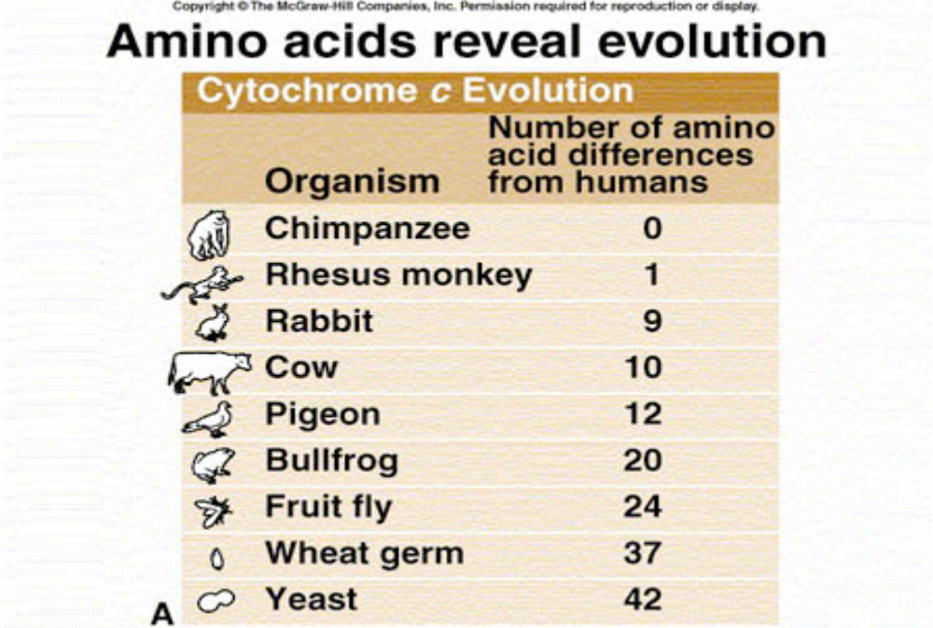
GENETIC EVIDENCE

Slide 5
GENETIC EVIDENCE
All species of life have the same basic genetic machinery of RNA and DNA and the genetic code is essentially universal.

Slide 6
GENETIC EVIDENCE
Sources of genetic variation in species:
    Mutations
    Independent Assortment
    Crossing over
    Sexual Reproduction

Slide 7
GENETIC EVIDENCE
Could it be that similar animals have similar precise needs for Cytochrome c? e.g., fish and dolphins, birds and bats? No!
As predicted by common descent, humans and dolphins are closer than dolphins and sharks; humans and bats closer than bats and birds
Evolutionary prediction strongly verified.

Slide 8
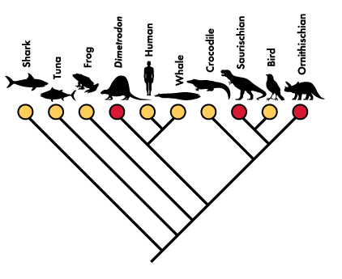
GENETIC EVIDENCE
Cladogram illustrating phylogenetic relationships among ten familiar kinds of animals. Notice how far sharks and whales are from each other.

Slide 9
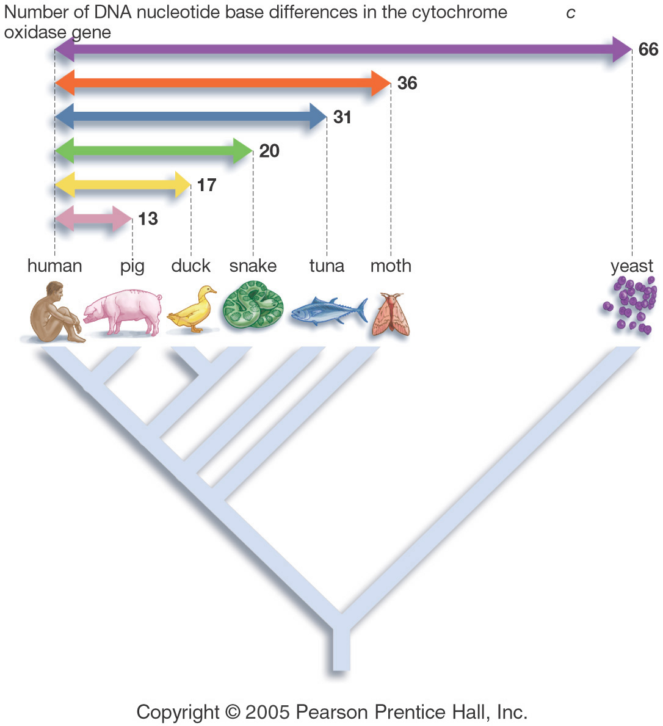
GENETIC EVIDENCE

Slide 10
COMPARATIVE MORPHOLOGY
Study of body forms and structures in an organism.
This can reveal similarities that suggest inheritance from a common ancestor.

Slide 11
COMPARATIVE MORPHOLOGY
HOMOLOGOUS STRUCTURES
structures have different mature forms, but developed from the same embryonic tissue.
Organisms have descended from a common ancestor.

Slide 12
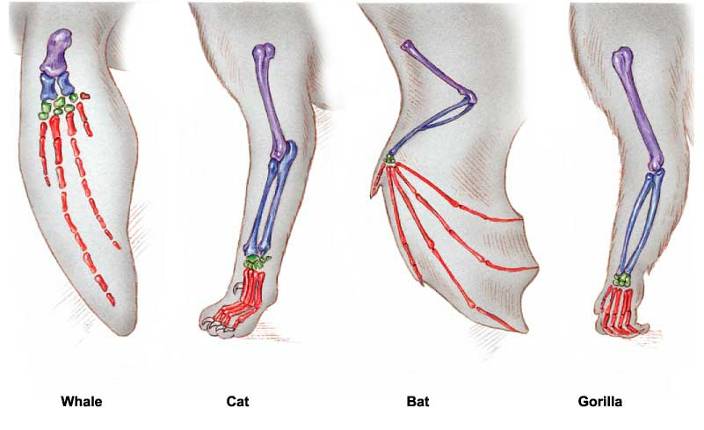
HOMOLOGOUS STRUCTURES

Slide 13
COMPARATIVE MORPHOLOGY
ANALOGOUS STRUCTURES
Structures have similar function and superficial appearance, but different anatomy.
Similarities are due to environmental pressures, but do not demonstrate common ancestry.

Slide 14
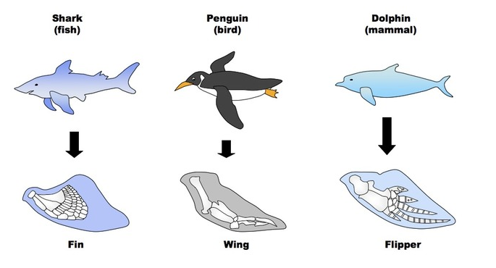
COMPARATIVE MORPHOLOGY

Slide 15
COMPARATIVE MORPHOLOGY
VESTIGAL ORGANS
organs that are reduced in size. They are traces of homologous organs in other species.
Structures have no current function, but can provide information about ancestors.

Slide 16
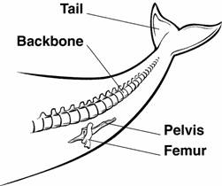
COMPARATIVE MORPHOLOGY
VESTIGAL ORGANS

Slide 17
VESTIGIAL ORGANS
Vestigial Organs in humans:
Appendix: This small pouch attached to your large intestine.
Tailbone: mammals find their tails useful for balance, but evolution converted the human one to just some fused vertebrae we call a coccyx.

Slide 18
VESTIGIAL ORGANS
Wisdom Teeth: the human jaw has become smaller over time and the wisdom teeth just have nowhere to grow.
Erector Pili and Body Hair: in many creatures, fear and confrontation cause muscle fibers called erector pili to activate, forcing hairs to stand up and make the animal appear larger and more threatening.

