Slide 1
WATCH
Natural Selection Animation

Slide 2
RESULTS OF NATURAL SELECTION
Directional Selection
Environmental changes occurs causing one phenotype to replace another. As a result, there can be a rapid shift in allele frequencies favoring one extreme. Example – peppered moth, antibiotic resistance

Slide 3
RESULTS OF NATURAL SELECTION
Diversifying (Disruptive) selection
When individuals at the extremes have a higher fitness than individuals in the middle. If the selection is strong and last long enough, the population can split into two different populations. Example - Darwin’s finches

Slide 4
RESULTS OF NATURAL SELECTION
Stabilizing Selection
When individuals in the middle have a higher fitness than individuals in the extreme. Intermediate forms increase and extreme forms decrease in the population. Example – human birth weights

Slide 5
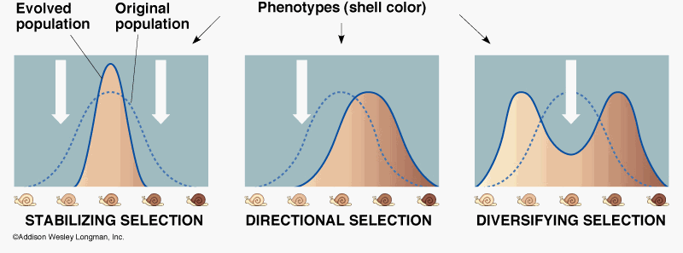
RESULTS OF NATURAL SELECTION

Slide 6
WATCH
Types of Natural Selection

