Slide 1
SAT VOCABULARY
analogous (adj.) similar to, so that an analogy can be drawn
dynamic (adj.) actively changing; powerful
paradox (n.) an apparently contradictory statement that is perhaps true
verdant (adj.) green in tint or color

Slide 2
SAT VOCABULARY
Coming back to school after a two week break is hard! It is _____________ to having to get out of bed after two hours of sleep – you just don’t want to do it. The _______________ is that we have to go back to school so that we can be done with it in May. You can only hope that your teachers and classes are ________________ so that the time will seem to go by fast. Before you know it, it will be spring and the grass with be ___________________ and the temperatures will be warm.

Slide 3
Evolution
Changes in Populations Over Time

Slide 4
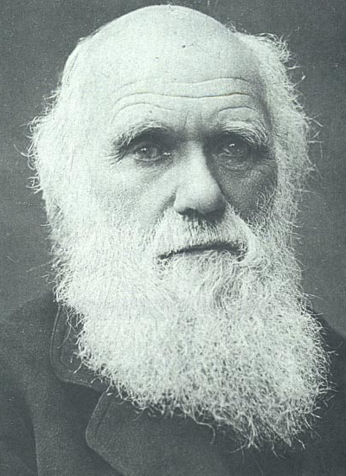
Evolution
“Nothing in biology makes sense EXCEPT in the light of evolution.” Theodosius Dobzhansky
Charles Darwin in later years

Slide 5
WATCH
Evolution

Slide 6
HISTORY OF EVOLUTIONARY THOUGHT

Slide 7
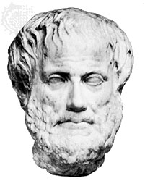
EARLY IDEAS ON EARTH’S ORGANISMS
Aristotle believed species were fixed creations arranged by their complexity
Idea lasted 2000 years

Slide 8
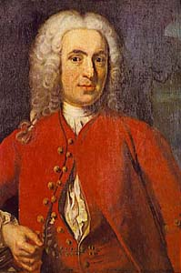
EARLY IDEAS ON EARTH’S ORGANISMS
Linnaeus – 1st to group similar organisms and assign them Latin names
Two word name (Genus species)
Known as Binomial nomenclature

Slide 9
CONTRIBUTOR’S TO DARWIN’S THINKING INCLUDED:
:
James Hutton - Gradualism
Thomas Malthus – struggle for existence (resources)
John Baptiste Lamarck – Inheritance of acquired Characteristics and Law of Use and Disuse
Charles Lyell – uniformintarianism (geologic processes still changing Earth)

Slide 10
CONTRIBUTOR’S TO DARWIN’S THINKING INCLUDED:
:
Alfred Russel Wallace – organisms evolved from common ancestors.

Slide 11
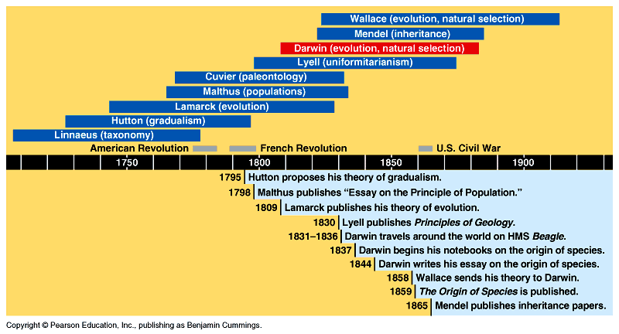
EVOLUTIONARY TIMELINE

Slide 12
HUTTON’S THEORY OF GEOLOGICAL CHANGE
James Hutton, 1785, Scottish geologist
Studied invertebrate fossils in Paris Museum.
Described the geological forces that have changed life on earth over millions of years (erosion, earthquakes, volcanoes, etc.)

Slide 13
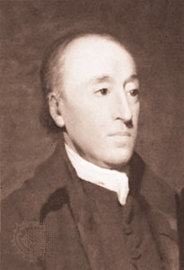
HUTTON’S THEORY OF GEOLOGICAL CHANGE
Proposes that Earth is shaped by geological forces that took place over extremely long periods of time – estimates Earth to be millions of years old.

Slide 14
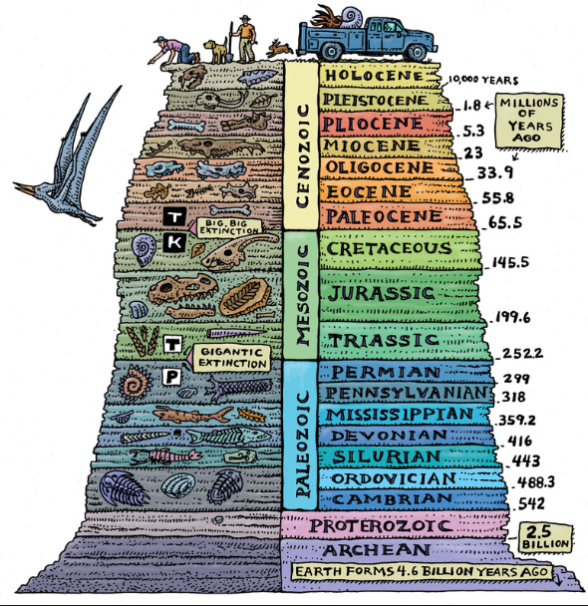
HUTTON’S THEORY OF GEOLOGICAL CHANGE
Idea known as Gradualism
Scientists now believe Earth is 4.6 billion years old.

Slide 15
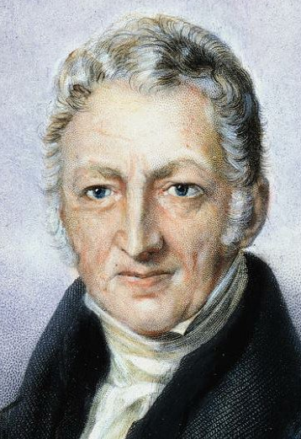
POPULATION GROWTH
Thomas Malthus, 1798, Economist
Observed babies being born faster than people were dying
Predicts that human populations outgrow food supply. Death and famine are inevitable.

Slide 16
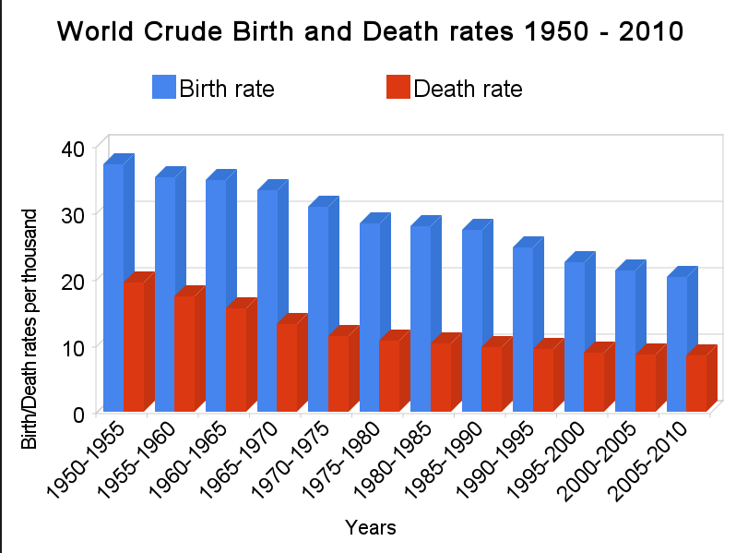
POPULATION GROWTH
Organisms struggle to exist!

Slide 17
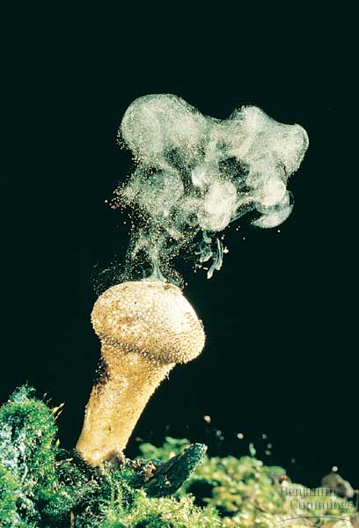
POPULATION GROWTH
Darwin realized Malthus’s principles were visible in nature.
Plants & animals produce far more offspring than can be supported.
  Most die
  If they didn’t – Earth would be overrun

Slide 18
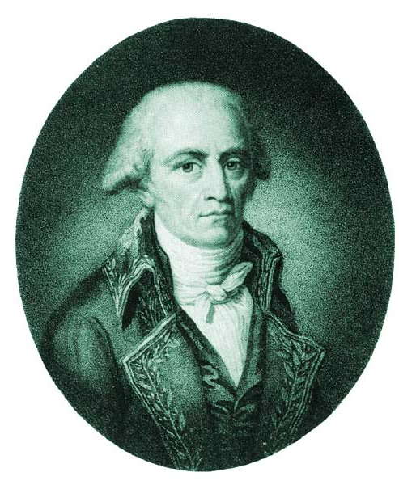
LAMARCK’S THEORY OF EVOLUTION
Jean-Baptiste Lamarck, 1809
One of first scientists to understand that change occurs over time.
Stated that changes are adaptations to environment acquired in an organism’s lifetime.

Slide 19
LAMARCK’S THEORY OF EVOLUTION
Called it Inheritance of Acquired Characteristics.
Published theory – organisms changed due to the demands of their environment.
These traits could then be passed on to their offspring
Over time this led to new species.

Slide 20
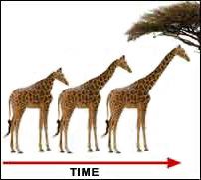
LAMARCK’S THEORY OF EVOLUTION
Use or Disuse Principle.
If a body part was used, it got stronger.
If body part NOT used, it deteriorated.

Slide 21
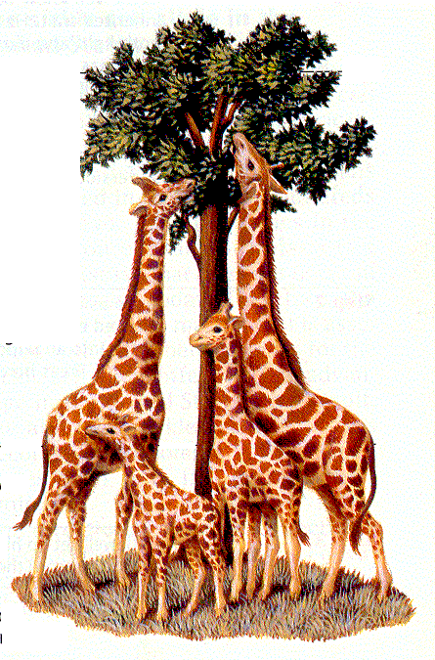
Lamarck’s Theory of Evolution
Use and Disuse - organisms could change the size or shape of organs by using them or not using them
Blacksmiths & their sons (muscular arms)
Giraffe’s necks longer from stretching)

Slide 22
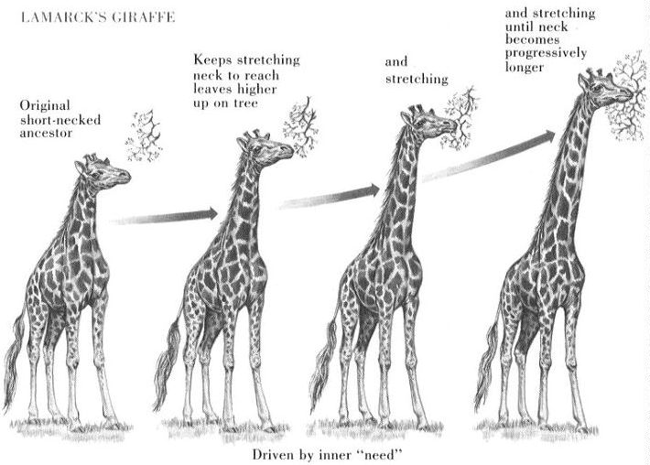

Slide 23
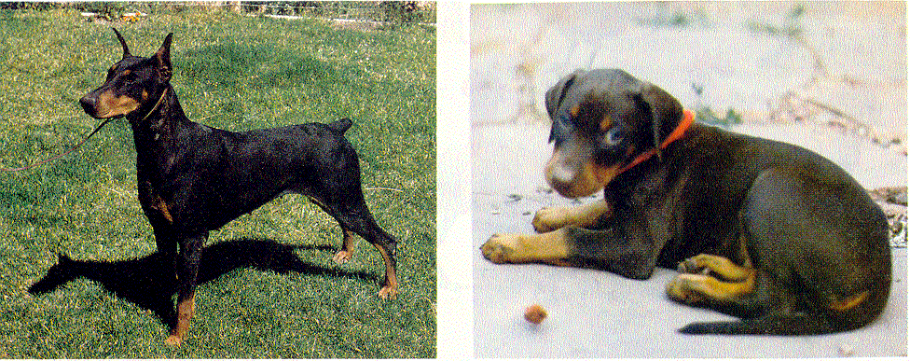
LAMARCK’S THEORY OF EVOLUTION
Inheritance Of Acquired Traits
  Traits acquired during one’s lifetime would be passed to offspring
Clipped ears of dogs could be passed to offspring!

Slide 24
LAMARCK’S THEORY OF EVOLUTION
Tendency toward perfection.
Organisms are continually changing and acquiring features that help them live more successfully in their environment.
Example: Bird ancestors desired to fly so they tried until wings developed
Proposed organisms change over time!

Slide 25
LAMARCK’S MISTAKES
Lamarck did NOT know how traits were inherited (Traits are passed through genes).
Genes are NOT changed by activities in life.
Change through mutation occurs before an organism is born.

Slide 26
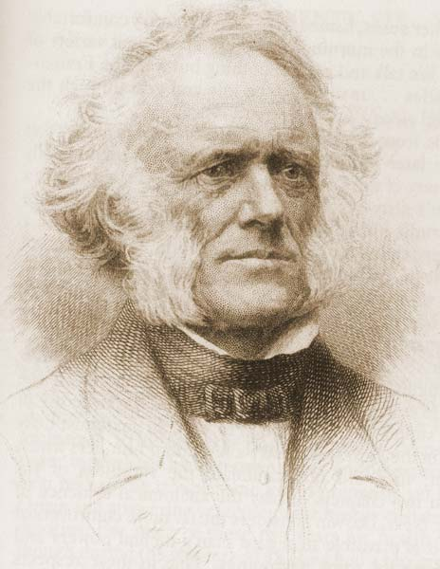
CHARLES LYELL
1833
Proposed theory of Uniformintarianism.
Geological processes at uniform rates building and wearing down Earth’s crust.
Proposed that the Earth was millions of years instead of a few thousand years old.

Slide 27
GEORGE LYELL
PRINCIPLES OF GEOLOGY - Published by Lyell just before the beagle set sail and read by Darwin.
Processes occurring now have shaped Earth’s geological features over long periods of time.
Helped Darwin understand sea shells in the Andes mountains at 12,000+ feet.

