Slide 1
WATCH
Bill Nye: Darwin & Natural Selection

Slide 2
ALFRED WALLACE
1858
organisms evolved from common ancestors.
He independently came up with the idea of natural selection as a driver of evolution.
Speculates on evolution by natural selection with emphasis on the idea of competition for resources as a main force of natural selection.

Slide 3
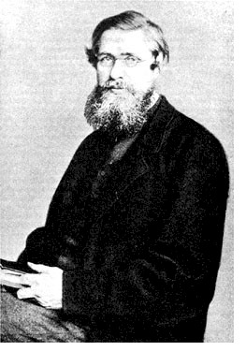
WALLACE’S CONTRIBUTION
Alfred Russel Wallace independently came to same conclusion as Darwin that species changed over time because of their struggle for existence
When Darwin read Wallace’s essay, he knew he had to publish his findings.

Slide 4
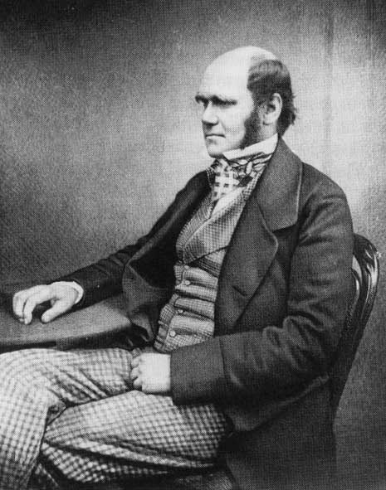
CHARLES DARWIN
Born Feb. 12, 1809.
Joined crew of HMS Beagle, 1831.
Naturalist (unpaid).
5 year science expedition around world.
Avid collector of flora and fauna.
Astounded by variety of life.

Slide 5
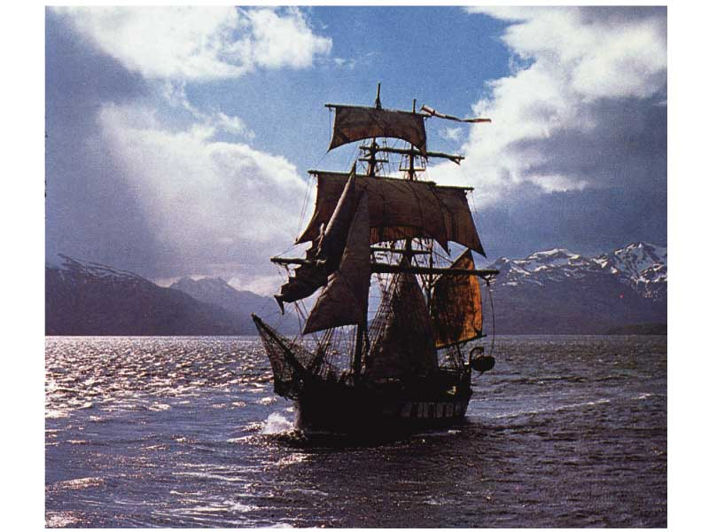
VOYAGE OF THE BEAGLE
A reconstruction of the HMS Beagle sailing off Patagonia.

Slide 6
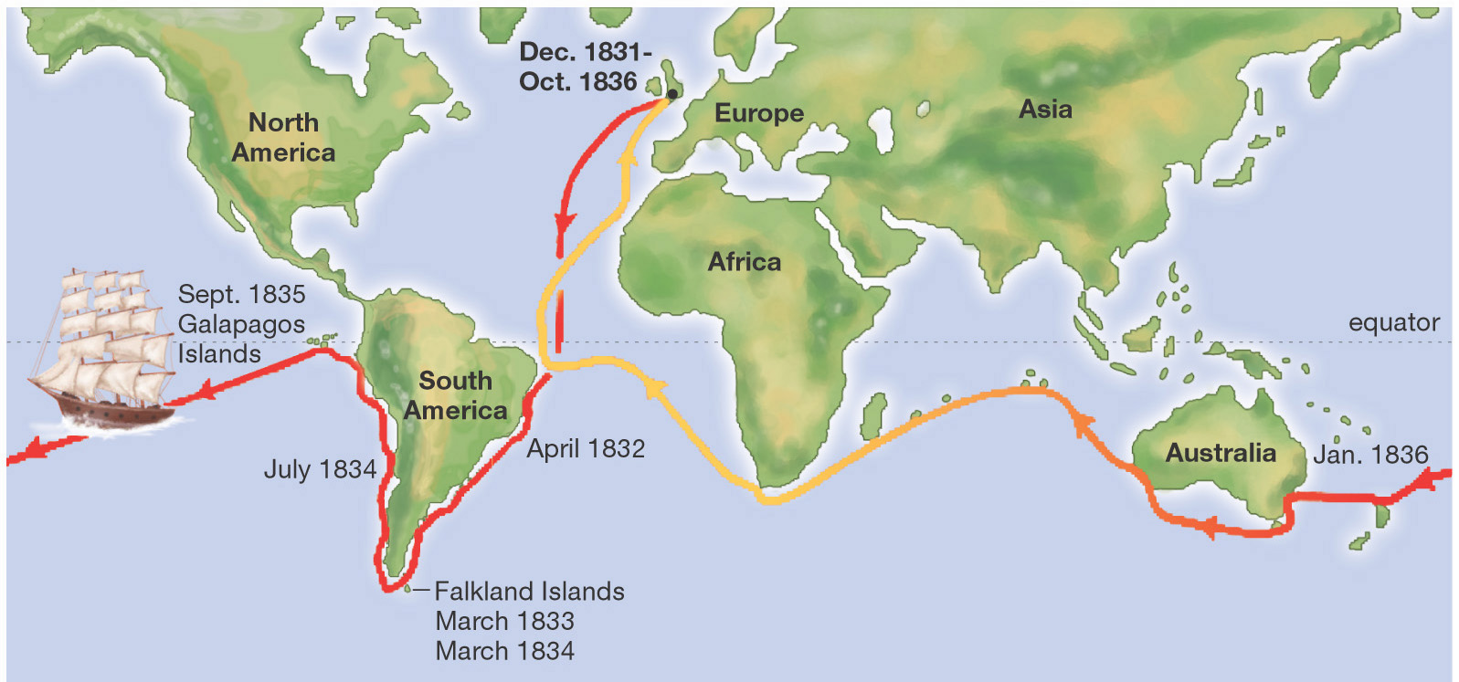
VOYAGE OF THE BEAGLE
Darwin left in 1831 and returned 5 years later.

Slide 7
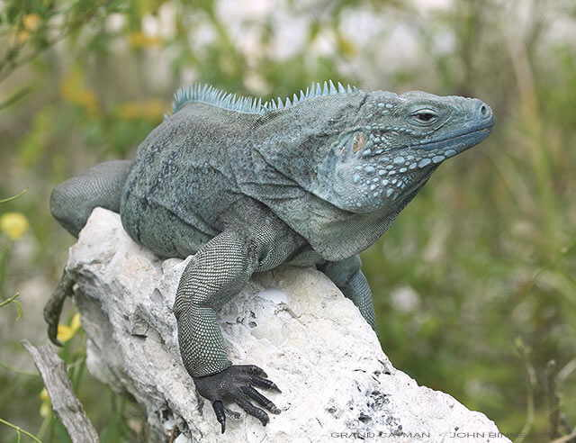
THE GALAPAGOS ISLANDS
Small group of islands 1000 km west of South America.
Each island has very different climates.
Animals on islands are unique.
    Tortoises
    Iguanas
    Finches

Slide 8
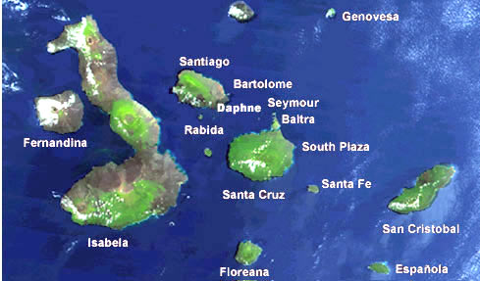
THE GALAPAGOS ISLANDS
Volcanic islands in origin.
Island species varied from mainland species and from island-to-island species.
Each island had long or short neck tortoises.

Slide 9
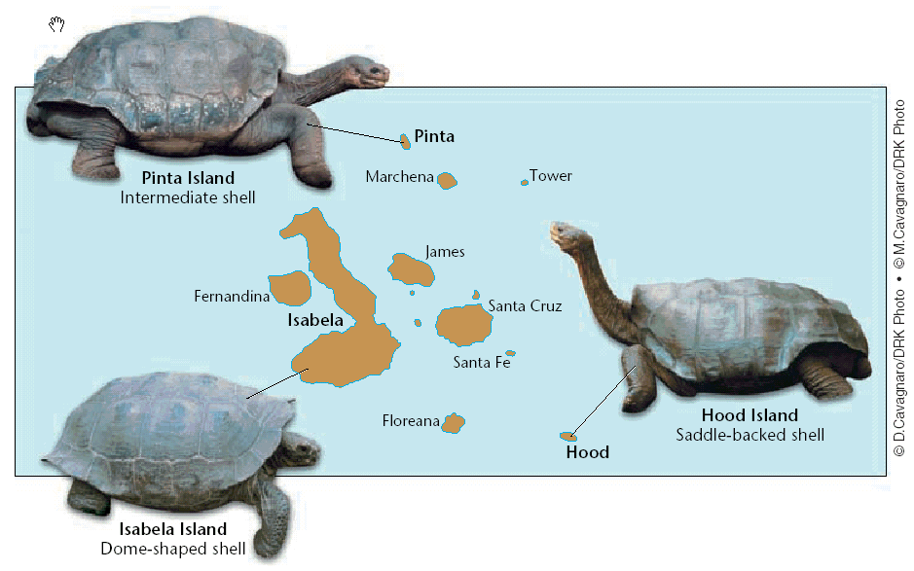

Slide 10
THE GALAPAGOS ISLANDS
Finches on the islands resembled a mainland finch.
More types of finches appeared on the islands where the available food was different (seeds, nuts, berries, insects).
Finches had different types of beaks adapted to their type of food gathering.

Slide 11
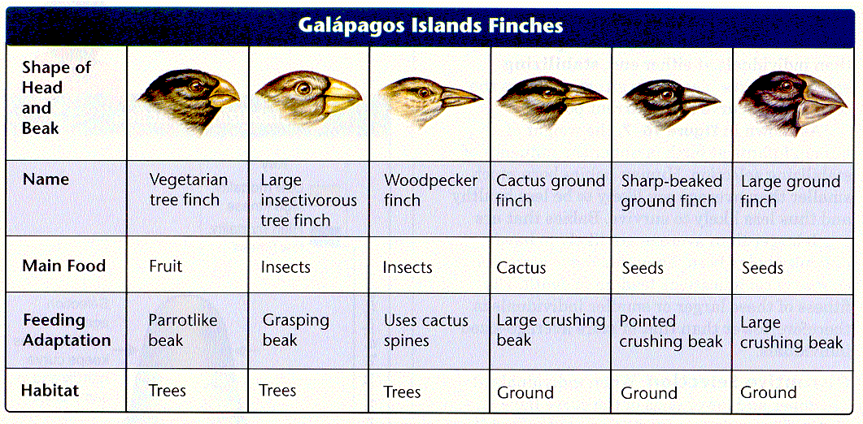

Slide 12
DARWIN’S OBSERVATIONS AND CONCLUSIONS
  During his travels, Darwin made numerous observations and collected evidence that led him to propose a revolutionary hypothesis about the way life changes over time.
  In South America, Darwin found fossils of extinct animals that were similar to modern species.

Slide 13
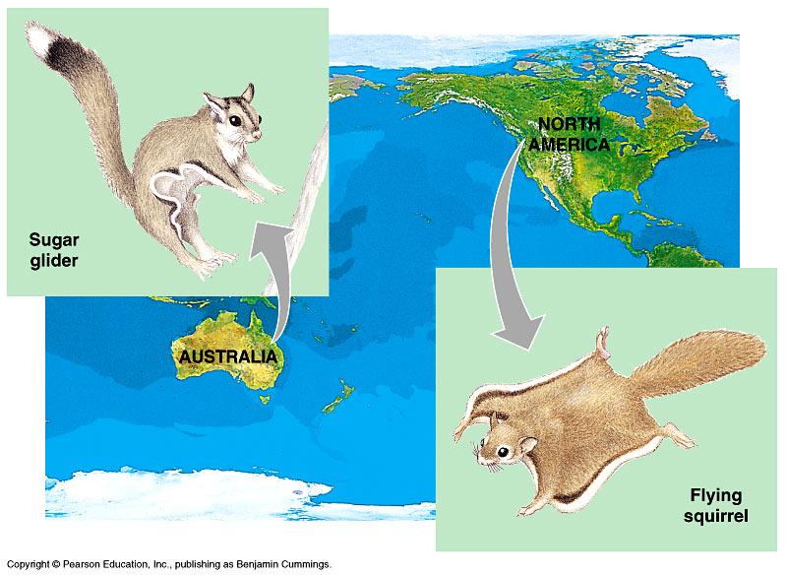
DARWIN’S OBSERVATIONS AND CONCLUSIONS
Patterns of diversity were shown.
Unique adaptations in organisms.
Species not evenly distributed
    Australia-kangaroos, but no rabbits
    S. America-Llamas

Slide 14
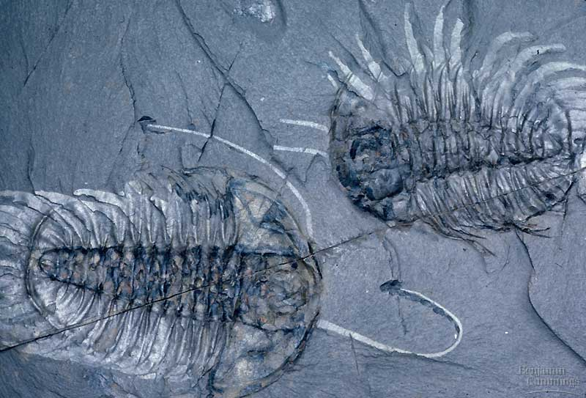
DARWIN’S OBSERVATIONS AND CONCLUSIONS
He collected both living organisms and fossils.
Fossils included:
    Trilobites → →
    Giant Ground Sloth of South America
These species NO longer existed.
What had happened to them?

Slide 15
DARWIN’S OBSERVATIONS AND CONCLUSIONS
In 1859, he publishes the “Origin of Species” explaining his theory of evolution by Natural Selection.

Slide 16
