Slide 1
WATCH
Evolution in the Galapagos
Third period: Bill Nye: Darwin & Natural Selection

Slide 2
NATURAL SELECTION
mechanism for evolution
Natural Variations (differences among individuals) exist in all organisms.
These variations are inherited and are called adaptations.
So adaptations are inherited traits.

Slide 3
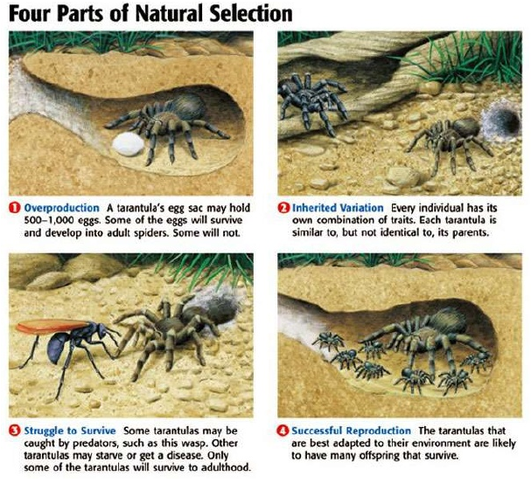

Slide 4
NATURAL SELECTION
ADAPTATIONS that are more favorable become more prevalent within the population.
These traits will be passed onto the next generation.
The GENE POOL of a population changes in favor of the “FITTEST” phenotype and genotype.

Slide 5
NATURAL SELECTION
Individuals compete for resources.
ONLY the best suited organisms to the environment will survive and reproduce.
“Survival of the Fittest” - Some phenotypes are better than others when it comes to competing for resources.

Slide 6
NATURAL SELECTION
The more “FIT” phenotype (best fitness) will survive and have the possibility of passing its alleles to the next generation.
Organisms with traits that don’t help them survive will die and will NOT be able to pass these traits on.
So the frequency of these “BAD” traits will decrease.

Slide 7
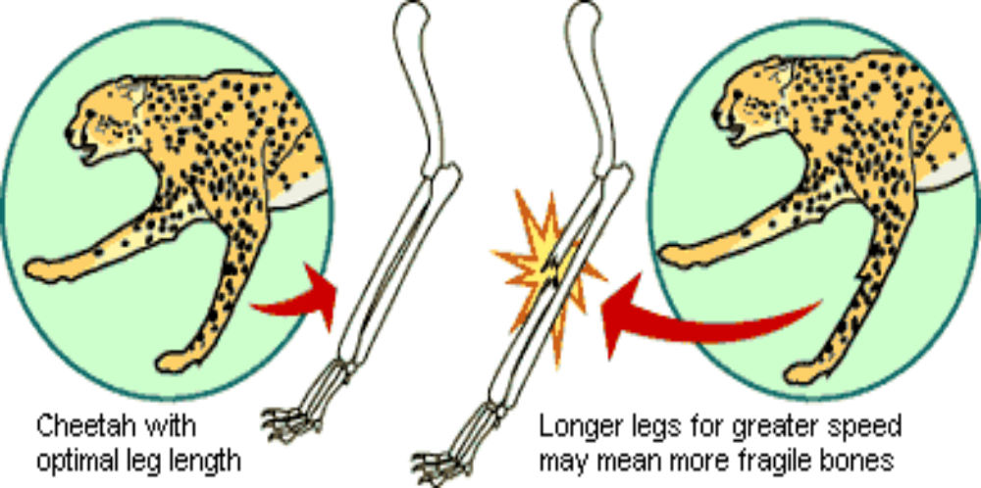
NATURAL SELECTION

Slide 8
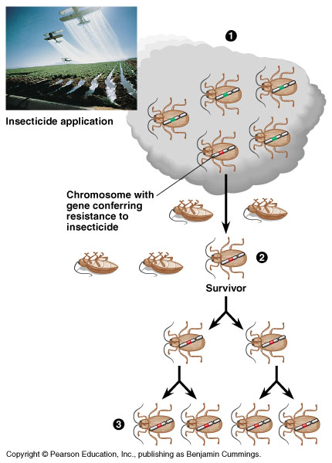
NATURAL SELECTION
Driving force for evolution.
During the struggle for resources, strongest survive and reproduce.
Idea that at least some of the differences between individuals, which impact their survival and fertility, are inheritable.
.

Slide 9
NATURAL SELECTION
So, NATURAL SELECTION is the adjustment of genes throughout generations based on factors that help it survive.

Slide 10
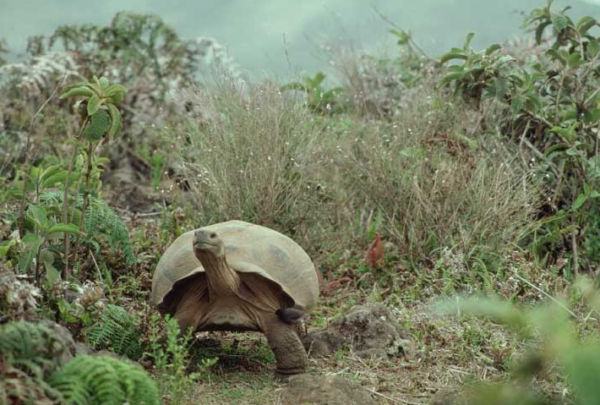
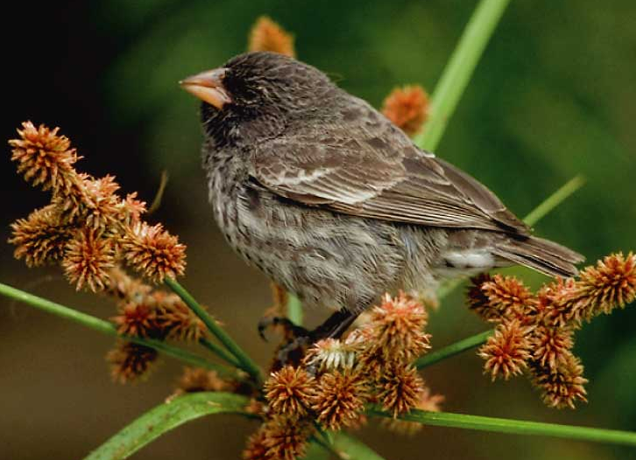
DEFINITION
Evolution is the slow , gradual change in a population of organisms over time

Slide 11
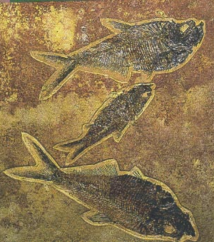
DARWIN’S OBSERVATIONS
Left unchecked, the number of organisms of each species will increase exponentially, generation to generation.
In nature, populations tend to remain stable in size.
Environmental resources are limited.

Slide 12
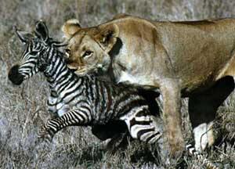
DARWIN’S CONCLUSION
Production of more individuals than can be supported by the environment leads to a struggle for existence among individuals.
Only a fraction of offspring survive each generation.
Survival of the Fittest

Slide 13
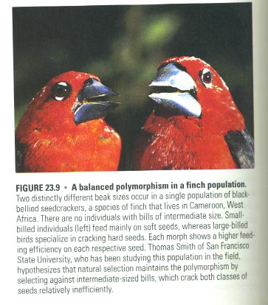
DARWIN’S OBSERVATIONS
Individuals of a population vary extensively in their characteristics with no two individuals being exactly alike.
Much of this variation between individuals is inheritable.

Slide 14
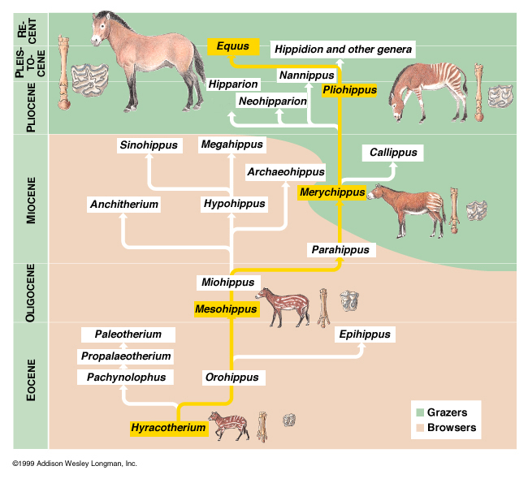
DARWIN’S CONCLUSION
Individuals who inherit characteristics most fit for their environment are likely to leave more offspring than less fit individuals.
Called Natural Selection.

Slide 15
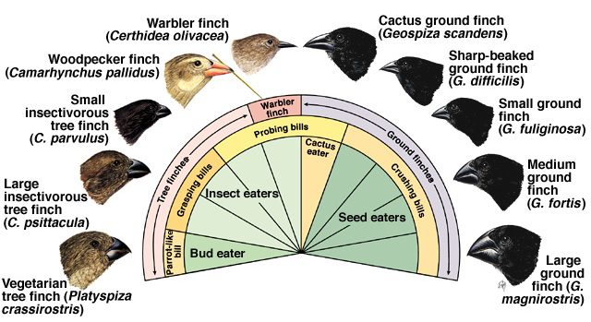
DARWIN’S THEORY OF EVOLUTION
The unequal ability of individuals to survive and reproduce leads to a gradual change in a population, with favorable characteristics accumulating over generations (natural selection).
New species evolve.

Slide 16
DARWIN’S THEORY OF EVOLUTION
Organisms Change Over Time

