Slide 1
WATCH
Section D ‘How does evolution really work?
Use the video on this page

Slide 2
SECTION E: VARIATION AND SELECTION OF THE EYGPTIAN ORGAMI BIRD
INTRODUCTION: The Egyptian Origami Bird (Avis papyrus) lives in arid regions of North Africa. Only those birds which can successfully fly the long distances between the sparsely spaced oases will be able to live long enough to breed successfully. You will breed several generations of Origami Birds and observe the effects on their evolutionary success.

Slide 3
PROCEDURE
1. All students will start with the same P generation dimensions. You will breed offspring to create your F1 generation. Flip a coin to determine if the mutation occurs on the front wing or the back wing. If heads, the mutation occurs on the front wing. If tails, the mutation occurs on the back wing.

Slide 4
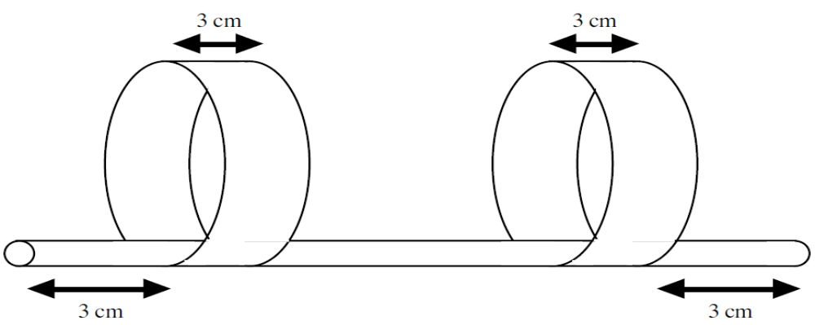
PROCEDURE
Egyptian Origami Bird, Avis papyrus

Slide 5
PROCEDURE
2. For each chick, throw your dice then record the results on the table. The dice throw determines how the mutation affects the wing. On the dice….
  1 = the wing moves 1 cm toward the end of the straw.
  2 = the wing moves 1 cm away from the end of the straw.

Slide 6
PROCEDURE
  3 = the circumference of the wing increases 2 cm.
  4 = the circumference of the wing decreases 2 cm.
  5 = the width of the wing increases 1 cm.
  6 = the width of the wing decreases 1 cm.
3. Continue to create offspring for the F2, F3, and F4 generation by throwing the dice each time to determine the type of mutation. Record the results on the table.

Slide 7
PROCEDURE
Generation | Genotypes (Measurements)
P | Front wing - Distance from end - 3x20 cm 3 cm Back wing - Distance from end – 3x20 cm 3 cm
F1 | Front wing - Distance from end - Back wing - Distance from end –
F2 | Front wing - Distance from end - Back wing - Distance from end –
F3 | Front wing - Distance from end - Back wing - Distance from end –
F4 | Front wing - Distance from end - Back wing - Distance from end –

Slide 8
PROCEDURE
4. Once you know the genotype of your F4 generation, create a model of your bird after all the mutations. Cut two strips of paper according to the length and width in the F4 generation. Loop each strip of paper with a 1 cm overlap and tape according to the distance in the F4 from the edge of the straw. You will need to add 1 cm to account for the overlap.

Slide 9
PROCEDURE
5. Now it’s time to see how your bird compares to the rest of the birds in the class. We will test to see which birds will be able to survive the long trek to the water source.
We will do this together. You will then answer the Discussion questions on your own.

