Slide 1
NATURAL SELECTION
The Struggle for Existence - Darwin realized that high birth rates and a shortage of life's basic needs would force organisms to compete for resources like food, living space, etc.
Therefore, organisms will produce more offspring than can survive, and many that do survive will NOT reproduce.

Slide 2
NATURAL SELECTION
Darwin referred to evolution as descent with modification – all organisms related through descent from an ancestor.
Ancestors accumulate diverse modifications or adaptations that ‘fit’ them to specific ways of life.
All organisms on Earth fit into a single tree of life.

Slide 3
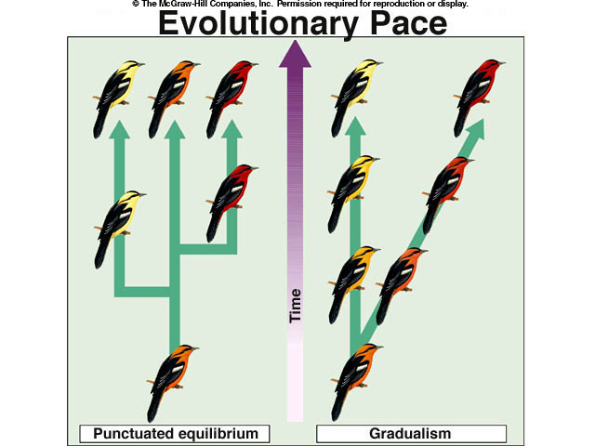
COMMON DESCENT WITH MODIFICATION
Organisms descended from common ancestors
Idea that organisms change with time, diverging from a common form
Caused evolution of new species

Slide 4
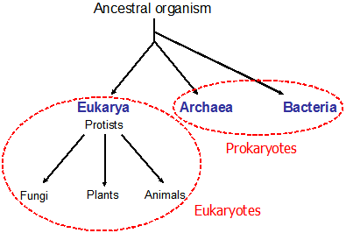
DESCENT WITH MODIFICATION

Slide 5
DESCENT WITH MODIFICATION
Takes Place Over Long Periods of Time
Natural Selection Can Be Observed As Changes In
  Body Structures
  Ecological Niches
  Habitats

Slide 6
DESCENT WITH MODIFICATION
Species today look different from their ancestors
Each living species has
  Descended
  With changes
  From other species
  Over time

Slide 7
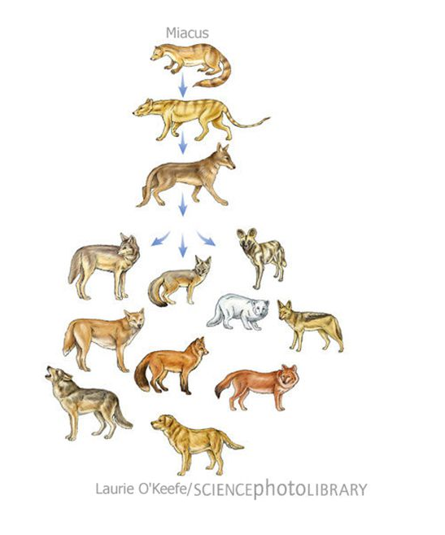
DESCENT WITH MODIFICATION

Slide 8
DESCENT WITH MODIFICATION
Implies
  All living organisms are related.
  Single tree of life
    DNA, Body Structures, Energy Sources
Common Descent
  All species, living and extinct, were derived from common ancestors.

Slide 9
ORIGIN OF SPECIES
CONCEPTS

Slide 10
EVOLUTION BY NATURAL SELECTION CONCEPTS
The Struggle for Existence - compete for food, mates, space, water, etc.
Survival of the Fittest - strongest able to survive and reproduce.
Descent with Modification - new species arise from common ancestor replacing less fit species.

Slide 11
SURVIVAL OF THE FITTEST
Fitness - Ability of an individual to survive and reproduce.
Adaptation - Inherited characteristic that increases an organisms chance for survival.

Slide 12
SURVIVAL OF THE FITTEST
Adaptations Can Be:
  Physical
    Speed, Camouflage, Claws, Quills, etc.
  Behavioral
    Solitary, Herds, Packs, Activity, etc.

Slide 13
SURVIVAL OF THE FITTEST
Fitness is central to the process of evolution
Individuals With low fitness
  Die
  Produce Few Offspring
Survival of the Fittest
Also known as Natural Selection

Slide 14
SURVIVAL OF THE FITTEST
Key Concept
  Over time, natural selection results in changes in the inherited characteristics of A population. These changes increase a species’ fitness in its environment.

Slide 15
WATCH
Video: Tree of Life

Slide 16
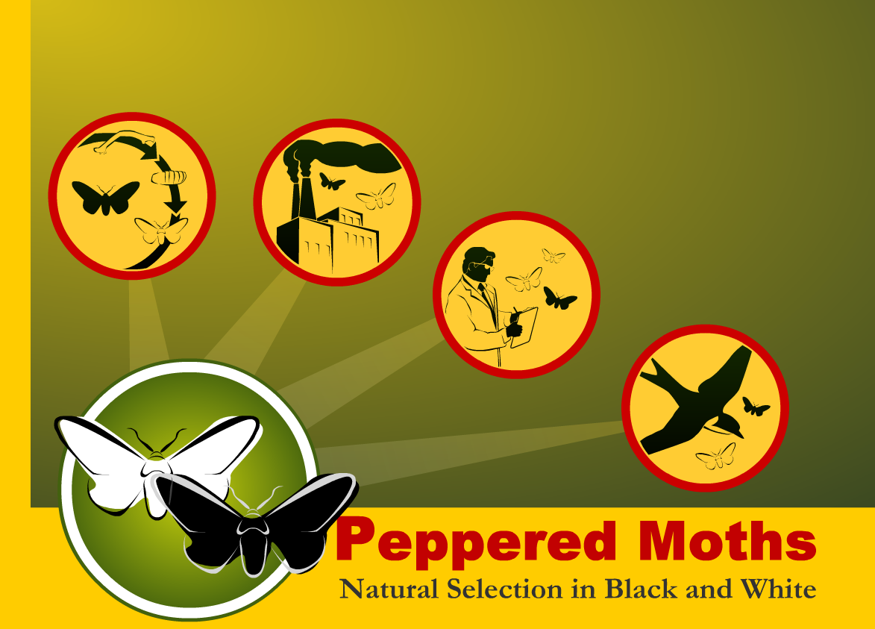
SECTION F
Peppered Moth Simulation (computers)
Choose the last circle

