Slide 1
WATCH
What is Natural Selection?

Slide 2
ARTIFICIAL SELECTION
Darwin presented evidence that evolution has been taking place for millions of years and continues to happen.
To explain Natural Selection, Darwin compared it to Artificial Selection the selection by humans for breeding of desired traits from the natural variation among different organisms.

Slide 3
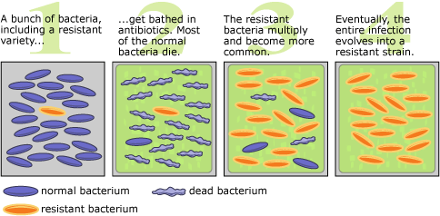
ARTIFICIAL SELECTION
Examples: domestication of animals, crops.

Slide 4
NATURAL VARIATION AND ARTIFICIAL SELECTION
He abandoned the idea that species were perfect and unchanging.
He observed significant variation in all species observed.
He observed farmers use variation to improve crops and livestock
This was called selective breeding.

Slide 5
NATURAL VARIATION AND ARTIFICIAL SELECTION
Natural Variation
  Differences among individuals of a species
Artificial Selection
  Selective breeding to enhance desired traits among stock or crops

Slide 6
NATURAL VARIATION AND ARTIFICIAL SELECTION
Key Concept:
  In Artificial Selection, nature provides the variation among different organisms and humans select those variations that they find useful.

Slide 7
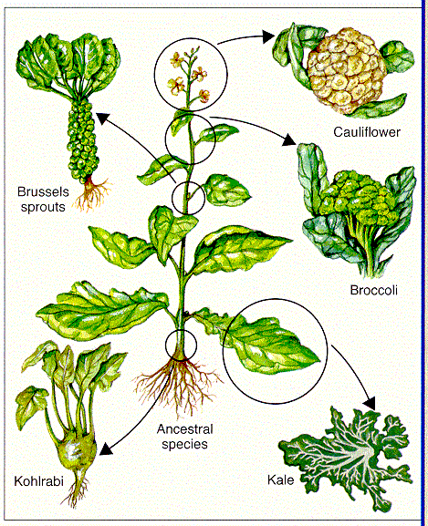

Slide 8
ARTIFICIAL SELECTION
Artificial Selection is a form of selection in which humans actively choose which traits should be passed onto offspring.
Humans have used selective breeding long before Darwin's Postulates and the discovery of genetics.
Farmers chose cattle with beneficial traits such as larger size or producing more milk, and made them breed.

Slide 9
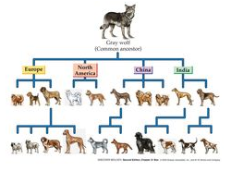
ARTIFICIAL SELECTION
We know as the domestic dog is actually a subspecies of the Gray wolf, Canis lupus; domestic dogs are known as Canis lupus familiarus.

