Slide 1
SAT VOCABULARY
Attribute (v) to credit, assign (n) a facet or trait
Permeate (v) to spread throughout, saturate
Transmute (v) to change or alter in form
Reciprocate (v) to give in return

Slide 2
SAT VOCABULARY
In the study of heredity, scientists share their research on genetics knowing that other scientists will _______________ in return. Scientists try to determine which genes code for which physical ______________. Over time, genes can ______________, or mutate, which allows different traits to be expressed. If a mutation is widespread enough, it may _____________ throughout a species’ population causing many to have the mutation.

Slide 3
GENETICS AND HEREDITY

Slide 4
HISTORY
Genetics is the branch of biology that deals with heredity.
Inheritance is how traits, or characteristics, are passed on from generation to generation.
Chromosomes are made up of genes, which are made up of DNA and found inside the nucleus of a cell.
Research on genetics began with Gregor Mendel who experimented with pea plants in the 1800s.
He is considered Tthe Father of Genetics.

Slide 5
GREGOR MENDEL
Austrian Monk.
Experimented with pea plants.
Used pea plants because:
  They were available.
  They reproduced quickly.
  They showed obvious differences in the traits.
Understood that there was something that carried traits from one generation to the next - “FACTOR”.

Slide 6
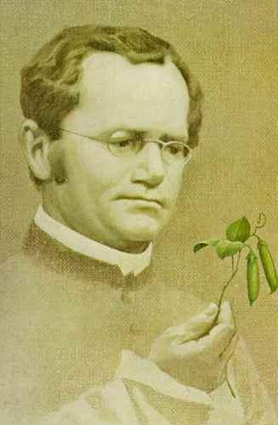

GREGOR MENDEL
In the mid-1800s, the rules underlying patterns of inheritance were uncovered in a series of experiments performed by an Austrian monk named Gregor Mendel.

Slide 7
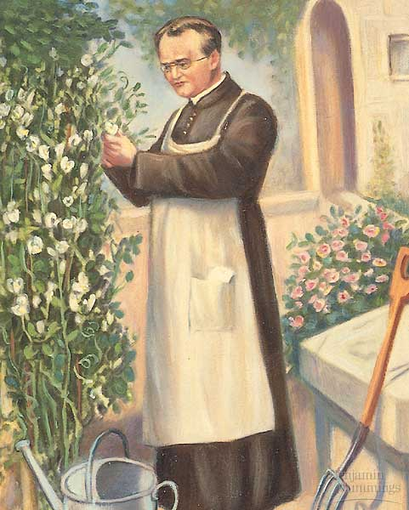
MENDELIAN GENETICS
Gregor Mendel was one of the first to apply an experimental approach to the question of inheritance.
For seven years, Mendel bred pea plants and recorded inheritance patterns in the offspring.

Slide 8
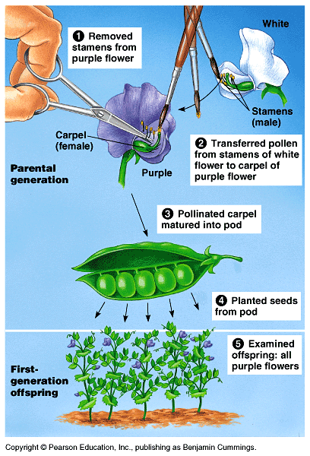
MENDELIAN GENETICS
Mendel probably chose to work with peas because they are available in many varieties.
The use of peas also gave Mendel strict control over which plants mated.
Fortunately, the pea traits are distinct and were clearly contrasting.

Slide 9
MENDEL’S EXPERIMENT
Mendel’s experiment- crossed pea plants that had different traits: tall x short, purple x white, round x wrinkled seeds
P (Parental Generation) True breeding plants
F1 (First Filial) offspring of the P generation displayed a single trait, the dominant one
F2 (Second Filial) offspring of F1 generation

Slide 10
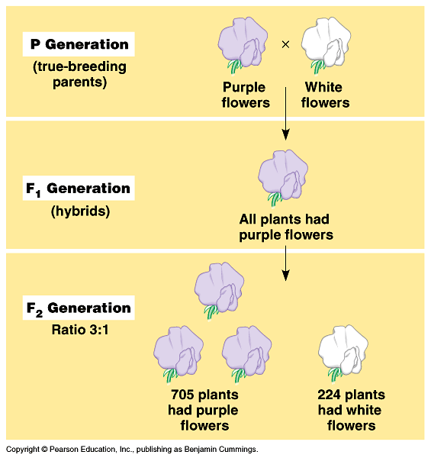
TYPICAL BREEDING EXPERIMENT
P generation (parental generation)
F1 generation (first filial generation, the word filial from the Latin word for "son") are the hybrid offspring.
Allowing these F1 hybrids to self-pollinate produces:
F2 generation (second filial generation).
It is the analysis of this that lead to an understanding of genetic crosses.

Slide 11
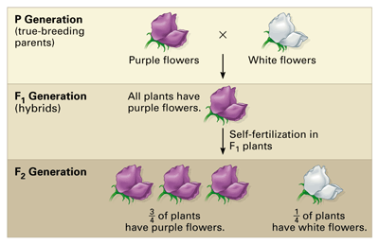
For each monohybrid cross, Mendel cross-fertilized true-breeding plants that were different in just one character—in this case, flower color. He then allowed the hybrids (the F1 generation) to self-fertilize.

Slide 12
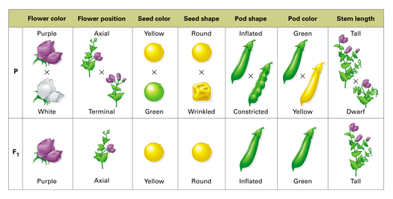
MENDEL’S EXPERIMENT

Slide 13
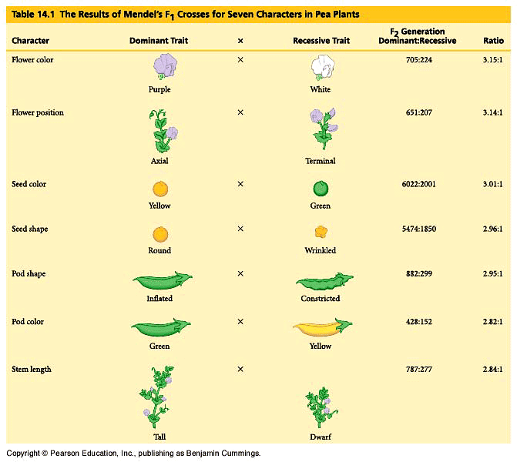
:
Statistics indicated a pattern.

Slide 14
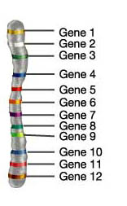
VOCABULARY
Gene - segment of DNA that codes for a protein
Allele – alternate forms of a gene; the different forms of a characteristic.
Homozygous- having two of the same allele, AA or aa; true breeding or pure breed.
Heterozygous- two different alleles, Aa; hybrid.

Slide 15
VOCABULARY
Dominant - allele that is expressed.
Recessive – allele that is hidden.
Dominant alleles are capital letters; recessive are lowercase; use the same letter.
Genotype - the organism’s alleles.
Phenotype – the physical appearance.
Punnett Square- shows how crosses are made.
Locus – spot on the chromosome where an allele (gene) is located.

Slide 16
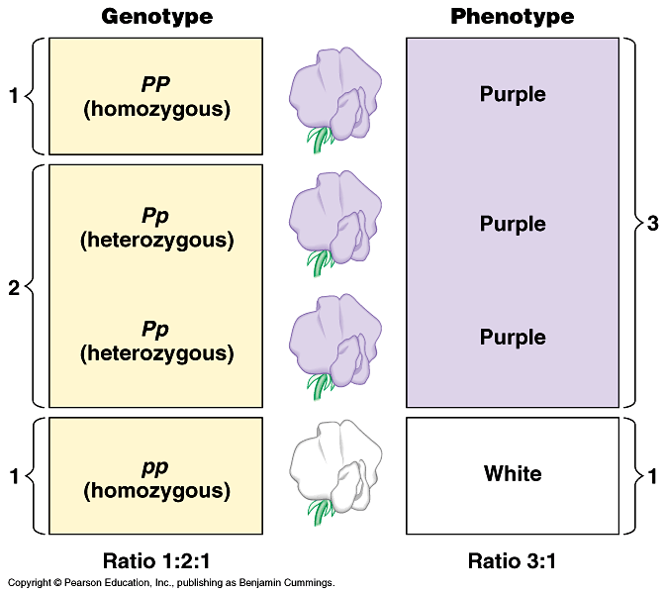
GENOTYPE VERSUS PHENOTYPE
How does a genotype ratio differ from the phenotype ratio?

Slide 17
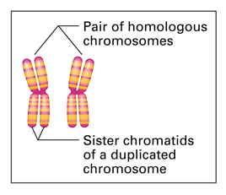
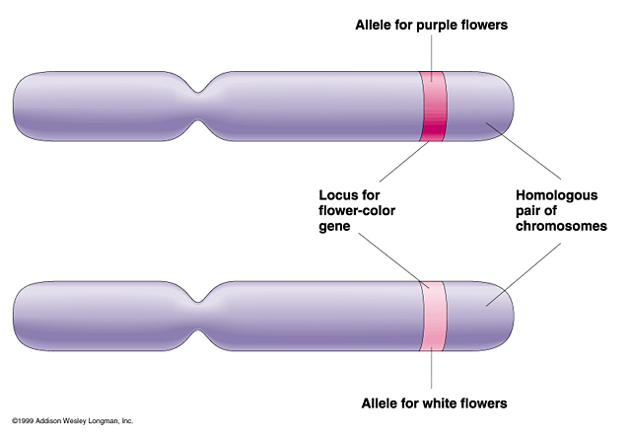
CHROMOSOMES
Homologous chromosome: one of a matching pair of chromosomes, one inherited from each parent.
Sister chromatids are identical

Slide 18
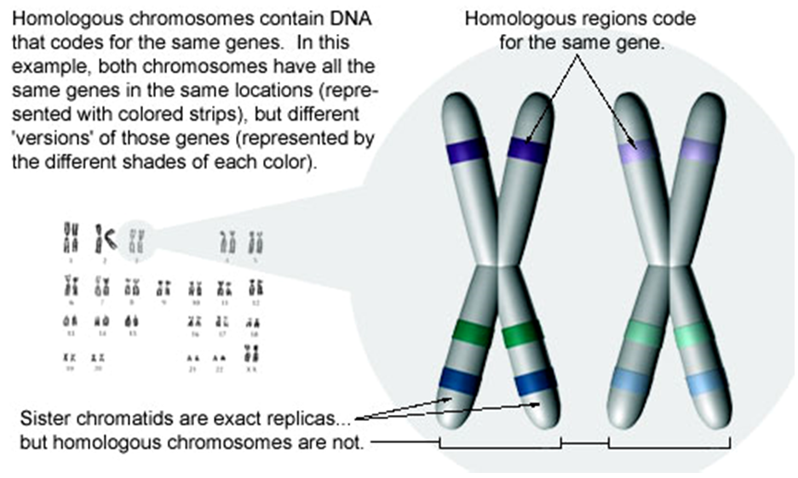
CHROMOSOMES

Slide 19
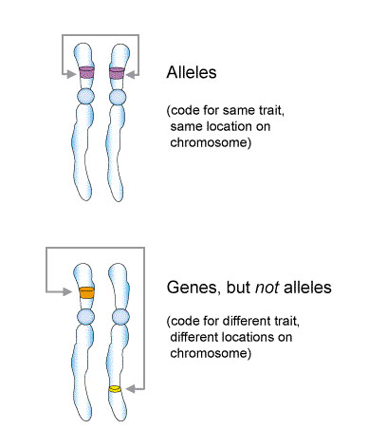
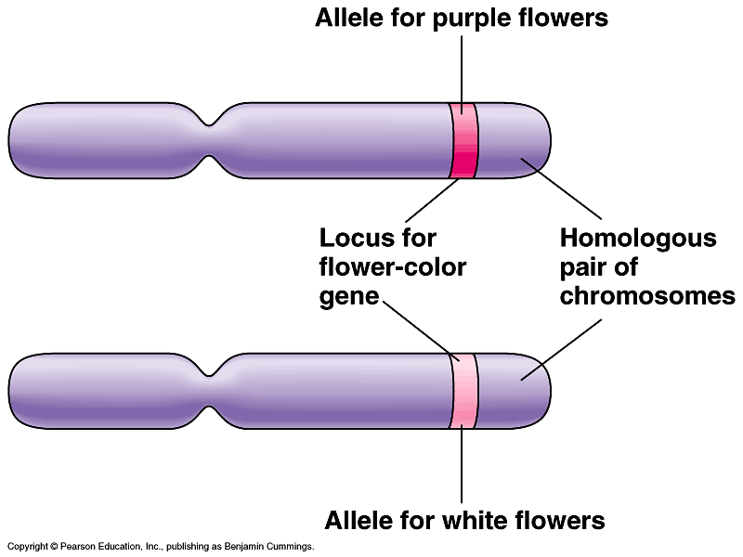
CHROMOSOMES
Alleles: alternative versions of a gene.
The gene for a particular inherited character resides at a specific locus (position) on homologous chromosome.
For each character, an organism inherits two alleles, one from each parent

Slide 20
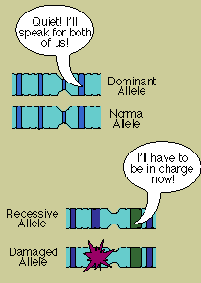
CHROMOSOMES
Dominant allele
Recessive allele
Recessive allele
Recessive allele
Dominant - the trait (allele) that is expressed regardless of the second allele.
Recessive – the trait that is only expressed when the second allele is the same (e.g. short plants are homozygous for the recessive allele).

Slide 21
TO DO
Mendel
Do Section A.
Make flashcards of ten vocabulary words: gene, allele, homozygous, heterozygous, dominant, recessive, genotype, phenotype, Punnett square, locus
Good review: Basic Principles of Genetics

