Slide 1
GENETICS AND HEREDITY

Slide 2
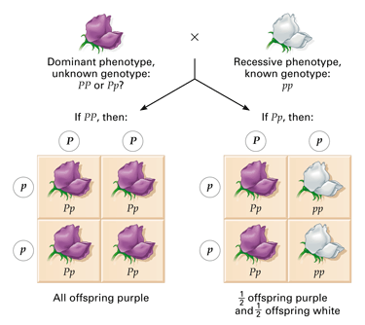
TEST CROSS
is designed to reveal whether an organism that displays the dominant phenotype is homozygous or heterozygous for that trait.

Slide 3
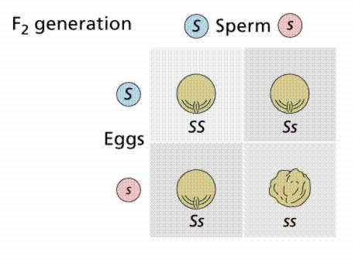
PUNNETT SQUARE
probability diagram illustrating the possible offspring of a mating.
Ss X Ss
gametes

Slide 4
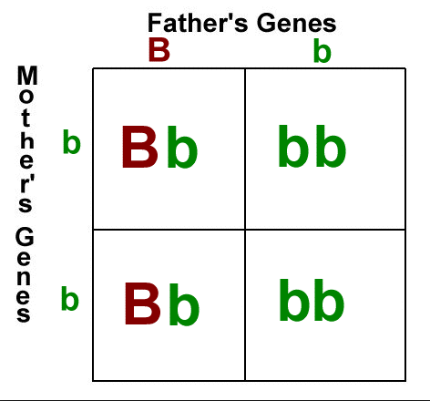
PUNNETT SQUARE
Animation
Mother: bb
Father: Bb
Punnett Sq.

Slide 5
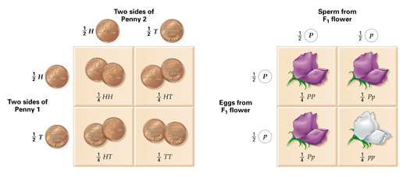
PUNNETT SQUARE
shows how gametes separate and come together during fertilization.
diagram showing the probabilities of the possible outcomes of a genetic cross.

Slide 6
DO NOW
Work on Section B.
PRACTICE:
Punnett Squares
Practice Crosses
Practice Problems

Slide 7
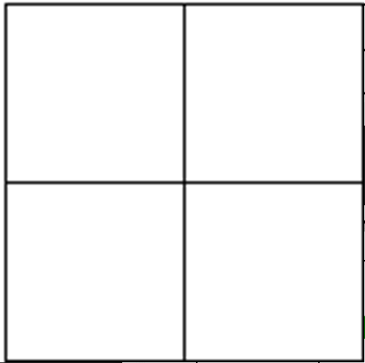
SECTION B-1
Round seeds (R) are dominant to wrinkled (r) seeds. Cross a homozygous dominant seed with a heterozygote.
Genotype: _____% RR
_____% Rr
_____% rr
Phenotype: _____% round
_____% wrink

Slide 8
SECTION B-2
2. In horses, straight manes are dominant to curly manes. A curly manned horse is mated to a hybrid horse.
Parents: _____ x _____
Genotype: _____% MM
_____% Mm
_____% mm
Phenotype: _____% straig
_____% curl

Slide 9
SECTION B-3
3. A black coat is dominant over brown coats in guinea pigs. Cross two heterozygous guinea pigs to see the possibilities of their offspring.
Parents: _____ x _____
Genotype: _____% BB
_____% Bb
_____% bb
Phenotype: _____% black
_____% brown

Slide 10
SECTION B-4
4. Oompa Loompas generally have gray faces (G) which is dominant. The recessive allele results in an orange face (g). Two heterozygous Oompa’s mate and have babies.
Parents: _____ x _____
Genotype: _____% GG
_____% Gg
_____% gg
Phenotype: _____% gray
_____% orange

Slide 11
SECTION B-5
5. Odie Oompa has a gray face, in fact everyone in Odie’s family has a gray face. The family likes to brag that they are ‘pure’ line. Much to the family’s horror, he married Ondi Oompa who has an orange face.
Parents: _____ x _____
Genotype: _____% GG
_____% Gg
_____% gg
Phenotype: _____% gray
_____% orange

Slide 12
SECTION B-6
6. A gray faced OOmpa (homozygous) is married to an orange faced Oompa. They have 8 children.
Parents: _____ x _____
How many have gray faces?
How many have orange faces?

Slide 13
SECTION B-7
7. Otis Oompa has an orange face and is married to Ona Oompa who has a gray face. They have 60 Oompa children, 30 of their children have orange faces.
What is Ona and Otis genotype?

Slide 14
SECTION B-8
8. In Squid people, the allele for light blue skin (B) is dominant over the green (b) allele. Everyone in Squidward’s family has light blue skin. What are the possible offspring outcomes? Would the children still be considered ‘purebred’? Why or why not?
Parents: _____ x _____
Genotype: _____% BB
_____% Bb
_____% bb
Phenotype: _____% blue
_____% green

Slide 15
SECTION B-9
9. In goats, a recessive gene causes the goats to ‘faint’ when they are startled. A farmer breeds two goats that have never fainted and their first offspring faints two days after its birth.
Parents: _____ x _____
Genotype: _____% FF
_____% Ff
_____% ff
Phenotype: _____% no faint
_____% faint

Slide 16
DO NOW
Get out notes and worksheet
Let’s go over the rest of Section B.

Slide 17
SECTION B-10
10. Two short-haired guinea pigs are mated several times. Out of 100 offspring, 25 of them have long hair.
Parents: _____ x _____
Genotype: _____% HH
_____% Hh
_____% hh
Phenotype: _____% short
_____% long

Slide 18
SECTION B-11
11. A tall plant of unknown genotype is test-crossed. Of the offspring, 869 are dwarf and 912 are tall.
Parent: _____

Slide 19
SECTION B-12
12. In humans, tongue rolling is a dominant trait. Those with the recessive condition cannot roll their tongues. Bob can roll his tongue, but his mother could not. He is married to Sally, who cannot roll her tongue.
What is the probability that their first born child will not be able to roll his tongue? __________

Slide 20
SECTION B-13
13. If both parents are heterozygous for both traits, what hare the expected phenotypes of their offspring and in what proportion?
Parents: _____ x _____
Genotype: _____ HH
_____ Hh
_____ hh
Phenotype: _____ short
_____ long

Slide 21
SECTION B-14
14. If out of 100 offspring, 52 have red eyes and 48 have brown eyes. What are the probable genotype and phenotype of the parents?
Parents: _____ x _____
Genotype: _____% BB
_____% Bb _____% bb

Slide 22
SECTION B-15
15. A round (R) seed plant is dominant to a wrinkled (r) seed plant. What parental genotypes will produce offspring that are 50% homozygous dominant and 50% heterozygous?
Parents: _____ x _____
Genotype: _____% RR
_____% Rr
_____% rr
Phenotype: _____% round
_____% wrinkled

