Slide 1
GENETICS AND HEREDITY

Slide 2
MENDEL’S LAWS
Law of Dominance
Law of Segregation
Law of Independent Assortment

Slide 3
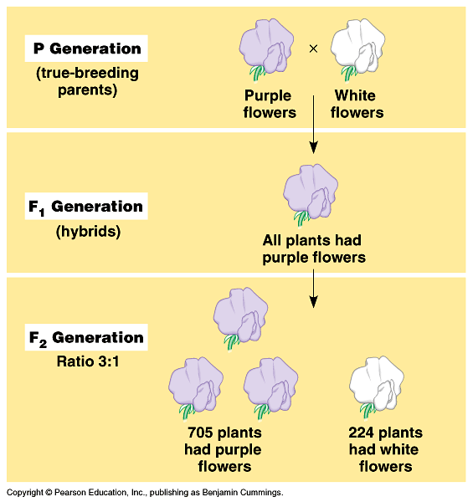
LAW OF DOMINANCE
One trait is covered up by another trait.
In the monohybrid cross (mating of two organisms that differ in only one character), one version disappeared.
What happens when the F1’s are crossed?

Slide 4
LAW OF DOMINANCE
The F1 crossed produced the F2 generation and the lost trait appeared with predictable ratios.
This led to the formulation of the current model of inheritance.

Slide 5
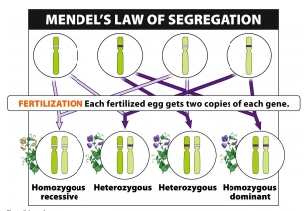
LAW OF SEGREGATION
Two alleles separate during gamete formation.

Slide 6
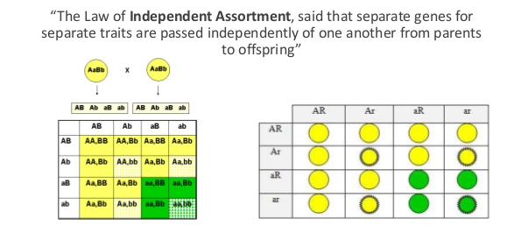
LAW OF INDEPENDENT ASSORTMENT
Each pair of alleles segregates independently of other pairs of alleles.

Slide 7
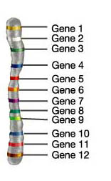
LINKAGE GROUPS
These genes are close together and will inherit together.
In actuality, many genes that are located on the same chromosome so they do not assort independently.
Instead they are inherited together.
The closer your loci are, the more likely they are to be inherited together.
Independent assortment/linked genes

Slide 8
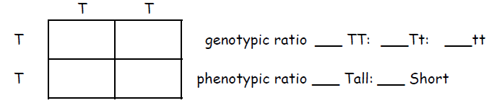
GENOTYPIC AND PHENOTYPIC RATIOS
MONOHYBRID CROSSES
First Cross _________________ x __________________

Slide 9
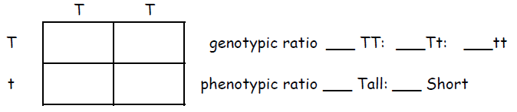
GENOTYPIC AND PHENOTYPIC RATIOS
MONOHYBRID CROSSES
Second Cross _________________ x __________________

Slide 10
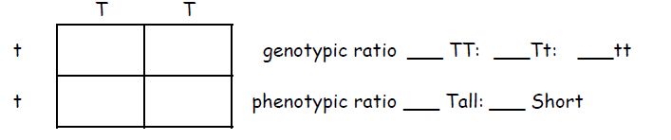
GENOTYPIC AND PHENOTYPIC RATIOS
MONOHYBRID CROSSES
Third Cross _________________ x __________________

Slide 11
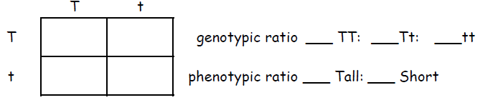
GENOTYPIC AND PHENOTYPIC RATIOS
MONOHYBRID CROSSES
Fourth Cross _________________ x __________________

Slide 12
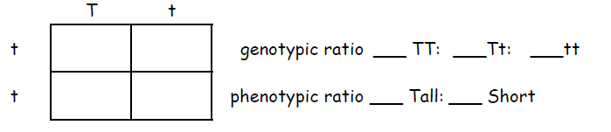
GENOTYPIC AND PHENOTYPIC RATIOS
MONOHYBRID CROSSES
Fifth Cross _________________ x __________________

Slide 13
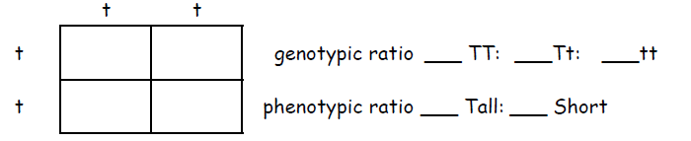
GENOTYPIC AND PHENOTYPIC RATIOS
MONOHYBRID CROSSES
Sixth Cross _________________ x __________________

Slide 14
DIHYBRID CROSS
Dihybrid cross is a cross between two pure lines (varieties, strains) that differ in two observed traits.
A genetic cross yielding a 9:3:3:1 ratio of offspring.
In Mendelian sense, between the alleles of both these loci, there is a relationship of complete dominance - recessive

Slide 15
DIHYBRID CROSS
A pea plant is heterozygous for both seed shape and seed color. S is the allele for the dominant, spherical shape characteristic; s is the allele for the recessive, dented shape characteristic. Y is the allele for the dominant, yellow color characteristic; y is the allele for the recessive, green color characteristic. What will be the distribution of these two alleles in this plant's gametes?

Slide 16
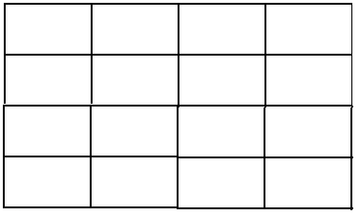
DIHYBRID CROSS
Cross: heterozygous dominant x heterozygous dominant

Slide 17
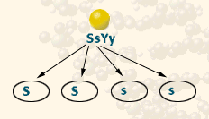
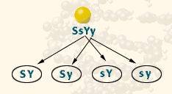
DIHYBRID CROSS
FIRST, sort the Ss alleles:
The gametes from the SsYy parent will receive one of the two alleles Ss.
Half will receive the dominant S allele, and half the recessive s allele.
SECOND, sort the Yy alleles.

Slide 18
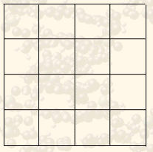
DIHYBRID CROSS
Since each Parent produces 4 different combinations of alleles in the gametes, draw a 4 square by 4 square Punnett square.

Slide 19
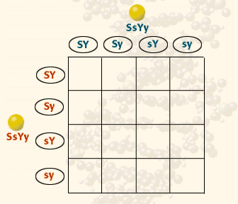
DIHYBRID CROSS
List the gametes for Parent 1 along one edge of the Punnett square and list the gametes for Parent 2 along the other edge of the Punnett square.

Slide 20
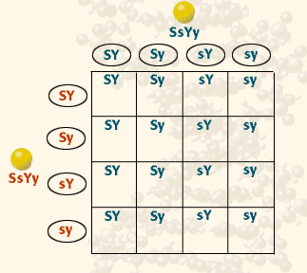
DIHYBRID CROSS
Fill out the squares with the alleles of Parent 1.

Slide 21
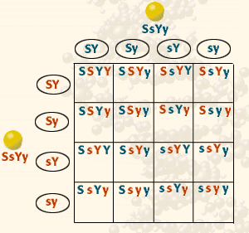
DIHYBRID CROSS
Fill out the squares with the alleles from Parent 2.

Slide 22
DIHYBRID CROSS
The result is the prediction of all possible combinations of genotypes for the offspring of the dihybrid cross, SsYy x SsYy.
So, what it the breakdown?

Slide 23
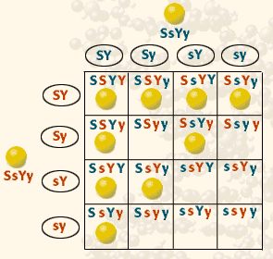
DIHYBRID CROSS
There are 9 genotypes for spherical, yellow seeded plants. They are:
SSYY (1/16)
SSYy (2/16)
SsYY (2/16)
SsYy (4/16)

Slide 24
DIHYBRID CROSS
Possible Genotypes:
1 SSYY 2 SSYy
2 SsYY 4 SsYy
_____ SSyy _____ Ssyy
_____ ssYY _____ ssYy
_____ ssyy

Slide 25
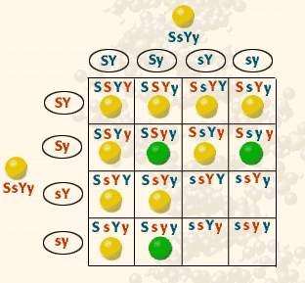
DIHYBRID CROSS
Two recessive alleles result in green seeded plants.
There are 2 genotypes for spherical, green seeded plants. They are:
SSyy (1/16)
Ssyy (2/16)

Slide 26
DIHYBRID CROSS
Possible Genotypes:
1 SSYY 2 SSYy
2 SsYY 4 SsYy
1 SSyy 2 Ssyy
_____ ssYY _____ ssYy
_____ ssyy

Slide 27
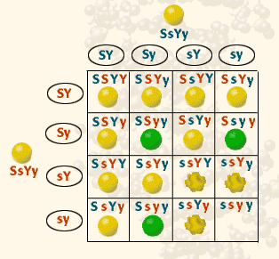
DIHYBRID CROSS
Two recessive s alleles result in dented seeded plants.
There are 2 genotypes for dented, yellow seeded plants. They are:
ssYY (1/16)
ssYy (2/16)

Slide 28
DIHYBRID CROSS
Possible Genotypes:
1 SSYY 2 SSYy
2 SsYY 4 SsYy
1 SSyy 2 Ssyy
1 ssYY 2 ssYy
_____ ssyy

Slide 29
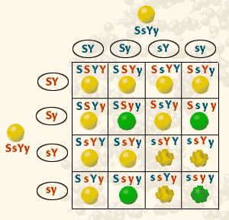
DIHYBRID CROSS
A ssyy plant would be recessive for both traits.
There is only 1 genotypes for dented, green seeded plants. It is:
ssyy (1/16)

Slide 30
DIHYBRID CROSS
Possible Genotypes:
1 SSYY 2 SSYy
2 SsYY 4 SsYy
1 SSyy 2 Ssyy
1 ssYY 2 ssYy
1 ssyy

Slide 31
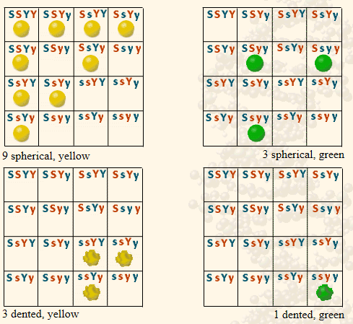
DIHYBRID CROSS
A phenotypic ratio of 9:3:3:1 is predicted for the offspring of a SsYy x SsYy dihybrid cross.

Slide 32
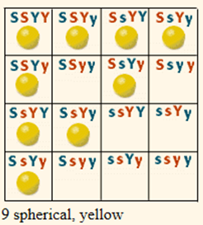
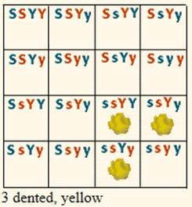
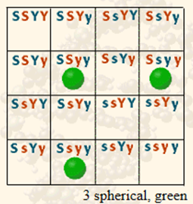
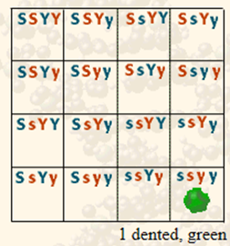
DIHYBRID CROSS
Phenotypes:
9 round, yellow
3 wrinkled, green
3 round, green
1 wrinkled, yellow
ratio: 9 : 3 : 3 : 1

Slide 33
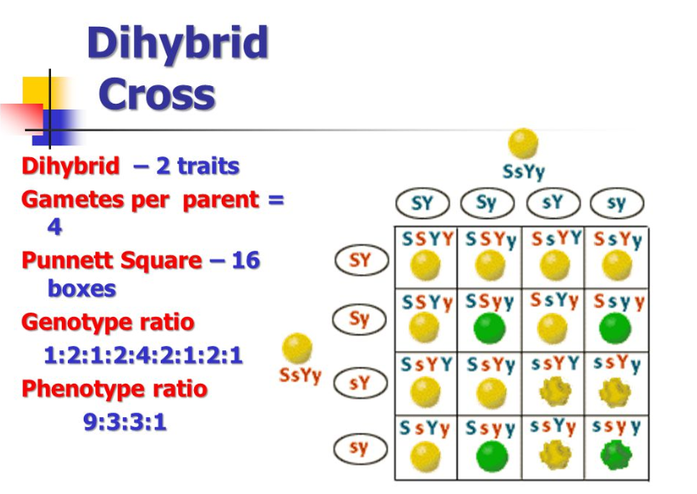

Slide 34
DIHYBRID CROSS
Dihybrid Cross
C-1 In guinea pigs, short hair is dominant to long hair and black eyes are dominant to red eyes. A male guinea pig that is homozygous dominant for both traits is crossed with a female who has long hair and red eyes.
Parents: _____ x _____

Slide 35
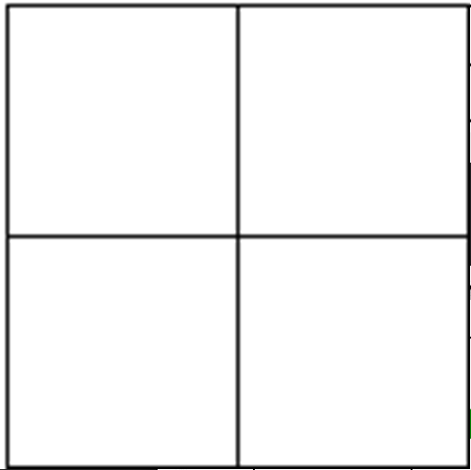
SECTION C-1
Parents: ________ x ________

