Slide 1
GENETICS AND HEREDITY

Slide 2
PATTERNS OF INHERITANCE
Codominance
Incomplete Dominance
Sex-Linked
Multiple Alleles

Slide 3
CO-DOMINANCE
Co-” means “together”.
the "recessive" & "dominant" traits appear together in the phenotype of hybrid organisms.
They are NOT blended but both appear.
Both alleles are expressed in the heterozygote!

Slide 4
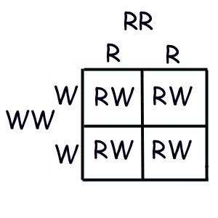
CO-DOMINANCE
Example:
Red cows crossed with white cows will generate roan cows. Roan refers to cows that have red coats with white blotches.
RR = red, WW = white, RW = red & white (roan)
Section D #1-3

Slide 5
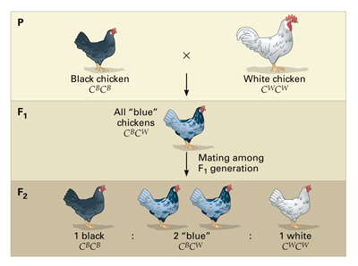
INCOMPLETE DOMINANCE
a cross between organisms with two different phenotypes produces offspring with a 3rd phenotype that is a blending of the parental traits.
Neither allele is dominant.
A BLENDING!

Slide 6
INCOMPLETE DOMINANCE
Example: In snapdragons, flower color can be red, pink, or white. The heterozygous condition results in pink flowers.
RR = red
RW = pink
WW = white
Section D #4-6

Slide 7
CO-DOMINANCE VERSUS INCOMPLETE DOMINANCE
The trick is to recognize when you are dealing with a question involving incomplete dominance or co-dominance.
Ask yourself a few questions.

Slide 8
CO-DOMINANCE VERSUS INCOMPLETE DOMINANCE
Are the offspring showing a third phenotype? In other words, The parents each have one, and the offspring are different from the parents.
Is it a blending of the traits? incomplete dominance
or are both traits showing equally? co-dominance

Slide 9
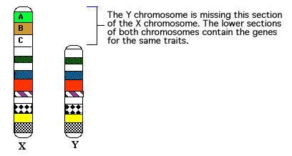
SEX-LINKED
If a gene is found only on the X chromosome and not the Y chromosome, it is said to be a sex-linked trait.
Because the gene controlling the trait is located on the sex chromosome, sex linkage is linked to the gender of the individual.
Usually such genes are found on the X chromosome. The Y chromosome is thus missing such genes.

Slide 10
SEX-LINKED
The result is that females will have two copies of the sex-linked gene while males will only have one copy of this gene.
If the gene is recessive, then males only need one such recessive gene to have a sex-linked trait rather than the customary two recessive genes for traits that are not sex-linked.
This is why males exhibit some traits more frequently than females.

Slide 11
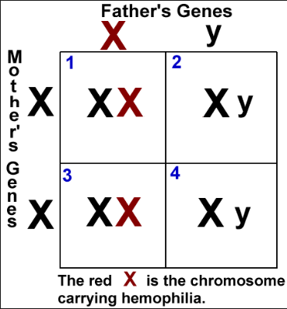
SEX-LINKED
In humans, male patterned baldness, hemophilia, Duchenne Muscular Dystrophy, and color blindness are sex-linked traits.

Slide 12
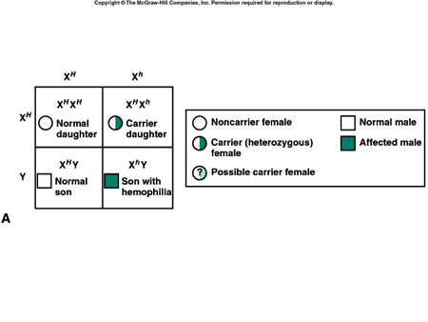
SEX-LINKED

Slide 13
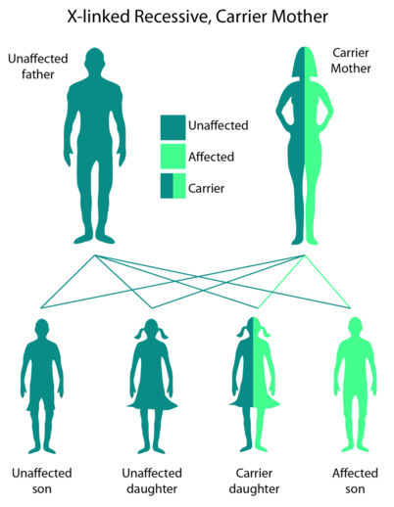
SEX-LINKED
Section D #7-12

Slide 14
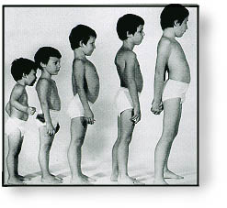
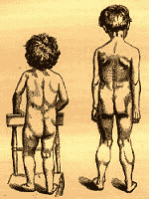
Sex-Linked Disorders in Humans
Duchenne muscular dystrophy, affects about one out of every 3,500 males born in the United States. People with Duchenne muscular dystrophy rarely live past their early 20s. The disease is characterized by a progressive weakening of the muscles and loss of coordination. Researchers have traced the disorder to the absence of a key muscle protein called dystrophin and have tracked the gene for this protein to a specific locus on the X chromosome.
Posture changes during progression of Duchenne muscular dystrophy.

Slide 15
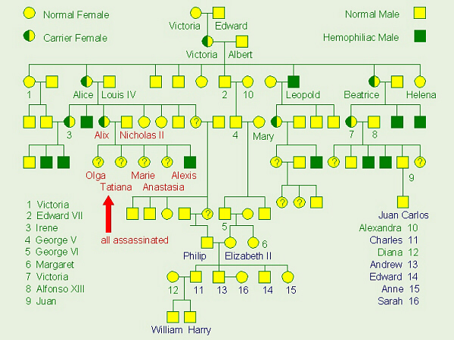
Hemophilia is a sex-linked recessive trait defined by the absence of one or more of the proteins required for blood clotting.

Slide 16
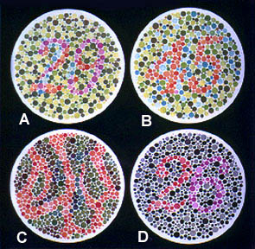
Color Blindness In Humans: An X-Linked Trait
Numbers That You Should See If You Are In One Of The Following
Four Categories: [Some Letter Choices Show No Visible Numbers]
Sex-Linked Traits:
Normal Color Vision:
A: 29, B: 45, C: --, D: 26
Red-Green Color-Blind:
A: 70, B: --, C: 5, D: --
Red Color-blind:
A: 70, B: --, C: 5, D: 6
Green Color-Blind:
A: 70, B: --, C: 5, D: 2

Slide 17
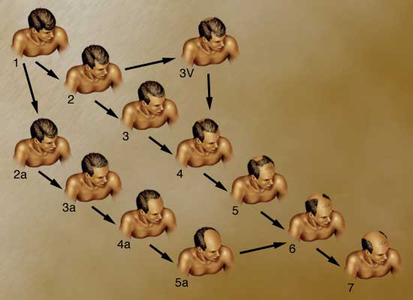
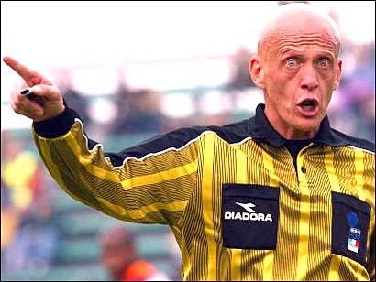
Pattern Baldness In Humans: A Sex Influenced Trait
Baldness is an autosomal trait and is apparently influenced by sex hormones after people reach 30 years of age or older.
In men the gene is dominant, while in women it is recessive. A man needs only one allele (B) for the baldness trait to be expressed, while a bald woman must be homozygous for the trait (BB).
What are the probabilities for the children for a bald man and woman with no history of baldness in the family?

