Slide 1
GENETICS AND HEREDITY

Slide 2
PATTERNS OF INHERITANCE
Codominance
Incomplete Dominance
Sex-Linked
Multiple Alleles

Slide 3
REMINDER
ALLELE
(n) a form of a gene which codes for one possible outcome of a phenotype.

Slide 4
BACKGROUND/REVIEW
When the gene for one trait exists as only two alleles and the alleles play according to Mendel's Law of Dominance, there are 3 possible genotypes (combination of alleles) & 2 possible phenotypes (the dominant one or the recessive one).
GENOTYPES
Homozygous Dominant (YY)
Heterozygous (Yy)
Homozygous Recessive (yy)

Slide 5
BACKGROUND/REVIEW
If there are only two alleles involved in determining the phenotype of a certain trait, but there are three possible phenotypes, then the inheritance of the trait illustrates either incomplete dominance or codominance.
In these situations a heterozygous (hybrid) genotype produces a 3rd phenotype that is either a blend of the other two phenotypes (incomplete dominance) or a mixing of the other phenotypes with both appearing at the same time (codominance).

Slide 6
MULTIPLE ALLELES
If there are FOUR or more possible phenotypes for a particular trait, then more than two alleles for that trait must exist in the population. We call this MULTIPLE ALLELES.
REMEMBER: There may be multiple alleles within the population, but individuals have only two of those alleles.
An excellent example of multiple allele inheritance is human blood type. Blood type exists as four possible phenotypes: A, B, AB, & O.

Slide 7
MULTIPLE ALLELES
Blood type is controlled by three alleles:
  A - dominant
  B - dominant
  o - recessive
Genotype | Phenotype
oo (IºIº) | Type O
Ao (I^{A}Iº) | Type A
AA (I^{A}I^{A}) | Type A
Bo (I^{B}I^{O}) | Type B
BB (I^{B}I^{B}) | Type B
AB (I^{A}I^{B}) | Type AB

Slide 8
MULTIPLE ALLELES
As you can count, there are six different genotypes and 4 different phenotypes for blood type.
There are two genotypes for both "A" & "B" blood either homozygous (AA or BB) or heterozygous with one recessive allele for "O" (Ao or Bo).
The only genotype for "O" blood is homozygous recessive (oo).
Section D #13-17
Genotype | Phenotype
oo (IºIº) | Type O
Ao (I^{A}Iº) | Type A
AA (I^{A}I^{A}) | Type A
Bo (I^{B}I^{O}) | Type B
BB (I^{B}I^{B}) | Type B
AB (I^{A}I^{B}) | Type AB

Slide 9
POLYGENIC TRAITS
Another exception to Mendel’s rules is polygenic inheritance, which occurs when a trait is controlled by groups of several genes.
This means that each dominant allele "adds" to the expression of the next dominant allele.
Height is a polygenic trait, controlled by at least three genes with six alleles. If you are dominant for all of the alleles for height, then you will be very tall.
There is also a wide range of skin color across people. Skin color is also a polygenic trait, as are hair and eye color.
Section D #18

Slide 10
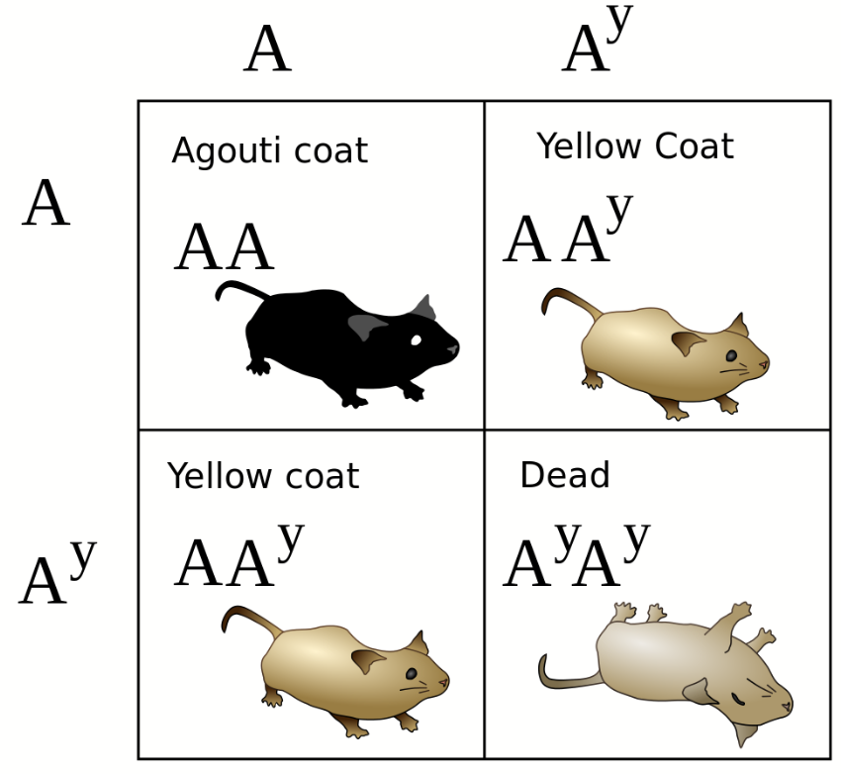
LETHAL GENES
Alleles that are lethal (cause an organism to die) only when present in homozygous condition are called lethal alleles.
The gene involved is considered an essential gene.
Section D #19

