Slide 1
GENETICS AND HEREDITY

Slide 2
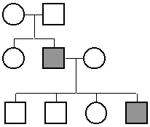
PEDIGREE
A pedigree is a diagram of family relationships that represents genetic relationships.
Pedigrees are often used to determine the inheritance of genetic diseases or traits.
Female
Male
Indicates a marriage
VIDEO: Pedigrees and Genetic Disorders

Slide 3
PEDIGREE
Fully shaded = has disease/disorder/trait
Half shaded = Carrier
No shading = no disease/disorder/trait
No disease
Has disease

Slide 4
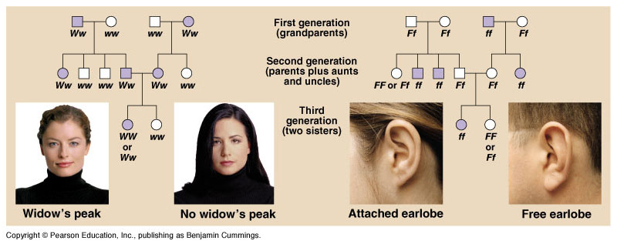
Pedigree analysis reveals Mendelian patterns in human inheritance
In these family trees, squares symbolize males and circles represent females. A horizontal line connecting a male and female (--) indicates a mating, with offspring listed below in their order of birth, from left to right. Shaded symbols stand for individuals with the trait being traced.

Slide 5
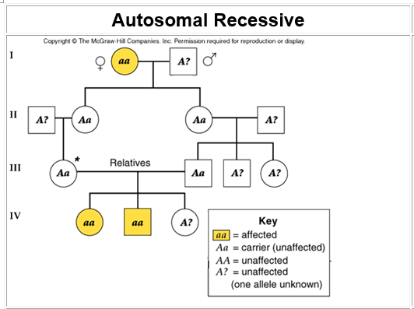
PEDIGREE ANALYSIS

Slide 6
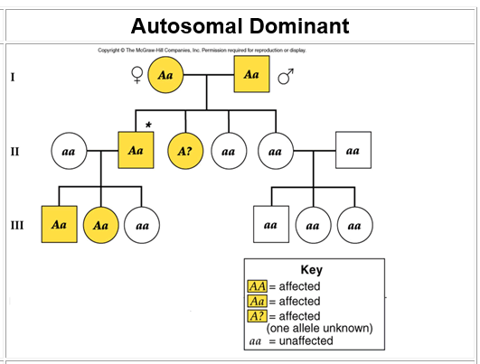
PEDIGREE ANALYSIS

Slide 7
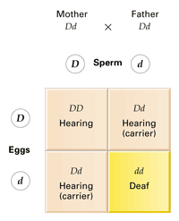
INHERITED TRAIT DISORDERS
Over a thousand human genetic disorders are known to have Mendelian inheritance patterns. Each of these disorders is inherited as a dominant or recessive trait controlled by a single gene. Most human genetic disorders are recessive.
A particular form of deafness is inherited as a recessive trait.

Slide 8
RECESSIVE TRAIT DISORDERS
Phenylketonuria (PKU)
PKU is caused by a defect in the gene that helps create the enzyme needed to break down phenylalanine. The person lacks the enzyme for normal metabolism. Phenylalanine builds up and causes brain damage. Changes in diet lead to normal life.
Babies in the United States and many other countries are screened for PKU soon after birth. Recognizing PKU right away can help prevent major health problems.

Slide 9
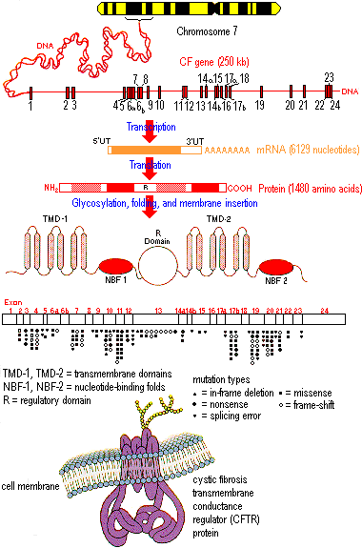
RECESSIVE TRAIT DISORDERS
Cystic fibrosis, which strikes one out of every 2,500 whites of European descent but is much rarer in other groups. One out of 25 Caucasians (4% ) is a carrier.
The normal allele for this gene codes for a membrane protein that functions in chloride ion transport between certain cells and the extracellular fluid. These chloride channels are defective or absent.
The result is an abnormally high concentration of extracellular chloride, which causes the mucus that coats certain cells to become thicker and stickier than normal which makes breathing difficult.

Slide 10
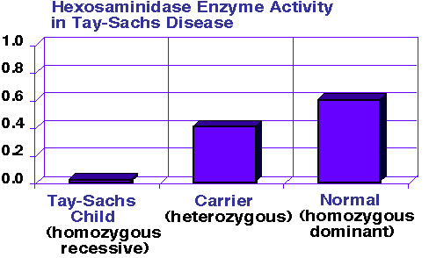
RECESSIVE TRAIT DISORDERS
Tay-Sachs disease is caused by a dysfunctional enzyme that fails to break down brain lipids of a certain class. Fat accumulates in brain destroying tissue and results in severe impairment and death. There is a proportionately high incidence of Tay-Sachs disease among Ashkenazic Jews, Jewish people whose ancestors lived in central Europe.

Slide 11
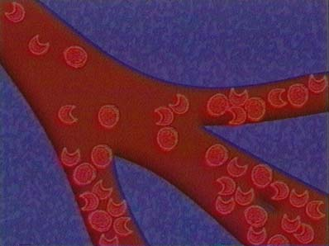
RECESSIVE TRAIT DISORDERS
Sickle-cell disease affects one out of 400 African Americans. Sickle-cell disease is caused by the substitution of a single amino acid in the hemoglobin protein of red blood cells and causes blood to be sickle shaped. This affects oxygen flow to the organs. Heterozygotes are resistant to malaria.

Slide 12
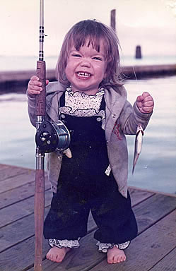
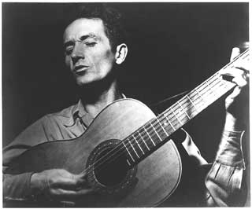
DOMINANT TRAIT DISORDERS
Huntington’s disease, a degenerative neurological disorder, is caused by a lethal dominant allele that has no obvious phenotypic effect until the individual is about 35 to 45 years old. Then there is progressive degeneration of the brain that leads to death at a early age.
Achondroplasia is a common form of dwarfism with an incidence of one case among every 10,000 people. Individuals have short arms and legs, and a normal torso. Heterozygous individuals have the dwarf phenotype. Homozygotes (AA) do not survive; it is a lethal gene.

