Slide 1
GENETICS AND HEREDITY

Slide 2
DIHYBRID CROSS
Dihybrid cross is a cross between two pure lines (varieties, strains) that differ in two observed traits.
A genetic cross yielding a 9:3:3:1 ratio of offspring.
In Mendelian sense, between the alleles of both these loci, there is a relationship of complete dominance - recessive

Slide 3
DIHYBRID CROSS
A pea plant is heterozygous for both seed shape and seed color. S is the allele for the dominant, spherical shape characteristic; s is the allele for the recessive, dented shape characteristic. Y is the allele for the dominant, yellow color characteristic; y is the allele for the recessive, green color characteristic. What will be the distribution of these two alleles in this plant's gametes?

Slide 4

DIHYBRID CROSS
Cross: heterozygous dominant x heterozygous dominant

Slide 5
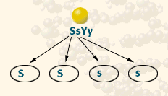
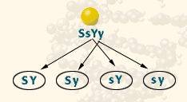
DIHYBRID CROSS
FIRST, sort the Ss alleles:
The gametes from the SsYy parent will receive one of the two alleles Ss.
Half will receive the dominant S allele, and half the recessive s allele.
SECOND, sort the Yy alleles.

Slide 6
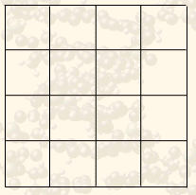
DIHYBRID CROSS
Since each Parent produces 4 different combinations of alleles in the gametes, draw a 4 square by 4 square Punnett square.

Slide 7
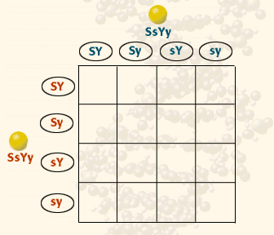
DIHYBRID CROSS
List the gametes for Parent 1 along one edge of the Punnett square and list the gametes for Parent 2 along the other edge of the Punnett square.

Slide 8
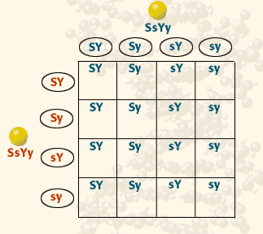
DIHYBRID CROSS
Fill out the squares with the alleles of Parent 1.

Slide 9
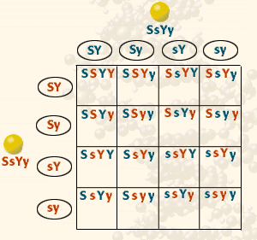
DIHYBRID CROSS
Fill out the squares with the alleles from Parent 2.

Slide 10
DIHYBRID CROSS
The result is the prediction of all possible combinations of genotypes for the offspring of the dihybrid cross, SsYy x SsYy.
So, what it the breakdown?

Slide 11
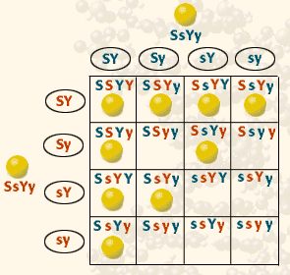
DIHYBRID CROSS
There are 9 genotypes for spherical, yellow seeded plants. They are:
SSYY (1/16)
SSYy (2/16)
SsYY (2/16)
SsYy (4/16)

Slide 12
DIHYBRID CROSS
Possible Genotypes:
1 SSYY 2 SSYy
2 SsYY 4 SsYy
_____ SSyy _____ Ssyy
_____ ssYY _____ ssYy
_____ ssyy

Slide 13
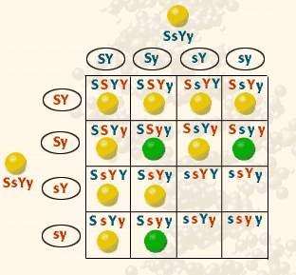
DIHYBRID CROSS
Two recessive alleles result in green seeded plants.
There are 2 genotypes for spherical, green seeded plants. They are:
SSyy (1/16)
Ssyy (2/16)

Slide 14
DIHYBRID CROSS
Possible Genotypes:
1 SSYY 2 SSYy
2 SsYY 4 SsYy
1 SSyy 2 Ssyy
_____ ssYY _____ ssYy
_____ ssyy

Slide 15
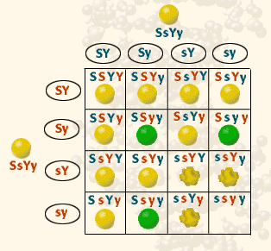
DIHYBRID CROSS
Two recessive s alleles result in dented seeded plants.
There are 2 genotypes for dented, yellow seeded plants. They are:
ssYY (1/16)
ssYy (2/16)

Slide 16
DIHYBRID CROSS
Possible Genotypes:
1 SSYY 2 SSYy
2 SsYY 4 SsYy
1 SSyy 2 Ssyy
1 ssYY 2 ssYy
_____ ssyy

Slide 17
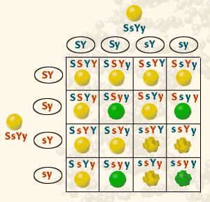
DIHYBRID CROSS
A ssyy plant would be recessive for both traits.
There is only 1 genotypes for dented, green seeded plants. It is:
ssyy (1/16)

Slide 18
DIHYBRID CROSS
Possible Genotypes:
1 SSYY 2 SSYy
2 SsYY 4 SsYy
1 SSyy 2 Ssyy
1 ssYY 2 ssYy
1 ssyy

Slide 19
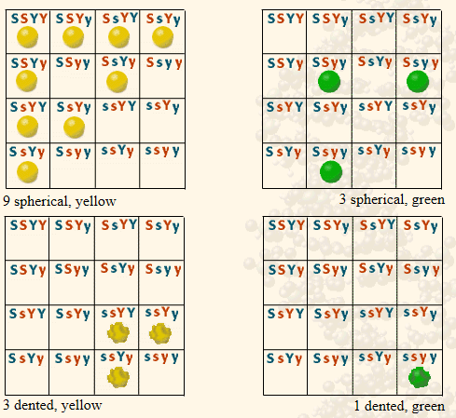
DIHYBRID CROSS
A phenotypic ratio of 9:3:3:1 is predicted for the offspring of a SsYy x SsYy dihybrid cross.

Slide 20
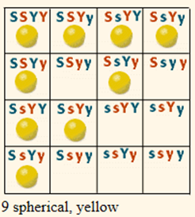
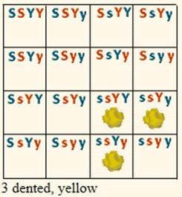
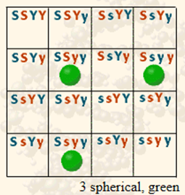
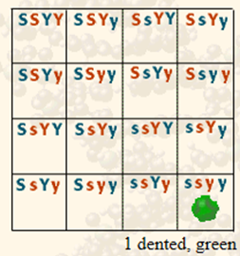
DIHYBRID CROSS
Phenotypes:
9 round, yellow
3 wrinkled, green
3 round, green
1 wrinkled, yellow
ratio: 9 : 3 : 3 : 1

Slide 21
