Slide 1
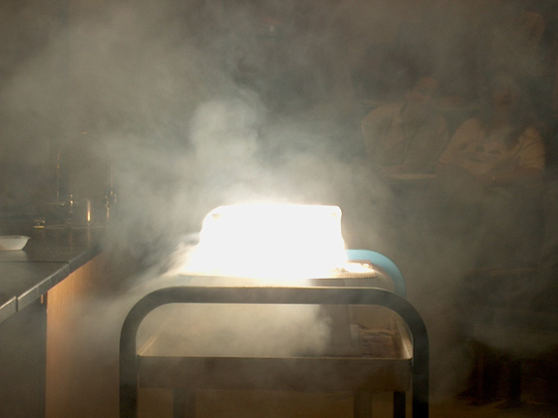
PHYSICAL SCIENCE
MATTER

Slide 2
CLASSES OF MATTER
Matter is anything that has mass and volume.
Substance – element or compound that cannot be broken down into simpler components and maintain the properties of the original substance.

Slide 3
MATTER
Homogeneous
Pure Substances
Solutions
Heterogeneous
Mixtures
Elements
Compounds

Slide 4
CLASSES OF MATTER
MATTER
Homogeneous
Pure Substances
Solutions
Heterogeneous
Mixtures
Elements
Compounds
HOMOGENEOUS MATTER
All parts of the substance are identical.

Slide 5
MATTER
Homogeneous
Pure Substances
Solutions
Heterogeneous
Mixtures
Elements
Compounds

Slide 6
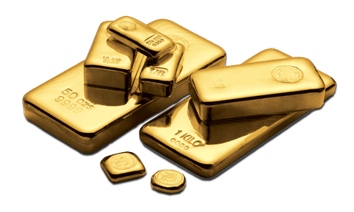
ELEMENT
the simplest pure substance.
cannot be changed into anything simpler through heat or a chemical reaction.
consist of all the same atoms (the building blocks of matter).
all parts are identical.
Examples: iron (Fe), copper (Cu), mercury (Hg)

Slide 7
MATTER
Homogeneous
Pure Substances
Solutions
Heterogeneous
Mixtures
Elements
Compounds

Slide 8
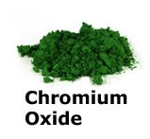
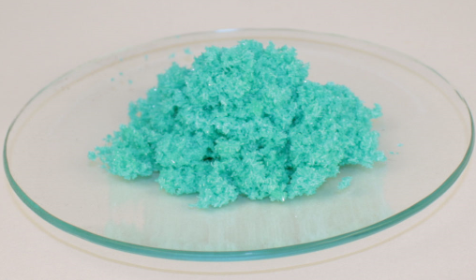
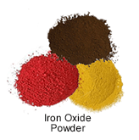
COMPOUND
made up of more than one element; any combination of two or more different kinds of elements.
substance formed from two or more elements in which the exact combination and proportion of elements is always the same.
The elements are chemically combined.
Copper (II) Chloride

Slide 9
COMPOUND
Can be broken down by heat or chemical reaction.
The properties of compounds are different from those of the elements that make them up.
All parts are identical.
There are a fixed number of components in compounds.
Examples: water, salt, sugar, and DNA.

Slide 10
MATTER
Homogeneous
Pure Substances
Solutions
Heterogeneous
Mixtures
Elements
Compounds

Slide 11
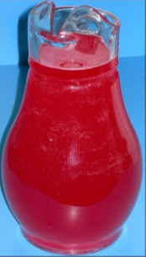
SOLUTIONS
two or more substances mixed together that appear to have the same composition, color, density, and taste throughout.
is physically combined, but not chemically combined.
Each substance in a solution keeps its own separate identity and most of its own properties.
All parts are identical.
Examples: sea water, air, coffee, brass

Slide 12
MATTER
Homogeneous
Pure Substances
Solutions
Heterogeneous
Mixtures
Elements
Compounds

Slide 13
CLASSES OF MATTER
Heterogeneous Matter
All parts of the substance are NOT identical.

Slide 14
MATTER
Homogeneous
Pure Substances
Solutions
Heterogeneous
Mixtures
Elements
Compounds

Slide 15
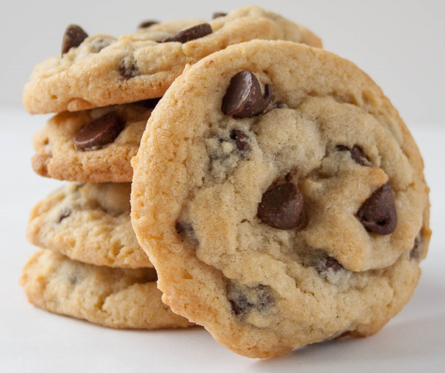
MIXTURES
two or more substances mixed together.
is physically combined, but not chemically combined.
Each substance in a mixture keeps its own separate identity and most of its own properties.
All parts are NOT identical.
Can be separated by filtration.
Examples: soil, raisin bran cereal, pizza

Slide 16
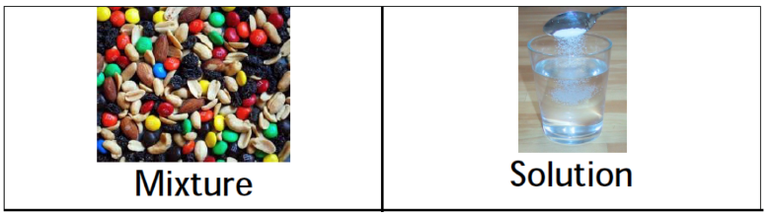
SOLUTIONS AND MIXTURES
There are three important properties of mixtures and solutions:
May change physical appearance
The parts that make it up can be present in any amount - the parts are not in fixed amounts.
Can be separated by simple physical means using methods based on physical properties.

Slide 17
SEPARATION TECHNIQUES
Filtration - Using a porous barrier to separate a solid from a liquid in a heterogeneous mixture.
Distillation - process that can separate two substances in a mixture by evaporating the liquid and recondensing its vapor. Based on boiling points of the substances involved. Separates homogeneous mixtures/solutions.

Slide 18
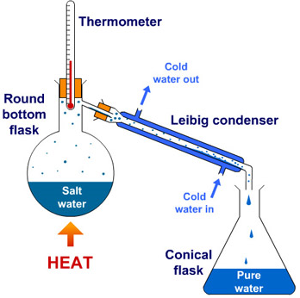
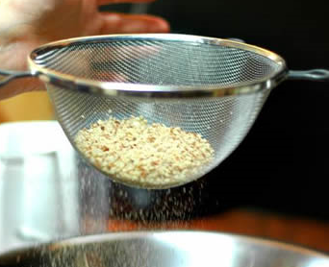
SOLUTIONS AND MIXTURES
Filtration Distillation

Slide 19
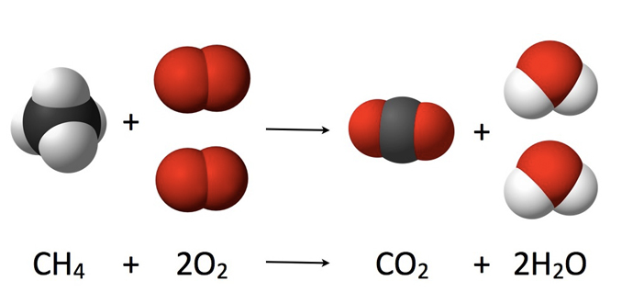
CONSERVATION OF MASS
Matter cannot be created or destroyed.
It can be converted into energy (not by you and I) through nuclear reactions, but not in chemical reactions.
As a result, mass_{reactants} should ALWAYS equal the mass_{products}. That is why we can balance equations.

