Slide 1
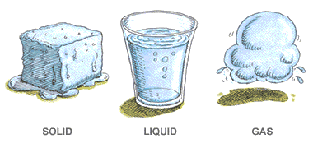
CHANGES OF STATE

Slide 2
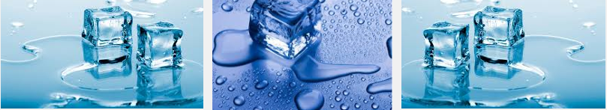
CHANGES OF STATE
Substances are made to change phase by adding or taking away heat energy.
When undergoing a phase change, the mass remains constant and volume changes. Thus, density changes.

Slide 3
CHANGES OF STATE
Phase changes are accompanied by a change in heat energy, but not temperature. Heat energy is used to overcome forces that hold the particles together.
Phase changes produce changes in physical properties only. The substance itself is not changed into something new.

Slide 4
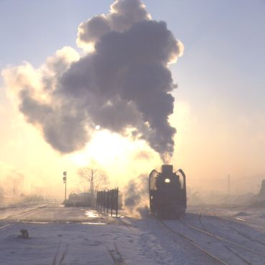

GAS-LIQUID PHASE CHANGES

Slide 5
GAS-LIQUID PHASE CHANGES
Vaporization is the change in state from a liquid to a gas - includes evaporation and boiling.
Evaporation is vaporization that occurs on the surface of a liquid and can occur at temperatures below a liquid’s boiling point.
Leave a glass of liquid water out on a counter top and it eventually all turns into a gas.

Slide 6
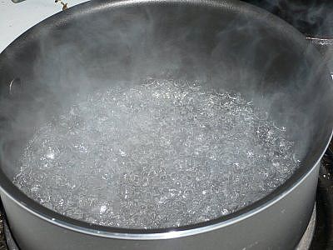
GAS-LIQUID PHASE CHANGES
As temperature increases, the pressure of the vapor in the liquid increases.
When the kinetic energy increases enough to overcome the internal pressure of the liquid caused by the pressure of the atmosphere on the liquid’s surface, the molecules collide violently enough to push each other apart.

Slide 7
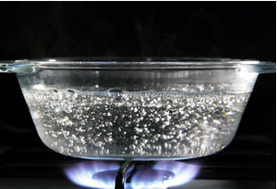
GAS-LIQUID PHASE CHANGES
The boiling point is the temperature at which the pressure of the vapor in the liquid is equal to the external pressure acting on the surface of the liquid.
When the vapor pressure is equal to atmospheric pressure, the liquid boils.
Boiling takes place throughout the entire liquid.

Slide 8
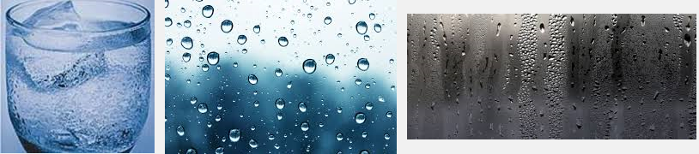
GAS-LIQUID PHASE CHANGES
Condensation is when a gas turns into a liquid. The particles of gas lose energy and the particles become attracted to each other.

Slide 9
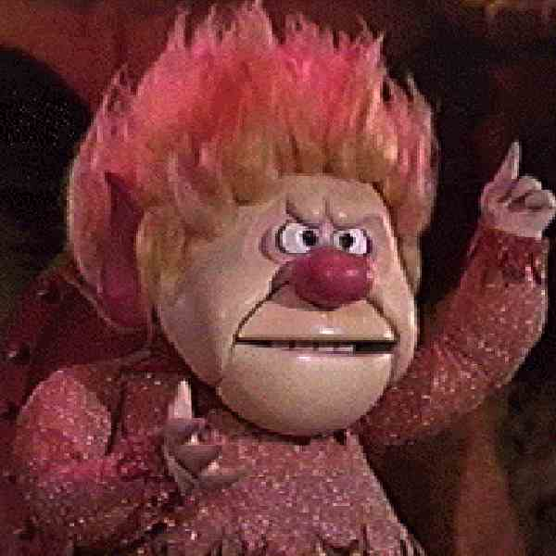
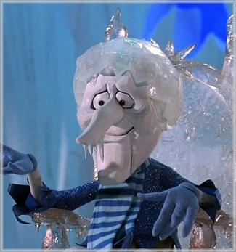
SOLID-LIQUID PHASE CHANGES
Freezing and melting require less change in energy than vaporization and condensation.
The atoms/molecules are already close together.

Slide 10
SOLID-LIQUID PHASE CHANGES
The Freezing point is the temperature at which the liquid loses enough energy to become a solid.
The Melting point is when the solid gains enough energy to become a liquid.

Slide 11
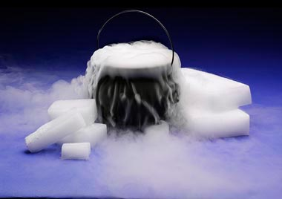
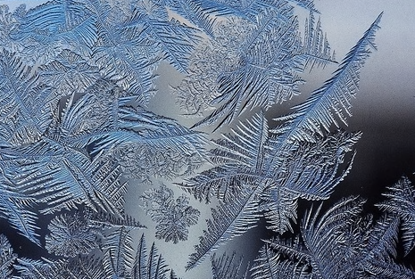
SOLID-GAS PHASE CHANGES
Some solids go straight from solid to gas, bypassing the liquid phase. This is called sublimation. The opposite change from a gas to a solid is called deposition.

Slide 12
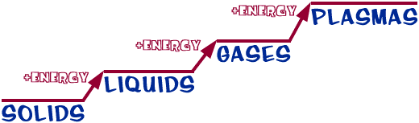

ENERGY DETERMINES THE STATE

Slide 13
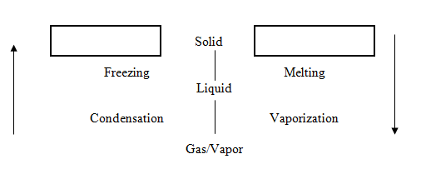
PHASE CHANGES
Exothermic
Endothermic

Slide 14
DIAGRAMS OF PHASE CHANGES
Heat is energy that causes the particles of matter to move faster and further apart. Therefore, particles can then change phases of matter.
Adding heat increases temperature.
Phase changes are accompanied by an increase in heat energy, but not temperature.
Heat energy is used to overcome the forces that hold the particles together.
Phase changes produce changes in physical properties only.

Slide 15
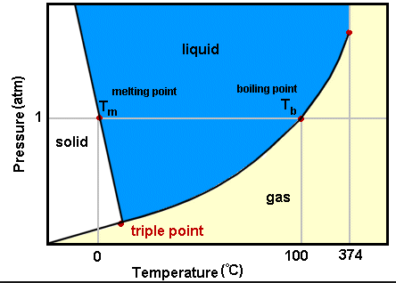
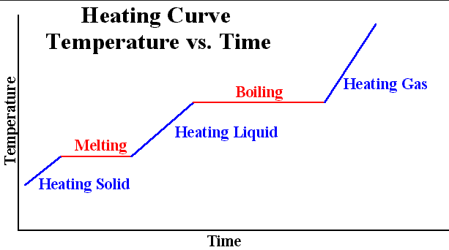
DIAGRAMS OF PHASE CHANGES
A HEATING CURVE shows how temperature and energy are related.
A PHASE DIAGRAM shows how temperature and pressure are related.

Slide 16
HEATING CURVE
Shows three phases and four phases changes.
Sublimation and deposition are not shown.
Clearly shows that temperature does not change during a phase change.

Slide 17
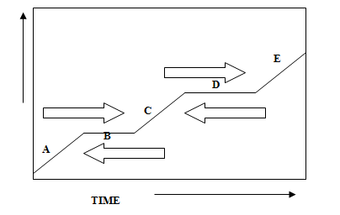
HEATING CURVE
TEMPERATURE

Slide 18
HEATING CURVE
As heat is supplied, the heat increases the kinetic energy of the molecules.

Slide 19
HEATING CURVE
B. When the substance reaches the melting point, all heat being supplied is used to change the phase (potential energy change). Temperature will NOT change until the phase is complete.

Slide 20
HEATING CURVE
C. When the phase change is complete, heat again raises the KE of the molecules, temperature changes, and increases to the boiling point.

Slide 21
HEATING CURVE
D. All heat is used the change the phase. Same as “B”.

Slide 22
HEATING CURVE
E. When the phase change is complete, heat again raises the KE of the molecules, temperature changes, and increases.

Slide 23
PHASE DIAGRAM
Shows three phases and six phases changes.
Shows that pressure affects the phases of matter and their changes.

Slide 24
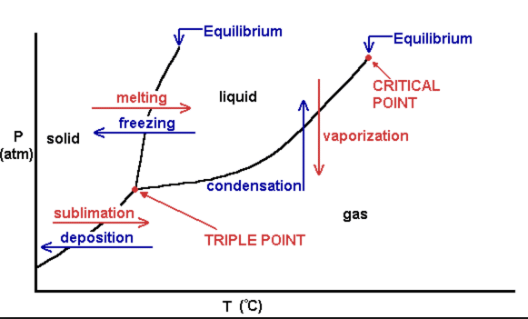
PHASE DIAGRAM
Triple Point - all three phases are at equilibrium
Solid lines are the equilibrium lines between phases. On these lines, both phases exist.

Slide 25
PHASE DIAGRAM
REMEMBER
Energy is conserved – it can be converted from one form to another, but it cannot be destroyed.
The energy stored in a substance because of its composition is CHEMICAL POTENTIAL ENERGY. Chemical potential energy plays an important role in chemical reactions.

Slide 26
PHASE DIAGRAM
In a chemical reaction, the potential energy can be released as heat.
Heat is the energy that flows from a warmer object to a colder object. Heat is measured using the SI unit Joule, J.

Slide 27
ENERGY AND CHANGES OF STATE
When heat is added to a solid, the kinetic energy of the molecules increases. When the melting point is reached, the added energy (heat) increases the KE of the molecules. The positions of the molecules are changed.

Slide 28
ENERGY AND CHANGES OF STATE
Heat of Fusion: the energy required to change a substance from the solid phase to the liquid phase. It takes 334,000 Joules of energy to melt 1 kg of ice. There is no temperature change.

Slide 29
ENERGY AND CHANGES OF STATE
Heat of Vaporization: the energy required for liquid particles to escape the attractive forces within a liquid or the energy required to change a liquid to a gas. It takes 2,260,000 Joules of energy to vaporize 1 kg of water.

