Slide 1
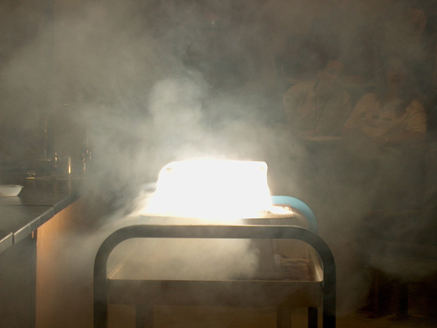
PHYSICAL SCIENCE
MATTER

Slide 2
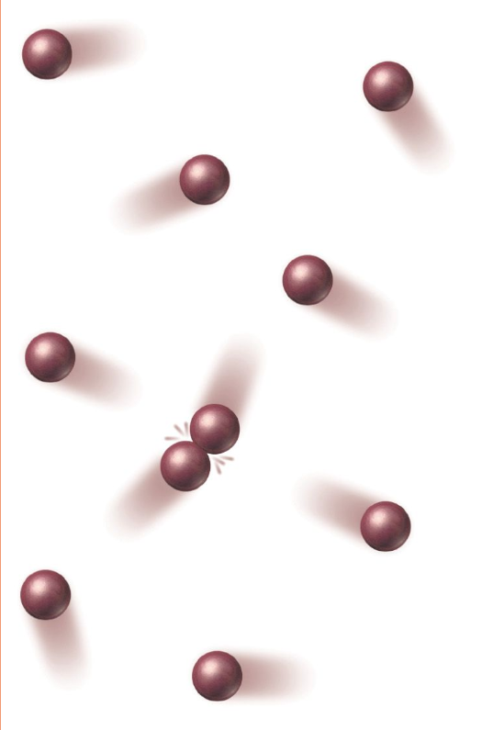
KINETIC THEORY OF MATTER
All matter is composed of tiny particles (atoms ions, or molecules).
The small particles are in constant, random motion.
These particles are colliding with each other and the walls of their container.

Slide 3
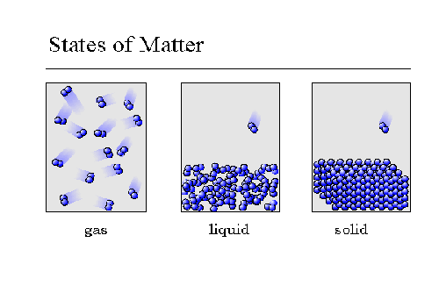
KINETIC THEORY OF MATTER
How tightly these particles are packed together and how strongly they are bonded will determine what state of matter the material is.

Slide 4

AVERAGE KINETIC ENERGY
The kinetic energies of all the particles of matter in a given sample. An impossible task to measure directly, so the temperature is specified.
The temperature of a substance is a measure of the average kinetic energy of the particles in a sample of matter.

Slide 5
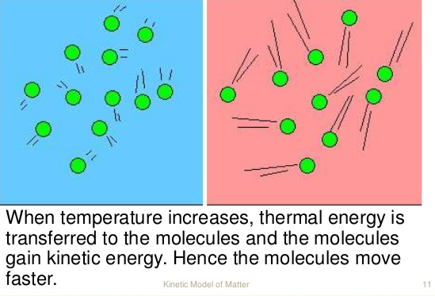
AVERAGE KINETIC ENERGY
Since kinetic energy is conserved, the average kinetic energy of the particles remains the same and can be measured.
Therefore, a decrease in temperature means that the particles, on the average, are moving more slowly.

Slide 6
KELVIN SCALE
Temperature scale based on absolute zero.
The SI unit of temperature.
Absolute zero is the temperature where all molecular motion ceases.
There is no energy. It is a theoretical limit. It cannot be directly measured.
0 kelvins (K) = -273ºC

Slide 7
THERMAL ENERGY
Temperature can also be used to determine the flow of energy.
Warmer objects will have a higher kinetic energy than a cooler object.
Energy will be transferred from warmer to cooler objects.
The amount of energy transferred is called Heat.

Slide 8


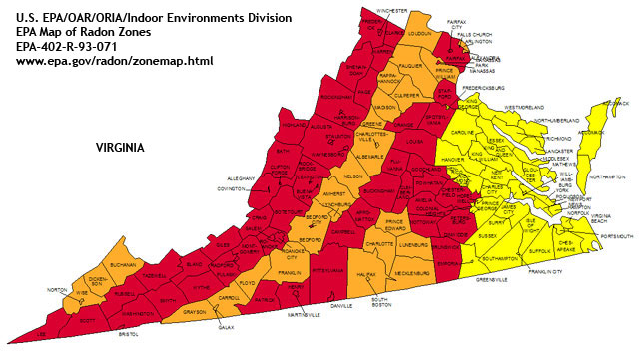
STATES
OF
MATTER

Slide 9



STATES OF MATTER
Solid
Liquid
Gas
Plasma

Slide 10


SOLIDS
definite rigid shape
definite volume
Particles are closely packed together
Particles are in a fixed position
Particles vibrate around a fixed point.

Slide 11

SOLIDS
Particles are attracted to each other
There are bonds between the particles.
Most have a geometric shape.

Slide 12
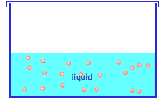


LIQUID
no definite shape (they take the shape of their container)
definite volume
Particles can flow past each other but cannot break away completely.

Slide 13

LIQUID
Particles are attracted to each other.
Particles have more kinetic energy that solids.

Slide 14


GAS
no definite shape
No definite volume
Particles have enough energy to break their bonds and go wherever they want inside their container.
Particles have more kinetic energy than liquids or solids.

Slide 15
GAS
Gases fill their container.
Another word for gas is vapor

Slide 16
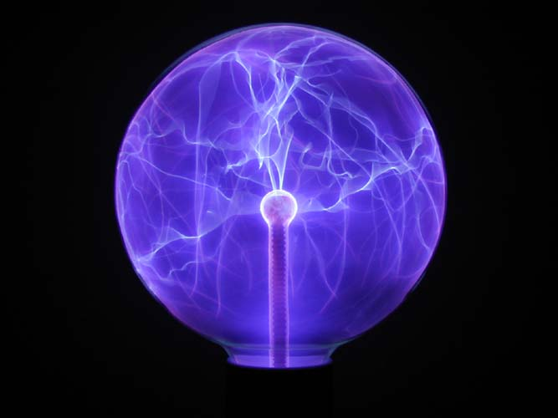
PLASMA
No definite shape
No definite volume
Composed of negatively and positively charged particles.
The electrons have been knocked away from the atom due to high temperatures.
The most common state of matter in the universe.

Slide 17
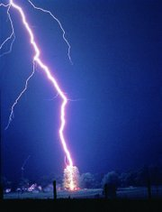
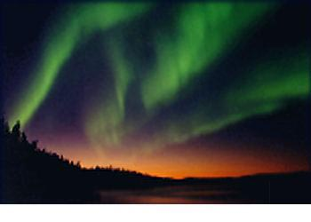
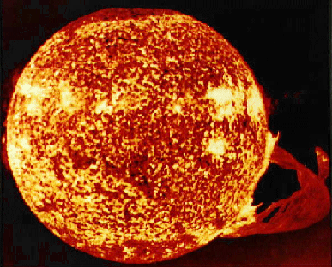
PLASMA
Found in the sun and other stars, lightning bolts, neon and fluorescent tubes, and auroras.

Slide 18

A plasma TV has a large number of tiny cells containing xenon and neon gases. When an electric current is passed through these individual cells, they give off energy which causes phosphors inside the cell to give off light. These tiny lights combine together to produce an image.

Slide 19
DRAWING MATTER
SOLID LIQUID GAS
Draw the three phases of matter in the boxes – think about what they would look like on the molecular level.

Slide 20
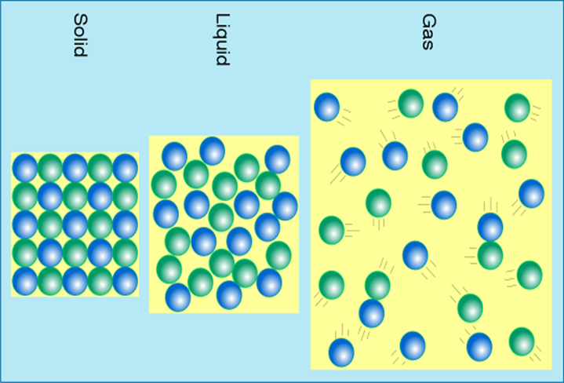
DRAWING MATTER

Slide 21
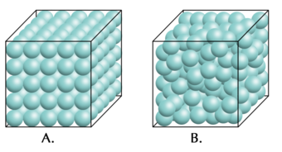
MORE ON SOLIDS
Density – more closely packed than a liquid, thus they are denser; Usually a 10% difference between the solid and liquid density of the same substance; Water is the exception.

Slide 22
MORE ON SOLIDS
Types of Solids – An amorphous solid is a solid where the particles are not arranged in a crystalline pattern; often forms when a molten (melted solid) cools too quickly to allow time for the crystals to grow; examples include glass, rubber, and many plastics. Crystalline solids are arranged in fixed geometric patterns.

Slide 23
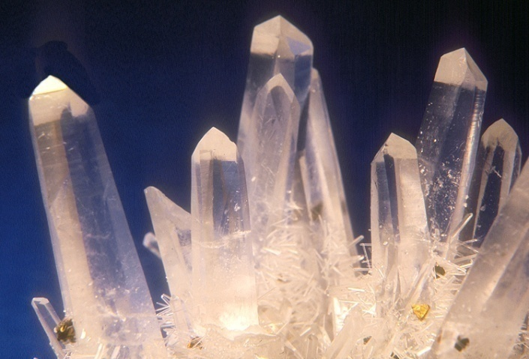
CRYSTALLINE AND AMORPHOUS SOLIDS
Crystalline solids
Gemstones, minerals like salt, and safety glass are all examples of crystalline solids. They have a predictable pattern of particles.

Slide 24
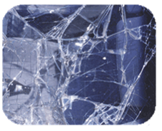
CRYSTALLINE AND AMORPHOUS SOLIDS
Amorphous solids
Examples include plastics, glass, and wax.

Slide 25
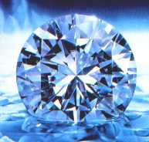
Diamonds form under tremendous pressure, and therefore their particles (carbon atoms) are packed very tightly. This is one reason why diamonds are so hard.

Slide 26
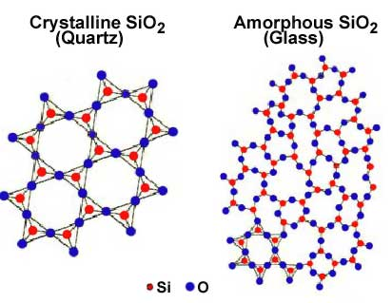
CRYSTALLINE AND AMORPHOUS SOLIDS

Slide 27
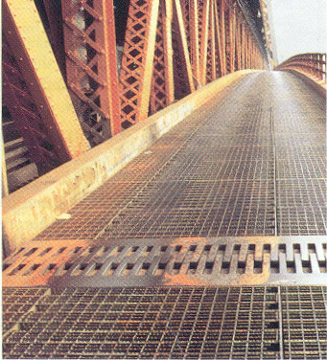

MORE ON SOLIDS
Thermal Expansion – most solids experience thermal expansion. Thermal Expansion is when objects are heated, they expand. When they are cooled, they contract. Example: joints in bridges, driveways, and roads.

Slide 28
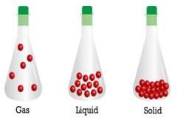
MORE ON LIQUIDS
Density – denser than gases.

Slide 29
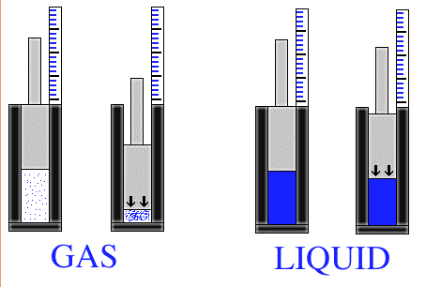
MORE ON LIQUIDS
Compression – enormous pressure can make liquids compress a small amount.

Slide 30

MORE ON LIQUIDS
Fluidity – ability to flow; gases and liquids are fluids because they can flow through each other. Liquids are slower to diffuse than gases.

Slide 31
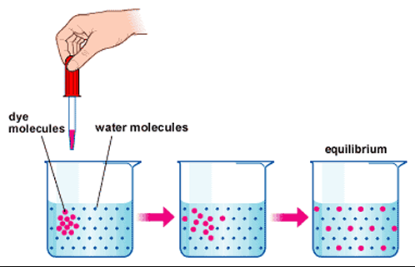
MORE ON LIQUIDS
Diffusion is the spreading of particles throughout a given volume until they are evenly sidtributed.

Slide 32

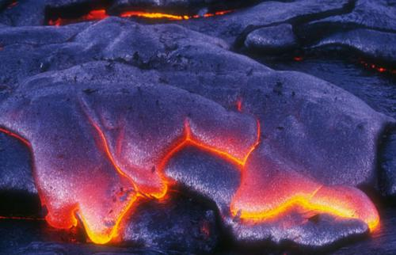
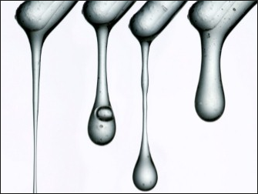
MORE ON LIQUIDS
Viscosity – a fluid’s resistance to flow; temperature can change it.
Low viscosity flows easily – high viscosity flows slowly.

Slide 33
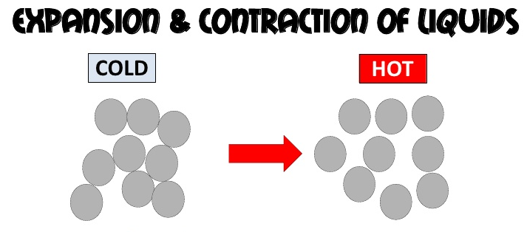
MORE ON LIQUIDS
Thermal Expansion – liquids experience more thermal expansion than solids. Example: thermometers

Slide 34
MORE ON GASES
Density – very low density.

Slide 35
MORE ON GASES
Compression – gases are easy to compress. There are a lot of spaces between the particles.

Slide 36
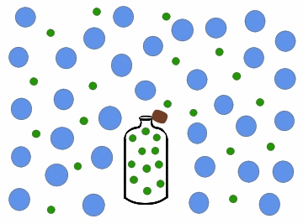
MORE ON GASES
Fluidity – ability to flow; gases and liquids are fluids because they can flow through each other. Gases diffuse faster than liquids.

Slide 37
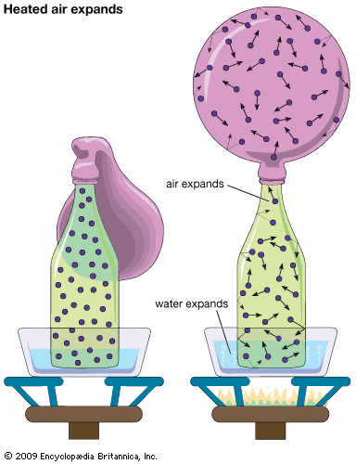
MORE ON GASES
Thermal Expansion – gases experience more thermal expansion than solids and liquids. Example: hot air balloons

