Slide 1
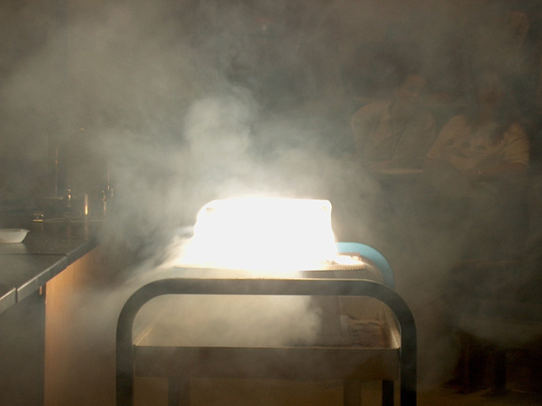
PHYSICAL SCIENCE
MATTER

Slide 2
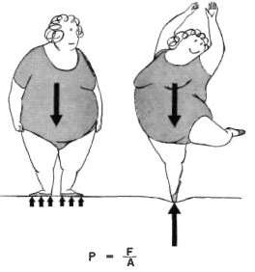
PRESSURE
Pressure is the force per unit area.
Gases exert pressure when they hit the walls of their container.
Even though a gas molecule has little mass, millions of millions of gas molecule’s pressure can add up.
There is pressure exerted by the atmosphere. At sea level this pressure is equal to one atmosphere.

Slide 3
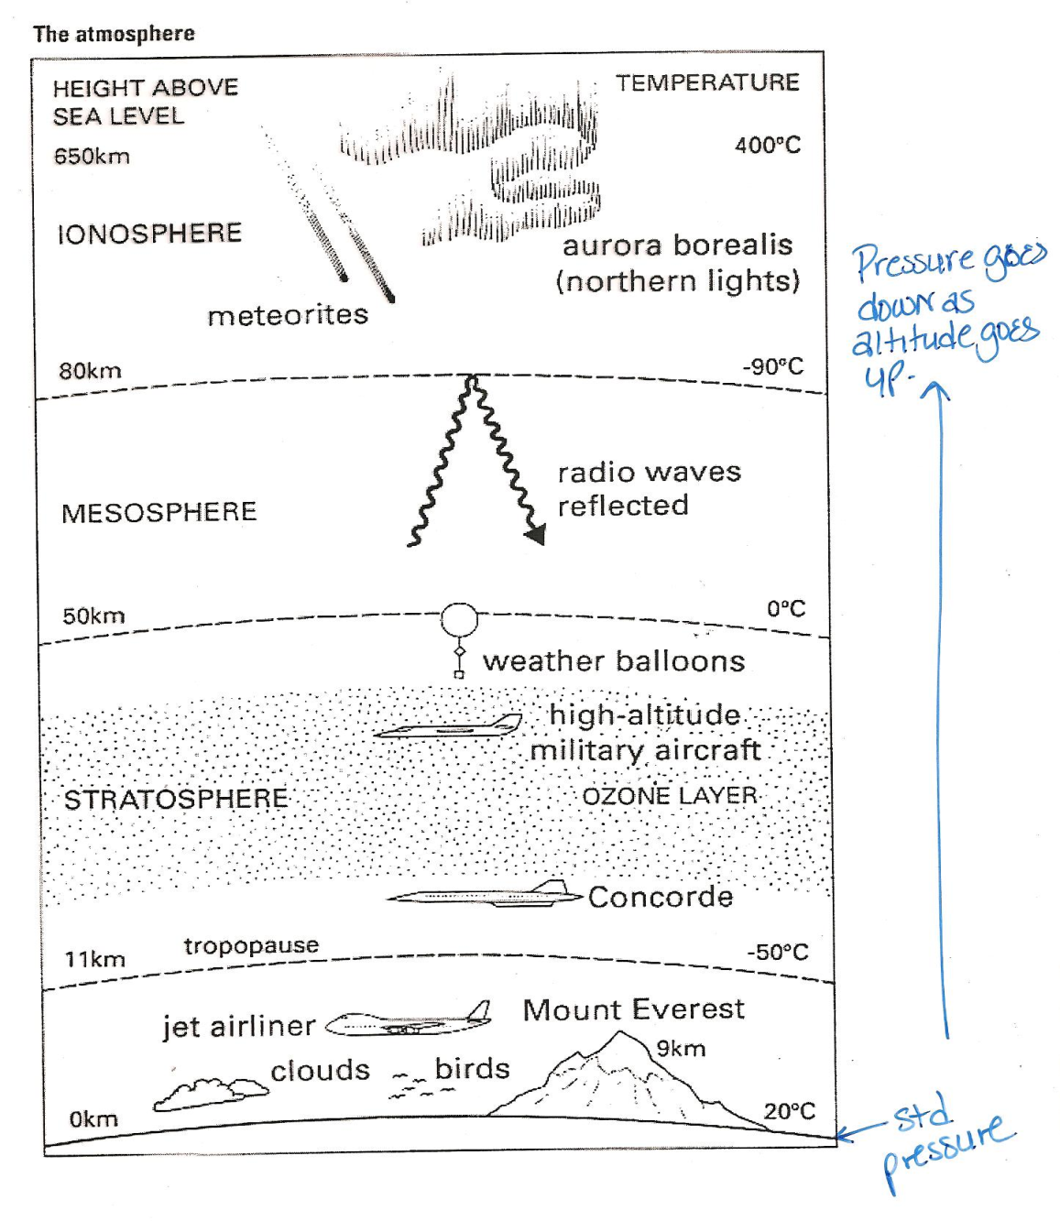
PRESSURE
Move up in altitude and the pressure decreases. There is less atmosphere pushing down.

Slide 4
PRESSURE
Pressure is measured in a variety of units.
UNIT | ABBREVIATION | COMPARE TO 1 ATM
Kilopascal | kPa | 101.3 kPa
Millimeters of mercury | mmHg | 760.0 mmHg
Torr | torr | 760.0 torr
Atmosphere | atm | 1.0 atm
Pounds per square inch* | psi | 14.7 psi
*Metric uses all of these but psi.

Slide 5


PROPERTIES OF FLUIDS
Archimedes Principle - the buoyant force on a submerged object is equal to the weight of the fluid that is displaced by the object.
An object immersed in a fluid displaces the same volume of fluid as the volume of the object.

Slide 6
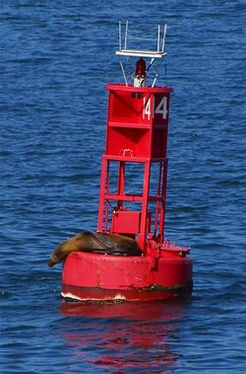
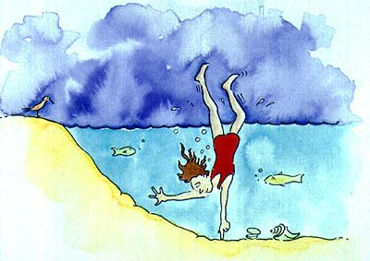
PROPERTIES OF FLUIDS
Buoyancy is the ability of a fluid to exert an upward force on an object immersed in the fluid. Can be a gas or a liquid.

Slide 7
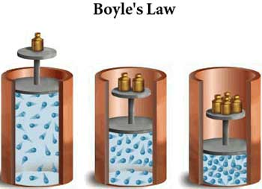
PROPERTIES OF FLUIDS
Boyle’s Law
shows a relationship between volume and pressure.
They are indirectly proportional.
As volume goes up, pressure goes down.
Assumes there is no change in temperature.
More pressure pushes the piston down, decreasing the volume

Slide 8
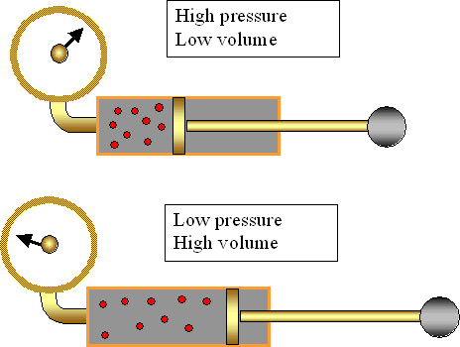
PROPERTIES OF FLUIDS
Indirectly proportional

Slide 9
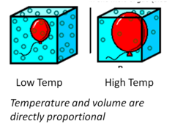
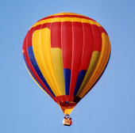
PROPERTIES OF FLUIDS
Charles’ Law
shows a relationship between volume and temperature.
They are directly proportional.
As temperature goes up, volume goes up.
Assumes there is no change in pressure.

Slide 10
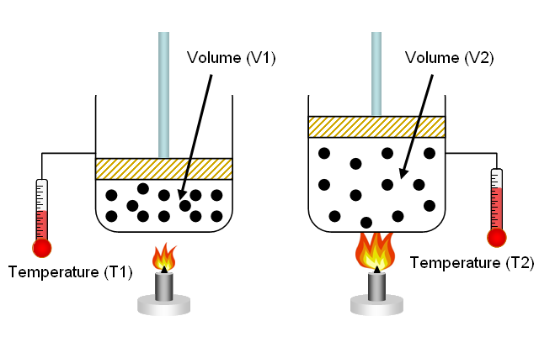
PROPERTIES OF FLUIDS
Directly Proportional

Slide 11
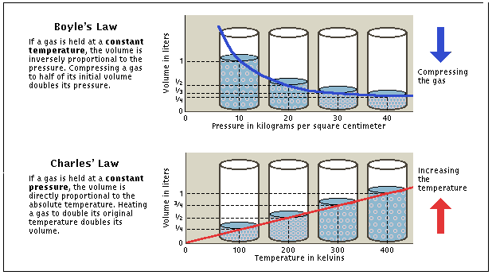
PROPERTIES OF FLUIDS

