Slide 1
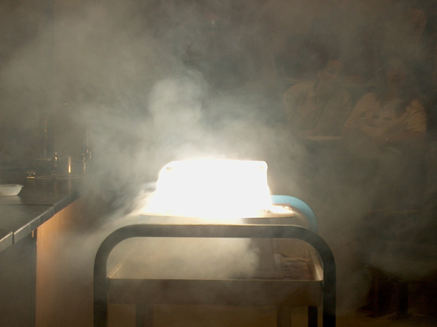
PHYSICAL SCIENCE
MATTER

Slide 2
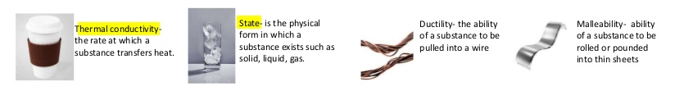
PROPERTIES OF MATTER
Physical Properties
The characteristics of a substance that you can observe without changing the identity of the substance.
Examples: color, texture, mass, volume, density, temperature, weight, hardness, phase (state), length.

Slide 3

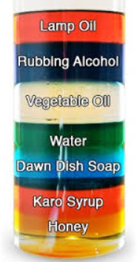
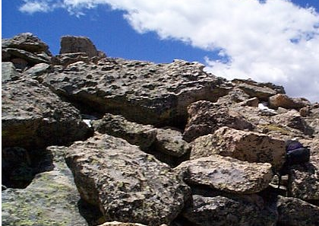
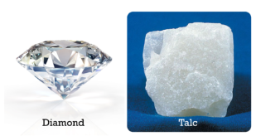
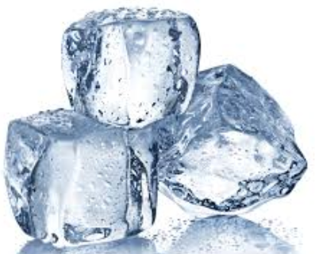
PROPERTIES OF MATTER
Color Texture Density
Hardness Phase

Slide 4
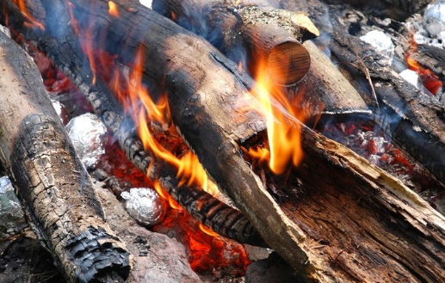

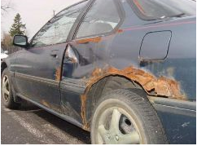
PROPERTIES OF MATTER
Chemical Properties
The characteristics of a substance that CANNOT be observed without changing the identity of the substance.
Examples: Flammability, oxidation (rusting, tarnishing)

Slide 5

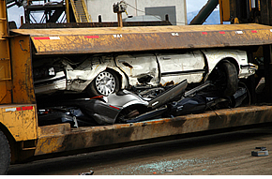
PROPERTIES OF MATTER
Physical Changes
Any change in size, shape, or state of matter in which the identity of the substance remains the same.
Examples: tearing, crushing, cutting, dissolving, phase changes (melting, freezing, etc.)

Slide 6
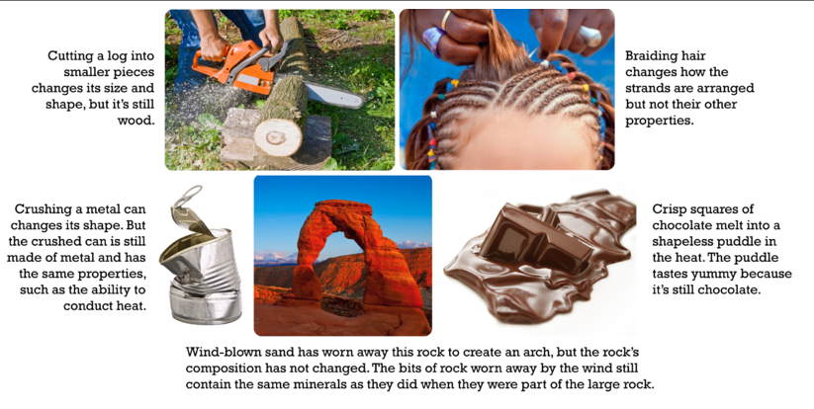
PROPERTIES OF MATTER
PHYSICAL CHANGES

Slide 7

PROPERTIES OF MATTER
Chemical Changes
Changes in matter from one substance to another.
Examples: rusting, burning, fermenting, metabolism, ANY chemical reaction

Slide 8
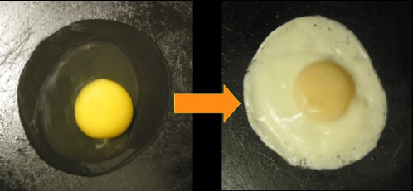
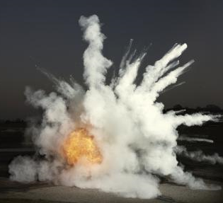
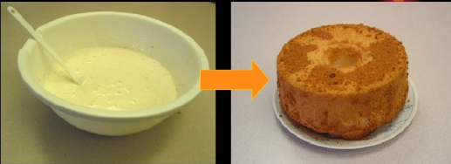
PROPERTIES OF MATTER
To distinguish between chemical and physical changes, you need to determine if the substance has been changed into something else. Look at the substance’s physical properties and see if they have changed.

Slide 9
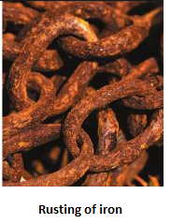
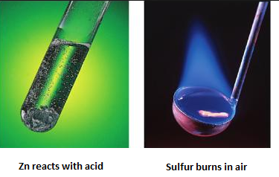
PROPERTIES OF MATTER
There are four clues:
New substance formed - new solid (precipitate), gas
New color or odor
Energy change
Explosion or flames

