Slide 1
SAT VOCABULARY TWO
So now we are going to study how DNA can mutate and cause genes to change. People who are deaf cannot hear and their deafness can be genetic. If someone is deaf, no sounds are ________. They may feel a sound wave ________________ but the wave does not translate into a sound. The wave can cause the ear drum to ____________ but the vibration is not transmitted into the middle ear. They cannot hear the harmony of singing or the ____________ of car horns blaring rush hour traffic.

Slide 2
SAT VOCABULARY TWO
Audible (adj.) able to be heard
Oscillate (v.) to sway from one side to another
Dissonance (n.) lack or harmony or consistency
Undulate (v.) to move in waves

Slide 3
DO NOW
Get out notes, worksheet, and review outline.
VIDEO: Transgenic Animal Creations

Slide 4
MUTATIONS and DNA TECHNOLOGY

Slide 5
MUTATIONS
Definition
Where they occur
  Somatic, Gamete
Causes
  Spontaneous
  Mutagenic agents
Helpful or Harmful

Slide 6
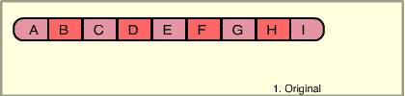
TYPES OF MUTATIONS
Chromosomal Mutations
  Definition
  Effects
  Types
    Deletion, Duplication, Inversion, Translocation,

Slide 7
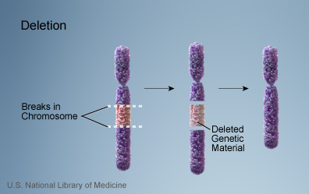
DELETION
Due to breakage.
Loss of a segment.

Slide 8
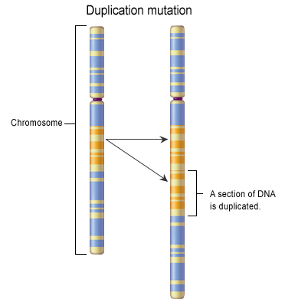
DUPLICATION
Occurs when sections are repeated.

Slide 9
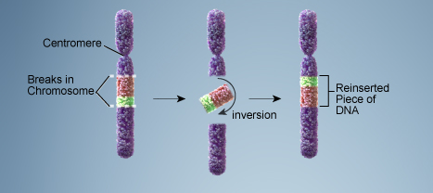
INVERSION
part of sequence becomes oriented in reverse direction.
Chromosome segment breaks off, segment flips around backwards, and reattaches.

Slide 10
TRANSLOCATION
Involves two chromosomes that aren’t homologous
Part of one chromosome breaks off.
The broken part is attached on a different chromosome.

Slide 11
TYPES OF MUTATIONS
    Nondisjunction
      Aneuploidy - define
      Polyploidy – define and benefits in plants
  Diseases/Problems caused (some examples listed)
    Down’s syndrome
    Turner’s syndrome
    Klinefelter’s syndrome

Slide 12
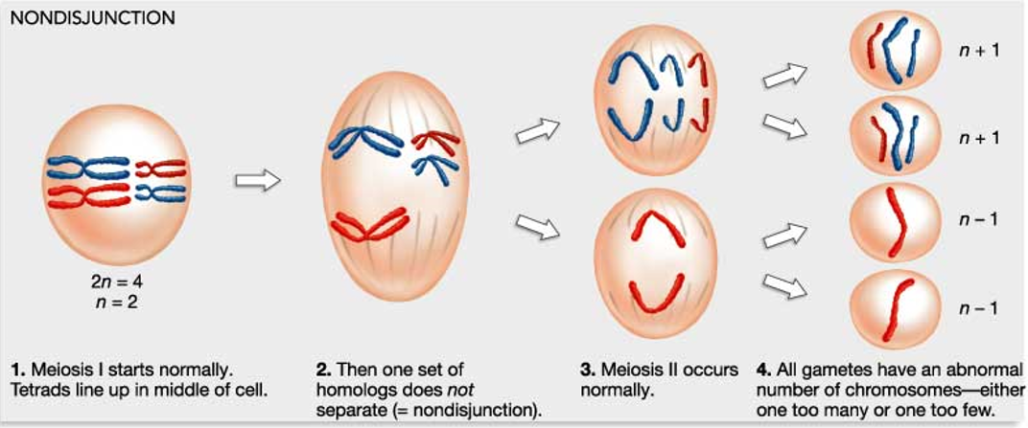
NONDISJUNCTION

Slide 13
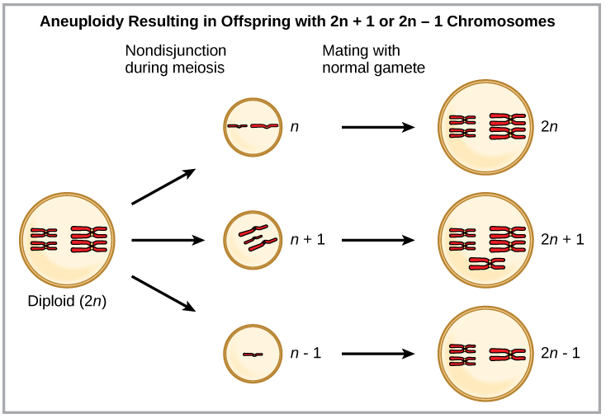
NONDISJUNCTION
Changes in Chromosome Number
Aneuploidy – A chromosomal mutation occurs resulting in cells with one extra or one less chromosome.

Slide 14
NONDISJUNCTION
Changes in Chromosome Number
Polyploidy – A chromosomal mutation occurs resulting in cells with three or more extra chromosomes.

Slide 15
TYPES OF MUTATIONS
Gene/Point Mutations
  Definition
  Effects
  Types
    Substitution, Frameshift (Deletion, Insertion)
  Diseases/Problems caused (some examples listed)
    Sickle cell, Cystic fibrosis

Slide 16
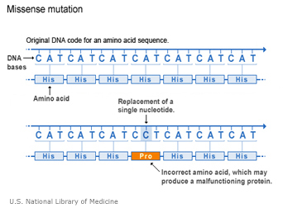
SUBSTITUTION
Replacement of one nucleotide with another nucleotide.

Slide 17
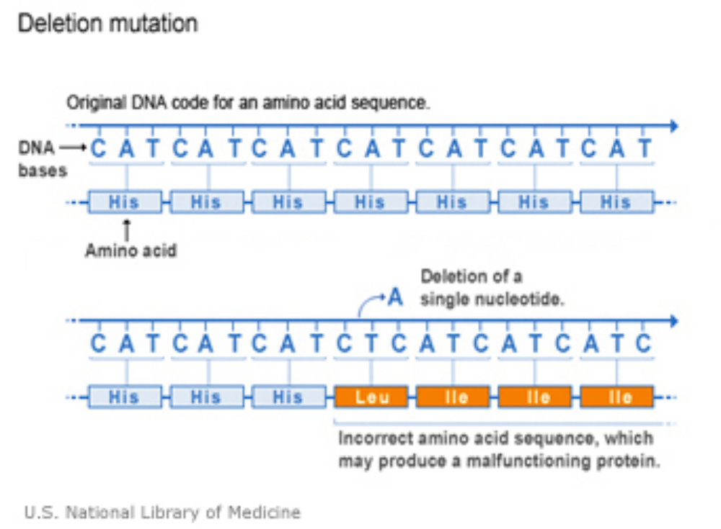
FRAME SHIFT MUTATION
DELETION

Slide 18
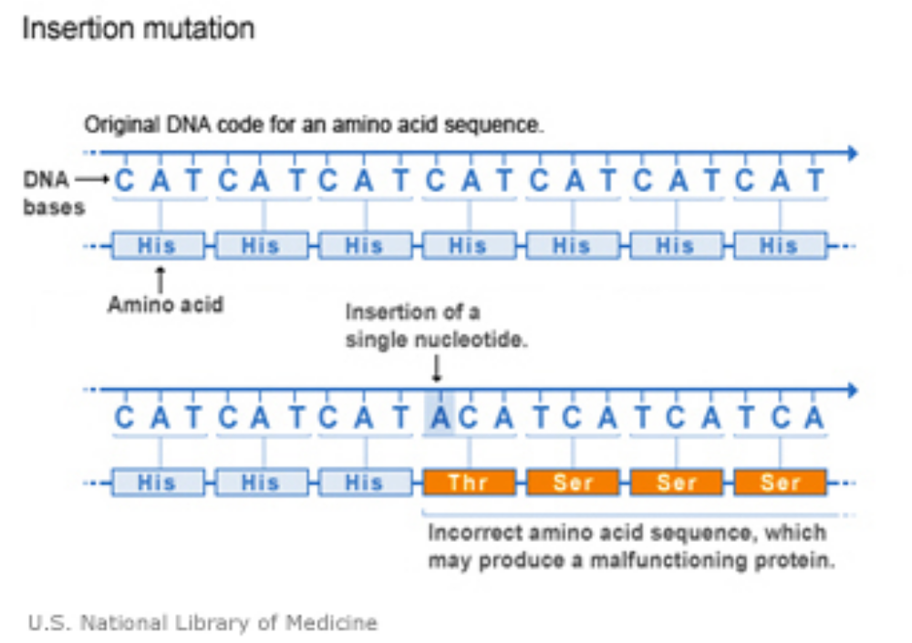
FRAME SHIFT MUTATION
INSERTION

Slide 19

POINT MUTATIONS

Slide 20
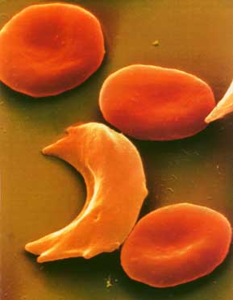
POINT MUTATION
Sickle Cell disease is the result of one nucleotide substitution.
Occurs in the hemoglobin gene.

Slide 21
DNA TECHNOLOGY
      Human Genome Project
        Purpose
        Insights
        Benefits

Slide 22
HUMAN GENOME PROJECT
The project’s purpose was to discover the human genes and map the 3 billion nucleotide sequences of DNA.
Only 2% of human genome codes for proteins (exons).
Only about 20,000 to 25,000 genes.
About 8 million single nucleotide polymorphisms (SNP) – places where humans differ by a single nucleotide.
Improvements in medical prevention of disease, gene therapies, diagnosis techniques; Production of useful protein products for use in medicine, agriculture,

Slide 23
GENE THERAPY
        Definition
        Purpose
        How it works
        Example

Slide 24
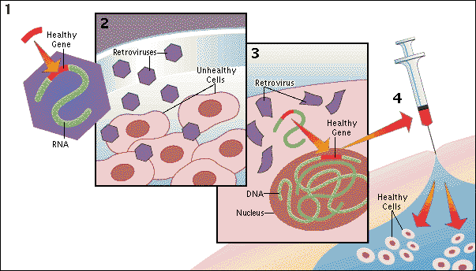
GENE THERAPY
http://encarta.msn.com/media_461561269/Gene_Therapy.html

Slide 25
CLONING
        Definition
        Purpose
        How it works
        Example

Slide 26
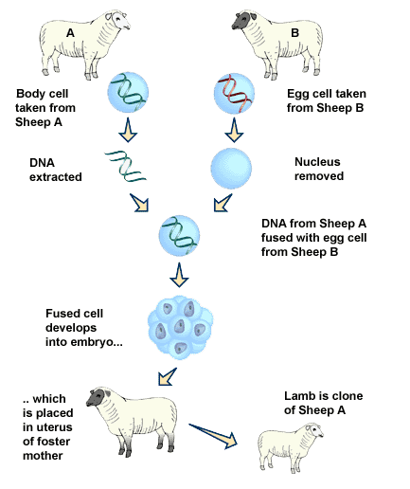
CLONING
Clone- a member of a group of genetically identical cells

Slide 27
DNA FINGERPRINTING
        Definition
        Purpose
        How it works
        Know what gel electrophoresis is
        Example

Slide 28
DNA FINGERPRINTING
How it Works:
Extract DNA
Cut DNA
Run a gel electrophoresis

Slide 29
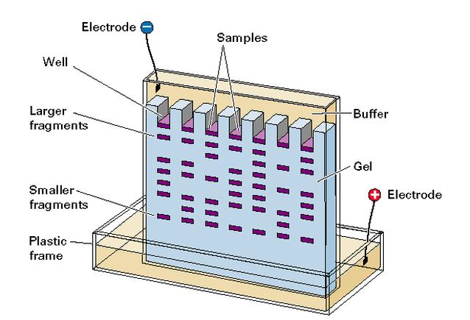
ELECTROPHORESIS
Negative DNA moves toward the positive end.
Smaller fragments move farther and faster that longer ones.

Slide 30
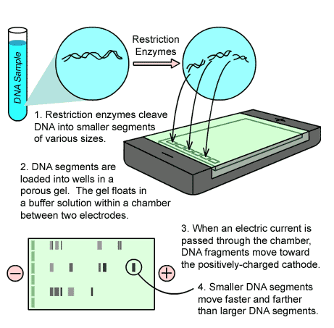
ELECTROPHORESIS

Slide 31
POLYMERASE CHAIN REACTION, PCR
        Definition
        Purpose
        How it works
        Example

Slide 32
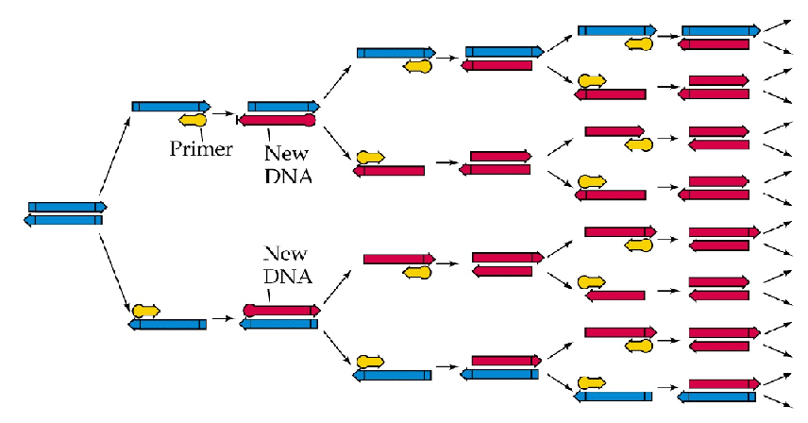
COPYING DNA
Polymerase Chain Reaction
Large amounts of DNA can be made from a small starting sample

Slide 33
GENETIC ENGINEERING
        Definition
        Purpose
        How it works
        Example
        Vocabulary
    Transgenic organism
    Recombinant DNA
    Restriction Enzyme
        Benefits
        Questions

Slide 34
GENETIC ENGINEERING
The process of changing the genetic makeup of an organism to introduce a desirable trait.
Genes are transferred from one species into another species resulting in a transgenic organism that contains recombinant DNA.

Slide 35
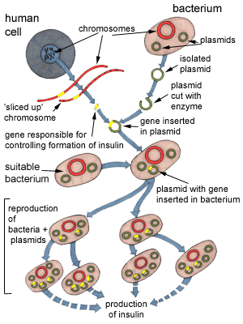
GENETIC ENGINEERING

Slide 36
GENETIC ENGINEERING
Recombinant DNA contains DNA spliced together from two different organisms.
Restriction enzymes are used to splice DNA at specific base sequences into fragments.
Recombinant DNA

Slide 37
BENEFITS
Transgenic plants
help farmers grow crops more efficiently and with less impact on the environment.
Transgenic animals
widely used in medical research – as sources of medically valued proteins or pharmacologicals.
food animals are being altered to be more nutritious, disease resistant, or easier to raise.

Slide 38
ENVIRONMENTAL BENEFITS
Reduced pesticide and herbicide use.
Lower energy requirements.
Cleaner water.
Less soil erosion.

Slide 39
SAT VOCABULARY
Audible (adj.) able to be heard
Oscillate (v.) to sway from one side to another
Dissonance (n.) lack or harmony or consistency
Undulate (v.) to move in waves

Slide 40
TO DO
VIDEO: Transgenics – positive or negative
Do Section I and any other worksheet section that is incomplete.
Review for test.

Slide 41
DO NOW
Turn in worksheet – is your name on it? Is it complete?
Pick up a Vis a Vis pen
Prepare for test.

