Slide 1
SAT VOCABULARY TWO
So now we are going to study how DNA can mutate and cause genes to change. People who are deaf cannot hear and their deafness can be genetic. If someone is deaf, no sounds are ________. They may feel a sound wave ________________ but the wave does not translate into a sound. The wave can cause the ear drum to ____________ but the vibration is not transmitted into the middle ear. They cannot hear the harmony of singing or the ____________ of car horns blaring rush hour traffic.

Slide 2
SAT VOCABULARY TWO
Audible (adj.) able to be heard
Oscillate (v.) to sway from one side to another
Dissonance (n.) lack or harmony or consistency
Undulate (v.) to move in waves

Slide 3
MUTATIONS

Slide 4
MUTATIONS
Changes in the nucleotide sequence of DNA
May occur in somatic cells (aren’t passed to offspring)
May occur in gametes (eggs & sperm) and be passed to offspring

Slide 5
MUTATIONS
A Mutation occurs when a DNA sequence is damaged or changed which can alter the genetic message.
Many mutations happen spontaneously when DNA is replicating.
Some mutations can occur when DNA is exposed to mutagenic factors such as x-rays, UV radiation, and chemicals.

Slide 6
HELPFUL OR HARMFUL?
Mutations happen regularly.
Almost all mutations are neutral.
Chemicals & Ultraviolet radiation cause mutations.
Many mutations are repaired by enzymes.

Slide 7
HELPFUL OR HARMFUL?
Some type of skin cancers and leukemia result from somatic mutations.
Some mutations may improve an organism’s survival (beneficial)

Slide 8
TYPES OF MUTATIONS

Slide 9
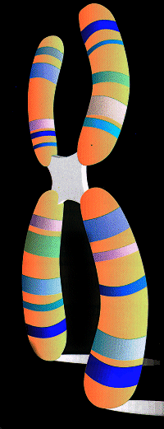
CHROMOSOME MUTATIONS
May Involve:
  Changing the structure of a chromosome
  The loss or gain of part of a chromosome

Slide 10
CHROMOSOME MUTATIONS
Changes in chromosome numbers or chromosomal arrangements affecting many genes.
These mutations can lead to serious disorders, cancers, or can be lethal.

Slide 11
CHROMOSOME MUTATIONS
Five types exist:
  Deletion
  Duplication
  Inversion
  Translocation
  Nondisjunction

Slide 12
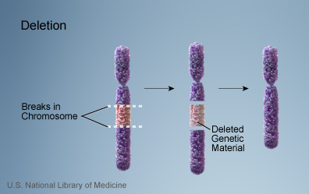
DELETION
Due to breakage.
Loss of a segment.

Slide 13
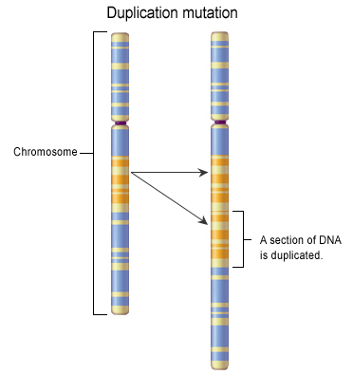
DUPLICATION
Occurs when sections are repeated.

Slide 14
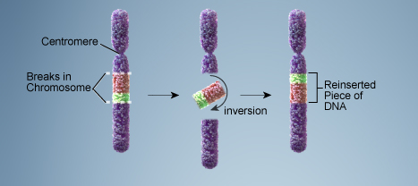
INVERSION
part of sequence becomes oriented in reverse direction.
Chromosome segment breaks off, segment flips around backwards, and reattaches.

Slide 15
TRANSLOCATION
Involves two chromosomes that aren’t homologous
Part of one chromosome breaks off.
The broken part is attached on a different chromosome.

Slide 16
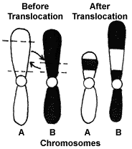
TRANSLOCATION

Slide 17
NONDISJUNCTION
Failure of chromosomes to separate during meiosis
Causes gamete to have too many or too few chromosomes.

Slide 18
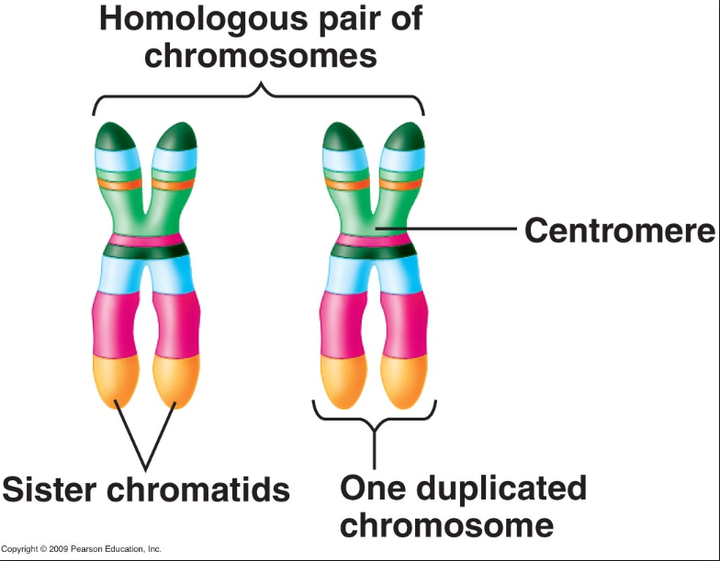
HOMOLOGOUS CHROMOSOMES
a chromosome pair, one inherited from the mother and one from the father, containing genes for the SAME trait or characteristic.

Slide 19
NONDISJUNCTION
The chromosome numbers can change due to NONDISJUNCTION which occurs when homologous chromosomes do not separate properly during meiosis.

Slide 20
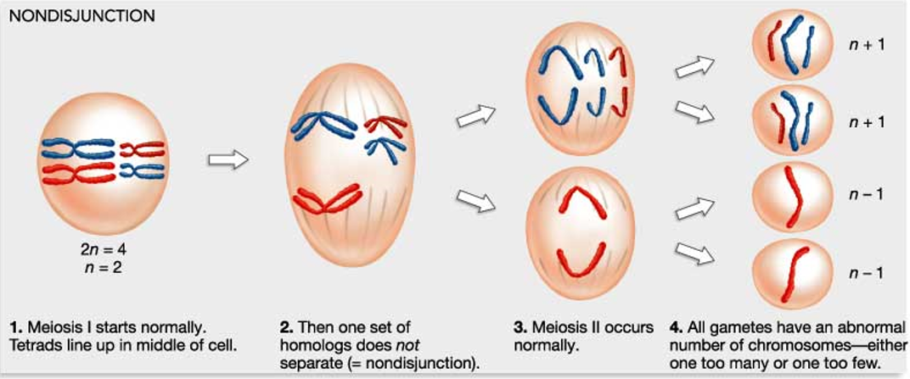
NONDISJUNCTION

Slide 21
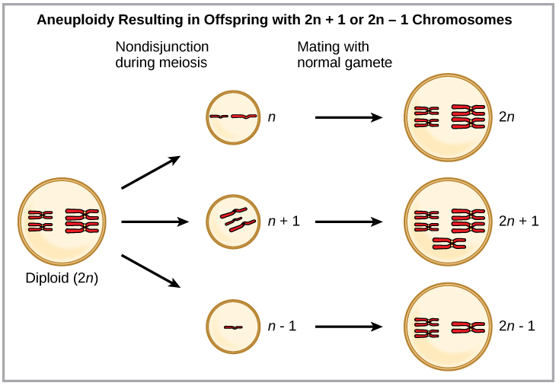
NONDISJUNCTION
Changes in Chromosome Number
Aneuploidy – A chromosomal mutation occurs resulting in cells with one extra or one less chromosome.

Slide 22
NONDISJUNCTION
Changes in Chromosome Number
Polyploidy – A chromosomal mutation occurs resulting in cells with three or more extra chromosomes.
POLYPLOIDY

Slide 23
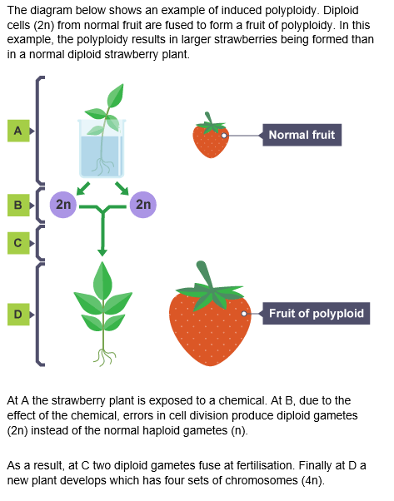
POLYPLOIDY

Slide 24
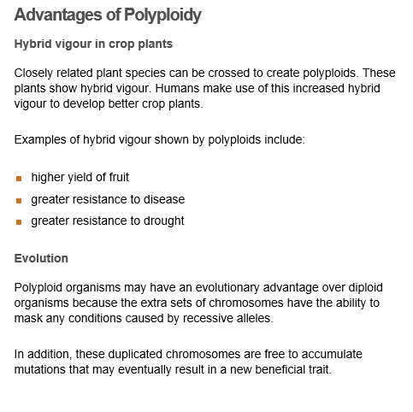
POLYPLOIDY

Slide 25
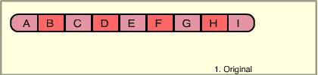
CHROMOSOME MUTATION ANIMATION

Slide 26
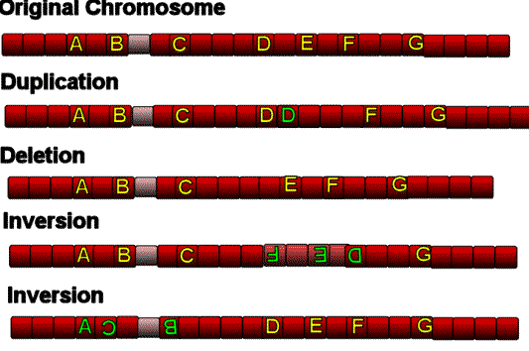

Slide 27
TO DO
Changes in Chromosome Structure
Do Section B now.
Handout for homework.

Slide 28
DO NOW
Genetics Part 4: Mutations

Slide 29
GENE MUTATIONS
Also known as point mutations.
Change in the nucleotide sequence of DNA.
May only involve a single nucleotide.
May be due to copying errors, chemicals, viruses, etc.

Slide 30
TYPES OF GENE MUTATIONS
Include:
  Point Mutations
  Substitutions
  Insertions
  Deletions
  Frameshift

Slide 31
POINT MUTATION
Change of a single nucleotide
Includes the deletion, insertion, or substitution of ONE nucleotide in a gene

Slide 32
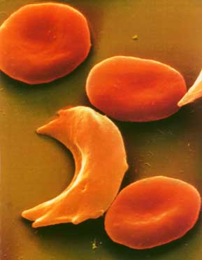
POINT MUTATION
Sickle Cell disease is the result of one nucleotide substitution.
Occurs in the hemoglobin gene.

Slide 33
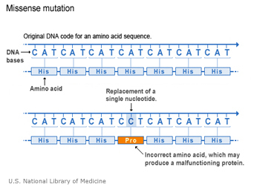
SUBSTITUTION
Replacement of one nucleotide with another nucleotide.

Slide 34
SUBSTITUTION
If a mutation occurs, then the DNA will be changed.
This change will cause a change in mRNA when it is transcribed.
The change in mRNA may cause a change in amino acids formed during translation.
If a different amino acid is made then the protein shape will be different resulting in a nonfunctional protein.

Slide 35
SUBSTITUTION
Mutations that occur in sex cells are passed on to the organism’s offspring.

Slide 36
FRAME SHIFT MUTATION
Insertion or deletion of nucleotides in a gene.
Changes the “reading frame” like changing a sentence.
Proteins built incorrectly.

Slide 37
FRAME SHIFT MUTATION
Original:
  The fat cat ate the wee rat.
Frame Shift (“a” added):
  The fat caa tet hew eer at.

Slide 38
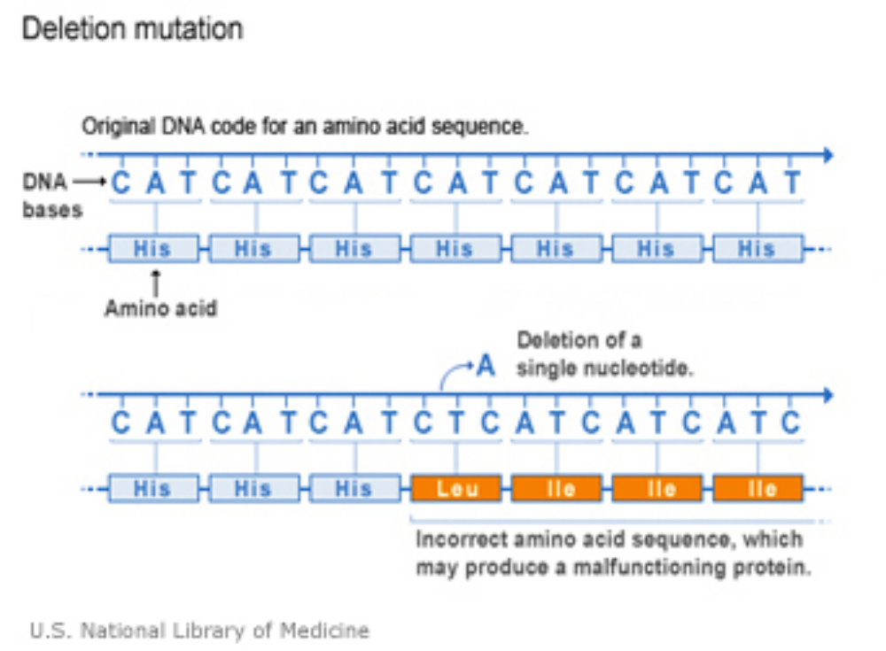
FRAME SHIFT MUTATION
DELETION

Slide 39
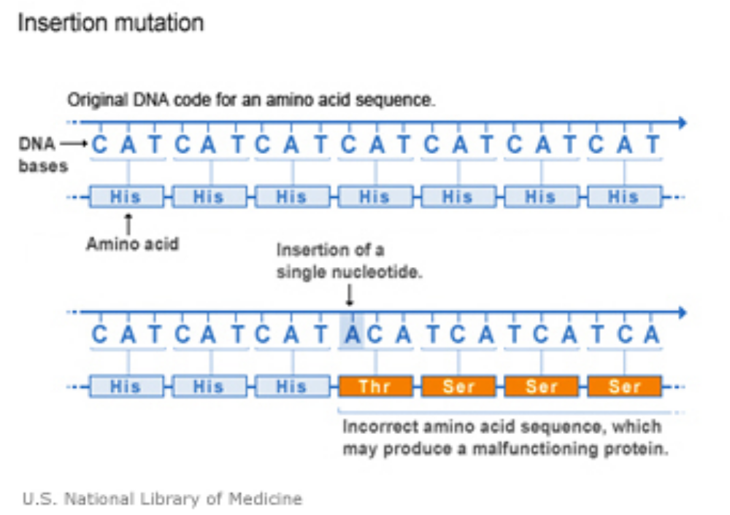
FRAME SHIFT MUTATION
INSERTION

Slide 40
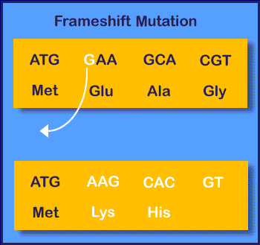
DELETION

Slide 41

ANIMATION
Sickle Cell Anemia

