Slide 1
ORGANIC CHEMISTRY
HONORS BIOLOGY

Slide 2
ORGANIC CHEMISTRY
Macromolecules song

Slide 3
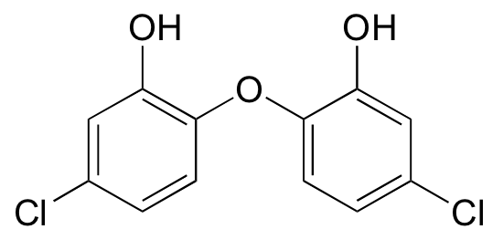
ORGANIC chemistry
Organic compounds are synthesized by cells and contain carbon – made of a carbon skeleton

Slide 4
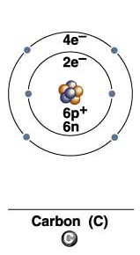
Organic Macromolecules
Contain Carbon
Question: How many electrons does carbon need to fill its outer energy level?
Answer: Four
Each carbon atom can make four covalent bonds with other types of atoms or additional carbons.

Slide 5
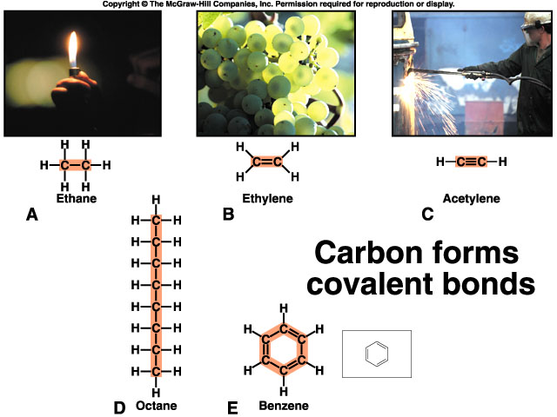
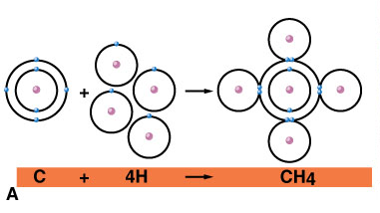

Slide 6
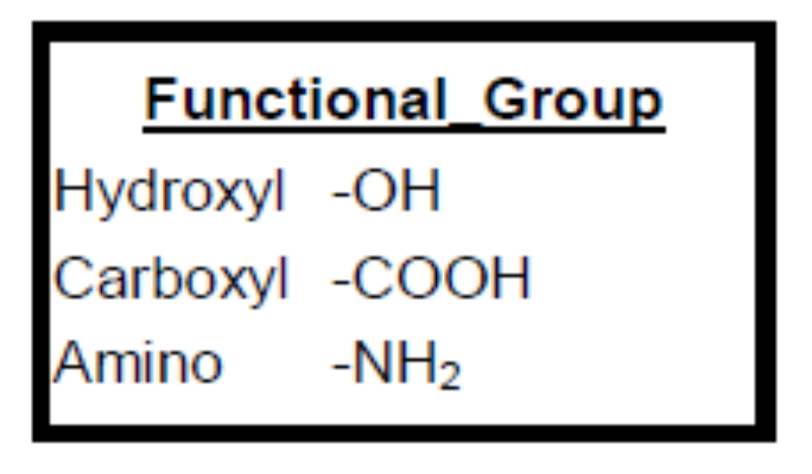
ORGANIC chemistry
Carbon skeletons are attached at a functional group – which is the area that participates in chemical reactions.
These then build macromolecules (aka organic compounds)

Slide 7
Macromolecules
Building Complex Molecules That Comprise Living Things
Molecule | Two or more atoms joined by chemical bonds
Macromolecule | Large polymer made of repeating monomer units
Four types of organic macromolecules
are important in living systems.

Slide 8
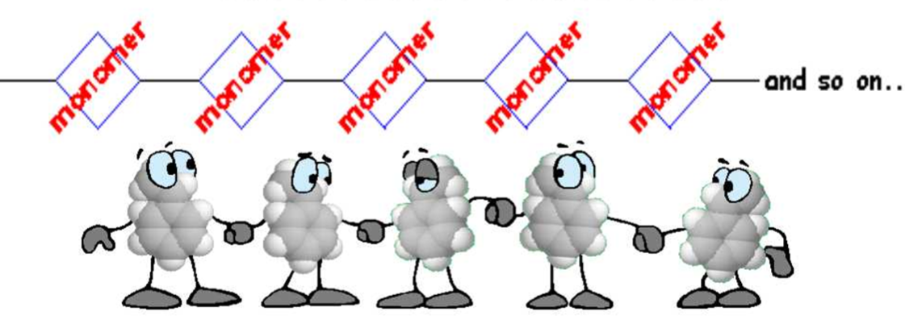
Macromolecules
Macromolecules are large molecules called polymers
These polymers are composed of monomer subunits.

Slide 9
Macromolecules
Macromolecule | Monomer Unit
Carbohydrates | Sugars
Lipids | Fatty acids
Proteins | Amino acids
Nucleic Acids | Nucleotides

Slide 10
Synthesis and Breakdown of Macromolecules
Condensation (Dehydration Synthesis) | Monomers are connected to produce polymers; water is released during the reaction.
Hydrolysis | Polymers are broken down into monomers; water is needed for the reaction to occur.

Slide 11
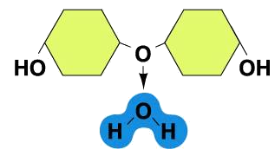
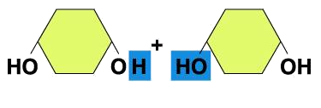
CONDENSATION
Water is expelled and the two molecules attach at their functional groups.

Slide 12
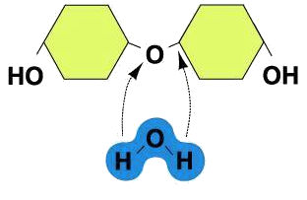
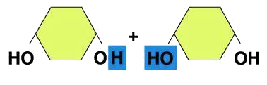
Hydrolysis
Water is consumed and the polymer splits into two molecules at the functional groups.
Enzymes assist in both reactions.

Slide 13
CONDENSATION AND HYDROLYSIS
Clip on the process

Slide 14
MACROMOLECULES
There are four types:
  Carbohydrates
  Lipids
  Proteins
  Nucleic acids

Slide 15
TO DO
Do section A: intro to organic compounds
Try this link: Hydrolysis and Condensation

Slide 16
DO NOW
Get out your notes and worksheet for organic chemistry
Organic Chemistry: Macromolecules

Slide 17
CARBOHYDRATES
Consist of C, H, O
Main source of energy –
It’s function: the breakdown of sugar supplies immediate energy to cells.
Excess is stored as complex sugars in cells

Slide 18
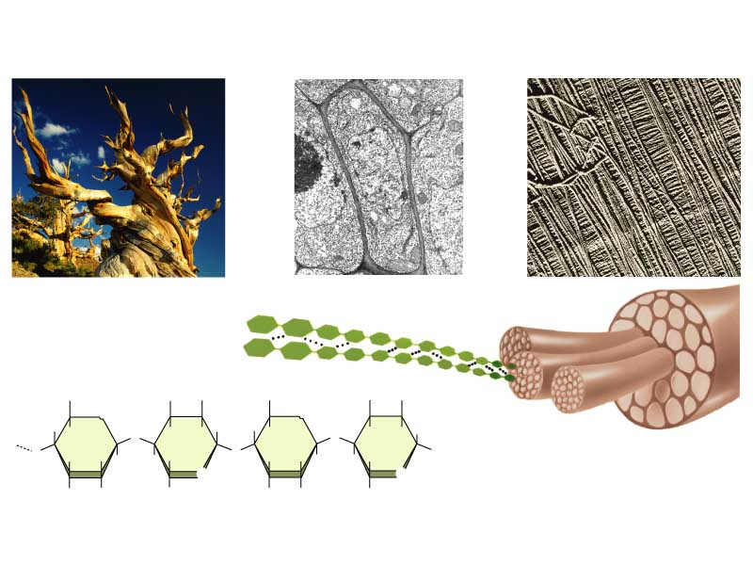
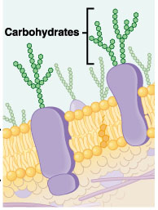
Carbohydrates: Functions
Energy source
Structural component
Cell-cell communication

Slide 19
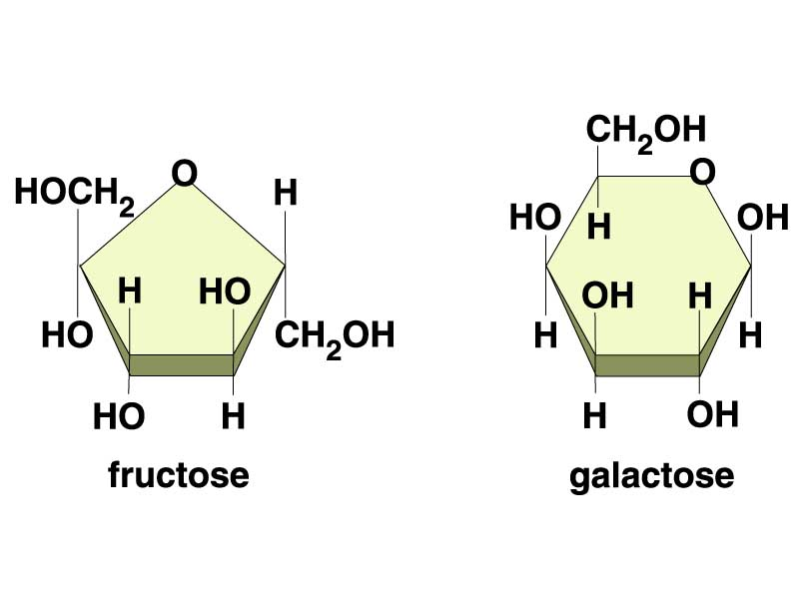
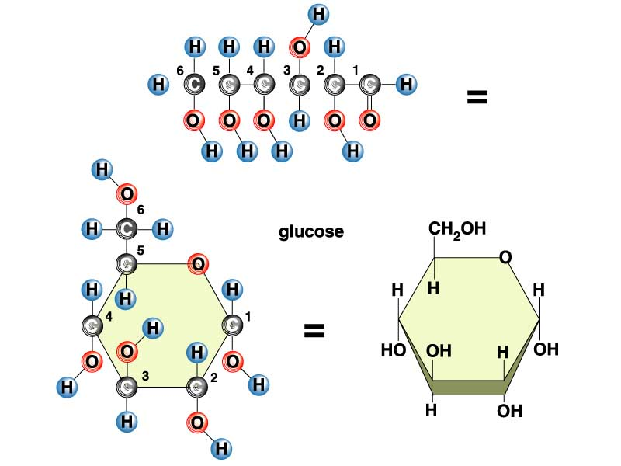
Carbohydrates: Structure
Simple
  Monosaccharides= one sugar unit
Glucose = blood sugar
All cells use glucose for energy

Slide 20
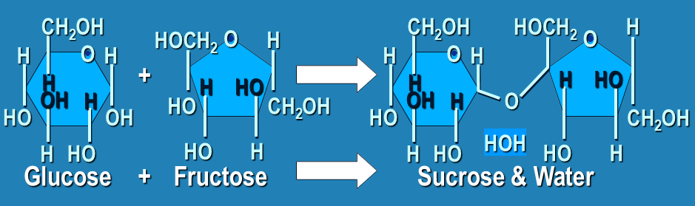
Carbohydrates - structure
Simple
  Disaccharides = two sugar units

Slide 21
Carbohydrates: Structure
Simple
  Disaccharides = two sugar units
    Sucrose = glucose + fructose table sugar
    Lactose = glucose + galactose milk sugar
    Maltose = glucose + glucose seed sugar

Slide 22
Carbohydrates: Structure
Complex
  Polysaccharides= many sugar units
    Starch -- storage in plants
    Glycogen -- storage in animals
    Cellulose -- plant cell walls, indigestible
    Chitin -- exoskeletons of insects,
    fungal cell walls

Slide 23
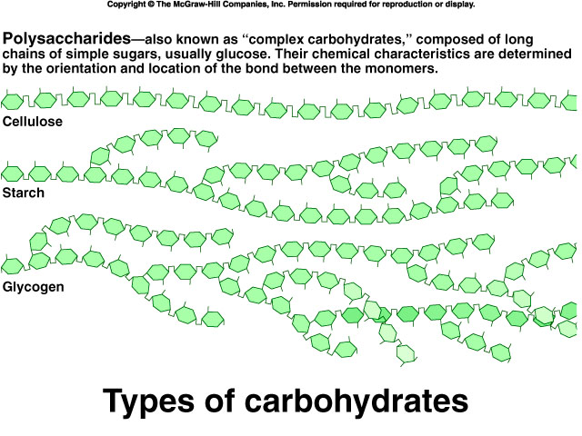

Slide 24
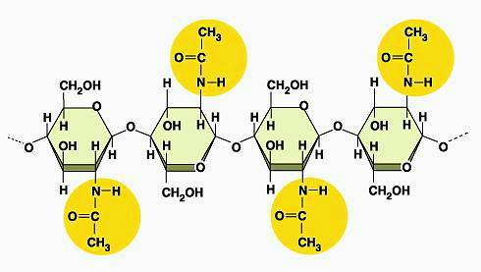
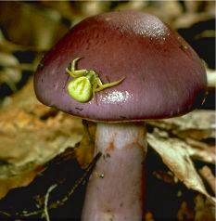
Chitin

Slide 25
Carbohydrates: Dietary Recommendations
58% of calories from carbohydrates
No more than 10% of calories from simple, refined sugars
Emphasize
  Complex carbohydrates
    Starch
    Fiber (cellulose)
  Naturally-occurring simple carbohydrates
    Fructose from fruit
    Lactose from milk

Slide 26
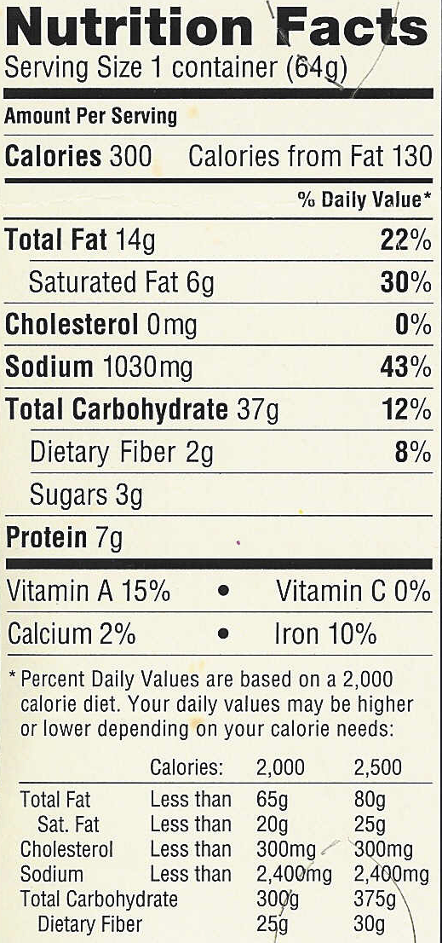
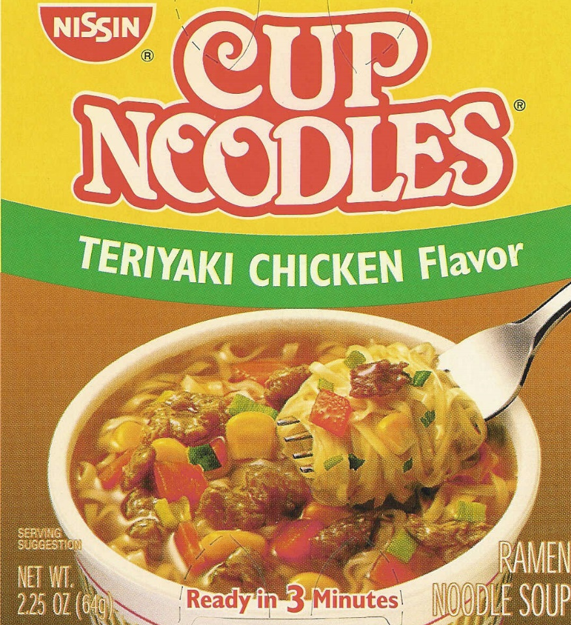
Macronutrients As
Energy Sources

Slide 27
Applying Your Knowledge
Which molecule consists of two sugar units?
Which choice best describes glycogen?
Which type of molecule provides the basic energy for your cells?
Which type of molecule is found in milk?
Monosaccharide
Polysaccharide
Disaccharide

Slide 28
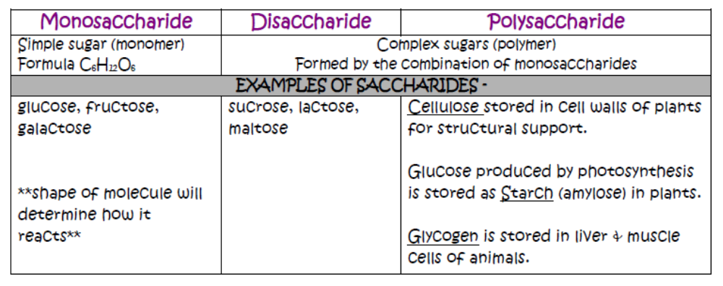

Slide 29
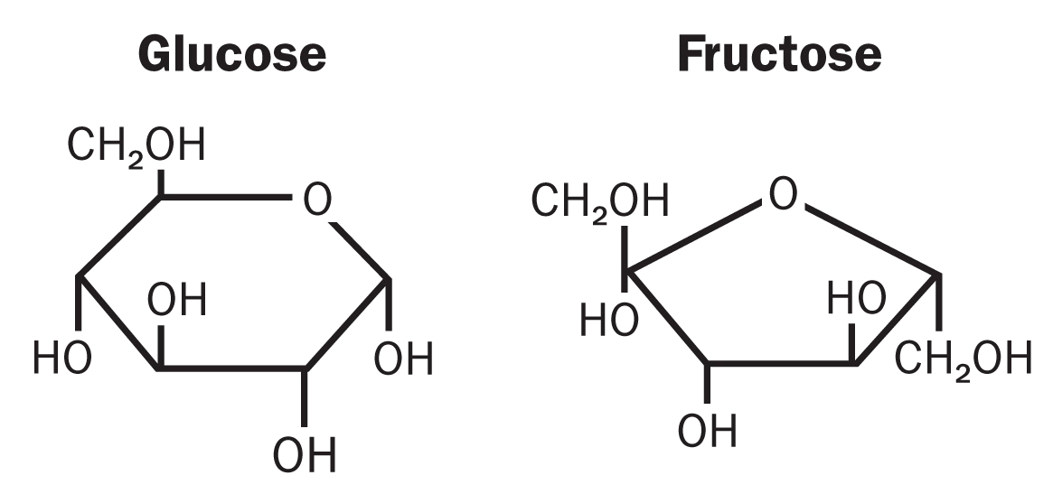
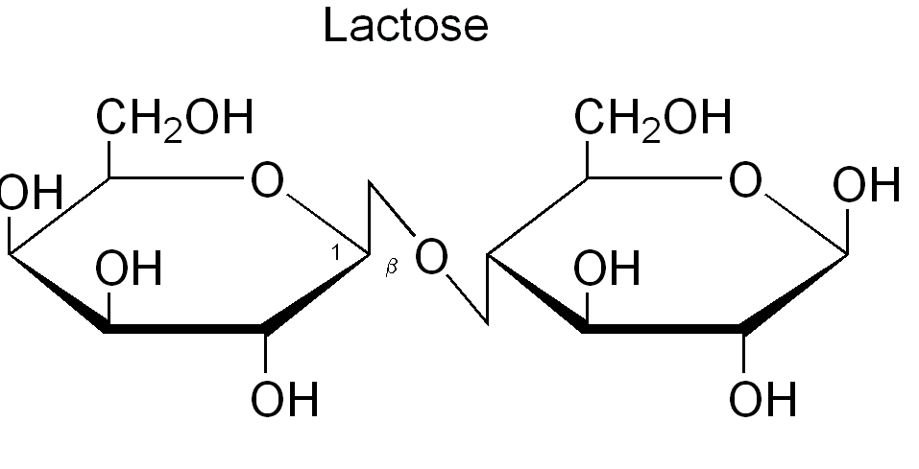
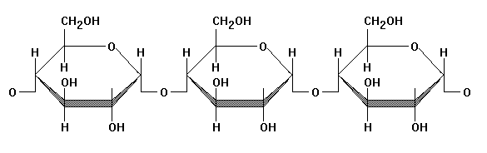
Glycosidic Linkage
In chemistry, a glycosidic bond is a type of covalent bond that joins a carbohydrate (sugar) molecule to another group, which may or may not be another carbohydrate.

Slide 30
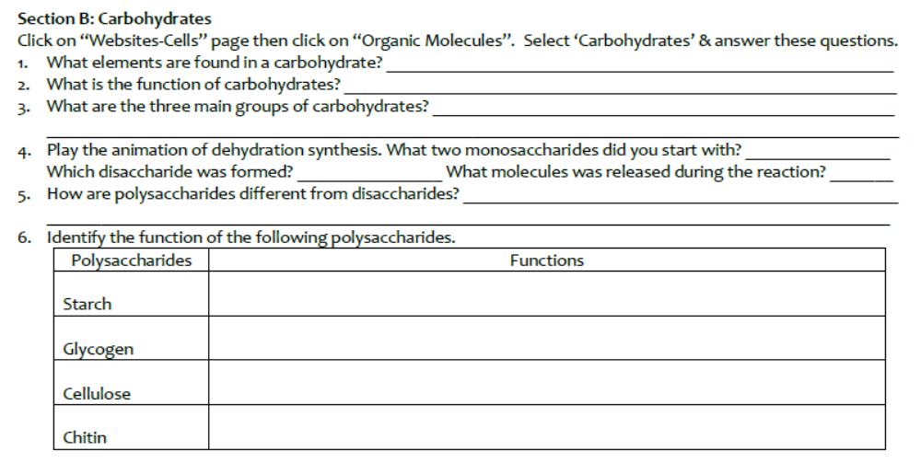
TO DO
Work on Section B: Carbohydrates.

Slide 31
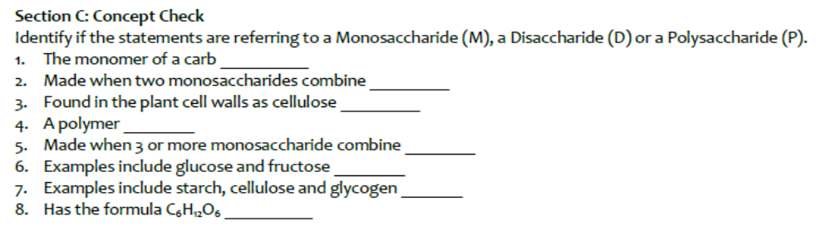
DO NOW
Get out notes and worksheet for organic chemistry. Do Section C on worksheet NOW.

Slide 32
LIPIDS
Consist of C, H, O
Includes waxes, oils, fats, steroids (cholestrol and sex hormones)

Slide 33
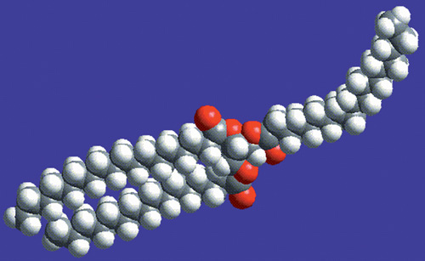
Lipids
Consist of C, H, O
Lipids are hydrophobic –”water fearing” - insoluble
Do NOT mix with water
Includes fats, waxes, steroids, & oils
FAT MOLECULE

Slide 34
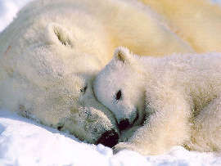
Function of Lipids
Energy Storage –breakdown of lipids provides a long-term energy supply; excess is stored in fat cells; yields twice as much as
carbohydates.
helps to insulate the body, and cushion and protect organs

Slide 35
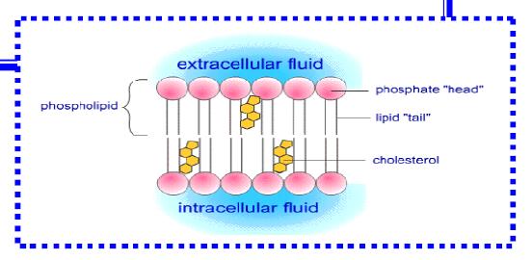
FUNCTION OF LIPIDS
A component of the cell membrane – phospholipids
Provides cushion, insulation and waterproofing (wax)

Slide 36
Types of Fatty Acids
Saturated fatty acids have the maximum number of hydrogens bonded to the carbons (all single bonds between carbons) – solid at room temperature.
Unsaturated fatty acids have less than the maximum number of hydrogens bonded to the carbons (a double bond between carbons) – liquids at room temperature.

Slide 37
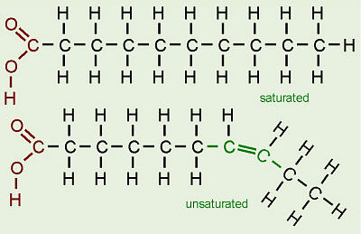
Types of Fatty Acids
Single Bonds in Carbon chain
Double bond in carbon chain

Slide 38
COMPOSITION
A fat is composed of two kinds of smaller molecules, glycerol and fatty acids (monomer).

Slide 39
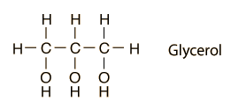
Triglyceride
A fat is composed of two kinds of smaller molecules, glycerol and fatty acids -Monomer of lipids
Composed of Glycerol & three fatty acid chains
Glycerol forms the “backbone” of the fat
Organic Alcohol (-OL ending)

Slide 40
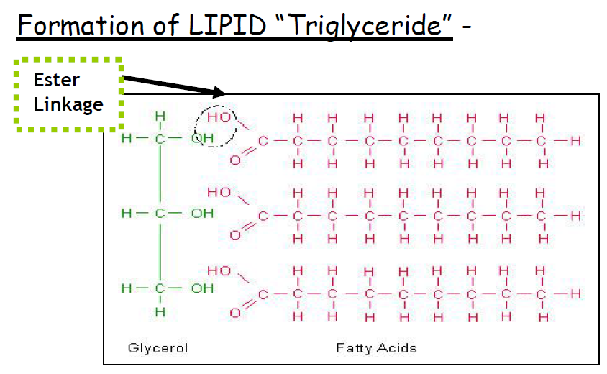
Formation of triglyceride

Slide 41
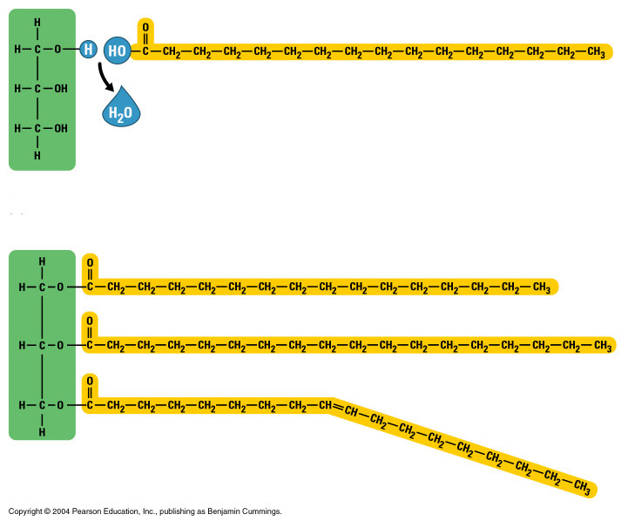
Triglyceride
Glycerol
Fatty Acid Chains

Slide 42
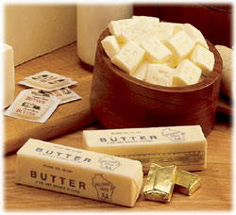
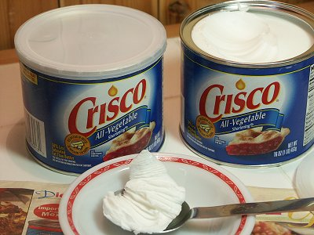
Fats in Organisms
Most animal fats have a high proportion of saturated fatty acids & exist as solids at room temperature (butter, margarine, shortening).

Slide 43
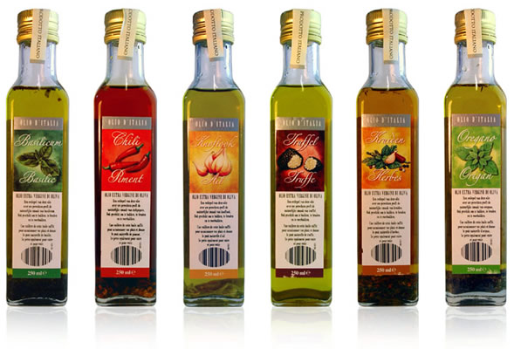
Fats in Organisms
Most plant oils tend to be low in saturated fatty acids & exist as liquids at room temperature (oils).

Slide 44
Fats
Dietary fat consists largely of the molecule triglyceride composed of glycerol and three fatty acid chains
Fatty Acid Chain
Glycerol
Dehydration links the fatty acids to Glycerol

Slide 45
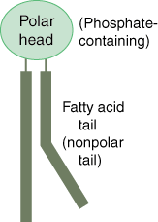
Lipids & Cell Membranes
Cell membranes are made of lipids called phospholipids.
Phospholipids have a head that is polar & attract water (hydrophilic).
Phospholipids also have two tails that are nonpolar and do not attract water (hydrophobic).

Slide 46
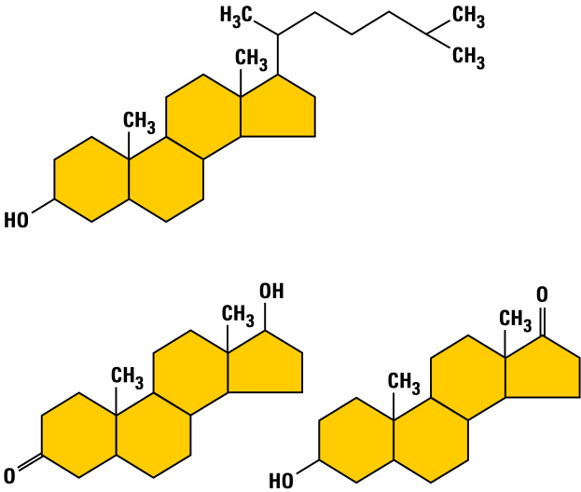
Steroids
Cholesterol is the “base steroid” from which your body produces other steroids.
Cholesterol
The carbon skeleton of steroids is bent to form four fused rings.
Estrogen
Testosterone
Estrogen & testosterone are also steroids

Slide 47
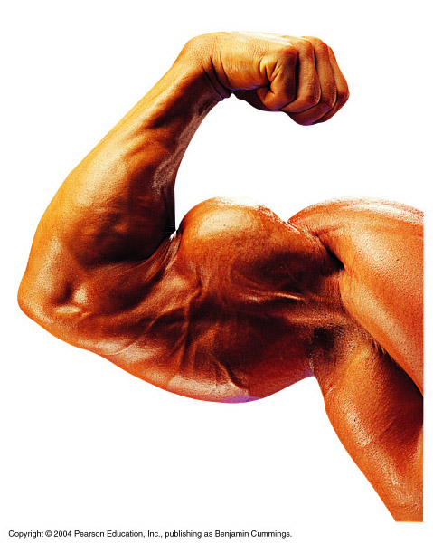
Synthetic Anabolic Steroids
Some athletes use them to build up their muscles quickly.
They are variants of testosterone.
They can pose serious health risks.

Slide 48
WATCH
Fuel Endurance

Slide 49
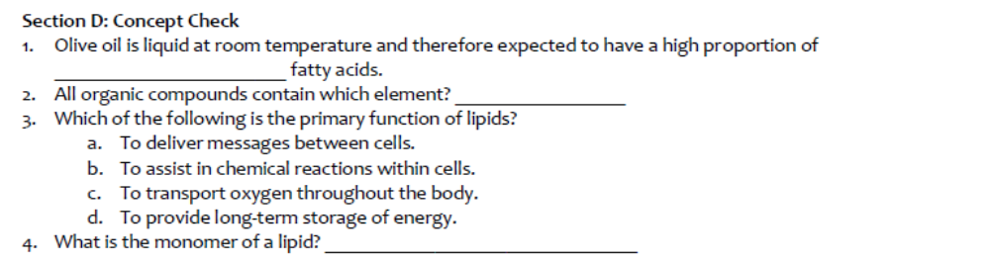
To do

Slide 50
Nucleic Acids
Consist of C, H, O, N, P
Polymers of nucleotides – monomer.
FUNCTION: Store and transmits genetic information
Contain information for making all the body’s proteins

Slide 51
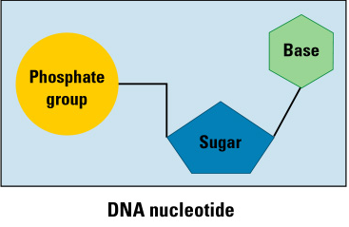
Nucleotide – Nucleic acid monomer

Slide 52
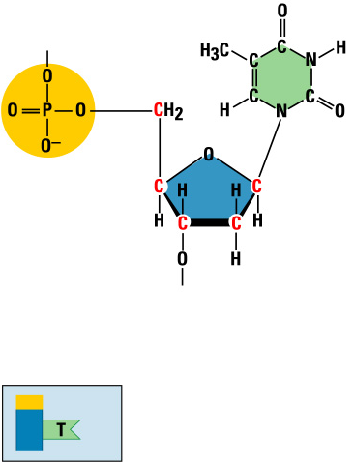
Nucleic Acids
Nucleotide
Nitrogenous base
(A,G,C, or T)
Nucleic acids are polymers of nucleotides
Phosphate
group
Thymine (T)
Sugar
(deoxyribose)
Phosphate
Base
Sugar

Slide 53
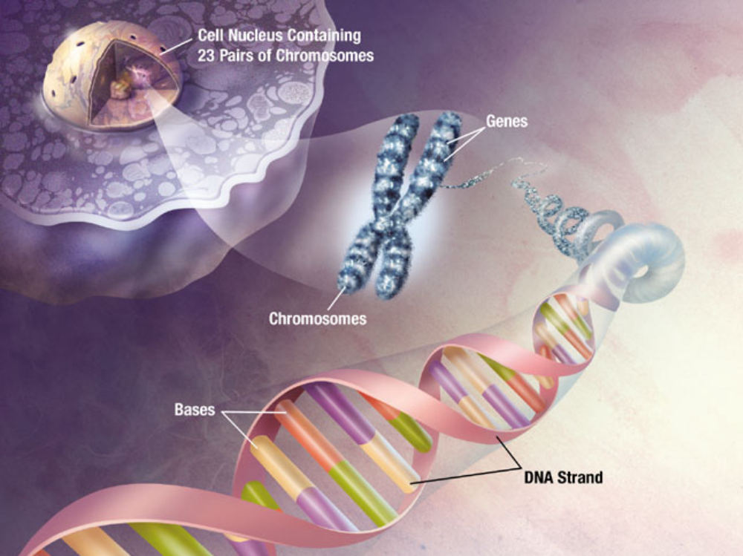

Slide 54
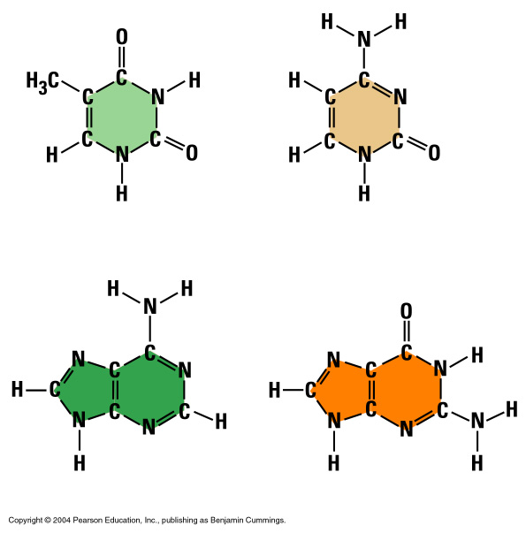
Bases
Thymine (T)
Cytosine (C)
Each DNA nucleotide has one of the following bases:
  Adenine (A)
  Guanine (G)
  Thymine (T)
  Cytosine (C)
Adenine (A)
Guanine (G)

Slide 55
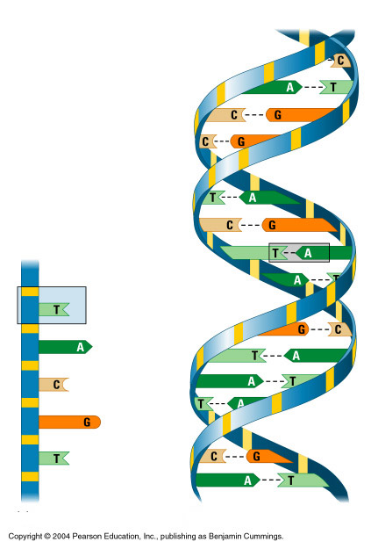
Nucleotide Monomers
Nucleotides are joined by sugars & phosphates on the side
Backbone
Form long chains called DNA
Nucleotide
Bases
DNA strand

Slide 56
DNA – deoxyribonucleic acid
Two strands of DNA join together to form a double helix
Base pair
Double helix

Slide 57
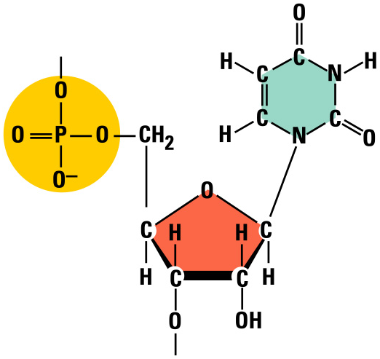
RNA – Ribonucleic Acid
Nitrogenous base
(A,G,C, or U)
Ribose sugar has an extra –OH or hydroxyl group
It has the base uracil (U) instead of thymine (T)
Uracil
Phosphate
group
Sugar (ribose)

Slide 58
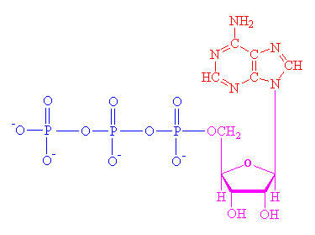
ATP – Cellular Energy – nongenetic nucleotides
ATP is used by cells for energy
Adenosine triphosphate
Made of a nucleotide with three phosphate groups

Slide 59
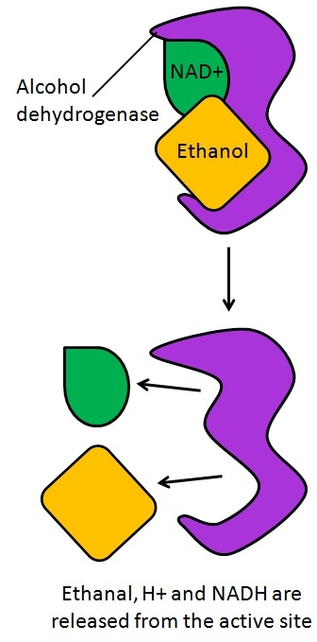
Coenzymes – nongenetic nucleotide
Subunits of coenzymes – these are enzymes that transport hydrogen atoms plus electrons from one reaction site to another (examples NAD+, FAD)

Slide 60
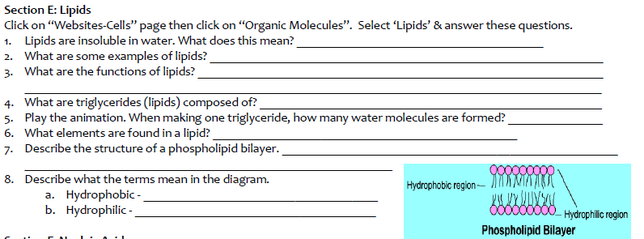
Do now– SECTION E - Lipids

Slide 61
WATCH
Lipids

Slide 62
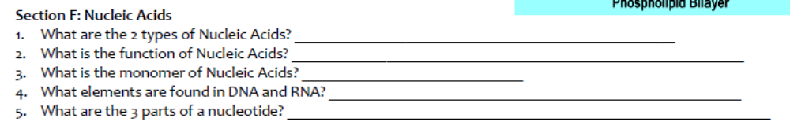
TO DO

Slide 63
WATCH
Nucleic Acids

Slide 64

DO NOW
Skip proteins for now.

Slide 65
PREPARE FOR QUIZ
You need something to write with.
When you get finished, work on Section G. You can pick up a “Proteins” packet when you turn in your quiz. Return it before the period is over.

Slide 66



Slide 67
DO NOW
Get out notes sheet and worksheet for organic chemistry.

Slide 68
Proteins
Consists of C, H, O N, S
Proteins are polymers made of amino acids (monomers).
All 20 amino acids have the same structure – but the R group is different.
The sequence of amino acids will determine which protein is made.

Slide 69




Four Types of Proteins
Storage
Structural
Transport
Contractile

Slide 70

20 Amino Acid Monomers

Slide 71

Structure of Amino Acids
Amino acids have a central carbon with 4 things bonded to it:
Amino
group
Carboxyl
group
R group
Leucine -hydrophobic
Serine-hydrophillic
1. Amino group –NH₂
2. Carboxyl group -COOH
3. Hydrogen -H
Side groups
4. Side group -R

Slide 72

BUILDING A PROTEIN
Amino
Carboxyl
The process is called dehydration synthesis
Amino group bonds to a carboxyl group of another amino acid.
Side Group
Dehydration Synthesis
The bond formed between the amino acids is called a PEPTIDE BOND.
Peptide Bond

Slide 73
FUNCTIONS of a protein
Structural element of hair and nails (keratin) and bone and cartilage (collagen)
Increase the rate of reaction as enzymes (biological catalyst).
Transport and storage of molecules.
Control of metabolism
Receptor proteins – signaling from cell to cell.
Tissue defense (antibodies)

Slide 74
Proteins as Enzymes
ManY proteins act as biological catalysts or enzymes.
Thousands of different enzymes exist in the body.
Enzymes control the rate of chemical reactions by weakening bonds, thus lowering the amount of activation energy needed for the reaction

Slide 75
Enzymes
Enzymes are globular proteins.
Their folded conformation creates an area known as the active site.
The nature and arrangement of amino acids in the active site make it specific for only one type of substrate.

Slide 76

Enzyme + Substrate = Product

Slide 77

How the Enzyme Works
Enzymes are reusable!!!
Called INDUCED FIT
Active site changes SHAPE

Slide 78

Primary Protein Structure
The primary structure is the specific sequence of amino acids in a protein
Amino Acid

Slide 79
Protein Structures
Secondary protein structures occur when protein chains coil or fold.
When protein chains called polypeptides join together, the tertiary structure forms because R groups interact with each other
In the watery environment of a cell, proteins become globular in their quaternary structure.

Slide 80

Protein structures or shapes

Slide 81

Protein Structures or shapes
Hydrogen bond
Pleated sheet
Polypeptide
(single subunit)
Amino acid
(a) Primary structure
Hydrogen bond
(d) Quaternary structure
Alpha helix
(b) Secondary structure
(c) Tertiary structure

Slide 82


Denaturing Proteins
Changes in temperature & pH can denature (unfold) a protein so it no longer works
Cooking denatures protein in eggs.
Milk protein separates into curds & whey when it denatures.

Slide 83

Changing Amino Acid Sequence
Substitution of one amino acid for another in hemoglobin causes sickle-cell disease
(a) Normal red blood cell
Normal hemoglobin
2
3
6
7. . . 146
1
4
5
(b) Sickled red blood cell
Sickle-cell hemoglobin
1
2
3
6
7. . . 146
4
5

Slide 84
Other Important Proteins
Blood sugar level is controlled by a protein called insulin.
Insulin causes the liver to uptake and store excess sugar as glycogen.
The cell membrane also contains proteins.
Receptor proteins help cells recognize other cells.

Slide 85


INSULIN
Cell membrane with proteins & phospholipids

Slide 86
Summary of Key Concepts

Slide 87

Macromolecules

Slide 88

Macromolecules

Slide 89

Nucleic Acids

Slide 90

TO DO

Slide 91

DO NOW
Get out notes – do proteins in section J and start reading through section I.

Slide 92
Section I – what’s in your food?
What are indicators? An indicator is a substance that changes color in the presence of a particular type of molecule. Today you will use several indicators to test for the presence of several organic compounds.
  Benedict’s solution
  Iodine
  Biuret Reagent

Slide 93
LAB SAFETY
Goggles are needed!
Hot plate is hot – make sure to keep clear of the hot surface.
Be careful when handling iodine solution as it can stain hands and clothing.
Biuret reagent contains sodium hydroxide, a strong base . if you get the reagent on you, wash if off immediately with water.

Slide 94
Indicator color
Indicator Solution | Beginning Color | Ending Color
Benedict’s Solution | Blue | Red, orange, yellow, or green
Iodine | Yellow-brown | Blue-black
Biuret Reagent | Blue | purple

Slide 95
POST LAB
Work on the POST lab questions.

Slide 96
DO NOW
Remember that the packet must be completed by tomorrow.
Organic chemistry test is tomorrow.
Get out your worksheet so we can go over section J.

Slide 97
WATCH
You are what you eat

