Slide 1
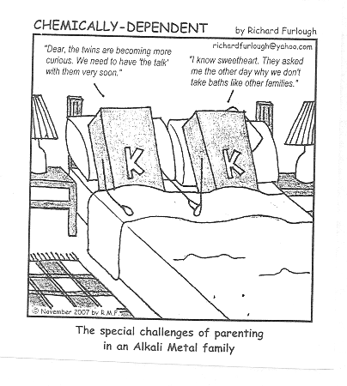
THE ELEMENT FAMILIES

Slide 2
HYDROGEN – a special case
one valence electron
Considered a nonmetal;
Not part of Group One;
acts as a metal and a nonmetal;
most abundant element in the universe;
flammable

Slide 3
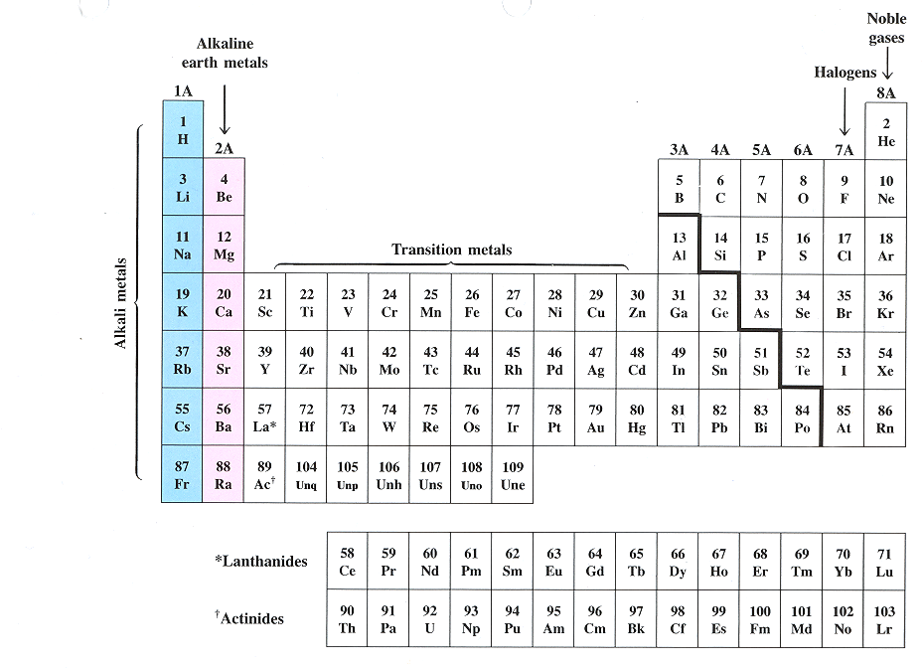
ALKALI METALS – group 1

Slide 4
GROUP 1: ALKALI METALS
Early in human history, people discovered that ashes mixed with water produced a slippery solution useful for removing grease.
By the Middle Ages, such mixtures were described as alkaline, a term derived from the Arab word for ashes, al-qali.
Alkaline mixtures found many uses, particularly in the preparation of soaps.
This is why they are called alkali metals.
We now know that alkaline ashes contain compounds of Group 1 elements, most notably potassium carbonate (potash).

Slide 5
ALKALI METALS – group one
one valence electron;
very reactive
Most reactive is francium;
not found in nature by themselves;
low electron affinity
SODIUM and POTASSIUM important to body functions
FRANCIUM – most reactive metal, but extremely rare

Slide 6
GROUP TWO:
ALKALINE EARTH METALS

Slide 7
ALKALINE EARTH METALS – group two
Elements in group 2 also form alkali solutions when placed in water.
Medieval alchemists noted that certain minerals do not melt or change when put into fire – we know these as group 2 elements.
These fire-resistant substances were known to alchemists as earth. As a holdover from these ancient times, group 2 elements are known as alkaline earth metals.

Slide 8
ALKALINE EARTH METALS – group two
two valence electrons;
less reactive, but similar to alkali metals;
low electron affinity,
CALCIUM – 5th most abundant element on earth (lime, calcium chloride, body functions)

Slide 9
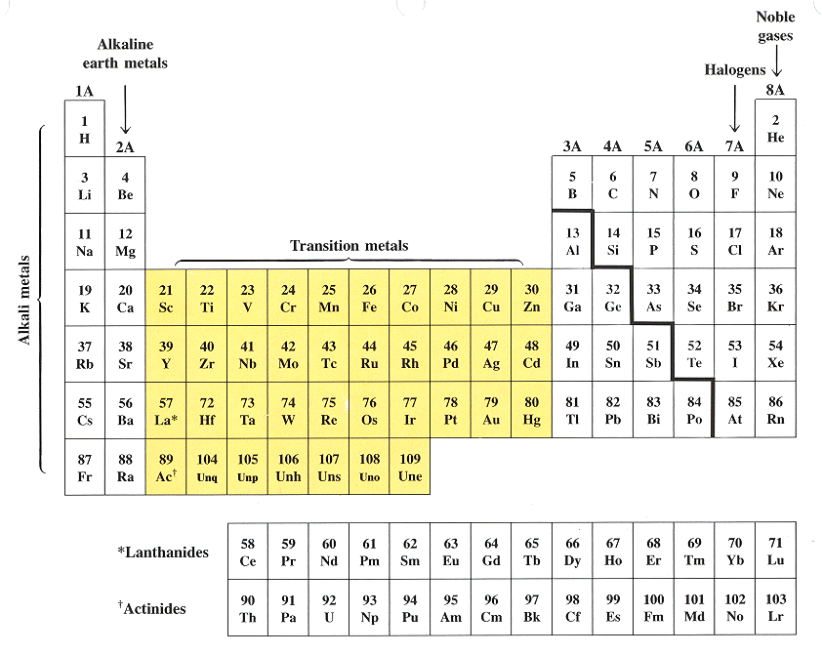
GROUPS 3-12:
TRANSITION ELEMENTS

Slide 10
TRANSITION ELEMENTS – groups 3-12
The elements in groups 3-12 are all metals that do not form alkaline solutions with water.
These metals tend to be harder than alkali metals and less reactive with water.
They are used for structural purposes.
Their name – transition metals – denotes their central position in the periodic table.

Slide 11
TRANSITION ELEMENTS – groups 3-12
Two, three, or four valence e-;
They all have properties similar to one another and to other metals: resistant to corrosion, high melting points, brittle
These metals are less reactive than Group 1 or 2, and are harder.
Include IRON (steel), CADMIUM (batteries), COPPER (wiring), COBALT (magnets), SILVER (dental fillings), ZINC (paints), GOLD (jewelry)

Slide 12
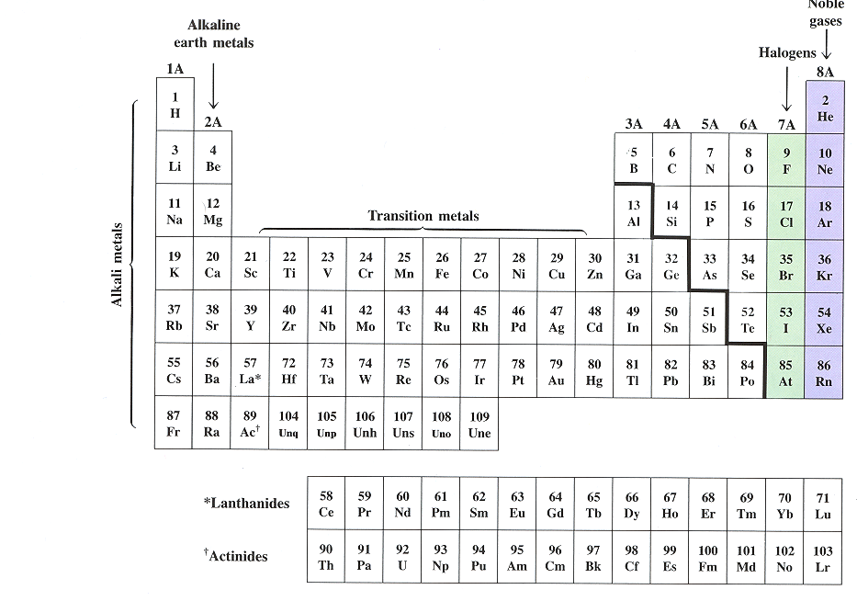
GROUP 13: Boron Family

Slide 13
Boron Family – group 13
three valence electrons
includes metalloids and metals
BORON – metalloid;
ALUMINUM – most plentiful metal in the earth's crust, has the most practical uses
GALLIUM – low melting point, component of blue lasers.

Slide 14
GROUP 14: CARBON FAMILY

Slide 15
CARBON FAMILY – group 14
four valence electrons;
generally react by sharing electrons,
Consists of a nonmetal, metalloids, and metals;
CARBON – most versatile element can form millions of compounds; field of organic chemistry; has several allotropes: graphite, diamond, fullerene, carbon black
SILICON – second most plentiful element in the earth’s crust (quartz); many industrial uses.
LEAD – toxic; used to be in paint, plumbing, gasoline

Slide 16
GROUP 15: NITROGEN FAMILY also called Pnictogen Family

Slide 17
NITROGEN FAMILY – group 15
five valence electrons;
Consists of nonmetals, metalloids, and a metal
Sometimes will share its five electrons
NITROGEN – found in fertilizers, TNT, medicines, proteins
PHOSPHORUS – compounds found in laxatives, cheese, and baking powders

Slide 18
GROUP 16: OXYGEN FAMILY also called Chalcogens

Slide 19
OXYGEN FAMILY – group 16
six valence electrons;
Consists of nonmetals and metalloids
OXYGEN - very reactive; most plentiful element in the earth’s crust; forms compounds with practically every element (except neon, argon, and helium); has two allotropes, O₂ and O₃.

Slide 20
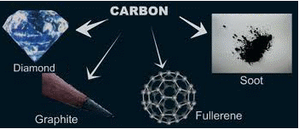
ALLOTROPES
Different forms of the same element.
Examples:
  Oxygen,O₂ and ozone, O₃
  Carbon – diamond, graphite, charcoal

Slide 21
DIATOMIC MOECULES
a molecule that consists of two atoms of the same element.
There are seven diatomic molecules: H₂, N₂, O₂, F₂, Cl₂, Br₂, and I₂
Noble gases are NOT diatomic.

Slide 22
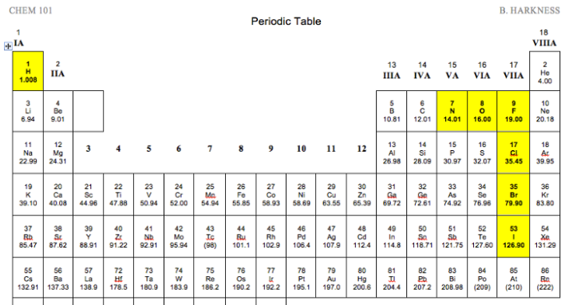
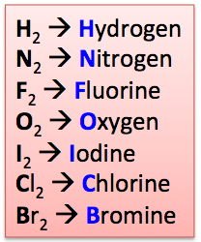
DIATOMIC MOLECULES

Slide 23
GROUP 17: HALOGEN FAMILY

Slide 24
HALOGEN FAMILY – group 17
Called Halogens - Swedish for “salt-forming”;
seven valence electrons
high electron affinity,
FLUORINE - most reactive nonmetal (element) due to its size; most electronegative element; reacts with all elements but neon, helium, and argon.
CHLORINE – deadly gas; compounds act as bleaching agents and disinfectants
IODINE – used to disinfect water and wounds (tincture of iodine)

Slide 25
GROUP 18:
NOBLE GAS FAMILY

Slide 26
NOBLE GAS FAMILY – group 18
Nonreactive gases that tend not to combine with other elements.
They are called the Noble gases, presumably because the nobility of early times were above interacting with the common people.

Slide 27
NOBLE GAS FAMILY – group 18
eight valence electrons (except Helium which has two)
has stable outer electron configurations and all electron energy levels are full;
low electron affinity
HELIUM – used in scuba diving; balloons
NEON, ARGON – lighting

Slide 28
INNER TRANSITION ELEMENTS – no group number

Slide 29
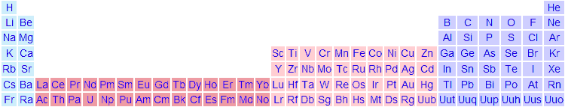
INNER TRANSITION ELEMENTS – no group number

Slide 30
INNER TRANSITION ELEMENTS – no group number
In the sixth and seventh periods, there are a subset of 28 metallic elements that are quite unlike any of the other transition elements.
Inserting the inner transition elements into the main body of the periodic table results in a long and cumbersome table, so these elements are pulled out below the table so it can fit nicely on a 8.5” x 11” piece of paper.
These two rows have no group number.

Slide 31
INNER TRANSITION ELEMENTS – no group number
The elements in each subset have properties that are so similar to one another that each subset can be viewed as a group.
Include the Lanthanides and the Actinides, names after the first element in each group.

Slide 32
INNER TRANSITION ELEMENTS – no group number
LANTHANIDES:
silvery metals with high melting points
high luster and conductivity
Tend to be mixed together in the same geologic zones and are hard to separate since they are so similar;
used in making high quality glass, television screens, lasers, tinted sunglasses, LEDs

Slide 33
INNER TRANSITION ELEMENTS – no group number
ACTINIDES:
Have similar properties and are not easily purified. This is a problem for the nuclear industry as it requires purified samples of uranium and plutonium.
all are radioactive
93-103 are synthetic (transuranium elements)
Most common are URANIUM and PLUTONIUM - used as nuclear fuel.

