Slide 1
ANOTHER WAY TO LOOK AT THE TABLE
All elements can be divided into three groups:
METALS
NONMETALS
METALLOIDS

Slide 2
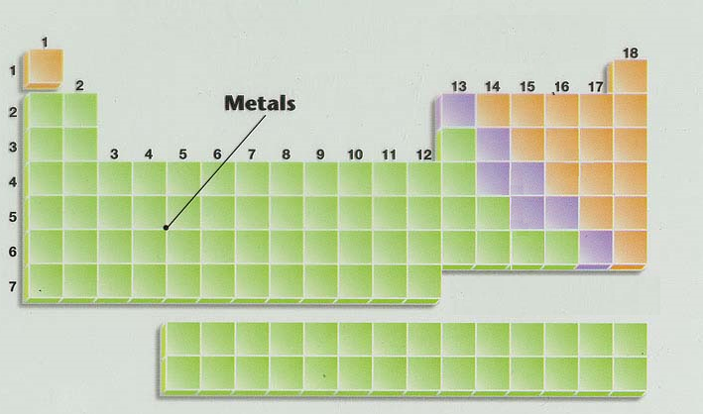
METALS

Slide 3
METALS
located on the left side and center.
good conductors of heat and electricity.
hard and shiny (not always silver)
can be pounded into different shapes - malleable
can be drawn into a wire - ductile
high density, high melting points
react with water and substances in the atmosphere
(ex. rusting, tarnishing)

Slide 4
METALS
has only a few electrons in the outer level
most elements are metals.
General rule: 3 or fewer electrons in outer level are considered to be metals.
Metals have a tendency to lose electrons when forming compounds.

Slide 5
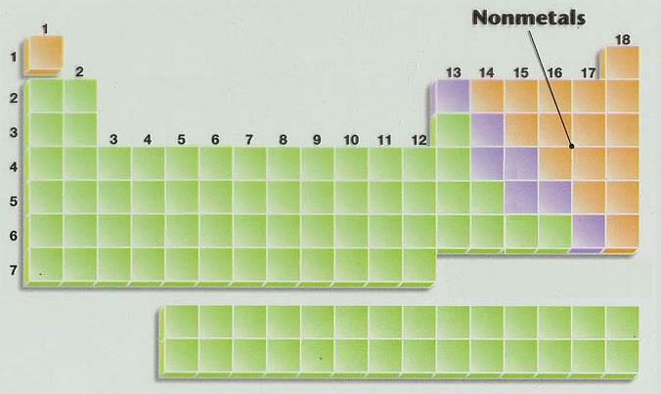
NONMETALS

Slide 6
NONMETALS
located on the right side (except hydrogen)
poor conductors of heat and electricity (solids are insulators)
brittle solids or gases or liquids
dull
shatter easily
lower density, lower melting points

Slide 7
NONMETALS
not as easy to recognize as a group
has more than 4 electrons in the outer level.
General rule: 5 or more electrons in outer level are considered to be nonmetals.
Nonmetals have a tendency to gain electrons when forming compounds

Slide 8
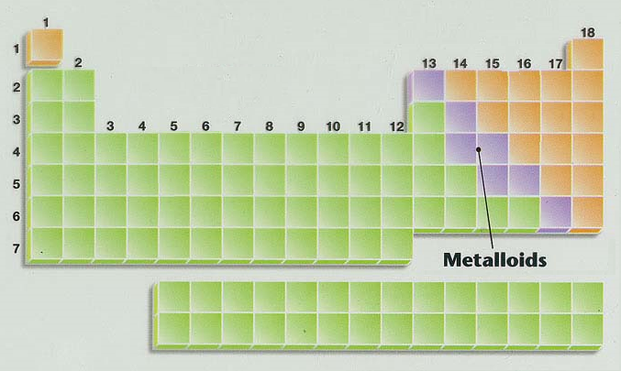
METALLOIDS

Slide 9
METALLOIDS
Sometimes called semi-metals.
have properties of metals and nonmetals
“metal-like”
located on either side of the staircase
all are shiny, white-gray in color
all are solids
okay conductors (as in semi-conductors), ductile, malleable

Slide 10
METALLOIDS
There are seven:
Boron, Silicon, Germanium, Arsenic, Antimony, Tellurium, Astatine
Aluminum is NOT a metalloid.
Polonium is sometimes classified as a metalloid.

Slide 11
METALLOIDS

Slide 12
UNKNOWN METALS LAB
Introduction: Most of the elements on the periodic table are metals and solids. These elements have observable properties that make it possible to identify an unknown element. Density is one of the properties that can be used to identify an unknown metal. As you know, density is the ratio of mass to volume. In equation form: Density = Mass ÷ Volume.

