Slide 1
PERIODIC TRENDS
OR
Why we call it the PERIODIC table

Slide 2
PERIODIC
REMEMBER:
It is periodic because there are patterns that repeat each row or period.

Slide 3
PERIODIC TRENDS
Elements have properties because of their atomic number which tells the number of electrons and thus the valence electrons.
Same column = similar valence electrons
Properties that are periodic:
metals/metalloids/nonmetals, boiling point, density, atomic radii, ionic radii, oxidation numbers, ionization energies, electron affinities, electronegativity

Slide 4
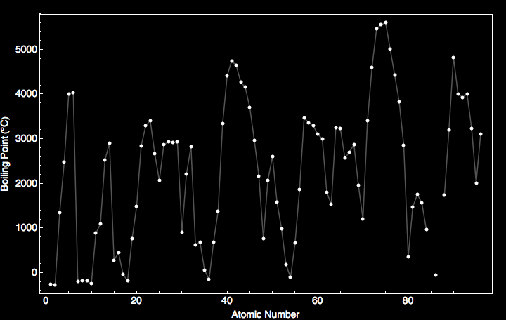
Boiling Point of the Elements

Slide 5
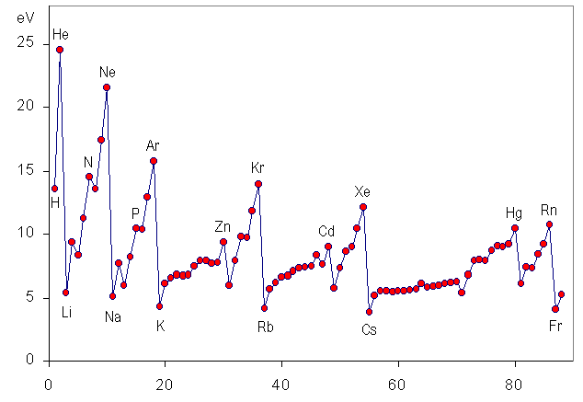
IONIZATION ENERGY

Slide 6
ALKALI METALS
Which element had the largest reaction?
Any idea why?

Slide 7
ATOMIC RADII (size)
As the electron energy levels increase down a group, the period number increases , and so does the atomic radii.
As the atomic number increases across a period, the positive charge also increases within the same energy level and so the electrons are more attracted to the nucleus
TREND: atomic radii increases down a group, atomic radii decreases across a period.

Slide 8
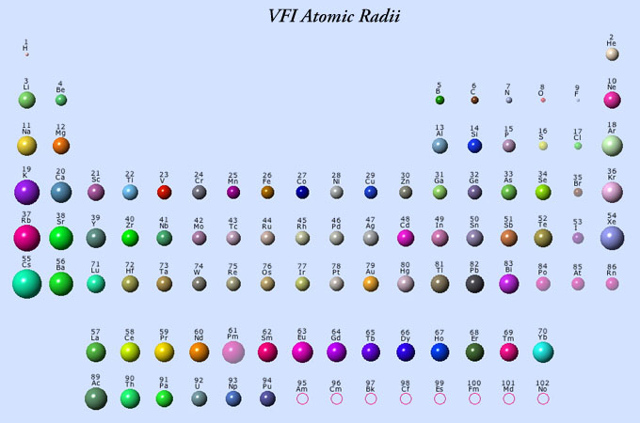
ATOMIC RADII

Slide 9
ELECTRON AFFINITY
The attraction of an atom for an electron.
If an element has a high electron affinity, it really wants to gain an electron.
TREND:
Metals have LOW electron affinities
Nonmetals have HIGH electron affinities (except the Noble Gases).

Slide 10
SUMMARY
Noble Gases:
- Eight valence electrons (except helium)
- atomic radii large for their row
- Electron Affinity LOW

Slide 11
SUMMARY
Halogens:
- Seven valence electrons
- atomic radii lowest for their row
- Electron Affinity HIGH

Slide 12
SUMMARY
Alkali Metals
- one valence electron
- Atomic radii largest for their row
- Electron Affinity LOW

Slide 13
SUMMARY
Alkaline Earth metals:
- two valence electrons
- Atomic radii second largest for their row
- Electron Affinity LOW

