Slide 1
VALENCE ELECTRONS
The valence electrons are the electrons in the outermost shell or energy level of an atom.
The valence electrons are the ones involved in forming bonds to adjacent atoms.
Therefore, the number of valence electrons is important for determining the number of bonds an atom will form.

Slide 2
VALENCE ELECTRONS
Group 1 1 valence electrons
Group 2 2 valence electrons
Group 13 3 valence electrons
Group 14 4 valence electrons
Group 15 5 valence electrons
Group 16 6 valence electrons
Group 17 7 valence electrons
Group 18 8 valence electrons

Slide 3
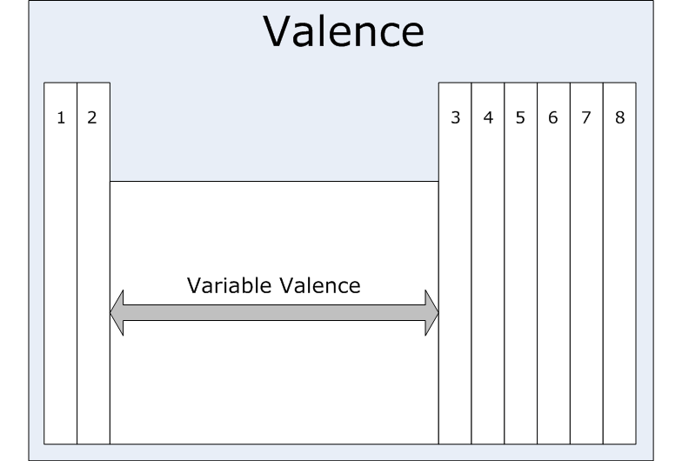
VALENCE ELECTRONS

Slide 4
VALENCE AND ELECTRON DOT DIAGRAMS
Valence electrons = electrons in outermost energy level of a Bohr Diagram.
Electrons in outermost energy level of a Bohr Diagram = electrons in electron dot diagram
SO
Valence electrons = electrons in electron dot diagram

Slide 5
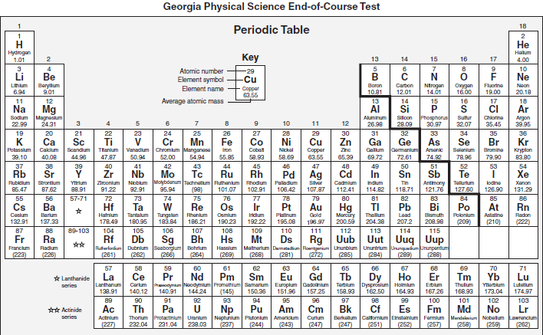

Slide 6
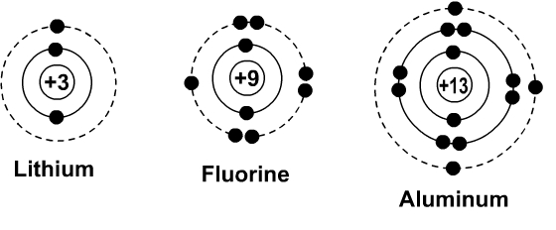
VALENCE AND ELECTRON DOT DIAGRAMS
Element | Period | Group | Valence Electrons | Electron Dot Diagram
Lithium
Fluorine
Aluminum

