Slide 1
ENERGY
ATP

Slide 2
WATCH
How Cells get energy

Slide 3
ADENOSINE TRIPHOSPHATE, ATP
Energy carrying molecule used by cells – ATP is made & used continuously by cells!!
Cells need energy for transport, cellular movement & synthesizing chemicals, etc.
When bonds break, energy is released. When bonds form, energy is stored.
Enzymes help break and form these bonds.

Slide 4
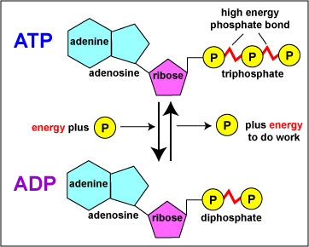
(adenine + ribose = adenosine; add 3 P)

Slide 5
STRUCTURE OF ATP
ATP stands for adenosine triphosphate.
It is composed of the nitrogen base ADENINE, the pentose (5C) sugar RIBOSE, and three PHOSPHATE groups.
The LAST phosphate group is bonded with a HIGH ENERGY chemical bond.
This bond can be BROKEN to release ENERGY for CELLS to use.

Slide 6
REMOVING A PHOSPHATE FROM ATP
Breaking the LAST PHOSPHATE bond from ATP, will ---
  Release ENERGY for cells to use.
  Form ADP.
  Produce a FREE PHOSPHATE GROUP.

Slide 7
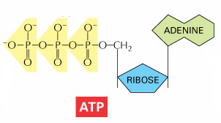
High Energy Phosphate Bond

Slide 8
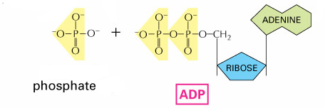
FREE PHOSPHATE can be re-attached to ADP reforming ATP.
Process called Phosphorylation

Slide 9
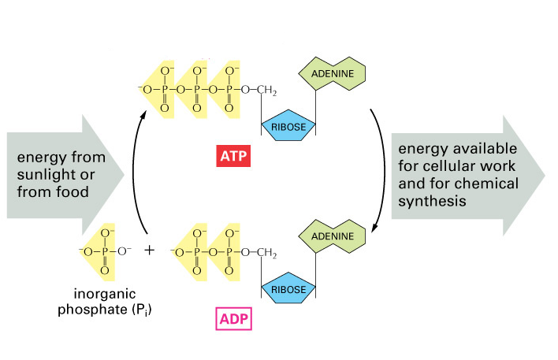
PHOSPHORYLATION

Slide 10
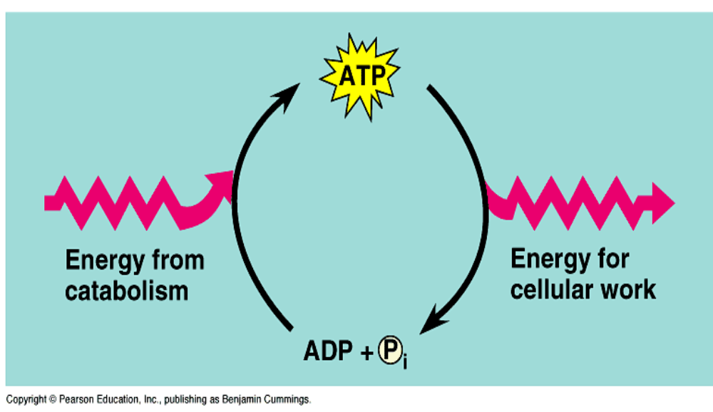
ATP
Phosphorylation refers to the chemical reactions that make ATP by adding P to ADP.
ADP + P +energy → ATP

Slide 11
TO DO
Section B
What is ATP and how does it work?

Slide 12
DO NOW
Photosynthesis

Slide 13
PHOTOSYNTHESIS

Slide 14
PHOTOSYNTHESIS
Autotrophs use energy from sunlight to convert water and carbon dioxide into oxygen and high-energy carbohydrates (glucose)
6CO₂ + 6H₂O → C₆H₁₂O₆ + 6O₂
photons
SUN
glucose

Slide 15
PHOTOSYNTHESIS
Anabolic (small molecules combined)
Endergonic (stores energy)
Carbon dioxide (CO₂) requiring process that uses light energy (photons) and water (H₂O) to produce organic macromolecules (glucose).

Slide 16
Question:
Where does photosynthesis take place?

Slide 17
PLANTS
Autotrophs – produce their own food (glucose)
Process called photosynthesis.
Mainly occurs in the leaves:
a. stoma - pores
b. mesophyll cells
Mesophyll
Cell
Chloroplast
Stoma

Slide 18
Stomata (stoma)
Pores in a plant’s cuticle through which water vapor and gases (CO₂ & O₂) are exchanged between the plant and the atmosphere.
Oxygen
(O₂)
Stoma
Guard Cell
Guard Cell
Carbon Dioxide
(CO₂)
Found on the underside of leaves

Slide 19
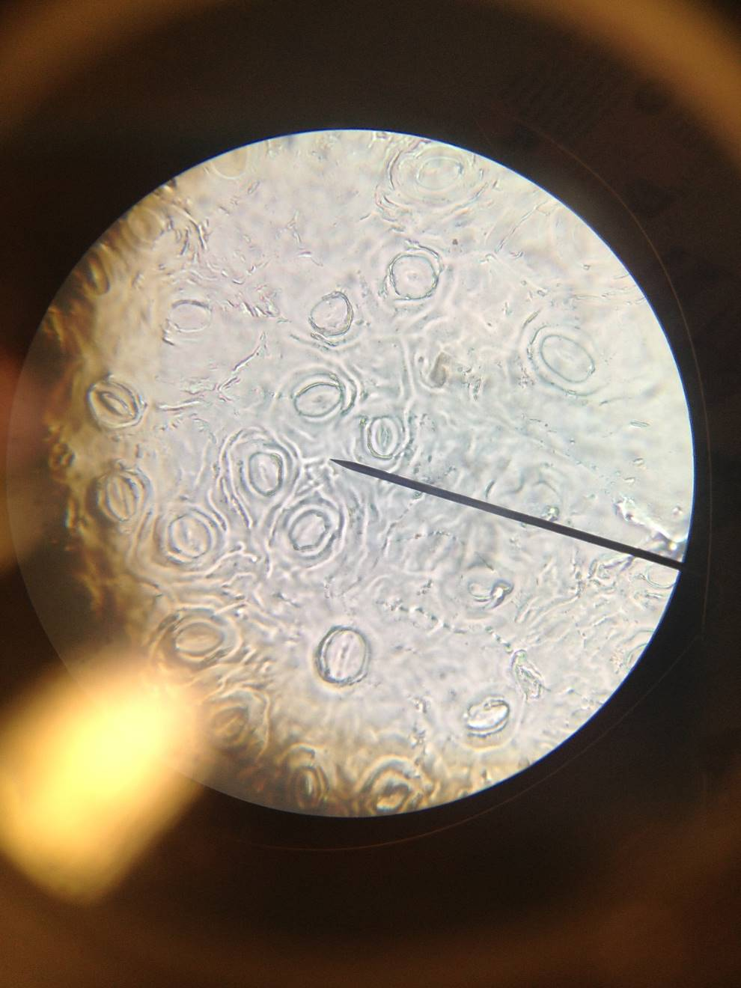
STOMA

Slide 20
MESOPHYLL CELL OF LEAF
Nucleus
Cell Wall
Chloroplast
Central Vacuole
Photosynthesis occurs in these cells!

Slide 21
CHLOROPLAST
Organelle where photosynthesis takes place.
Stroma
Outer Membrane
Thylakoid
Granum
Inner Membrane
Thylakoid stacks are connected together

Slide 22
CHLOROPLAST
Things to remember:
Contains DNA
Contains ribosomes
Make enzymes required for photosynthesis
Contain chlorophyll

Slide 23
Question:
Why are plants green?

Slide 24
LIGHT PHOTONS AND PIGMENTS
In addition to H₂O and CO₂, photosynthesis requires light and pigments.
Pigments are molecules that absorb light photons.
Different pigments absorb different wavelengths of light.

Slide 25
WAVELENGTH OF LIGHT (NM)
Sunlight is a mixture of many different wavelengths… light must be absorbed before it can be converted & used by living systems.
400
500
600
700
Short wave
Long wave
(more energy)
(less energy)

Slide 26
CHLOROPHYLL
main pigment
chlorophyll absorbs only red, blue & violet light
chlorophyll a – transforms photons to chemical energy
chlorophyll b – traps other wavelengths & transfers it to chlorophyll a
Located in the thylakoid membranes.

Slide 27
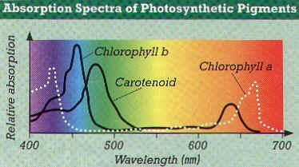
CHLOROPHYLL
Chlorophyll pigments harvest energy (photons) by absorbing certain wavelengths (blue-420 nm and red-660 nm are most important)
Plants are green because the green wavelength is reflected, not absorbed.
Chlorophyll absorbs blue-violet & red light best.

Slide 28
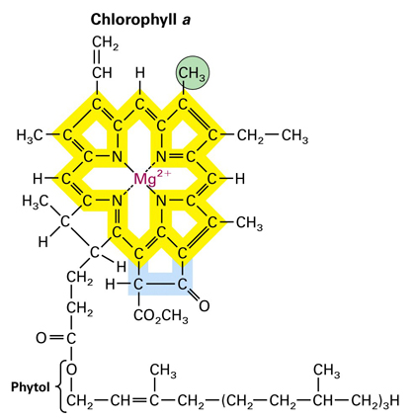
Chlorophyll have Mg⁺ in the center.

Slide 29
Question:
During the fall, what causes the leaves to change colors?

Slide 30
FALL COLORS
In addition to the chlorophyll pigments, there are other accessory pigments present.
During the fall, the green chlorophyll pigments are greatly reduced revealing the other pigments
Carotenoids are pigments that reflect either yellow, orange, or red.
They expand the range of wavelengths available for photosynthesis.

Slide 31
WATCH
Photosynthetic Pigments

Slide 32
TO DO
Section C
Intro to Photosynthesis

Slide 33
DO NOW
CSI clip – chromatography

Slide 34
Environmental Factors that affect photosynthesis
color of light
light intensity
temperature
CO₂ availability
water availability

Slide 35
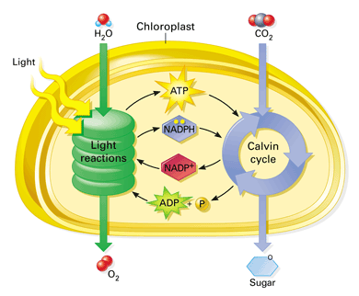
PHOTOSYNTHESIS OVERVIEW

Slide 36
TWO PARTS OF PHOTOSYNTHESIS
Two reactions make up photosynthesis:
1.Light Dependent Reaction -
Light energy is converted to chemical energy which is temporarily stored in the form of ATP and NADPH (chemical energy).
SUN

Slide 37
TWO PARTS OF PHOTOSYNTHESIS
2. Light Independent Reaction (The Calvin Cycle)
CO₂ is used to make glucose molecules.
The chemical energy stored in ATP and NADPH powers to formation of glucose.
Also called Carbon Fixation or C₃ Fixation

Slide 38
TO DO
Section C
Intro to Photosynthesis

Slide 39
TO DO
Section I: Waterweed Simulation

Slide 40
DO NOW
Photosynthesis song

Slide 41
Question:
What do cells use for energy?

Slide 42

ENERGY FOR LIFE ON EARTH
Sunlight is the ULTIMATE energy for all life on Earth
Plants store energy in the chemical bonds of sugars.
Chemical energy is released as ATP during cellular respiration.

Slide 43
PARTS OF PHOTOSYNTHESIS
Photosynthesis

Slide 44
LIGHT DEPENDENT REACTION
(ELECTRON FLOW)
Energy is captured from sunlight by the pigments.
Energy is transferred to convert ADP into ATP and NADP+ into NADPH.
Occurs in the Thylakoid membranes
During the light reaction, there are two systems:
  Photosystem II
  Photosystem I

Slide 45
PHOTOSYSTEMS
Occurs in the thylakoid membrane
Uses Electron Transport Chain (ETC).
Generates O₂, ATP and NADPH.

Slide 46
PS I and PS II
Primary
Electron
Acceptor
2e⁻
Enzyme
Reaction
Primary
Electron
Acceptor
2e⁻
2e⁻
ETC
SUN
2e⁻
2e⁻
NADPH
P700
Photon
ATP
P680
Photon
H₂O
1/2O₂ + 2H⁺
Photosystem I
Photosystem II
H₂O is split in PSII & ATP is made, while the energy carrier NADPH is made in PSI.

Slide 47
PS I and PSII
ADP + → ATP
NADP⁺ + H → NADPH
Oxygen comes from the splitting of H₂O, not CO₂
H₂O → 1/2 O₂ + 2H⁺
P

Slide 48
ATP SYNTHESIS
SUN
(Proton Pumping)
H⁺ H⁺
Thylakoid
E
PS II
T
PS I
C
high H⁺
concentration
H⁺ H⁺
H⁺ H⁺
H⁺ H⁺
Thylakoid
Space
H⁺
ATP Synthase
ADP + P
low H⁺
concentration
ATP
H⁺

Slide 49
PHOTOSYSTEM II
sunlight (photons) splits H₂O molecules.
Photolysis (water splitting) releases O₂ that diffuses out of the chloroplast.
Electrons produced from the split travel down electron transport chain (ETC) releasing energy.
Energy provided in the ETC is used to make ATP from ADP.

Slide 50
PHOTOSYSTEM I
sunlight (photons) boost electrons to a higher energy state
electrons travel down electron transport chain
energy is used to make NADPH from NADP⁺.

Slide 51
CALVIN CYCLE
Carbon Fixation (light independent reaction).
CO₂ splits and the C is used to make glucose.
occurs in C₃ plants (80% of plants on earth).
Occurs in the stroma.
The chemical energy ATP and NADPH fuels the cycle.
The Calvin Cycle

Slide 52
CHLOROPLAST
STROMA– where Calvin Cycle occurs
Outer Membrane
Thylakoid
Granum
Inner Membrane

Slide 53
CALVIN CYCLE
(C₃ FIXATION)
(36C)
(6C)
6C-C-C-C-C-C
6CO₂
(unstable)
6C-C-C
6C-C-C
12PGA
(36C)
6ATP
6ATP
(30C)
6C-C-C-C-C
6NADPH
6NADPH
RuBP
(36C)
6ATP
6C-C-C
6C-C-C
12G₃P
C₃
(30C)
(6C)
glucose
C-C-C-C-C-C
Glucose

Slide 54
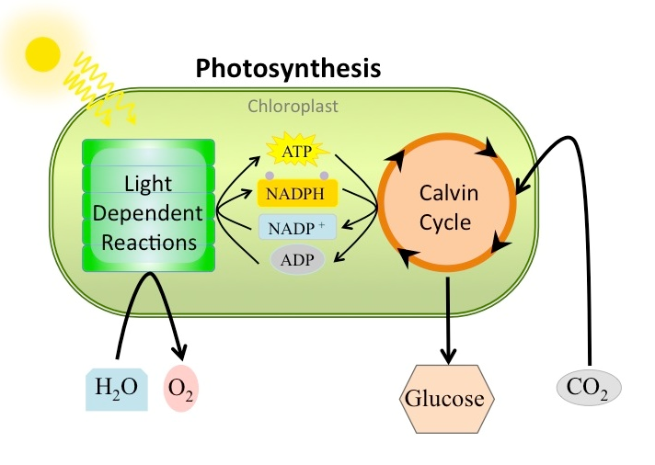
PUTTING IT TOGETHER
Photosynthesis Animation

