Slide 1
KINGDOM PLANTAE

Slide 2
KINGDOM PLANTAE
Something to ponder:
Plants are not boring. Plants have devised fabulous mechanisms for sustaining and supporting themselves.
Plants may not be able to move, but in their own way, they have figured out ways to do many things better than animals – evolved different strategies.
What is an animal really doing when it eats an apple? It is the ultimate bribe – tricking the animal to eat something delicious so that the animal will spread its seeds over great distances.

Slide 3
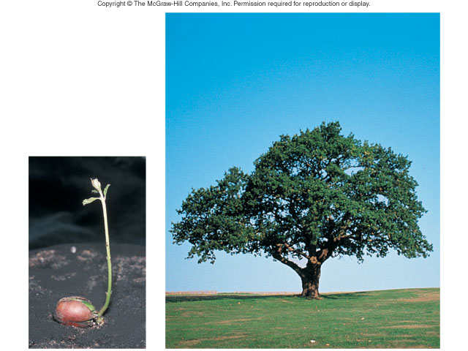
KINGDOM PLANTAE
Cell wall - composed of cellulose
Eukaryotes
Autotrophic
  Absorb sunlight to make glucose – Photosynthesis
Multicellular
Notes:
Growth, with increases in size and number of cells, is part of development.
Development involves many stages from conception until death.

Slide 4
KINGDOM PLANTAE
Domains | EUKARYA
Kingdoms | PLANT
Cell Type – Prokaryote or Eukaryote | EUKARYOTE
# of cells – Unicellular or Multicellular or Both | MULTICELLULAR
Cell Structure – Cell wall composition | CELL WALL MADE WITH CELLULOSE
Nutrition – Autotroph or Heterotroph or Both | AUTOTROPHS

Slide 5
PLANTS VERSUS ALGAE
Green algae is believed to be the ancestors of plants.
ALGAE
PLANTS
unicellular, colonial, or multi-cellular.
Eukaryotic photosynthesizers
Parts: holdfasts, stapes and blades
Cell wall made of cellulose
Each algae cell must obtain its own nutrients from water for survival.
Some algae cannot move, others float in the water
Multicellular
Eukaryotic photosynthesizers
Roots, stems, leaves, flowers, fruits, seeds, cones
Cell wall made of cellulose
Has vascular systems to transport water and nutrients
Cannot move, rooted to ground

Slide 6
TO DO
Watch Tree and Plant Life in the Jungle

Slide 7
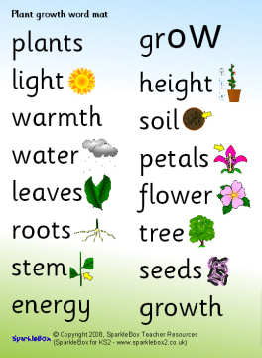
SURVIVAL NEEDS
Sunlight
Gas exchange
Water and minerals
Movement of water and nutrients

Slide 8
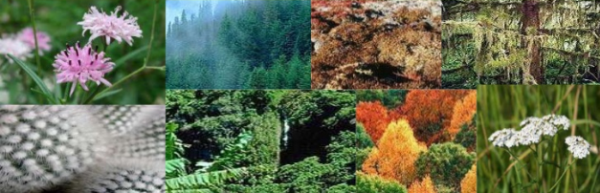
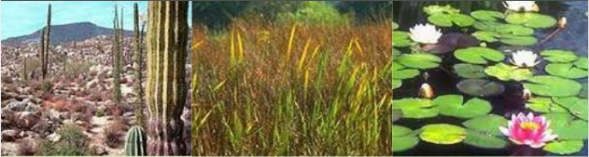
PLANT ADAPTATIONS

Slide 9
DEFINITION OF ADAPTATION
The adjustment or changes in behavior, physiology, and structure of an organism to become more suited to an environment.
It is derived form the Latin word “adaptare” which mean “to fit”.

Slide 10
PLANT ADAPTATIONS
Plants have adaptations to help them live and grow in different areas.
These adaptations make it very difficult for the plant to survive in a different area.
This is why plants are found in one area, but not in another.
For example, you wouldn’t see a cactus living in the Arctic. Nor would you see lots of really tall trees growing in the grasslands.

Slide 11
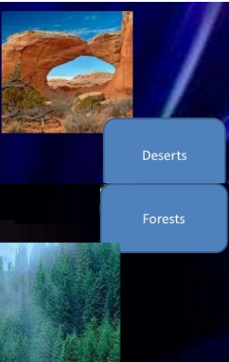
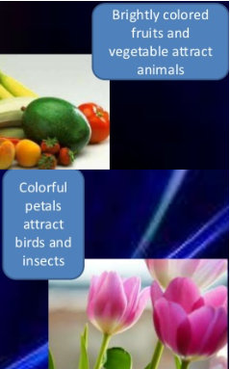
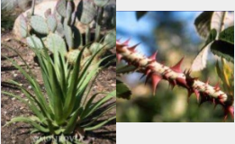
WHY DO PLANTS ADAPT?
For climate/location – to get the necessary resources
To reduce water loss
For reproduction
To defend themselves

Slide 12
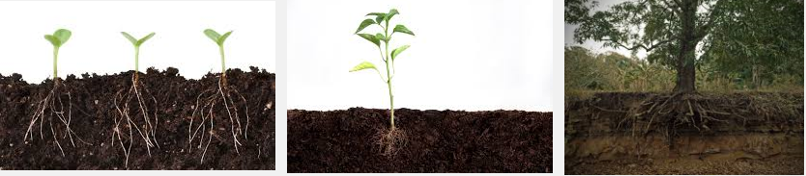
ATTAINMENT OF RESOURCES
Evolutionary trend was to move from water to land, so plants had to adapt
Land plants evolved methods to gain vital minerals from the soil.
Green algae absorb nutrients they need directly from the water they live in.
Land plants have to live without being suspended in water.

Slide 13
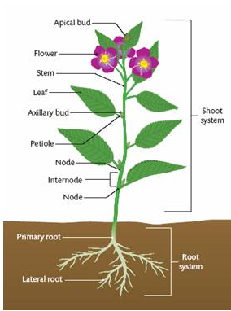
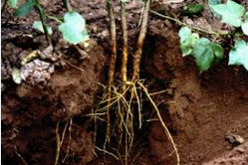
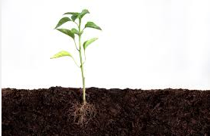
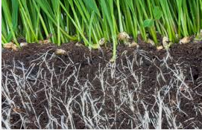
ATTAINMENT OF RESOURCES
Roots developed as a structure that allowed plants to obtain minerals and water from the soil.

Slide 14
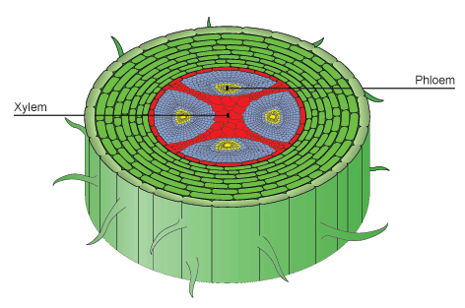
ATTAINMENT OF RESOURCES
Some plants developed vascular tissue (xylem and phloem) that act as a transport system to bring water and other substances such as minerals up the plant body, allowing for increased plant size.

Slide 15
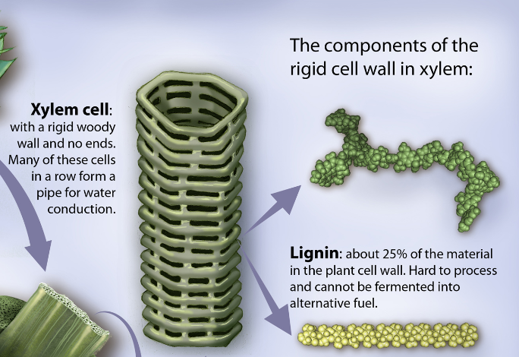
ATTAINMENT OF RESOURCES
All plants contain lignin which binds to cellulose fibers to harden and strengthen the cell walls of plants to support growth.

Slide 16
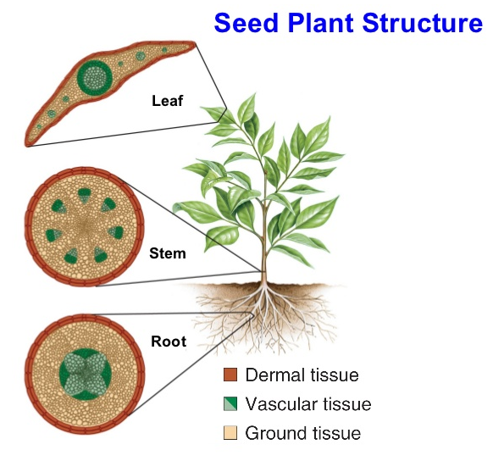
ATTAINMENT OF RESOURCES
Stems developed to store and transport water & nutrients.
Leaves are modified to maximize photosynthesis.

Slide 17
TO DO
How the Quiver tree survives in the desert

Slide 18
ADAPTATIONS
To reduce water loss
Reproduction

Slide 19
WATER LOSS
Strategies to catch and retain water were vital for the survival of land plants.
Once removed from moist, swampy areas, plants risk desiccation, or drying out.
  Desiccation means to dry out due to a lack of water.

Slide 20
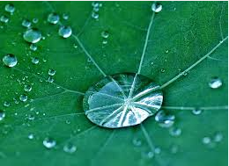
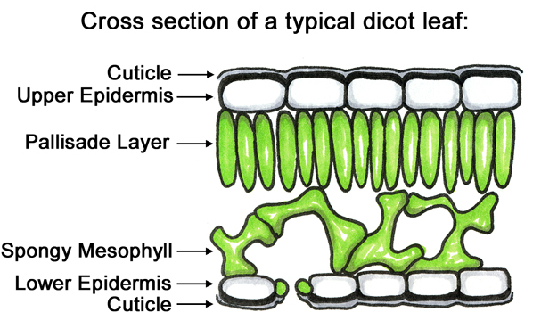
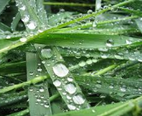
WATER LOSS
To prevent desiccation, many plants developed a cuticle (a thick, waxy, watertight barrier) that covers the plant and prevents loss of moisture to the air.

Slide 21
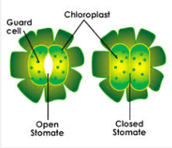
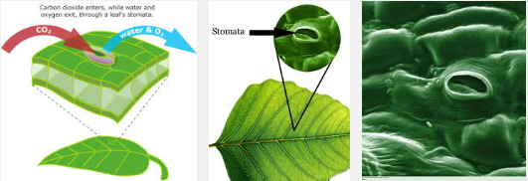
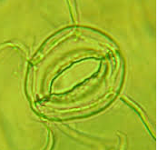
WATER LOSS
The stomata are openings in the cuticle that allow for gas exchange and transpiration of water as the plant photosynthesis.

Slide 22
WATER LOSS
There are several regions of the Earth that plants have had to adapt to:
Deserts
Grasslands
Taiga
Tropical Rain Forest

Slide 23
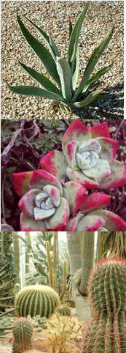
WATER LOSS
- DESERT
Plants called SUCCULENTS store water in their stems and leaves.
Some plants have no leaves or leaves that only grow after it rains. Leafless green plants conduct photosynthesis in their green stems.
Long roots spread out wide or go deep into the ground to absorb water.
Leaves with hair help shade the plant, reducing water loss.
Some leaves turn during the day to expose a minimum surface area to the heat.
Grow slowly – uses less water.

Slide 24
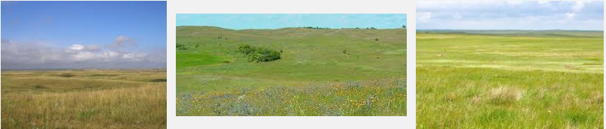
WATER LOSS
- GRASSLAND
Roots extend deep into the ground to absorb as much moisture as they can.
Prairie grasses have narrow leaves which slow water loss.

Slide 25
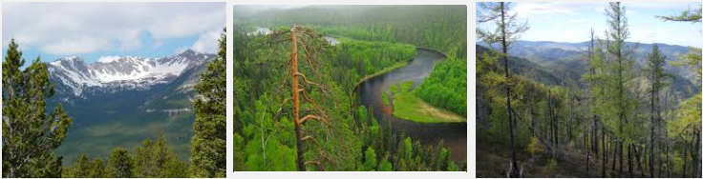
WATER LOSS
- TAIGA
Many trees have needle-like leaves whose shape reduced water loss
Waxy coating on leaves prevents evaporation

Slide 26
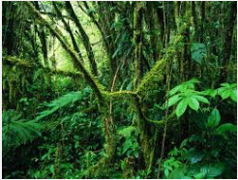
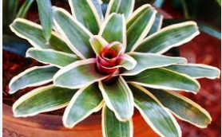
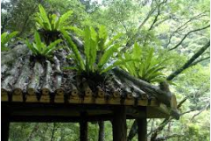
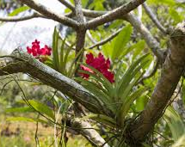
WATER LOSS – TROPICAL RAIN FOREST
Here there can be too much water!
Drip tips and waxy surfaces allow water to run off to discourage growth of bacteria and fungi.
Smooth bark or waxy flowers speed the run-off of water.
Many bromeliads are epiphytes (plant that live on other plants). Instead of collecting water with roots, they collect water in a central reservoir from which they absorb the water.
Epiphytic orchids have aerial roots that cling to the host plant, absorbs minerals, and absorb water from the air.

Slide 27
TO DO
Plant Structure and Adaptations

Slide 28
REPRODUCTION
The reproductive processes of the earliest plants to evolve from green algae still required an aquatic environment.
Consequently, these primitive land plants could live only in highly moist, swampy areas.
Plants evolved the ability to reproduce without water and began to populate drier environments.

Slide 29
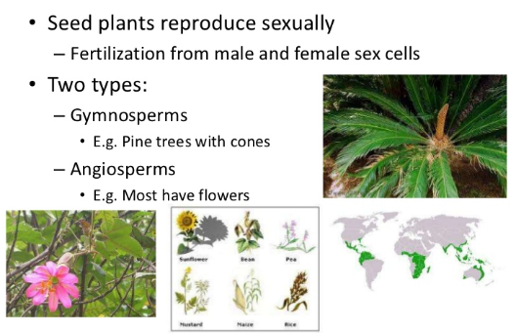
REPRODUCTION
The seed allowed safe dispersal of plant embryos by supplying it with nutrition and protection against hostile conditions. Seeds can remain dormant during unfavorable conditions.

Slide 30
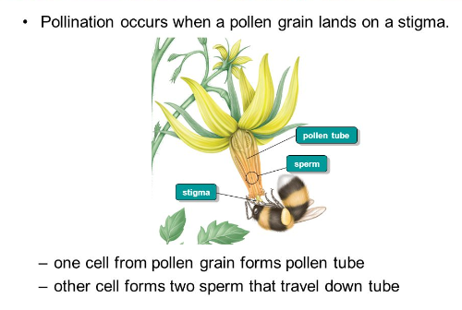
REPRODUCTION
Pollen grains containing the male gamete could be dispersed without water.

Slide 31
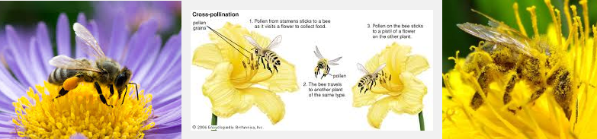
REPRODUCTION
Flowers developed to attract pollinators and allow for greater dispersal of the pollen.

Slide 32
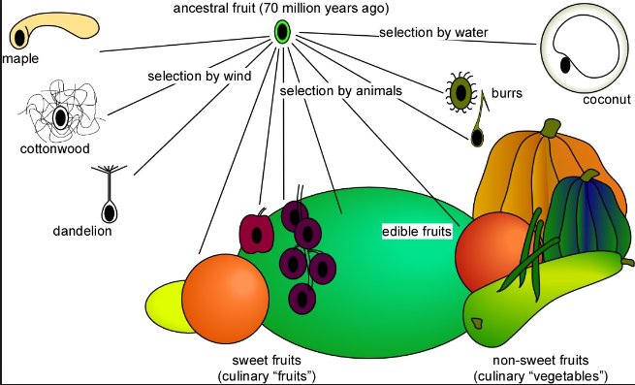
REPRODUCTION
Fruits developed to protect the embryo and allow for greater dispersal of the plant.

Slide 33
TO DO
Watch: Adaption to Extremes

Slide 34
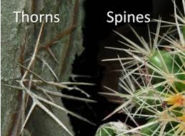
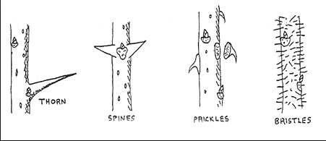
PLANT DEFENSES
Mechanical defense - incorporated into the physical structure of the organism.
  thorns, spines and stiff hairs that repel a predator

Slide 35
PLANT DEFENSES
Chemical defense - occurs when the plant produces stinging sensations, paralysis, poisoning, or just a bad taste.
Chemical Defense

Slide 36
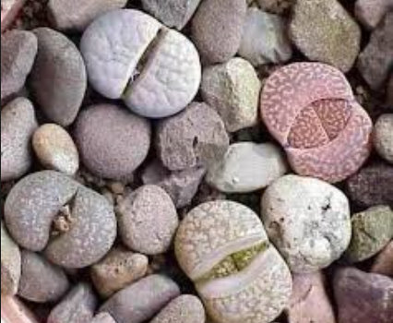
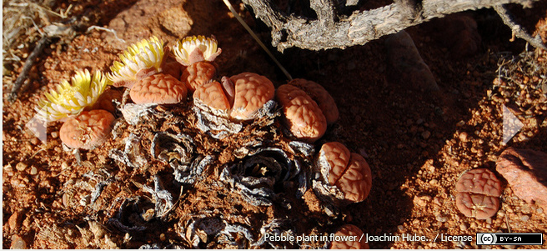
PLANT DEFENSES
Camouflage - the organism blends into its environment or appear to be something they are not
Pebble Plant
Lithops

