Slide 1
KINGDOM PLANTAE

Slide 2
PLANT EVOLUTION
Plants appeared 430 million years ago.
Life was concentrated in the oceans, lakes, and streams.
Algae and plants made the earth more habitable for animals by providing food and oxygen.
The first plants evolved from a organism much like the green algae living today.
Plants had to learn how to acquire, transport, and conserve water once they left the water.

Slide 3
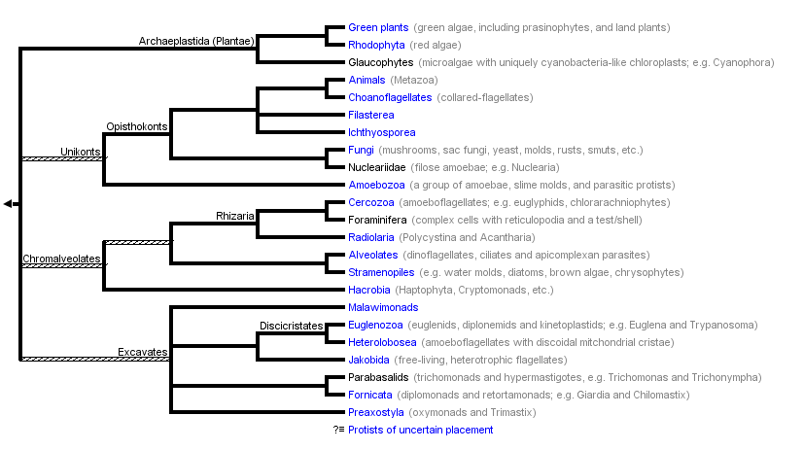
PLANT EVOLUTION

Slide 4
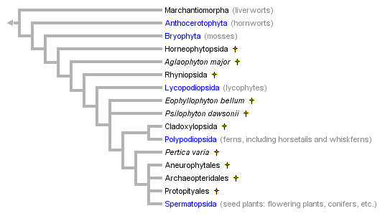
PLANT EVOLUTION

Slide 5
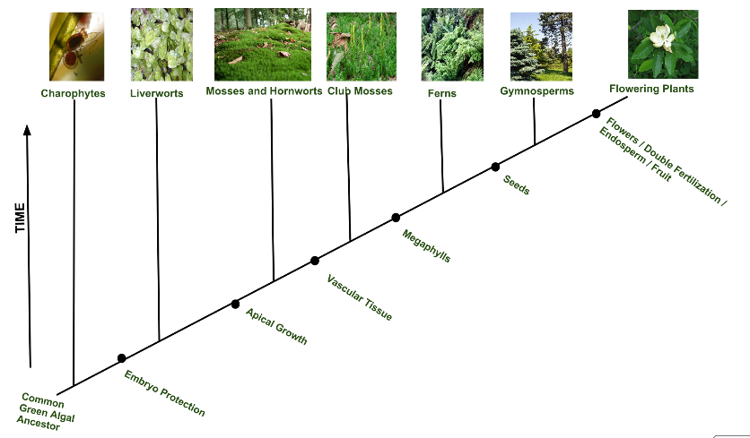
PLANT EVOLUTION
Reproduce with seeds
Reproduce with spores only
Millions of Years

Slide 6
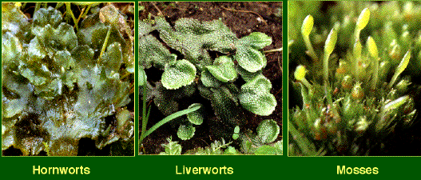
PLANT EVOLUTION
Nonvascular Plants: Bryophytes
  nonvascular – instead uses rhizoids for movement of minerals and water via diffusion; need a moist environment.
  produces spores (reproductive cells) – sperm require water for fertilization
  habitats and size of plant is limited due to lack of vascular tissue

Slide 7
PLANT EVOLUTION
Nonvascular Plants: Bryophytes
  Examples include hornworts, liverworts, and mosses.

Slide 8
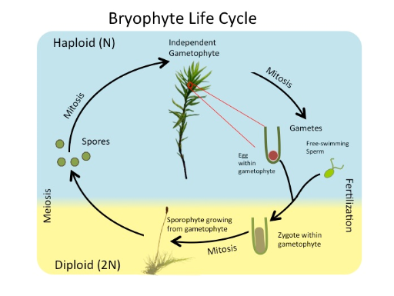
PLANT EVOLUTION
Very noticeable alternation of generations.
Fertilization depends on water.

Slide 9
PLANT EVOLUTION
Reproduce with seeds
Reproduce with spores only
Millions of Years

Slide 10
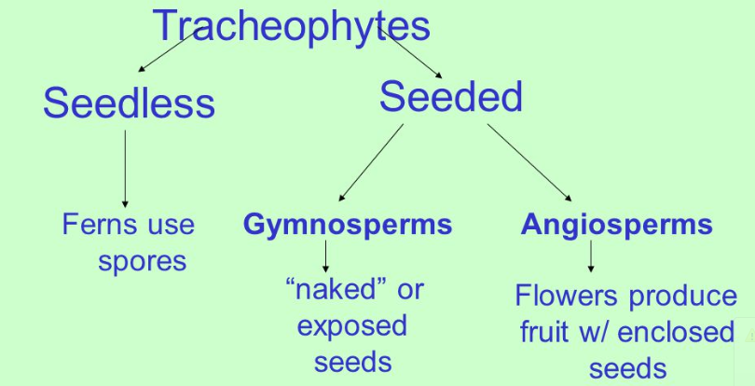
PLANT EVOLUTION

Slide 11
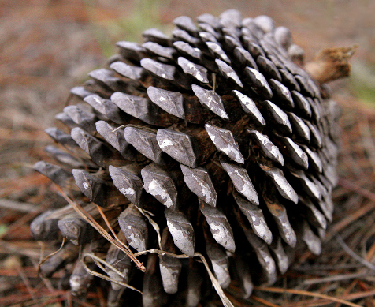
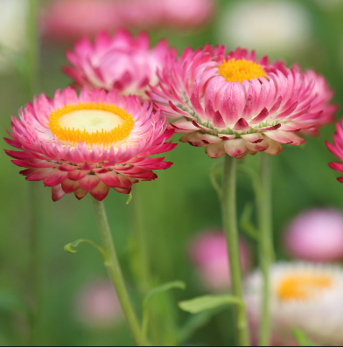
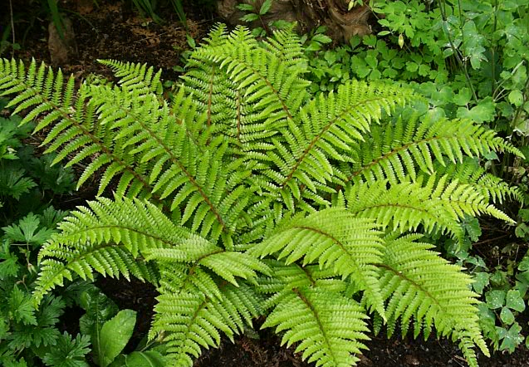
PLANT EVOLUTION
Vascular Plants: Tracheophytes
Seedless vascular – reproduce with spores
Gymnosperms – produces seeds in cones
Angiosperms – produces flowers and seeds in fruit

Slide 12
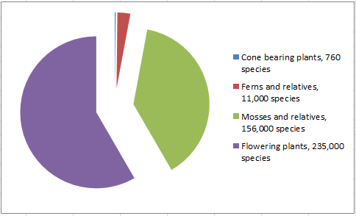
PLANT EVOLUTION

Slide 13
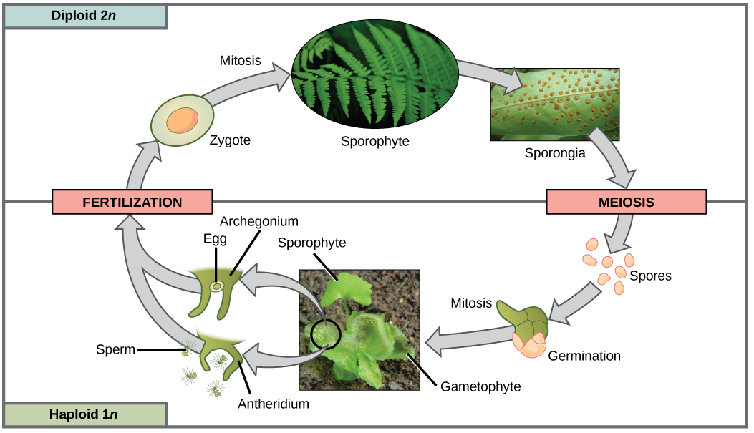
REPRODUCTION - FERN

Slide 14
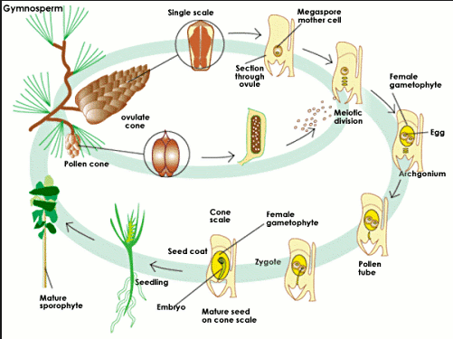
REPRODUCTION - GYMNOSPERMS

Slide 15
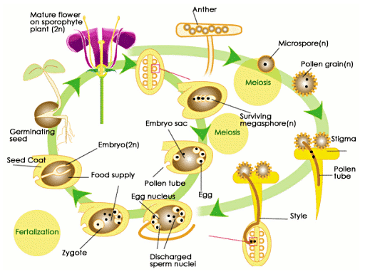
REPRODUCTION - ANGIOSPERMS

Slide 16
TROPISMS
Plants, Tropisms, and Hormones

Slide 17
TROPISMS
Plants do not have nervous systems
They can respond to their environment.
These responses are known as tropisms – Greek word that means “to turn”.

Slide 18
TROPISMS
Plants adjust growth in response to environmental stimuli
Plants will shift the positions of their roots, stems, leaves, and flowers in response to environmental conditions such as sunlight, temperature, water, and gravity.

Slide 19
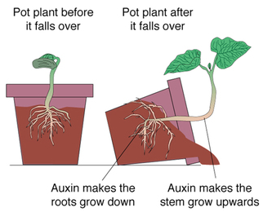
TROPISMS
Gravitropism or Geotropism– a growth response to gravitational forces.
When a seed sprouts, it is important for it to know to put the roots growing down and the stem growing up. It does not matter which way the seed was plants.

Slide 20
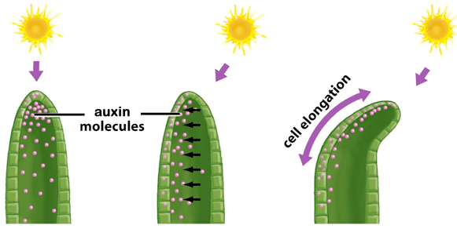
TROPISMS
Phototropism— when stems/leaves adjust the direction of growth in response to light
If a plant is placed near a window or another source of light, the plant will grow in the direction of the light source.

Slide 21
TROPISMS
Thigmotropism— plants shift a direction of growth as they contact objects
Climbing plants, ivy, and vines use this to find their way up and around a solid object for support.
Some plants us it to move away from other objects.
Some plants us it to not grow as big if there are a lot of plants around.

Slide 22
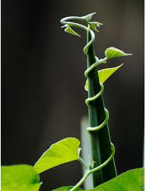
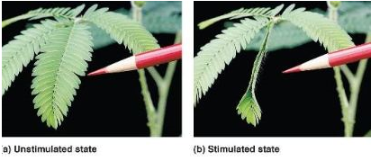
TROPISMS

Slide 23
TROPISMS
Tropisms

Slide 24
CONTROLLING GROWTH
Most plants control their growth in response to environmental stimuli by using chemical messengers known as hormones.
A hormone is a chemical that is produced in one part of an organism and transferred to another part to affect the activities of that part of the plant.

Slide 25
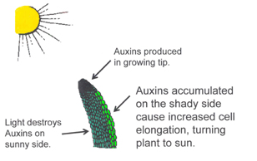
CONTROLLING GROWTH
Auxins
hormone responsible for regulating phototropism in a plant by stimulating the elongation of cells and helps promote the growth of fruit.
High concentrations of auxins help promote the growth of fruit and minimize the falling off of fruit from the plants. When auxin concentrations decrease, the fruit will fall off.
During fall auxin levels decrease causing ripened fruit to fall and plants will lose their leaves

Slide 26
CONTROLLING GROWTH
Abscisic Acid
inhibits plant growth during times of stress such as cold temperature or drought.

Slide 27
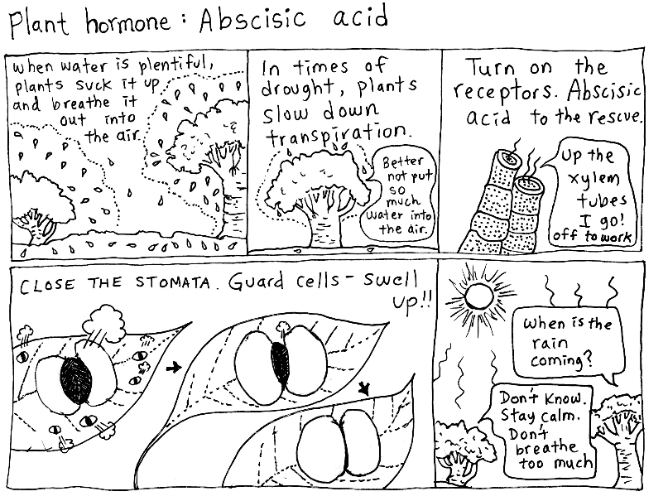
CONTROLLING GROWTH

Slide 28
CONTROLLING GROWTH
Gibberellins
growth hormones that cause plants to grow taller and increase the rate of seed germination and bud development.
There are certain tissues in seeds that release large amounts of gibberellins to signal that it is time to sprout.

Slide 29
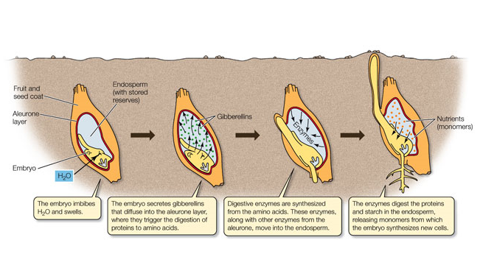
CONTROLLING GROWTH

Slide 30
CONTROLLING GROWTH
Plant Control

