Slide 1
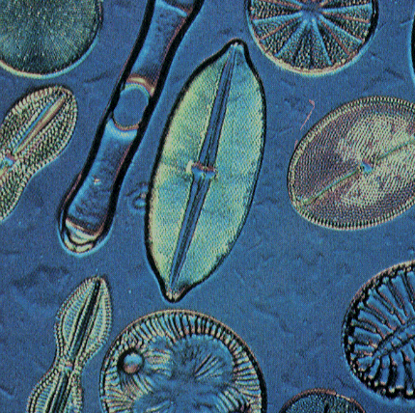
PROTISTS

Slide 2
PROTIST: SIMILARITIES AND DIFFERENCES
Eukaryotes (cells with nuclei).
More than 200,000 species.
Mostly Unicellular or some multicellular.
First Eukaryotic organism on Earth – appeared about 1.5 billion years ago.
Live in watery/moist surroundings.
Autotrophs, heterotrophs, or both.
Some can move - others cannot.
Do not have tissues.

Slide 3
PROTIST: SIMILARITIES AND DIFFERENCES
Really are classified by what they are not:
  Not a plant
  Not and animal
  Not a fungi
  Not a prokaryote

Slide 4
CLASSIFICATION BY NUTRIENT MODE
Animal-like – heterotroph
Plant-like – autotroph
Fungus-like - heterotroph

Slide 5
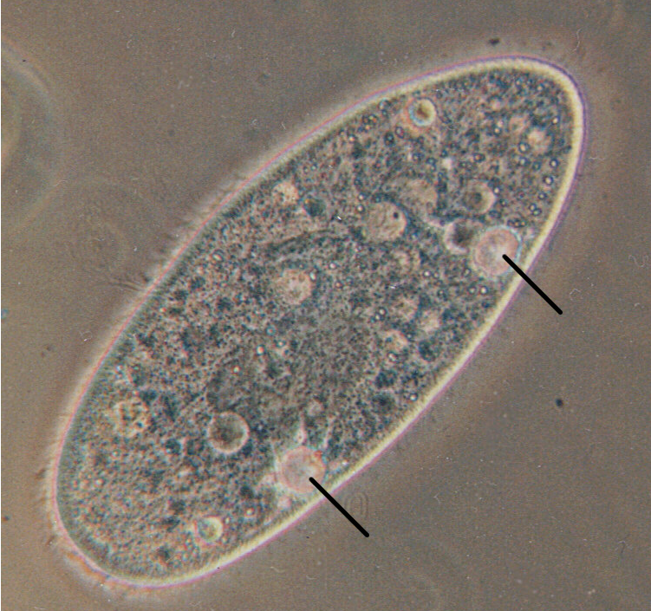
ANIMAL-LIKE PROTISTS
PROTOZOANS
* Unicellular Heterotrophs
* Contractile Vacuole – regulates water level in organism

Slide 6
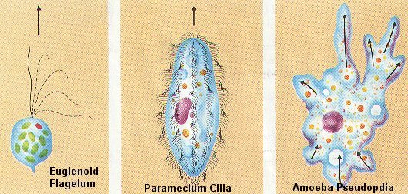
ANIMAL-LIKE PROTISTS
PROTOZOANS
Groups are based on movement:
Flagella Cilia pseudopods
and ‘others’.

Slide 7
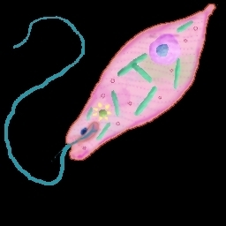
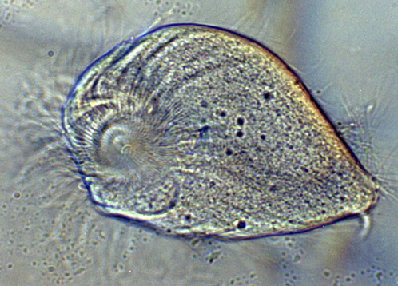
PROTOZOANS WITH FLAGELLA
Organisms called zooflagellates
Use long whip-like part called flagella to move.
These usually live inside other organisms.
Most reproduce asexually through binary fission.

Slide 8
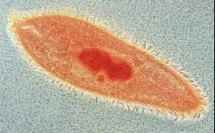
PROTOZOANS WITH CILIA
Most common – paramecium
Cilia – hair-like structures - help organisms move, get food and sense environment.
Multicellular with two nuclei.
  One nuclei (Macronucleus)controls everyday functions
  One nuclei (Micronucleus) is for reproduction.
Reproduce by binary fission or conjugation.

Slide 9

PROTOZOANS WITH CILIA
Oral groove lined with cilia - moves H₂0 containing food into food vacuole at the end of oral groove.
Food vacuole breaks down food and sends through cell.
Anal pore sends out waste.
Example of protozoan with cilia: paramecium.

Slide 10
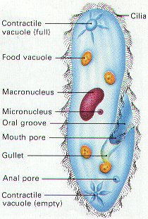
Contractile
Vacuole
Cilia
Food
Vacuole
Oral groove
Food
Vacuole
Anal pore

Slide 11
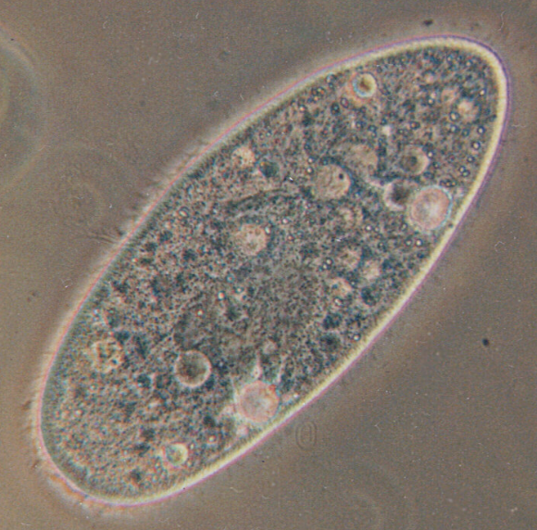
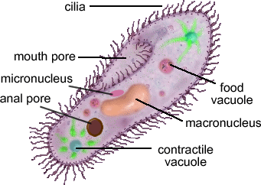
PROTOZOANS WITH CILIA

Slide 12
PROTOZOANS WITH PSEUDOPODS
Phylum Sarcodina (sarcodine) – includes amoebas.
Pseudopods: ‘false feet’
Cell membrane pushes in one direction and the cytoplasm flows into the bulge.
This allows the protozoan to move, dragging the rest of the cell behind it.

Slide 13
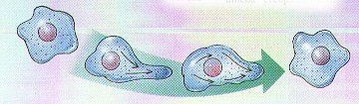
EXAMPLE OF HOW PSEUDOPODS MOVE
FLOW
PUSH
DRAG

Slide 14
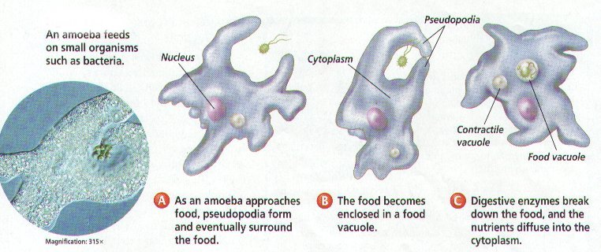
PROTOZOANS WITH PSEUDOPODS
It can form two pseudopods to surround and trap food. Then form a food vacuole to break down food in the cytoplasm.

Slide 15
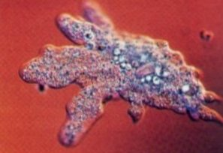
PROTOZOANS WITH PSEUDOPODS
Reproduce by binary fission like bacteria.
Contractile vacuole - it collects extra H₂O and expels it from cell.
Thin cell membrane
No definite shape.

Slide 16
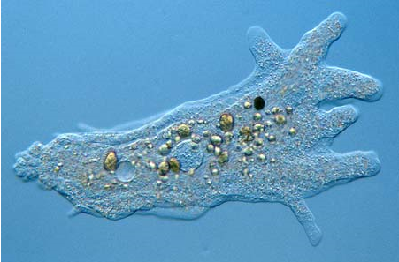
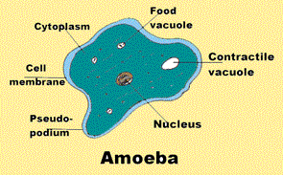
AMOEBA

Slide 17
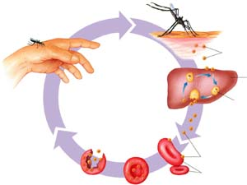
OTHER PROTOZOANS
Called sporozoans - parasites
Feed on cells and body fluids of hosts
Sporozoans like Plasmodium (causes malaria) have more than one host: mosquitoes and then humans

Slide 18
ANIMAL-LIKE PROTISTS
Disease | Protozoan
Malaria | Plasmodium species – carrier Anopheles mosquito
Giardiasis | Giardia species – carrier beavers; contaminated H₂O
African Sleeping Sickness | Trypanosoma species – carrier Tsetse fly
Amoebic Dysentery | Entamoeba species – contaminated H₂O

Slide 19
ANIMAL-LIKE PROTISTS
Malaria - a life-threatening disease caused by parasites that are transmitted to people through the bites of infected female mosquitoes
Giardiasis - a major diarrheal disease found throughout the world
African Sleeping Sickness - an infection caused by germs carried by certain flies. It results in swelling of the brain.
Amoebic Dysentery - a type of bloody diarrhea caused primarily by the amoeba Entamoeba histolytica.

Slide 20
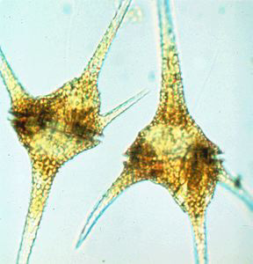
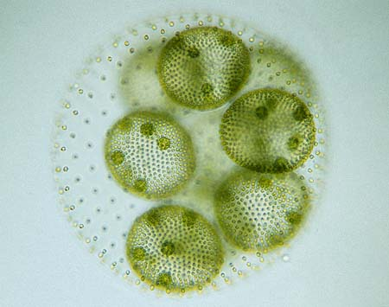
PLANT-LIKE PROTISTS
Unicellular or multicellular
Better known as algae
Unicellular (algae)
  Euglena
  Dinoflagellates – algal blooms produce red tide
  Diatoms – cell walls rich in silicon
Multicellular (algae/seaweed)
  Red, brown, green algae

Slide 21
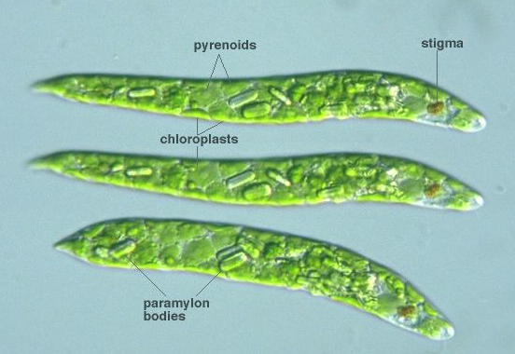
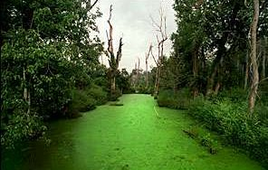
PLANTLIKE PROTISTS
Autotrophs
Contain different pigments so they come in different colors.
Euglena: special type of algae -when there is no sunlight they become heterotrophic.

Slide 22
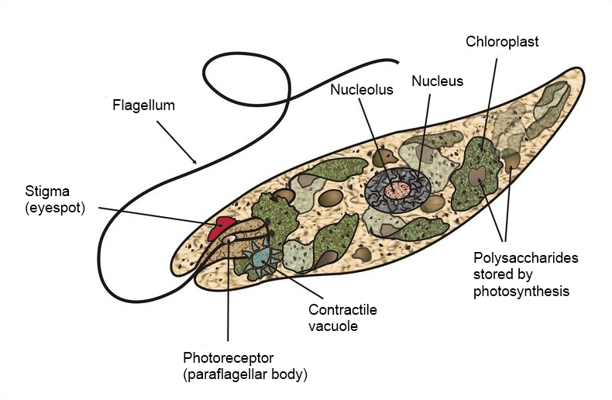
PLANTLIKE PROTISTS -EUGLENA

Slide 23
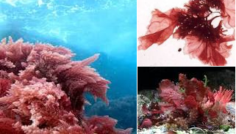
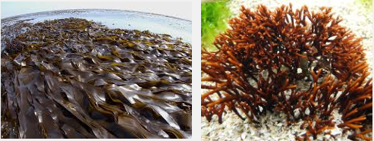
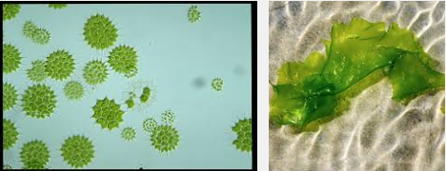
PLANTLIKE PROTISTS
Multicellular Examples
Red algae: Coralline algae
Brown Algae: Giant Kelp
Green Algae: Volvox, Ulva

Slide 24
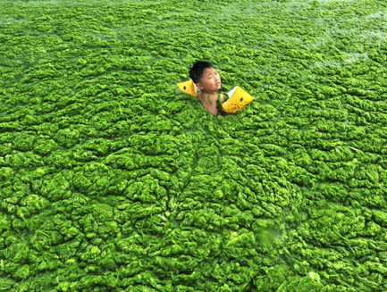
PLANTLIKE PROTISTS
Phytoplankton – population of photosynthetic organism.
Cell walls composed of cellulose
when waste is excessive, algae grows into masses called algal blooms; depletes nutrients and oxygen in H₂O which kills aquatic organisms.

Slide 25
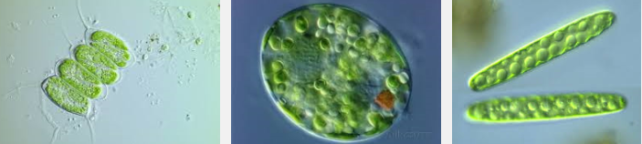
PLANTLIKE PROTISTS
Pigments vary to efficiently harvest light energy for photosynthesis.
Chlorophyll and accessory pigments allow algae to harvest and use energy from sunlight. The allows algae to use a wide range of light colors to get the energy for photosynthesis.

Slide 26
HUMAN USES OF PLANT-LIKE PROTISTS
Much of Earth’s O₂ is produced by algae – uses photosynthesis to produce oxygen
Chemicals in algae – medicines (treat ulcers, arthritis), make plastics, deodorants, paints etc.
Food - nori wraps in sushi, ice cream, candy bars, syrups, etc.

Slide 27
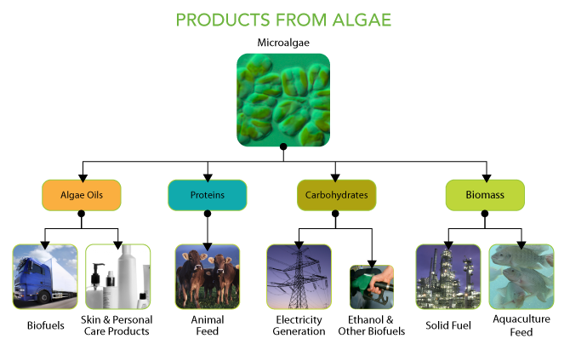
HUMAN USES OF PLANT-LIKE PROTISTS

Slide 28
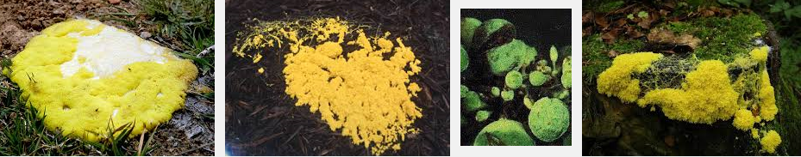
FUNGI-LIKE PROTISTS
Multicellular
Heterotrophs (like animals)
Cell Walls made of cellulose (like plants)
Not in fungi kingdom because they can move at one point in their lives.

Slide 29
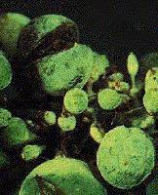
FUNGI-LIKE PROTISTS
Decomposers
Produce spores (tiny cells that can grow into a new organism)
Includes, slime molds, and water molds, mildew.

Slide 30
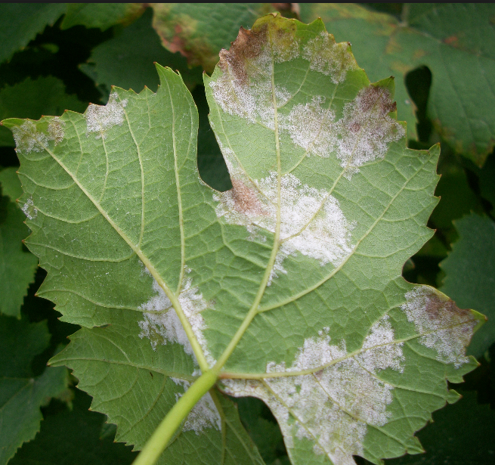
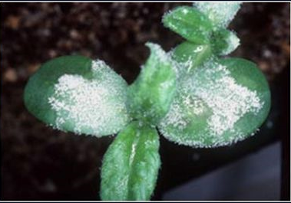
FUNGI-LIKE PROTISTS
Can be parasitic to plants – cause diseases such as blight, mildews.

Slide 31
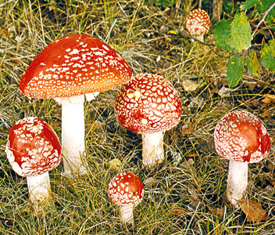
FUNGI

Slide 32
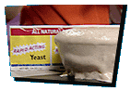
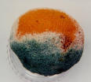

FUNGI KINGDOM
Fungus - Latin meaning sponge. The plural of fungus is fungi.
Eukaryotes
Heterotrophs - decomposers
All are multicellular except for yeast.
Have a cell wall composed of chitin.

Slide 33
FUNGI KINGDOM
Have a cell wall composed of chitin.
Like plants, fungi often grow in soil but they cannot make food from sunlight.
The stalk and the head of the toadstool are the fungi's fruiting body .This releases tiny spores. New fungus grow from these.

Slide 34
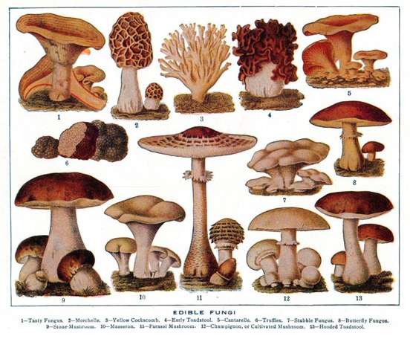
FUNGI KINGDOM
Use spores to reproduce.
Need warm, moist places to grow.
Cannot move.
Examples: yeast, molds and mushrooms.

Slide 35
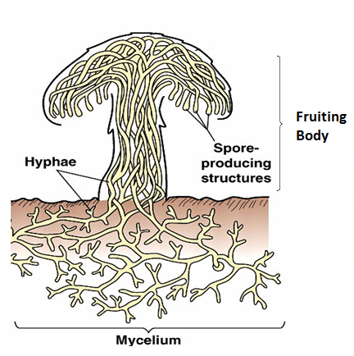
FUNGI STRUCTURES
Cell walls – contain chitin (carbohydrate)
Hyphae – thin filament
  Each hypha is one cell thick
  Shape of fungi depends on how hyphae used.
Mycelium – thick mass of hyphae
Fruiting bodies – reproductive structure

Slide 36
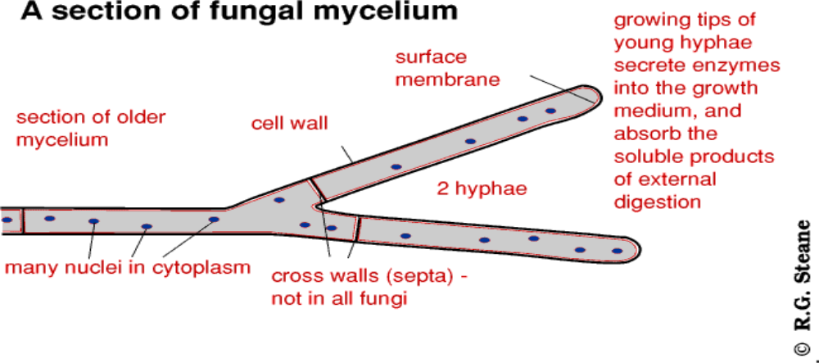
FUNGI STRUCTURES

Slide 37
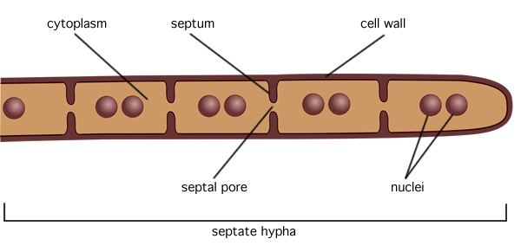
FUNGI -OBTAINING FOOD
Use a structure called hyphae to get their food.
Except for yeast because they are unicellular.

Slide 38
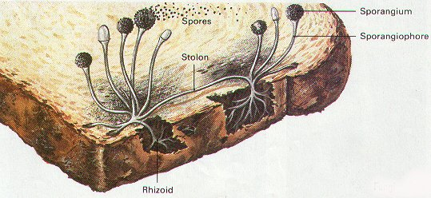

FUNGI -OBTAINING FOOD
The fungus grows hyphae into food. The hyphae secrete digestive enzymes into food. After the food is broken down, hyphae absorb it.

Slide 39
HOW DO FUNGI SPREAD?
Fungi need proper temperature, moisture and food or they remain dormant in soil.
Spores are scattered by wind, water or animals.

Slide 40
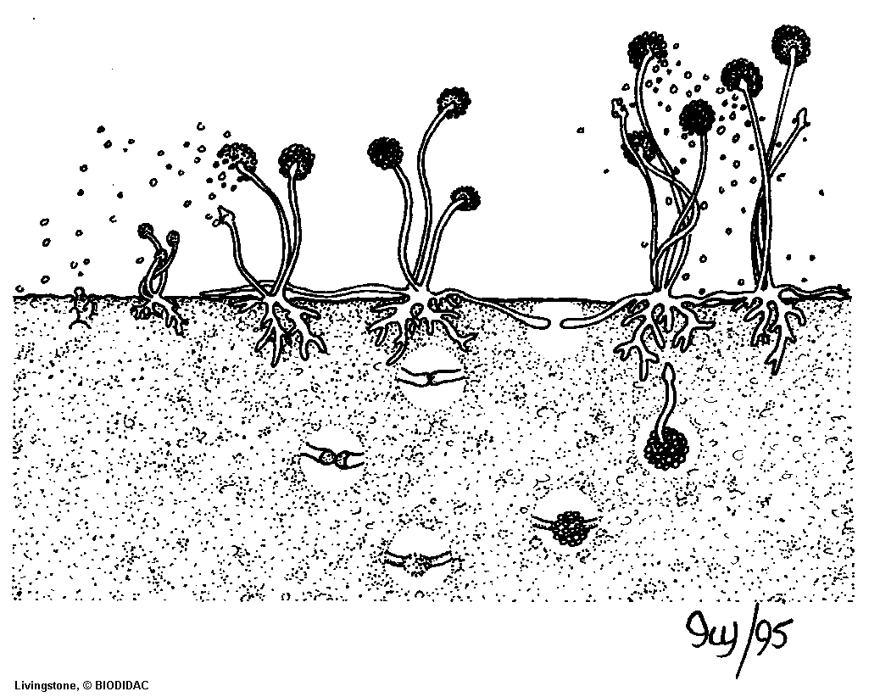
REPRODUCTION IN FUNGI
Budding (asexual)
Spores (asexual)
Sexual reproduction

Slide 41
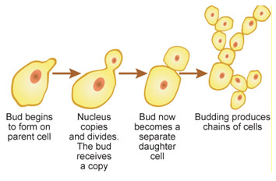
REPRODUCTION IN FUNGI
Budding (asexual) – cells break off and grow new fungus
Since yeast is unicellular, they reproduce by budding. A well-fed cell grows from the body of the mother cell and breaks off from the mother.

Slide 42
REPRODUCTION IN FUNGI
Spores (asexual) – reproductive cell germinates into new fungus
produce thousands of spores with a protective covering: carried by water and air.
spores land in a warm, moist place and they grow.
When there is plenty of moisture, fungi reproduce asexually by releasing the spores.

Slide 43
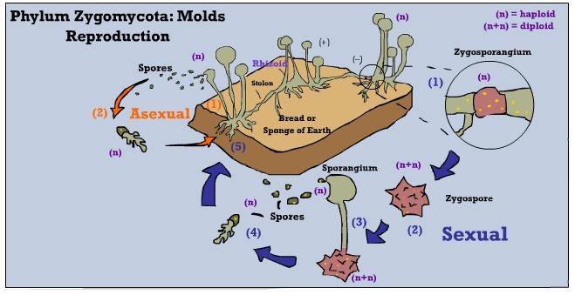
REPRODUCTION IN FUNGI
Sexual reproduction – Two mating types (+ and -) fuse nuclei, then divide to produce haploid spores which germinate into new fungi – produce genetically diverse spores
This occurs when conditions are not good.

Slide 44
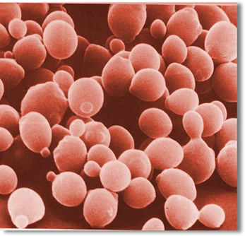
FOUR CLASSIFICATIONS OF FUNGI
Classified by how they reproduce.
Threadlike - produce spores in their threadlike hyphae (ex. bread mold)
Sac - produce spores in structures that look like sacs (ex. yeast)

Slide 45
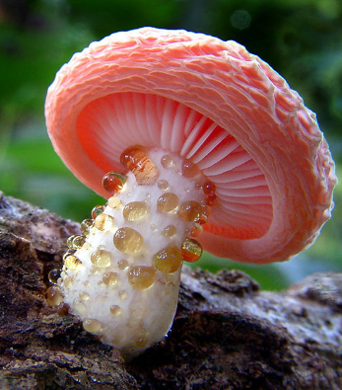
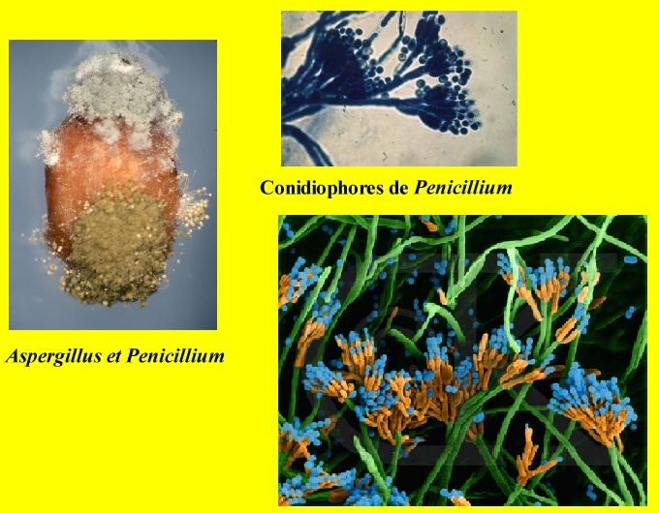
FOUR CLASSIFICATIONS OF FUNGI
Club - produce spores in structures that look like clubs (ex. mushrooms)
Imperfect - those that cannot reproduce sexually (ex. penicillin)

Slide 46
ECOLOGICAL ROLES OF FUNGI
Saprophytes (decomposer) - absorb nutrients from dead organic matter.
Fungi are decomposers like bacteria and help to recycle organic matter to inorganic = saprophytic.

Slide 47
ECOLOGICAL ROLES OF FUNGI
Parasites - absorb nutrients from body fluids of host organism causing plant and human diseases. (wheat rust, corn smuts, ringworm, yeast infection, thrush, etc.)
Cause diseases like ringworm, athletes foot,

Slide 48
ECOLOGICAL ROLES OF FUNGI
Used to produce medicines - penicillin, cortisone, antibiotics, vitamins
Drugs made from fungi cure diseases and stop the rejection of transplanted hearts and other organs.

Slide 49
ECOLOGICAL ROLES OF FUNGI
Fermentation process to produce food – cheese, bread, etc.
Examples of foods:
Yeast
Beer and Wine
Bread
Mushrooms
White button, crimini,portabella
Truffles, chanterelles

Slide 50
ECOLOGICAL ROLES OF FUNGI
Mycoprotein (food additive like tofu)
Cheese
  Rennin
  blue cheese
Soy sauce
Tempeh
Citric acid
  In soft drinks

Slide 51
ECOLOGICAL ROLES OF FUNGI
Mutualistic symbionts - both reciprocate with some beneficial function.
Mycorrhiza – special roots and fungi association (fungi increase absorption of water/minerals and fungi release enzymes to free nutrients in the soil and plant provides product from photosynthesis)

Slide 52
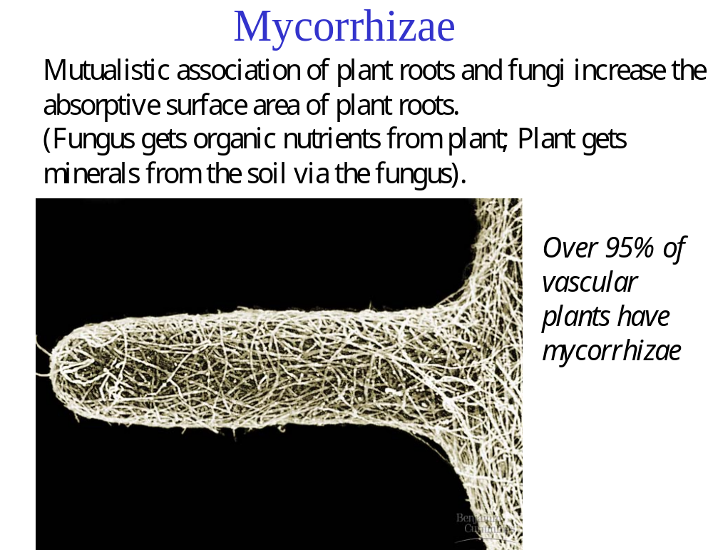
ECOLOGICAL ROLES OF FUNGI
Root hair
hyphae

Slide 53
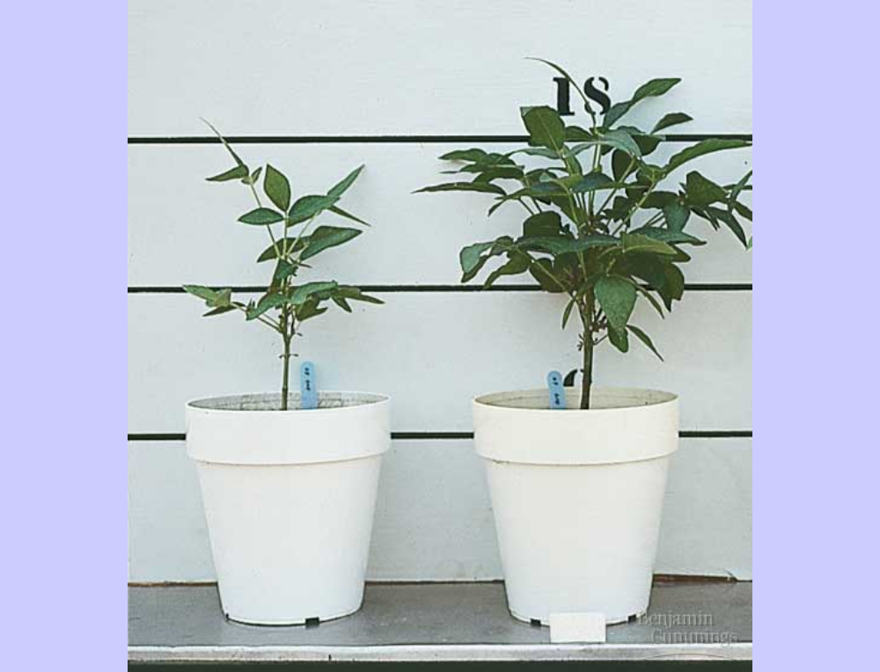

Slide 54
ECOLOGICAL ROLES OF FUNGI
Lichen – fungus and green algae association (algae carries out photosynthesis, providing the fungus with a source of energy and fungus provides water, minerals and protect the algae)

Slide 55
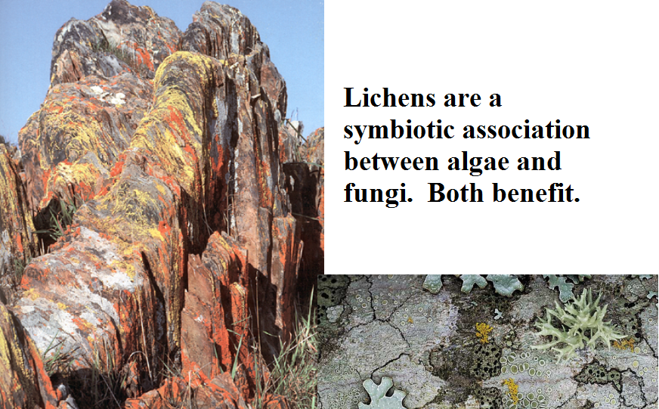

Slide 56
