Slide 1
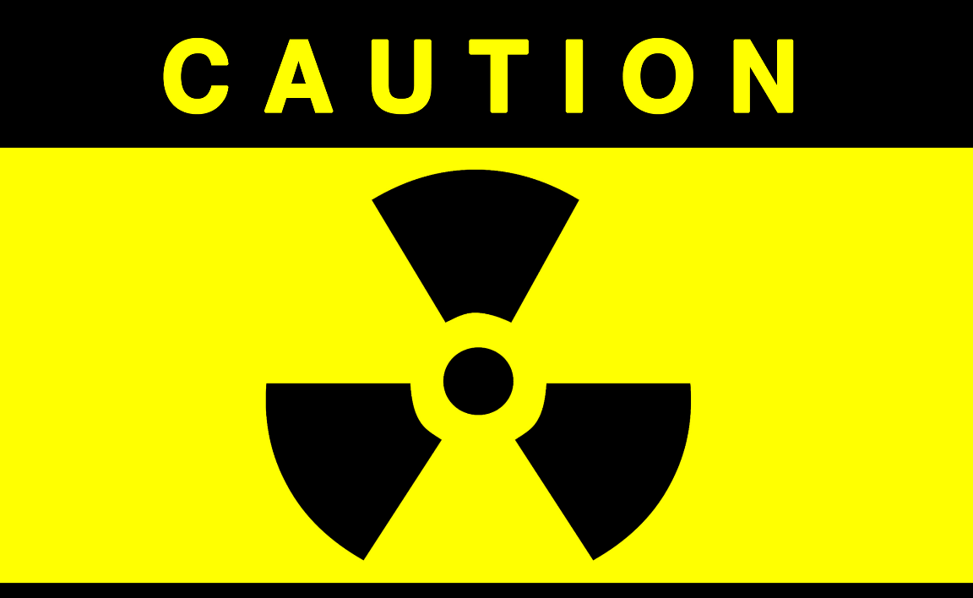
RADIOACTIVITY

Slide 2
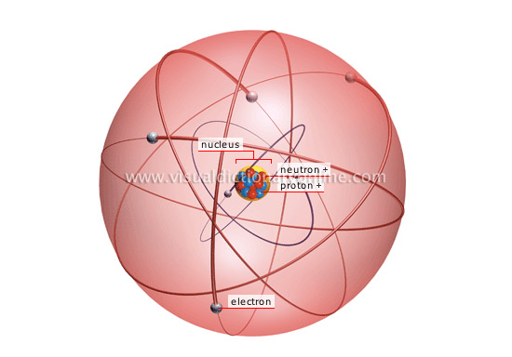
REVIEW
In the nucleus, there are protons and neutrons.
They are packed tightly together and are 99.9% of the mass of the atom.

Slide 3
REVIEW
The nucleus occupies only a tiny fraction of the entire atom.
The rest of the atom is the electron cloud where the electrons are.

Slide 4
THREE TYPES OF NUCLEAR REACTIONS
NUCLEAR DECAY - a single nucleus releases energy and/or particles of matter
NUCLEAR FUSION - two nuclei join together
NUCLEAR FISSION - a nucleus is split in two
*ALWAYS involves a change in the nucleus and a release of energy

Slide 5
STRONG FORCE
Like charges repel using the electric force so protons repel each other in the nucleus. This electric force is a long range force.
A second force, the strong force, causes protons and neutrons to be attracted to each other. This is the strongest force in nature but only acts over a very short distance.
In an atom like carbon, with few protons and neutrons, the nucleus is held together tightly. There are not many protons to repel each other.

Slide 6
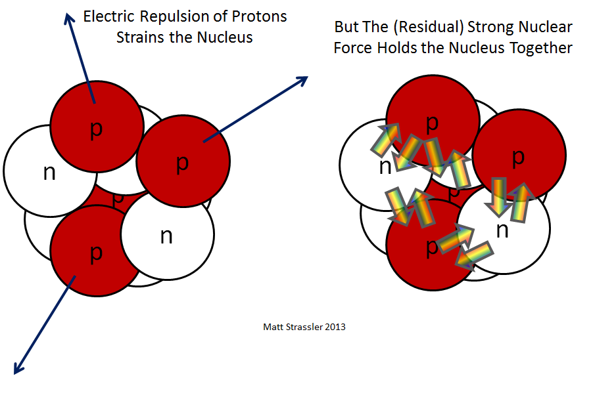
STRONG FORCE
In an atom like uranium with a lot of protons and neutrons, the nucleus is held together less tightly. There are lots of protons to repel.

Slide 7
STABILITY
An atom’s stability will depend on a ratio or comparison of protons to neutrons in the nucleus.
Ideal ratio: For light elements → 1:1 ratio;
Ideal ratio: for heavy elements → 3:2 ratio of neutrons to protons;
a nucleus with either too many or too few neutrons compared to protons is radioactive.

Slide 8
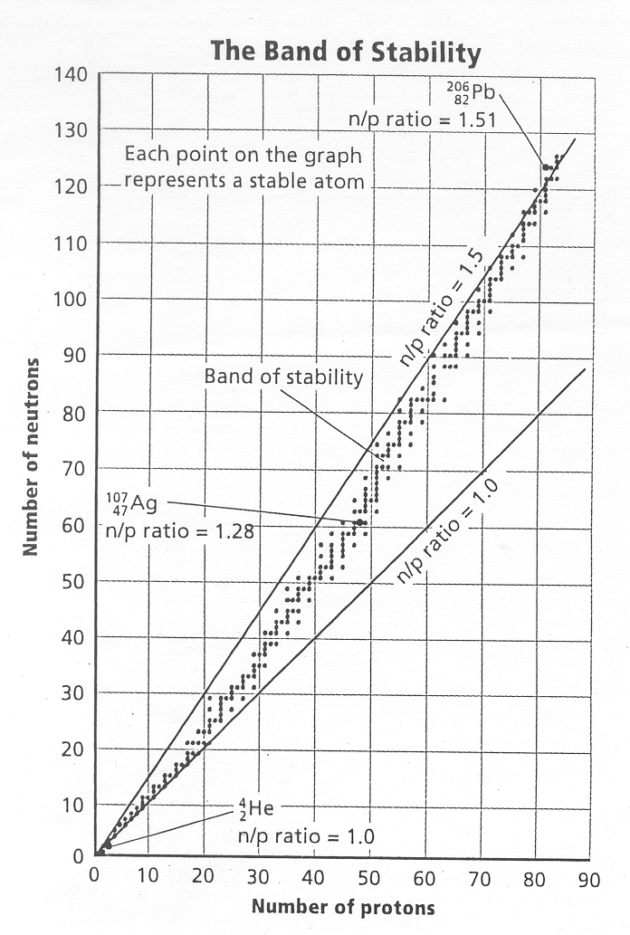
STABILITY

Slide 9
RADIOACTIVITY
In many nuclei, the strong force is able to keep the nucleus permanently together.
These nuclei are considered stable.
When the strong force is not strong enough, the nucleus can decay and give off matter and energy.
This process of nuclear decay is called radioactivity.
Elements with an atomic number greater than 83 are radioactive.

Slide 10
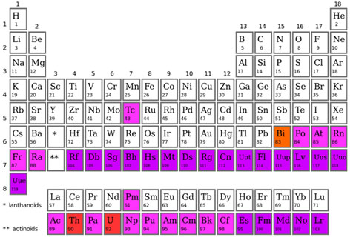
ALL THE ELEMENTS HEAVIER THAN BISMUTH

Slide 11
RADIOACTIVITY
Elements with atomic numbers 1-82 have isotopes that may be radioactive.
Remember that all the elements after atomic number 92 are manmade and are produced in laboratories.
These synthetic elements are unstable and decay soon after they are created.
Radioactivity is the spontaneous emission of radiation from an element because the strong force cannot hold the nucleus together

Slide 12
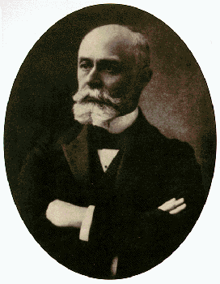
HISTORY
1896
Henri Becquerel
discovered mysterious rays coming from uranium.
Called it RADIATION.

Slide 13
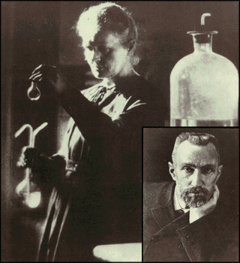
HISTORY
1898
Marie and Pierre Curie
discovered these rays in radium and polonium

Slide 14
NUCLEAR DECAY
Unstable nuclei lose energy by emitting matter and energy in a spontaneous (does not require energy) process called radioactive decay.
These particles and energy are called radiation.
The atom undergoes radioactive decay until it becomes stable.
By emitting radiation, an atom of one element changes into an atom of another element.

Slide 15
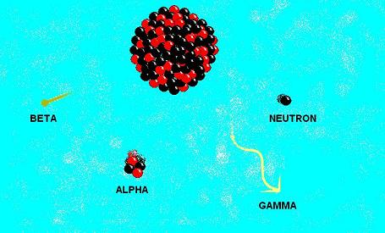
NUCLEAR DECAY

Slide 16
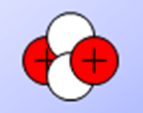
TYPES OF RADIATION
Alpha radiation, α
Made of alpha particles;
is composed of two protons and two neutrons;
the largest radiation particle;
has a 2+ charge and a mass of 4 amu;
has the least amount of energy of any of the radiation;

Slide 17
TYPES OF RADIATION
Alpha radiation, α
is stopped by paper.
A new element is created when alpha decay happens.
The mass number and the atomic number change.

Slide 18
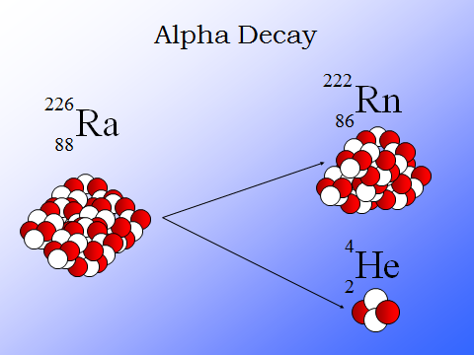
TYPES OF RADIATION

Slide 19
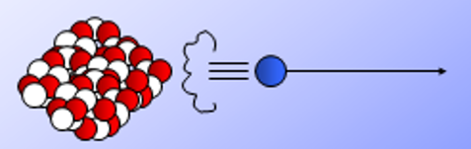
TYPES OF RADIATION
Beta radiation, β
made of fast moving electrons;
has a –1 charge and a mass of 1/1840;
an electron is emitted during beta decay because it has been removed from a neutron, leaving behind a proton;
has more energy than alpha radiation.
It is stopped by a sheet of metal.

Slide 20
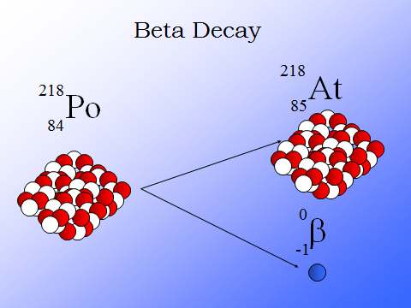
TYPES OF RADIATION

Slide 21
TYPES OF RADIATION
Gamma radiation, γ
high energy radiation that possesses no mass;
is the most penetrating;
has no charge;
usually accompanies alpha or beta radiation;
is slowed down by lead or concrete.
Accounts for most of the energy lost in a radioactive decay process.

Slide 22
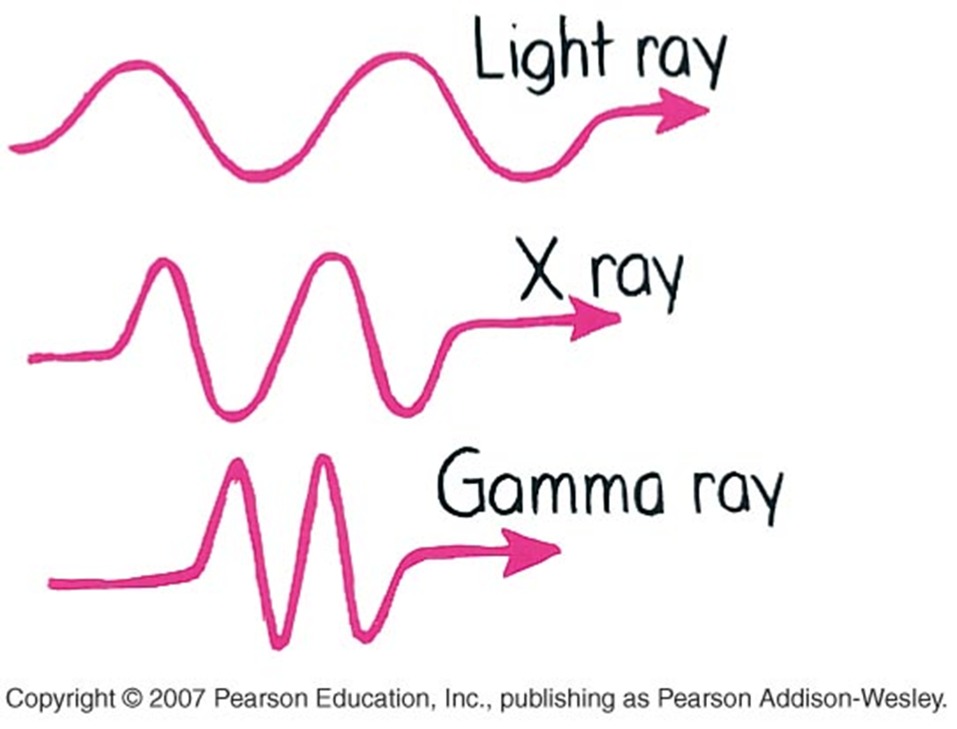
WHICH IS MORE PENETRATING?

Slide 23
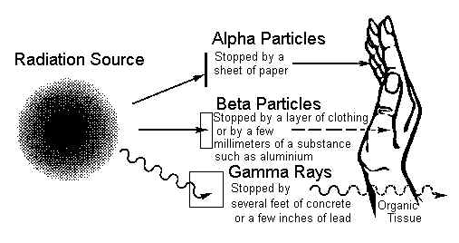
TYPES OF RADIATION
Animation

Slide 24
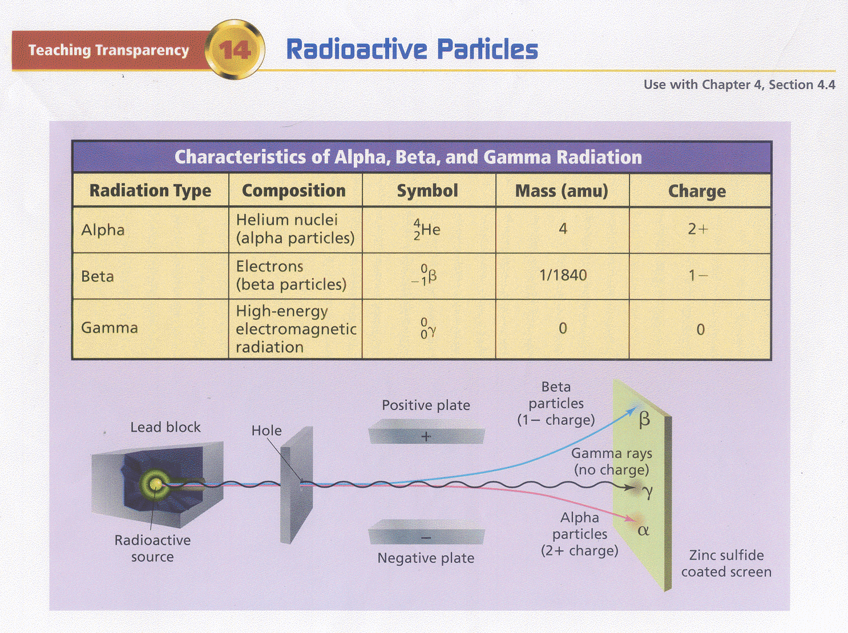
TYPES OF RADIATION

Slide 25
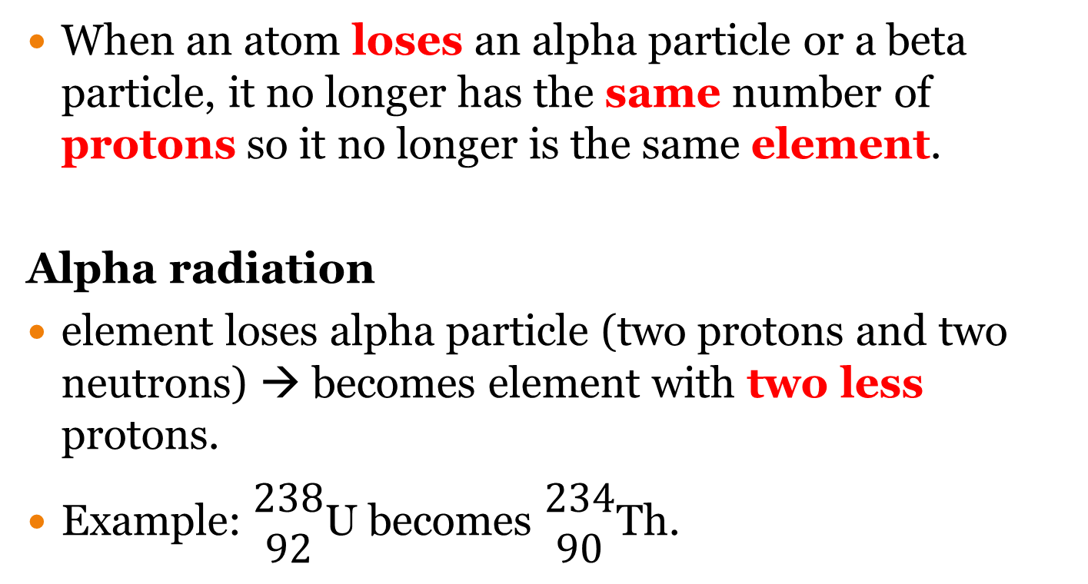
TRANSMUTATION
When an atom loses an alpha particle or a beta particle, it no longer has the same number of protons so it no longer is the same element.
Alpha radiation
element loses alpha particle (two protons and two neutrons) → becomes element with two less protons.
Example: $\begin{matrix}238 \\ 92\end{matrix}$U becomes $\begin{matrix}234 \\ 90\end{matrix}$Th.

Slide 26
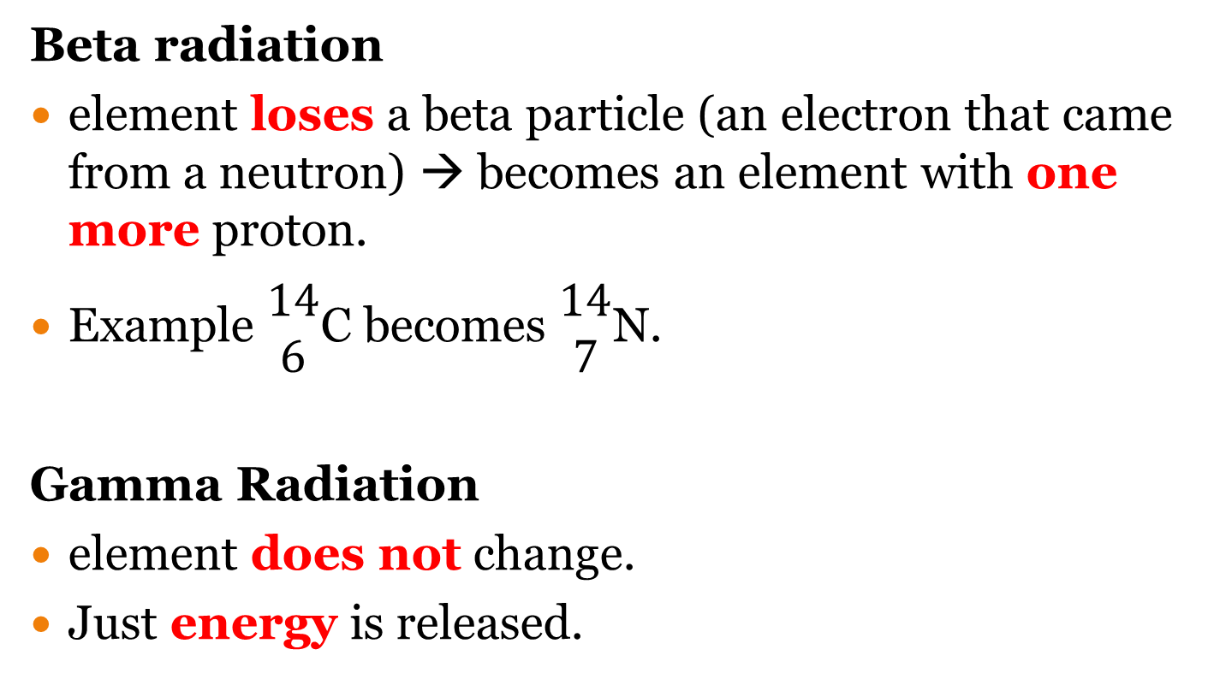
TRANSMUTATION
Beta radiation
element loses a beta particle (an electron that came from a neutron) → becomes an element with one more proton.
Example $\begin{matrix}14 \\ 6\end{matrix}$C becomes $\begin{matrix}14 \\ 7\end{matrix}$N.
Gamma Radiation
element does not change.
Just energy is released.

Slide 27
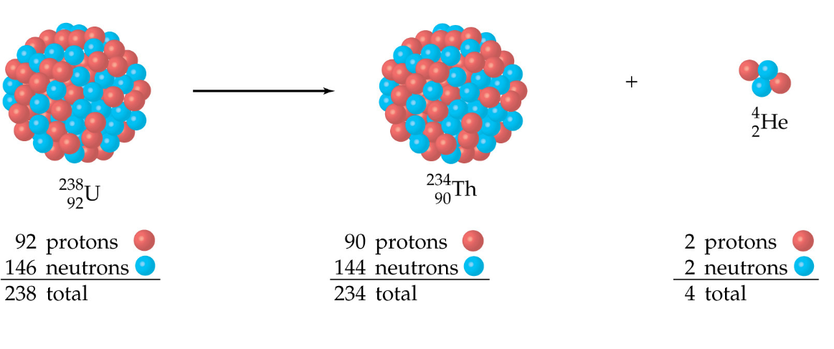
TRANSMUTATION

Slide 28
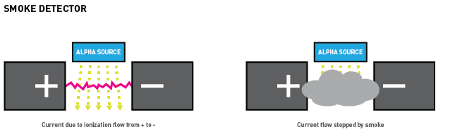
APPLICATIONS OF RADIATION
Smoke detectors give off alpha particles.
These particles allow an electrical circuit to be closed.
When there is smoke, the circuit cannot be completed and the alarm goes off.

Slide 29
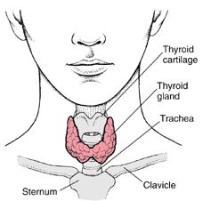
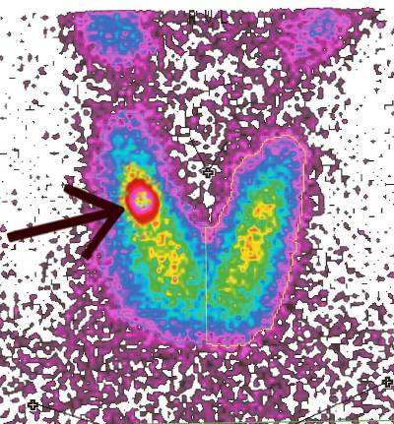
APPLICATIONS OF RADIATION
Hospitals, doctors, and dentists use a variety of nuclear materials and procedures to diagnose, monitor, and treat a wide assortment of medical conditions in humans.
Example (not in notes): Iodine-131, a beta emitter, is taken as sodium iodide in drinking water. Almost all of it will find its way to the thyroid

Slide 30
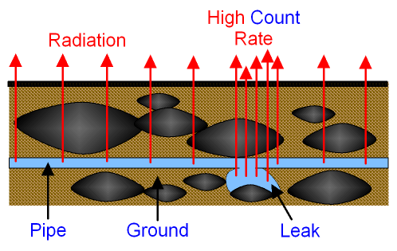
APPLICATIONS OF RADIATION
Researchers can study the paths that different types of air and water pollution take through the environment by labeling the substances that pass through plants, animals, or the atmosphere with radioisotopes.

Slide 31

APPLICATIONS OF RADIATION
Foods, medical equipment, and other substances are exposed to certain types of radiation (such as x-rays) to kill germs without harming the substance that is being disinfected and without making it radioactive.
When treated in this manner, foods take much longer to spoil, and medical equipment (such as bandages, hypodermic syringes, and surgical instruments) are sterilized without being exposed to toxic chemicals or extreme heat.
Irradiated food symbol

