Slide 1
RADIOACTIVE DECAY SERIES
A series of nuclear reactions that begins with an unstable nucleus and results in the formation of a stable nucleus is called a radioactive series.
Uranium-238 goes through a radioactive series and eventually become lead-206 which is stable.

Slide 2
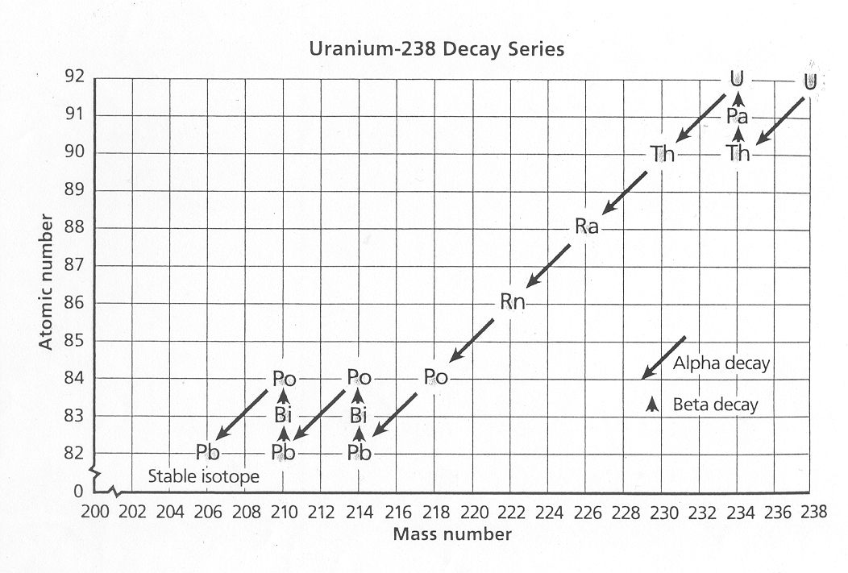
RADIOACTIVE DECAY SERIES
Starts here
Ends here

Slide 3
RADIOACTIVE HALF-LIFE
Naturally occurring radioactive isotopes (radioisotopes) are not uncommon on earth.
Even though radioisotopes have been decaying for 15 billion years (as long as there has been an earth), there are still some left to decay.
If an element is radioactive, it will decay. It may take seconds (polonium-214 - 163.7 microseconds), days (radon-222 - 3.8 days), or years (uranium-238 - 4460000000 years or carbon-14 - 5730 years).

Slide 4
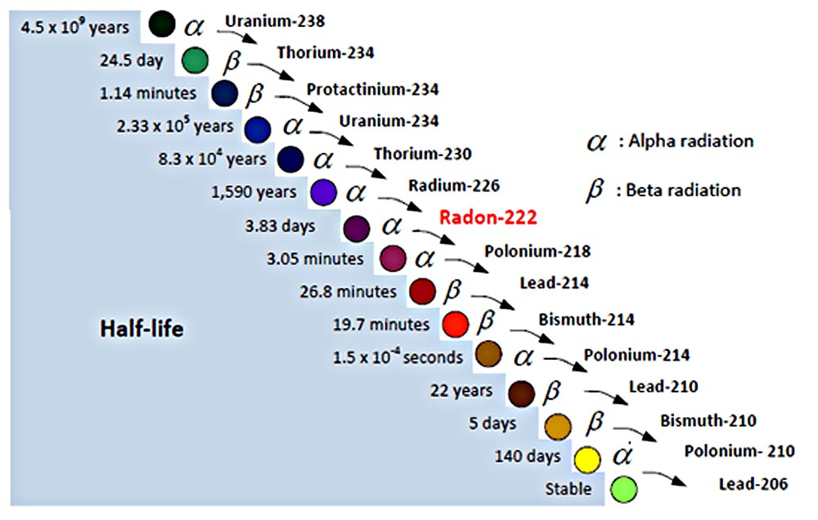
RADIOACTIVE HALF-LIFE

Slide 5
RADIOACTIVE HALF-LIFE
The difference in different isotopes decay rates provides the explanation.
Radioactive decay rates are measured in half-lives.
A HALF-LIFE is the time it takes for one half of the radioactive sample to decay.
Different isotopes have different half-lives.
EXAMPLE: If you were given a 10.0g sample of carbon-14, how much would be stable after 3 half-lives?

Slide 6

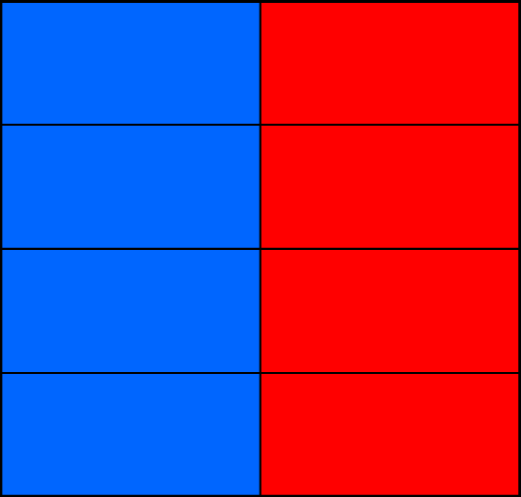
RADIOACTIVE HALF-LIFE
One
half-life
1st half-life: 5.0g stable and 5.0g not stable

Slide 7
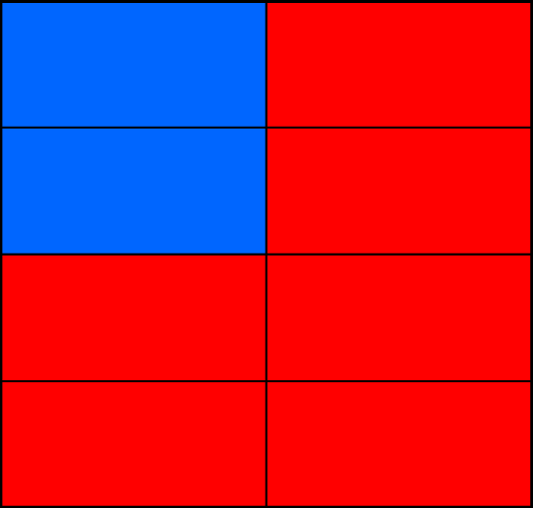
RADIOACTIVE HALF-LIFE
Two
half-lives
2nd half-life: 7.5g stable and 2.5g not stable

Slide 8
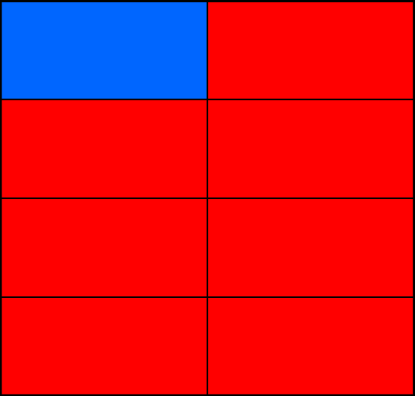
RADIOACTIVE HALF-LIFE
Three
half-lives
3rd half-life 8.75g stable and 1.25g not stable

Slide 9
RADIOACTIVE HALF-LIFE
Another way to look at that same example is like this:
TIME (number of half-lives) | SAMPLE MASS Still Radioactive | SAMPLE MASS Not Radioactive
0 | 10.0g | 0.0g
1 | 5.0g | 5.og
2 | 2.5g | 7.5g
3 | 1.25g | 8.75g

Slide 10
PRACTICE
The half-life of cobalt-60 is 5.26 years. How many half-lives have passed in 10.52 years? SHOW YOUR WORK!
Time (Number of half-lives) | Years
0 | 0
1 | 5.26
2 | 5.26+5.26 = 10.52
ANSWER: Two half-lives

Slide 11
PRACTICE
2. 12.5% of a radioactive sample is left. How many half-lives have passed? SHOW YOUR WORK!
Time (Number of half-lives) | Percentage of sample
0 | 100%
1 | 50%
2 | 25%
3 | 12.5%
4
Answer: 3 half-lives

