Slide 1
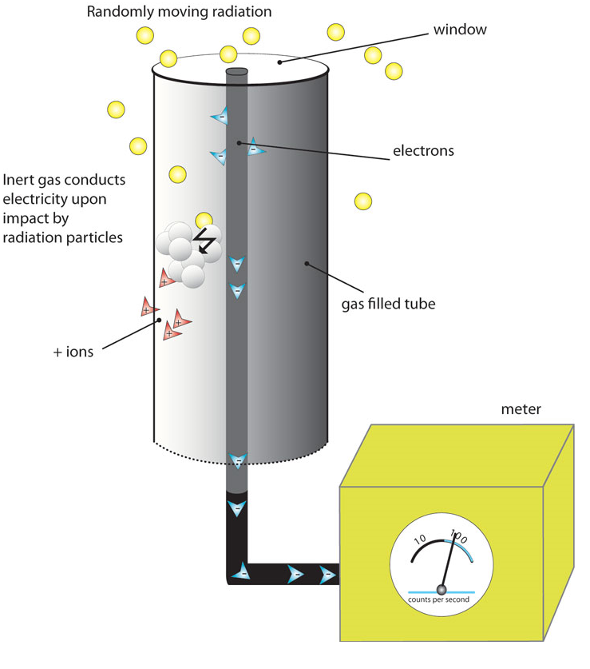
MEASURING RADIATION
Large doses of radiation are harmful to living tissue.
Radiation can be measured with a Geiger counter – a device that measures radioactivity by producing an electric current when radiation is present.
It produces a clicking sound.
The more clicks there are, the more radiation is being detected.

Slide 2
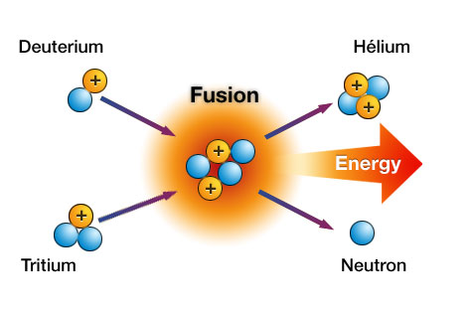
NUCLEAR FUSION
Two nuclei with low masses are combined to form one nucleus of a larger mass.
Fusion requires high temperatures and fast moving particles.
Remember that the nuclei normally are positive and want to repel each other.

Slide 3
NUCLEAR FUSION
The sun is a great example of nuclear fusion.
Most of the energy produced by the sun is given off when hydrogen nuclei fuse to create helium.
It takes several steps, but the end result is that four hydrogen nuclei fuse to form one helium nuclei.
A tiny amount of mass is converted into an enormous amount of energy.
Earth receives a small amount of this energy as heat and light.

Slide 4
NUCLEAR FISSION
This is the process of splitting a nucleus into two nuclei with smaller masses.
Only large nuclei like uranium and plutonium can undergo nuclear fission.
Usually when an atom is split, two smaller masses as well as some neutrons and energy are released.
A tremendous amount of energy is released.
A CHAIN REACTION can occur is there are enough nuclei present to be split.

Slide 5
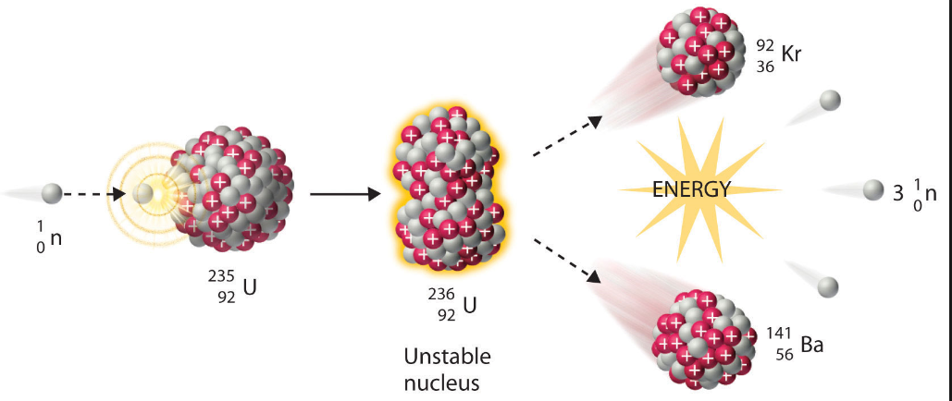
NUCLEAR FISSION
The original nucleus was split when a neutron was fired at it.
When that atom splits, it releases more neutrons which can split more atoms.
When controlled, the large amounts of energy released can be used to generate electricity.

Slide 6
REMEMBER
Fusion fuses/joins atomic nuclei together .
and
Fission splits nuclei apart.

Slide 7
NUCLEAR ENERGY
A nuclear reactor uses energy from controlled nuclear fission reactions to generate electricity.
Only certain elements can undergo fission.
Uranium-235 is the isotope used.
The heat generated from the fission reaction heats water.
The steam then turns a turbine which produces electricity through electromagnetic induction.

Slide 8
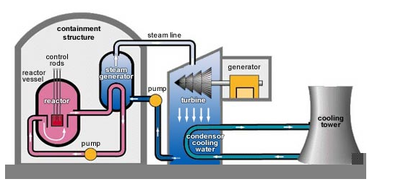
NUCLEAR ENERGY
NUCLEAR POWER PLANT

Slide 9
NUCLEAR ENERGY
Advantages
does not rely on fossil fuels;
does not produce gaseous pollutants that cause ozone depletion and acid rain;
cheap to make electricity this way but expensive to build the power plant;
more energy in the known uranium reserves than in the known reserves of coal and oil

Slide 10
NUCLEAR ENERGY
Disadvantages
mining the uranium can cause environmental damage.
The water used to cool the system is hot at the end and must be cooled before being released into the environment.
Radiation could be accidentally released in a reactor accident.
The nuclear waste (spent uranium) must be disposed of. There is controversy on how and where to store this waste.

