Slide 1
EVOLUTION REVIEW
Natural Selection

Slide 2
REVIEW
I. HISTORY – PERSON AND PROPOSAL
  James Hutton
  Thomas Malthus
  Jean-Baptiste Lamarck
  Charles Lyell
  Alfred Wallace
  Charles Darwin
    Voyage – ship, purpose of trip
    Observations
    Publication

Slide 3
HISTORY
James Hutton – Gradualism - Described the geological forces that have changed life on earth over millions of years.
Thomas Malthus – struggle for existence (resources)
John Baptiste Lamarck – Inheritance of acquired Characteristics and Law of Use and Disuse; agreed that there was change over time
Charles Lyell – uniformintarianism - geologic processes still changing Earth
Alfred Russel Wallace – organisms evolved from common ancestors; independently came up with natural selection

Slide 4
HISTORY
Charles Darwin
  theory of evolution that used natural selection as its mechanism;
  The unequal ability of individuals to survive and reproduce leads to a gradual change in a population, with favorable characteristics accumulating over generations (natural selection);
  New species evolve.

Slide 5
REVIEW
II. NATURAL SELECTION
  Mechanism for evolution
  Overproduction
  Natural Variations
    Adaptation
    Fitness
  Struggle for Existence
    Competition for resources
    Survival of the Fittest
  Successful Reproduction
  Descent with Modification

Slide 6
NATURAL SELECTION
Individuals who inherit characteristics most fit for their environment are likely to leave more offspring than less fit individuals.
Called Natural Selection.

Slide 7
NATURAL SELECTION
Overproduction – produce more offspring than can possibly survive.
Natural Variations – differences among individuals exist in all organisms.
Fitness - Ability of an individual to survive and reproduce.
Adaptation - Inherited characteristic that increases an organisms chance for survival.

Slide 8
NATURAL SELECTION
The Struggle for Existence - compete for food, mates, space, water, etc.
  Competition for resources – environmental resources are limited
  Survival of the Fittest - strongest able to survive and reproduce.

Slide 9
NATURAL SELECTION
Successful Reproduction – those that adapt best will reproduce offspring that survive
Descent with Modification - new species arise from common ancestor replacing less fit species.

Slide 10
REVIEW
III. ARTIFICIAL SELECTION
Breeding for desired traits
Examples
Artificial Selection is the selection by humans for breeding of desired traits from the natural variation among different organisms.

Slide 11
REVIEW
IV. RESULTS OF NATURAL SELECTION
A. Direction Selection
  Definition
  example
B. Diversifying (Disruptive) Selection
  Definition
  example
C. Stabilizing Selection
  Definition
  Example

Slide 12
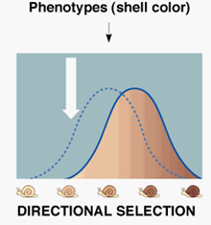
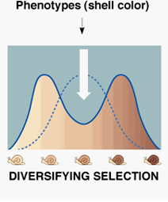
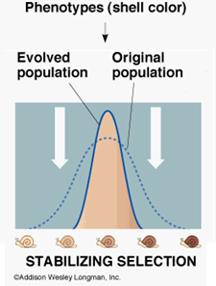
REVIEW
IV. RESULTS OF NATURAL SELECTION
A. Direction Selection – natural selection favors one extreme
B. Diversifying (Disruptive) Selection – natural selection favors the extremes
C. Stabilizing Selection – natural selection favors the middle

Slide 13
REVIEW
In a population of mice that live in the woods, natural selection will tend to favor individuals that best blend in with the forest floor and are less likely to be spotted by predators.
Assuming the ground is a fairly consistent shade of brown, those mice whose fur is most-closely matched to that color will most probably survive and reproduce, passing on their genes for their brown coat.
Mice that carry alleles that make them slightly lighter or slightly darker will stand out against the ground and will more probably die from predation.
What type of natural selection?

Slide 14
REVIEW
Light-colored oysters are more cryptic – have a coloration that allows an organism to match its background and hence become less vulnerable to predation or recognition by prey – because they match the rock color.
Dark-colored oysters blend into the shadows cast by the rocks.
Light colored and dark colored oysters survive to reproduce.
Intermediate-colored oysters would be most heavily preyed upon by the crabs.
Which type of natural selection is this?

Slide 15
REVIEW
V. EVIDENCE OF EVOLUTION
A. Fossil Record
  What kinds of rocks
  What can it tell us
B. Geographic Distribution
  Adaptive Radiation
C. Embryonic Development

Slide 16
FOSSILS
Darwin saw fossils as a record of the history of life on Earth.
By comparing fossils from older rock layers with fossils from younger layers, scientists could document that life on Earth has changed over time.
Through the examination of sedimentary rock strata (layers), fossils have been used to trace the history of modern life.

Slide 17
ADAPTIVE RADIATION
The evolution of many diversely adapted species from a common ancestor.
Usually occurs when a population colonizes an area of diverse geographic or ecological conditions.
Many species become so different that the possibility of cross breeding is no longer possible due to the accumulation of genetic changes.

Slide 18
EMBRYONIC DEVELOPMENT
The same groups of embryonic cells develop in similar patterns to produce the tissues and organs of all vertebrates.
This shows a common ancestor.

Slide 19
REVIEW
Genetic Evidence
  a. DNA and RNA, universal code
  b. Sources of Genetic Variation
    Mutations
    Independent Assortment
    Crossing Over
    Sexual Reproduction
    We looked at cytochrome C.

Slide 20
REVIEW
E. Comparative Morphology
  a. Homologous Structure
    Definition
    What it can tell us
    Example
  b. Analogous Structure
    Definition
    What it can tell us
    Example
  c. Vestigial Organs
    Definition
    What it can tell us
    Example

Slide 21
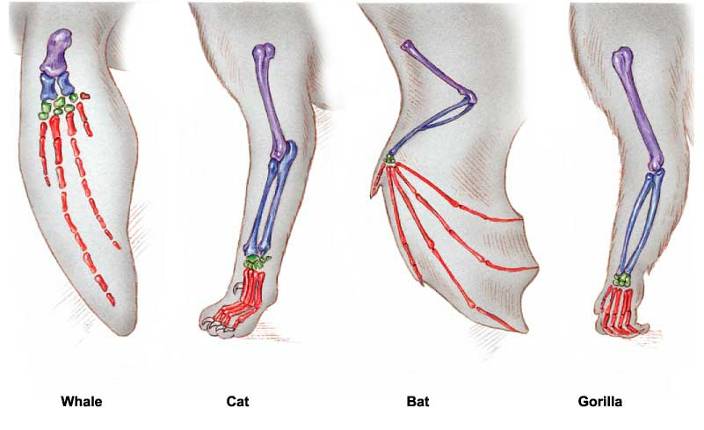
HOMOLOGOUS
structures have different mature forms, but developed from the same embryonic tissue.
Organisms have descended from a common ancestor.

Slide 22
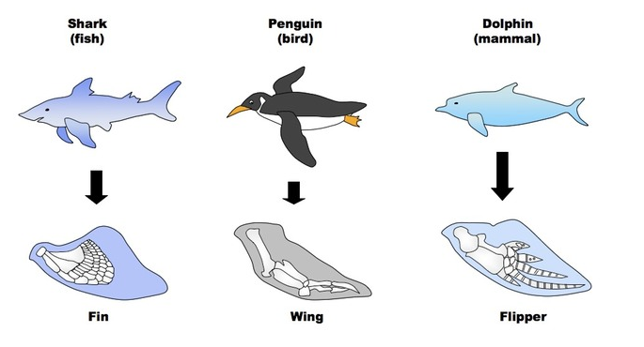
ANALOGOUS
Structures have similar function and superficial appearance, but different anatomy.
Similarities are due to environmental pressures, but do not demonstrate common ancestry.

Slide 23
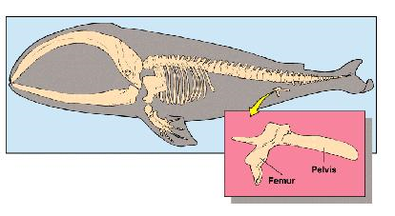
VESTIGIAL
Organs that are reduced in size. They are traces of homologous organs in other species.
Structures have no current function, but can provide information about ancestors.

Slide 24
REVIEW
SAT Vocabulary Four
  Analogy
  Dynamic
  Paradox
  Verdant

Slide 25
SAT VOCABULARY
analogous (adj.) similar to, so that an analogy can be drawn
dynamic (adj.) actively changing; powerful
paradox (n.) an apparently contradictory statement that is perhaps true
verdant (adj.) green in tint or color

