Slide 1
CHEMICAL REACTIONS AND EQUATIONS
A Review

Slide 2
REVIEW
Identify the reactants and products in a chemical reaction
A. There are always two kinds of substances:
1. Reactant - substance that enters into a chemical reaction; substance that reacts.
2. Product - substance produced by a chemical reaction; the substance that is made or produced.
Reactants → Products

Slide 3
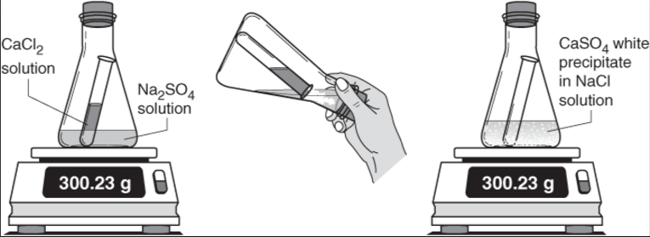
REVIEW
2. Determine how a chemical reaction satisfies the law of conservation of mass.
MATTER CANNOT BE CREATED OR DESTROYED!
CaCl₂ + Na₂SO₄ → CaSO_{4(s)} + 2NaCl

Slide 4
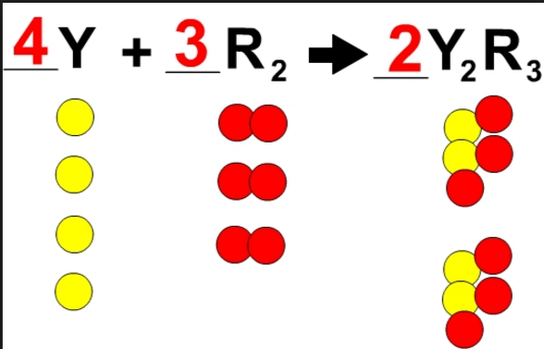
REVIEW
Law of Conservation of Mass

Slide 5
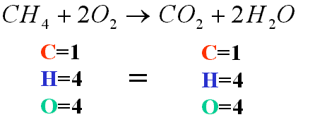
REVIEW
Balance chemical equations.
Rules to follow:
  Change coefficients only.
  Never change a symbol, formula, or subscript.
  Place coefficients in front of the entire chemical formula.

Slide 6
REVIEW
Balance chemical equations.
- If you show your work by counting your atoms and get it wrong, I will give partial credit.
- If you do not show your work and get it wrong, I will NOT give partial credit.

Slide 7
REVIEW
4. Identify the five general types of chemical reactions.
Synthesis + →
Decomposition → +
Single Replacement + → +
Double Replacement + → +
Combustion + O₂ → CO₂ + H₂O

Slide 8
REVIEW
5. Compare and contrast endergonic and exergonic reactions as well as exothermic and endothermic reactions.
Endergonic – energy of products is higher than reactants.
Exergonic – energy of products is lower that reactants.

Slide 9
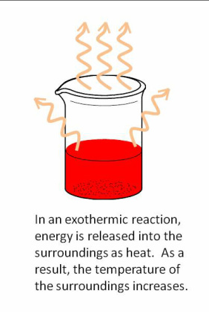
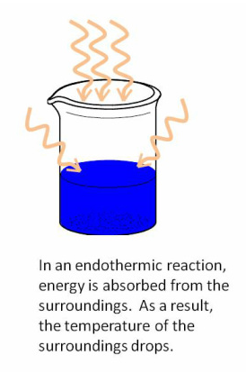
REVIEW
5. Compare and contrast endergonic and exergonic reactions as well as exothermic and endothermic reactions.

Slide 10
REVIEW
6. Examine the effects of catalysts and inhibitors on the speed of chemical reactions.
A catalyst is a substance that speeds up a chemical reaction without being permanently changed itself.
An inhibitor is a substance that slows down a chemical reaction or prevents it from occurring by bonding with a reactant.
Catalysts and inhibitors do not change the amount of reactants used or products formed. They only change the speed of the reaction.

Slide 11
REVIEW
SAT Words – List #8
arboreal (adj.) of or relating to trees
aquatic (adj.) relating to water
potable (adj.) suitable for drinking
conduit (n.) a pipe or channel through which something passes
reservoir a. (n.) reserves, large supply; b. (n.) a body of stored water

