Slide 1
CLASSIFICATION, VIRUSES, AND BACERIA
A Review

Slide 2
REVIEW
CLASSIFICATION
Define: the logical grouping of organisms based on criteria & characteristics of “biological significance.”
TAXONOMY
Define: the branch of science that classifies organisms and names them using “Binomial Nomenclature.”

Slide 3
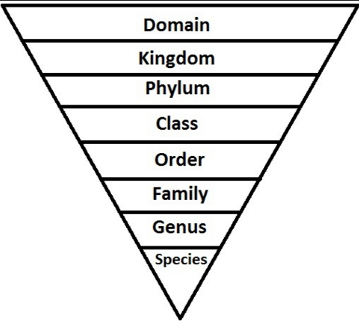
REVIEW
    Broadest, most Inclusive
    Narrowest, most
    Exclusive

Slide 4
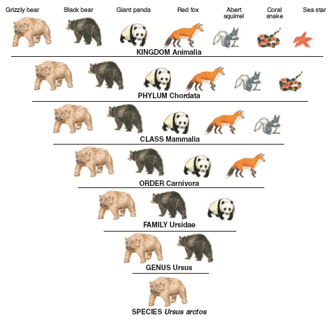
Dear
King
Phillip
Came
Over
From
Great
Spain!

Slide 5
REVIEW
CLASSIFICATION
  c. Carolus Linnaeus
18th century taxonomist
developed a classification system based on physical characteristics
Developed naming system still used today

Slide 6
REVIEW
CLASSIFICATION
  How organisms are divided into taxa
    Physical Characteristics (Linnaeus only)
    Phylogeny
    Genetics
Linnaeus only used physical characteristics to group and name organisms.
Phylogeny- examining how organisms are related to each other based on evolution.
Genetics - Similarities in an organism’s genes can be used to help determine how

Slide 7
REVIEW
CLASSIFICATION
Binomial Nomenclature
  Genus
  Species
  Language used
  Binomial nomenclature is the scientifically accepted naming system using two names.
  Genus - ALWAYS CAPITALIZED!
  species- always lower case!
  Names are Latin – universal language

Slide 8
REVIEW
CLASSIFICATION
Domains - Broadest, most inclusive taxon; there are three
  Archae - unicellular prokaryotes
  Bacteria - unicellular prokaryotes
  Eukarya - more complex and have a nucleus and membrane-bound organelles

Slide 9
REVIEW
Kingdoms

Slide 10
DOMAINS
Domains | ARCHAE
Kingdoms | ARCHAEBACTERIA
Cell Type – Prokaryote or Eukaryote | PROKARYOTE
# of cells – Unicellular or Multicellular or Both | UNICELLULAR
Cell Structure – Cell wall composition | CELL WALL WITH no PEPTIDOGLYCAN
Nutrition – Autotroph or Heterotroph or Both | BOTH

Slide 11
DOMAINS
Domains | BACTERIA
Kingdoms | EUBACTERIA
Cell Type – Prokaryote or Eukaryote | PROKARYOTE
# of cells – Unicellular or Multicellular or Both | UNICELLULAR
Cell Structure – Cell wall composition | CELL WALL WITH PEPTIDOGLYCAN
Nutrition – Autotroph or Heterotroph or Both | BOTH

Slide 12
DOMAINS
Domains | EUKARYA
Kingdoms | PROTIST
Cell Type – Prokaryote or Eukaryote | EUKARYOTE
# of cells – Unicellular or Multicellular or Both | MOSTLY UNICELLULAR
Cell Structure – Cell wall composition | CELL WALL WITH CELLULOSE
Nutrition – Autotroph or Heterotroph or Both | BOTH

Slide 13
DOMAINS
Domains | EUKARYA
Kingdoms | FUNGI
Cell Type – Prokaryote or Eukaryote | EUKARYOTE
# of cells – Unicellular or Multicellular or Both | MULTICELLULAR EXCEPT ONE
Cell Structure – Cell wall composition | CELL WALL CONTAIN CHITIN
Nutrition – Autotroph or Heterotroph or Both | HETEROTROPHS

Slide 14
DOMAINS
Domains | EUKARYA
Kingdoms | PLANT
Cell Type – Prokaryote or Eukaryote | EUKARYOTE
# of cells – Unicellular or Multicellular or Both | MULTICELLULAR
Cell Structure – Cell wall composition | CELL WALL MADE WITH CELLULOSE
Nutrition – Autotroph or Heterotroph or Both | AUTOTROPHS

Slide 15
DOMAINS
Domains | EUKARYA
Kingdoms | ANIMALS
Cell Type – Prokaryote or Eukaryote | EUKARYOTE
# of cells – Unicellular or Multicellular or Both | MULTICELLULAR
Cell Structure – Cell wall composition | NO CELL WALL
Nutrition – Autotroph or Heterotroph or Both | HETEROTROPHS

Slide 16
REVIEW
VIRUS
Define- Viruses are nonliving particles that can only reproduce within a HOST CELL (living cell).
Incapable of reproducing independently.
Do not grow.
Do not have homeostasis.
Do not metabolize.
Can crystallize.

Slide 17
REVIEW
VIRUS
Structure and Function
  Nucleic Acid – DNA or RNA
  Capsid - protein coat surrounding nucleic acid; arrangement determines shape; contains special sites on its protein surface that allow the virus to attach and penetrate the host cell membrane
  Envelope - membrane surrounding the capsid; not found in all viruses; helps the virus enter cells. Made up of proteins, lipids, and glycoproteins.

Slide 18
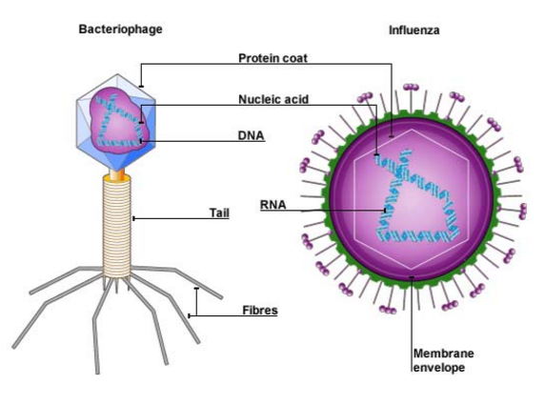
REVIEW
VIRUS
Structure and Function

Slide 19
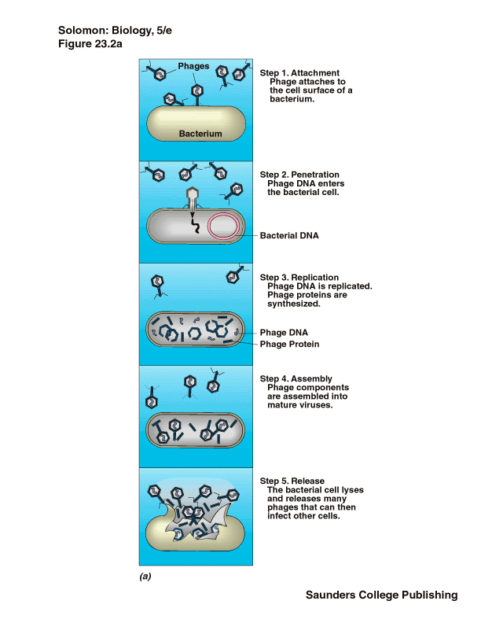
REVIEW
VIRUS
Replication
LYTIC CYCLE
Attach
Entry
Replication
Assembly
Release

Slide 20
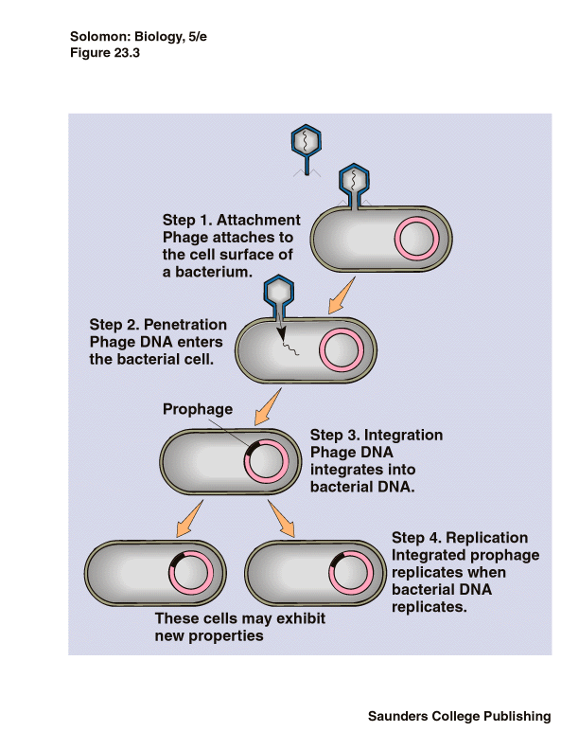
REVIEW
VIRUS
Replication
  Lysogenic Cycle
Attach
Entry
Integration
Replication

Slide 21
REVIEW
VIRUS
Replication
  Know symptoms of organism
treat symptoms or suppress the virus
Your immune system has to kill the virus
Active infection is the Lytic Cycle.
Inactive infection is the Lysogenic Cycle.
Lysogenic can change into the Lytic Cycle.

Slide 22
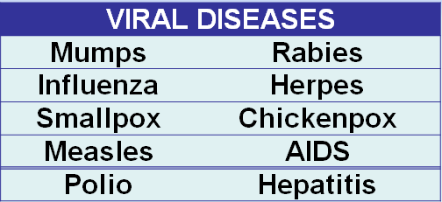
REVIEW
Viral Diseases
  Host specific – many cannot jump to a new species
  Cell specific – can enter only certain cell types in an organism
  Diseases caused
Viruses tend to attack particular species of animals and plants and specific cells in the organism.

Slide 23
REVIEW
VIRUS
Antiviral drugs – treat symptoms or suppress the virus.
Your immune system has to kill the virus.
Vaccine – preparation of weakened or killed virus/viral particle; stimulates immune system to prevent infection by “teaching” it to recognize virus

Slide 24
REVIEW
VIRUS
Oncogenic viruses – cause cancer; genes disrupt cell cycle.
Retrovirus – contains RNA; produces a DNA copy of the viral RNA and inserts viral DNA into host cell.
Prion – protein particle with no nucleic acid; accumulation of proteins in an area and kills cells.
Viroid - small naked single-stranded RNA molecules that cause plant diseases.

Slide 25
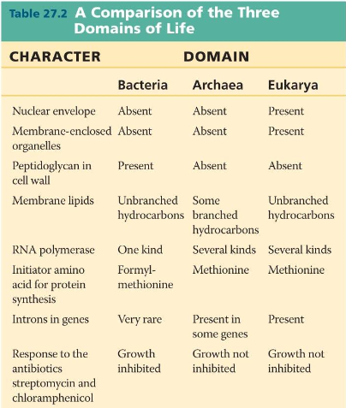
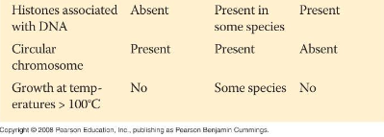
REVIEW
BACTERIA
      Two Domains – Archae and Bacteria

Slide 26
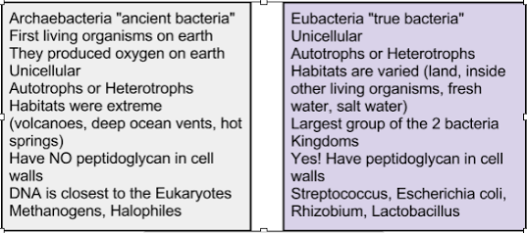
REVIEW
BACTERIA
      Two Kingdoms – Archaebacteria and Eubacteria

Slide 27
REVIEW
BACTERIA
Archaebacteria
Characteristics - Make oxygen; may be ancestors of eukaryotes - DNA sequences of key genes are more like eukaryotes
Types
          Methanogens
          Halophiles
          Thermoacidophiles

Slide 28
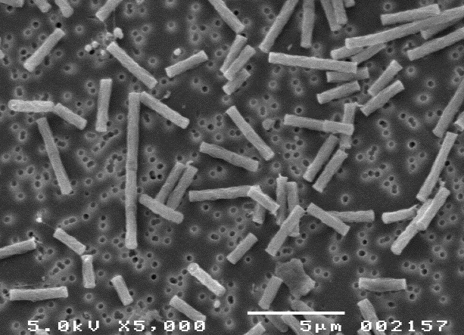
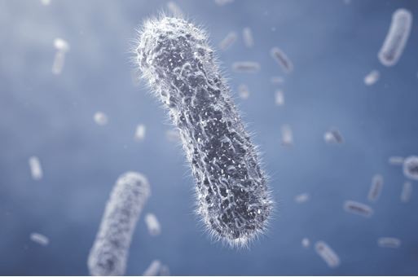
METHANOGENS
All anaerobes (no oxygen)
Produce methane from carbon dioxide
Live in marsh mud, swamps, etc.

Slide 29
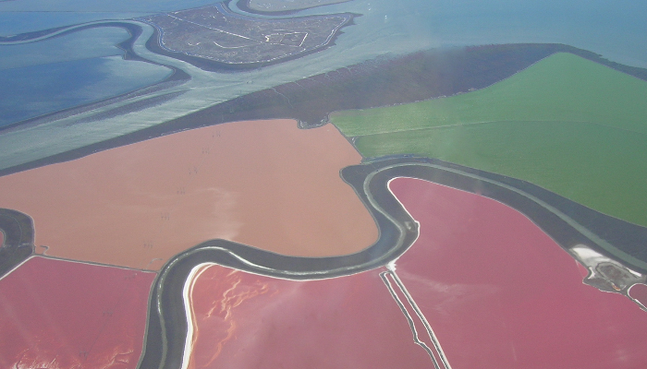
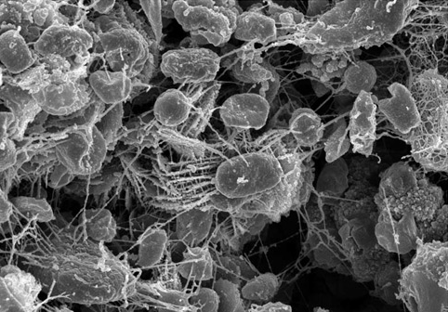
HALOPHILES
Aerobic or anaerobic
Live in extreme salt environments
Require sodium chloride for growth
In the Great Salt Lake in Utah

Slide 30
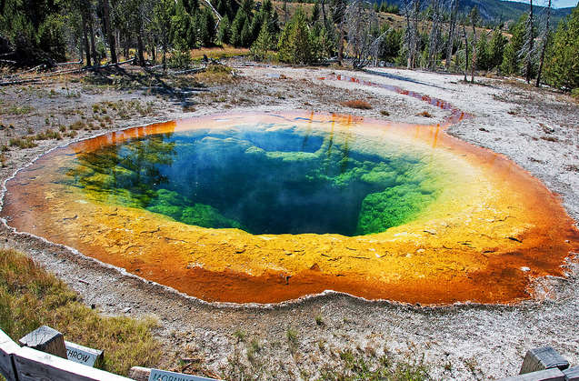
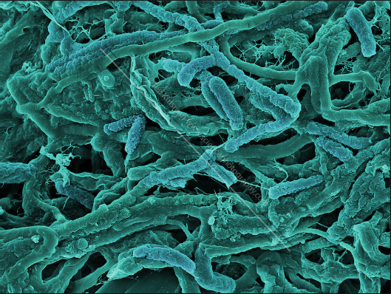
THERMOACIDOPHILES
Aerobic or anaerobic (require sulfur)
live in acidic/hot places; thrives in 41°C to 122°C temperatures
Found in volcanic vents, hot springs
Suggested by some to be some of the earliest bacteria.

Slide 31
REVIEW
Eubacteria
Characteristics – prokaryotes; cells walls with peptidoglycan (sugar & amino acid molecule); can live almost everywhere; cause diseases

Slide 32
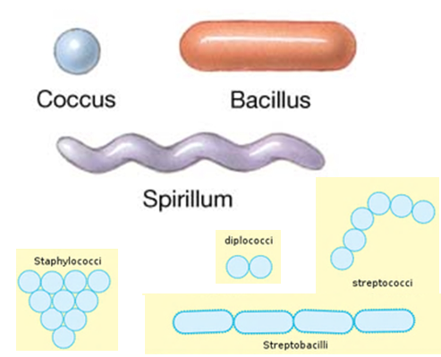
REVIEW
Eubacteria
b. Classifications - Shape and Cell arrangement
1. staphylo, strepto, diplo
2. coccus, bacillus, spirillum

Slide 33
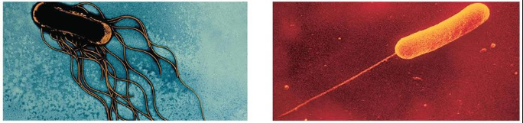
REVIEW
Eubacteria
Movement - flagella and cilia

Slide 34
REVIEW
Nutrition
Heterotroph – finds its food
Autotroph – makes its own food using light
Chemoautotroph – makes its own food using inorganic materials and carbon dioxide

Slide 35
REVIEW
Oxygen Requirements
Obligate anaerobe (can’t survive in O₂)
Obligate aerobes (must have O₂ to survive)
Facultative anaerobe (live with or without O₂)

Slide 36
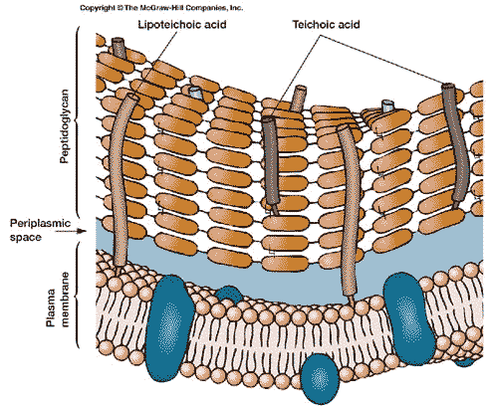
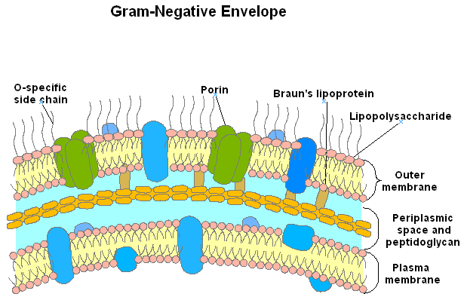
REVIEW
    Gram Stain test
    Gram Positive – PURPLE Gram negative - PINK
    because of a large amount Less peptidoglycan in
    of peptidoglycan in cell wall cell wall

Slide 37
REVIEW
Structure and Function
Flagella – used for movement
Pili - allow bacteria to stick to surfaces
Capsule - sticky protective layer that helps evade immune system and adhere to substances
Cell Wall: outer covering; gives shape and rigidity to the cell; peptidoglycan included.
Cell Membrane: Selectively permeable

Slide 38
REVIEW
Structure and Function
Plasmid: accessory rings of DNA; can be used as vectors to carry foreign DNA into bacteria during genetic engineering procedures; can carry resistant genes
Bacterial chromosome: a single circular piece of DNA.
Ribosome: site of protein synthesis
Endospore: thick internal wall that encloses the DNA; formed so bacteria can remain dormant during harsh environmental conditions.

Slide 39
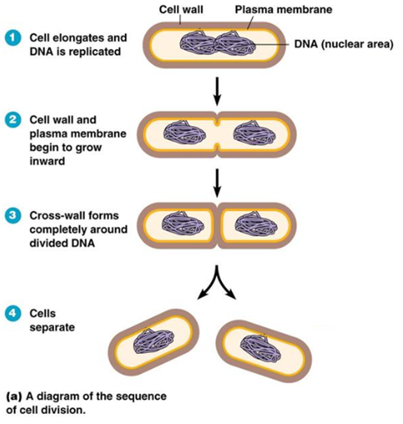
REVIEW
Bacterial Reproduction
Binary Fission
1. Process
2. Asexual or sexual
3. What does it produce?

Slide 40
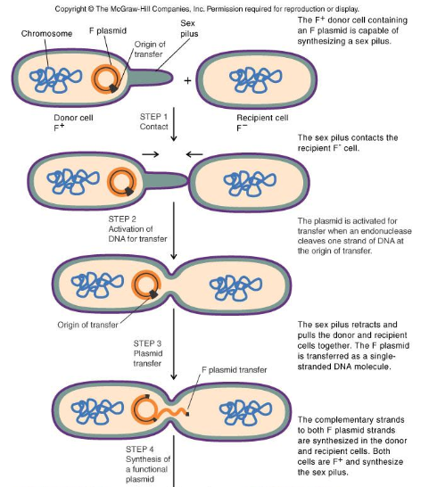

REVIEW
Bacterial Reproduction
Conjugation
1. Process
2. Asexual or sexual
3. What does it produce?

Slide 41
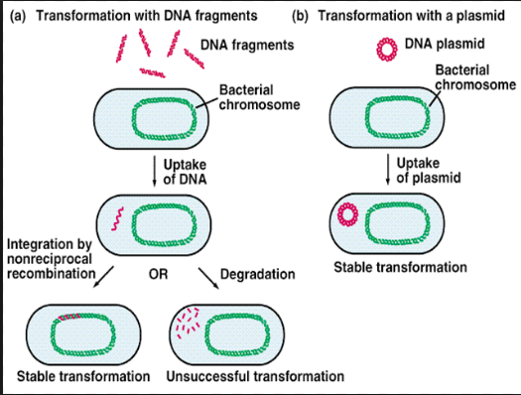
REVIEW
Bacterial Reproduction
Transformation
1. Process 2. Asexual or sexual
3. What does it produce?

Slide 42
REVIEW
Helpful Bacteria
Decomposers – these break down dead matter and recycle nutrients.
Nitrogen Fixation – these convert atmospheric nitrogen into soil nitrogen form.
Denitrification – convert excess soil nitrogen form into atmospheric nitrogen.
Photosynthesis – produces oxygen
Human Uses – food, digest petroleum, remove waste from H₂O, synthesize drugs, bacterial enzymes used in genetic engineering
Mutualistic Relationships – both organisms benefit; ex. bacteria in human colon

Slide 43
REVIEW
  Harmful Bacteria
    Pathogens – cause disease by breaking down tissue or release toxins
    Know some common ones
BACTERIAL DISEASES
Strep throat | Syphilis
Tuberculosis | Lyme disease
Typhoid fever | Pneumonia
Tetanus | Gonorrhea

Slide 44
REVIEW
  Treatment
    Antibiotics – destroy bacterial cells by inhibiting cell wall growth or protein synthesis
    Antibiotic resistance - changes in the DNA of the bacterium or transfer of genes that are resistant to antibiotics:
Vaccine (prevention) – stimulates immune response

Slide 45
REVIEW
  Controlling Bacteria
Sterilization – kill bacteria by heat or chemical action .
Refrigeration – bacteria grows at a slow rate in cold temperatures.
Hand Sanitizer – the alcohol kills bacteria by dissolving the bacteria's cellular membrane which kills the cell.
Canning – kill bacteria by heat when preserving food.

