Slide 1
TO DO
How Scientists Know About Punctuated Equilibrium

Slide 2
REVIEW
CURRENT THEORY
A. Genes
B. Populations
Today’s theory on evolution
Recognizes that GENES are responsible for the inheritance of characteristics.
Recognizes that POPULATIONS, not individuals, evolve due to natural selection and genetic drift.
Recognizes that SPECIATION usually is due to the gradual accumulation of small genetic changes.

Slide 3
REVIEW
CURRENT THEORY
C. Vocabulary
  Population / Species / Speciation / Gene Pool
Population - a localized group of individuals of the same species.
Species - a group of populations whose individuals have the ability to breed and produce fertile offspring.
Speciation - Formation of a new group of organisms that can reproduce fertile offspring.
Gene Pool - all of the alleles of all individuals in a population.

Slide 4
REVIEW
PROCESS OF EVOLUTION
A. Microevolution (define)
MICROEVOLUTION refers to evolution that occurs within a population.

Slide 5
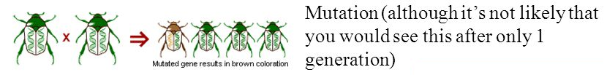
REVIEW
PROCESS OF EVOLUTION
A. Mechanisms of Evolution (define)
Mechanisms of evolution – mechanisms of evolution lead to changes in allele frequencies!
a. Genetic Mutations
A mutation is an error in the replication of a nucleotide sequence provides the genetic variation that evolution acts on.
Some “green genes” randomly mutated to “brown genes” (mutations alone cannot account for a big change in allele frequency).
Mutations can be transmitted in gametes to offspring, and immediately affect the composition of the gene pool.

Slide 6
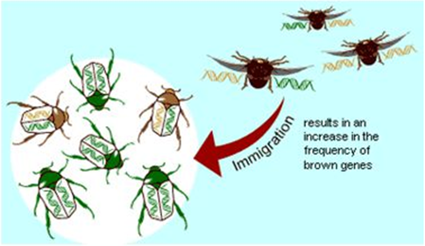
REVIEW
PROCESS OF EVOLUTION
B. Mechanisms of Evolution
b. Gene Flow
Genes from one population are incorporated into a different population.
Some beetles with brown genes immigrated from another population or some beetles carrying green genes emigrated.

Slide 7
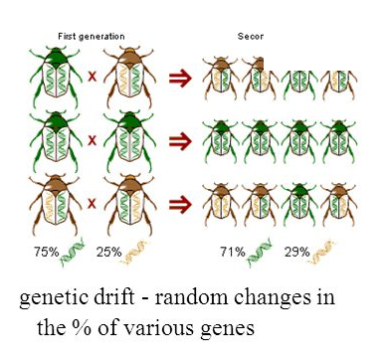
REVIEW
PROCESS OF EVOLUTION
B. Mechanisms of Evolution
c. Genetic Drift
Genetic drift = the alteration of the gene pool of a small population due to chance.
It is random changes in the frequency of alleles within a population.

Slide 8
REVIEW
PROCESS OF EVOLUTION
B. Mechanisms of Evolution
d. Natural Selection
Differential success in reproduction based on heritable traits results in selected alleles being passed to relatively more offspring (Darwinian inheritance).
The only agent that results in adaptation to environment.
Beetles with brown genes escaped predation and survived to reproduce more frequently than beetles with green genes, so that more brown genes were passed to the next generation.

Slide 9
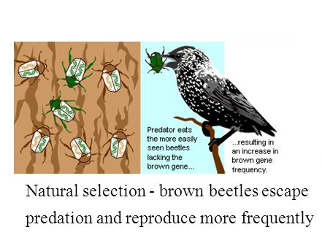
NATURAL SELECTION

Slide 10
REVIEW
PATTERN OF EVOLUTION
A. Divergent Evolution
  Define
  End result
  Recognize examples
Divergent evolution is the process of two or more related species becoming more and more dissimilar.
Organisms, who share a common ancestry, have evolved into different organisms.
They diverge because they are adapted by different environments.
Over millions of years, related species become dissimilar as they adjust to their environment.

Slide 11
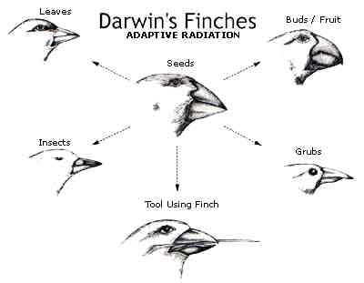
DIVERGENT EVOLUTION
Darwin’s finches went through adaptive radiation - process by which ancestral species evolve into a number of different species.

Slide 12
REVIEW
PATTERN OF EVOLUTION
B. Convergent Evolution
  Define
  End result
  Recognize examples
Convergent evolution is the emergence of biological structures or species that exhibit similar function and appearance but that evolved through widely different evolutionary pathways.
result of geographic isolation and niches to be filled.
process by which different species evolve similar structures or adaptations to similar (but different) environments.

Slide 13
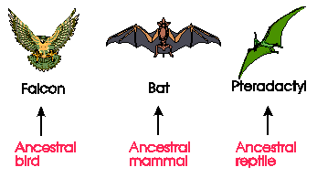
CONVERGENT EVOLUTION
The similarities evolved due to exposure to similar environmental pressures.

Slide 14
REVIEW
PATTERN OF EVOLUTION
C. Co-Evolution
  Define
  End result
  Recognize examples
Co-Evolution is the joint change of two or more species in close interaction.
Example - Bumblebees and the flowers they pollinate have coevolved so that both have become dependent on each other for survival.
When two different organisms change in response to each other

Slide 15

REVIEW
MACROEVOLUTION (define)
Macroevolution is evolution on a scale of separated gene pools.
Is it large scales evolutionary change.

Slide 16
REVIEW
      A. Speciation
        Define - Formation of a new species (group of organisms that can reproduce fertile offspring)
        End result - produces a NEW species
        Mechanisms
          a. Geographic Isolation
            example
          b. Temporal Isolation
            example
          c. Behavioral isolation
            example

Slide 17
REVIEW
a. Geographic Isolation
Separated by bodies of water or mountains.
b. Temporal Isolation
Reproduction takes place at different times of the year
c. Behavioral Isolation
Populations are capable of interbreeding, but have different courtship rituals or other type of behavior.

Slide 18
REVIEW
RATES OF EVOLUTION
Gradualism
  Define
  End result
  Recognize examples
Gradualism – organisms descend from a common ancestor slowly over a long period of time.
Very gradually, over a long time, the population changes. Change is slow, constant, and consistent.

Slide 19
REVIEW
RATES OF EVOLUTION
Punctuated Equilibrium
  Define
  End result
  Recognize examples
Punctuated Equilibrium – new species appear suddenly after long periods of little change.
In punctuated equilibrium, change comes in spurts. There is a period of very little change, and then one or a few huge changes occur, often through mutations in the genes of a few individuals.

