Slide 1
REVIEW
Genetics and Heredity

Slide 2
REVIEW
MENDELIAN GENETICS
Gregor Mendel
  Who was he?
  What did he do?
  What plant did he use?

Slide 3
GREGOR MENDEL
Austrian Monk.
Experimented with pea plants.
Used pea plants because:
  They were available.
  They reproduced quickly.
  They showed obvious differences in the traits.
Understood that there was something that carried traits from one generation to the next - “FACTOR”.

Slide 4
REVIEW
MENDELIAN GENETICS
Typical Breeding Experiment
  Parent Generation, P
  First Generation, F1
  Second Generation, F2

Slide 5
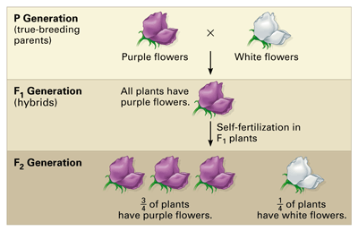
For each monohybrid cross, Mendel cross-fertilized true-breeding plants that were different in just one character—in this case, flower color. He then allowed the hybrids (the F1 generation) to self-fertilize.

Slide 6
REVIEW
MENDELIAN GENETICS
Vocabulary
  Gene, Allele
  Homozygous, Heterozygous
  Dominant, Recessive
  Genotype, Phenotype
  Punnett Square
  Locus

Slide 7
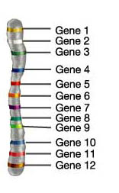
VOCABULARY
Gene - segment of DNA that codes for a protein
Allele – alternate forms of a gene; the different forms of a characteristic.
Homozygous- having two of the same allele, AA or aa; true breeding or pure breed.
Heterozygous- two different alleles, Aa; hybrid.

Slide 8
VOCABULARY
Dominant - allele that is expressed.
Recessive – allele that is hidden.
Dominant alleles are capital letters; recessive are lowercase; use the same letter.
Genotype - the organism’s alleles.
Phenotype – the physical appearance.
Punnett Square- shows how crosses are made.
Locus – spot on the chromosome where an allele (gene) is located.

Slide 9
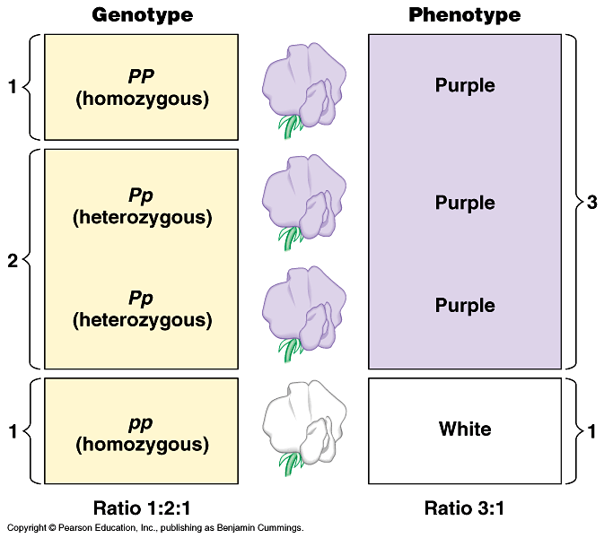
GENOTYPE VERSUS PHENOTYPE
How does a genotype ratio differ from the phenotype ratio?

Slide 10
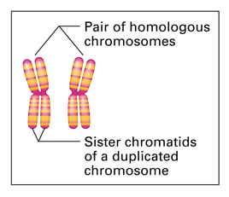
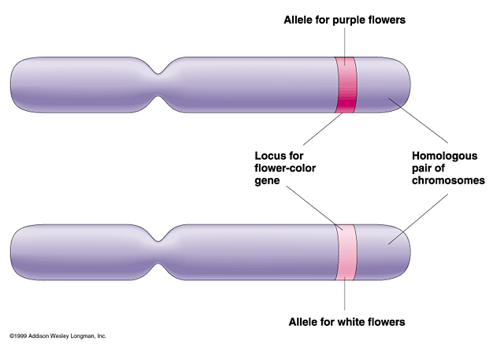
CHROMOSOMES
Homologous chromosome: one of a matching pair of chromosomes, one inherited from each parent.
Sister chromatids are identical

Slide 11
REVIEW
MENDELIAN GENETICS
Test Cross
  Why is it needed
  What genotypes are used in the cross.

Slide 12
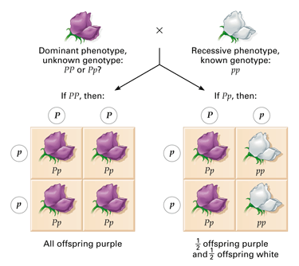
TEST CROSS
is designed to reveal whether an organism that displays the dominant phenotype is homozygous or heterozygous for that trait.

Slide 13
REVIEW
MENDELIAN GENETICS
Punnett Square
  Be able to use it correctly
  Monohybrid
    Know typical crosses and ratios
  Dihybrid
    Know typical crosses and ratios

Slide 14
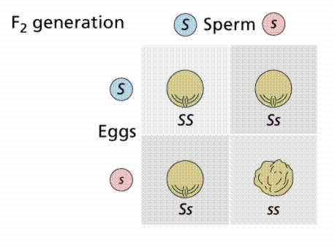
PUNNETT SQUARE
probability diagram illustrating the possible offspring of a mating.
Ss X Ss
gametes

Slide 15
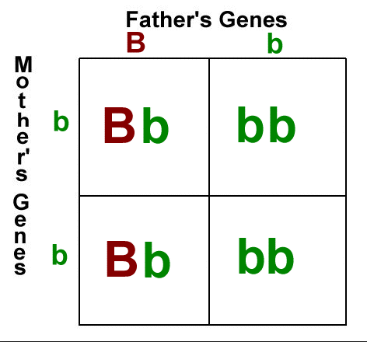
PUNNETT SQUARE
Mother: bb
Father: Bb

Slide 16
DIHYBRID CROSS
Dihybrid cross is a cross between two pure lines (varieties, strains) that differ in two observed traits.
A genetic cross yielding a 9:3:3:1 ratio of offspring.
In Mendelian sense, between the alleles of both these loci, there is a relationship of complete dominance - recessive

Slide 17
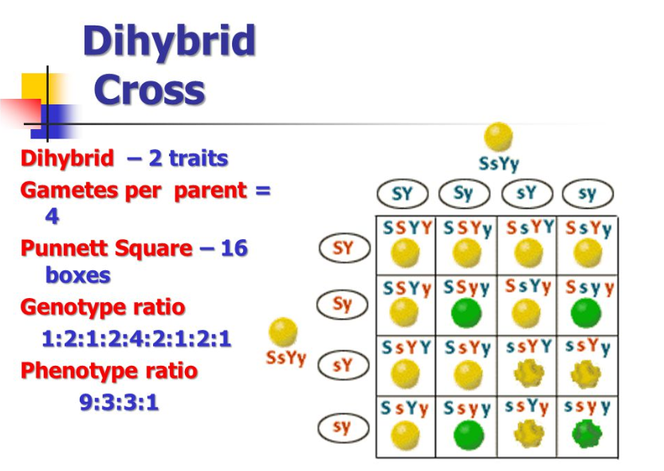

Slide 18
REVIEW
MENDELIAN GENETICS
Law of Dominance
Law of Segregation
Law of Independent Assortment
Linkage Groups

Slide 19
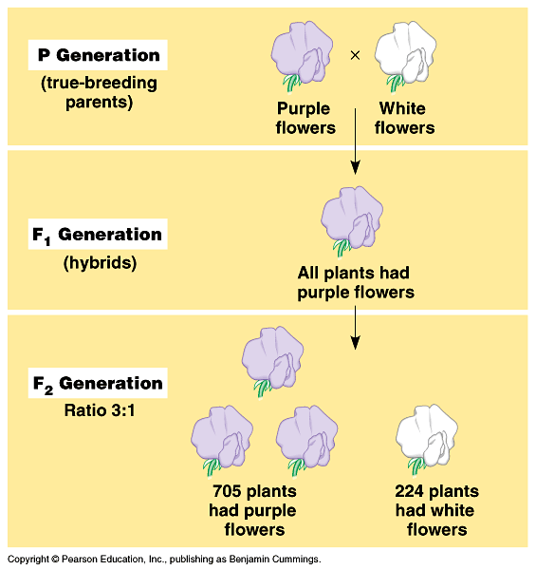
LAW OF DOMINANCE
One trait is covered up by another trait.
In the monohybrid cross (mating of two organisms that differ in only one character), one version disappeared.
What happens when the F1’s are crossed?

Slide 20
LAW OF DOMINANCE
The F1 crossed produced the F2 generation and the lost trait appeared with predictable ratios.
This led to the formulation of the current model of inheritance.

Slide 21
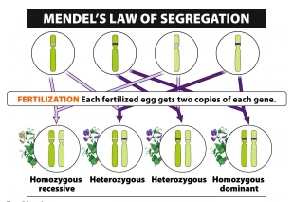
LAW OF SEGREGATION
Two alleles separate during gamete formation.

Slide 22
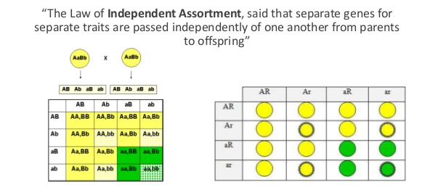
LAW OF INDEPENDENT ASSORTMENT
Each pair of alleles segregates independently of other pairs of alleles.

Slide 23
LINKAGE GROUPS
These genes are close together and will inherit together.
In actuality, many genes that are located on the same chromosome so they do not assort independently.
Instead they are inherited together.
The closer your loci are, the more likely they are to be inherited together.
Independent assortment/linked genes

Slide 24
REVIEW
PATTERNS OF INHERITANCE
Co-dominance
  What is it?
  How do you recognize it?
  What is the cross?

Slide 25
CO-DOMINANCE
Co-” means “together”.
the "recessive" & "dominant" traits appear together in the phenotype of hybrid organisms.
They are NOT blended but both appear.
Both alleles are expressed in the heterozygote!

Slide 26
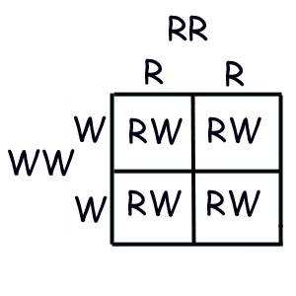
CO-DOMINANCE
Example:
Red cows crossed with white cows will generate roan cows. Roan refers to cows that have red coats with white blotches.
RR = red, WW = white, RW = red & white (roan)
Section D #1-3

Slide 27
REVIEW
PATTERNS OF INHERITANCE
Incomplete Dominance
  What is it?
  How do you recognize it?
  What is the cross?

Slide 28
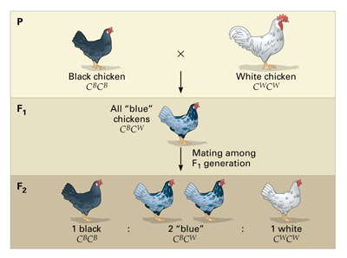
INCOMPLETE DOMINANCE
a cross between organisms with two different phenotypes produces offspring with a 3rd phenotype that is a blending of the parental traits.
Neither allele is dominant.
A BLENDING!

Slide 29
INCOMPLETE DOMINANCE
Example: In snapdragons, flower color can be red, pink, or white. The heterozygous condition results in pink flowers.
RR = red
RW = pink
WW = white
Section D #4-6

Slide 30
CO-DOMINANCE VERSUS INCOMPLETE DOMINANCE
Are the offspring showing a third phenotype? In other words, The parents each have one, and the offspring are different from the parents.
Is it a blending of the traits? incomplete dominance
or are both traits showing equally? co-dominance

Slide 31
REVIEW
PATTERNS OF INHERITANCE
Sex-Linked
  What is it?
  How do you recognize it?
  What are the possible crosses?
  Know the disorders
    Duchenne Muscular Dystrophy
    Hemophilia
    Color Blindness

Slide 32
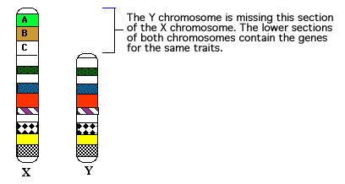
SEX-LINKED
If a gene is found only on the X chromosome and not the Y chromosome, it is said to be a sex-linked trait.
Because the gene controlling the trait is located on the sex chromosome, sex linkage is linked to the gender of the individual.
The result is that females will have two copies of the sex-linked gene while males will only have one copy of this gene.

Slide 33
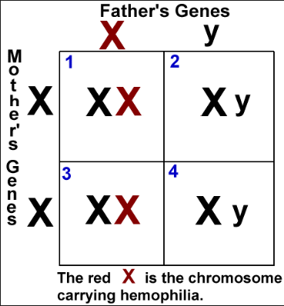
SEX-LINKED
In humans, male patterned baldness, hemophilia, Duchenne Muscular Dystrophy, and color blindness are sex-linked traits.

Slide 34
REVIEW
PATTERNS OF INHERITANCE
Multiple Alleles
  What is it?
  How do you recognize it?
  Example – Blood Type

Slide 35
MULTIPLE ALLELES
If there are FOUR or more possible phenotypes for a particular trait, then more than two alleles for that trait must exist in the population. We call this MULTIPLE ALLELES.
REMEMBER: There may be multiple alleles within the population, but individuals have only two of those alleles.
An excellent example of multiple allele inheritance is human blood type. Blood type exists as four possible phenotypes: A, B, AB, & O.

Slide 36
MULTIPLE ALLELES
Blood type is controlled by three alleles:
  A - dominant
  B - dominant
  o – recessive
  There are six different genotypes and 4 different phenotypes for blood type.
Genotype | Phenotype
oo (IºIº) | Type O
Ao (I^{A}Iº) | Type A
AA (I^{A}I^{A}) | Type A
Bo (I^{B}I^{O}) | Type B
BB (I^{B}I^{B}) | Type B
AB (I^{A}I^{B}) | Type AB

Slide 37
REVIEW
PATTERNS OF INHERITANCE
Polygenic Traits
  What is it?
  How do you recognize it?
  Examples: skin color, hair, eye color

Slide 38
POLYGENIC TRAITS
Another exception to Mendel’s rules is polygenic inheritance.
occurs when a trait is controlled by groups of several genes.
This means that each dominant allele "adds" to the expression of the next dominant allele.
Examples: Height (at least three genes with six alleles); skin color; hair color; eye color.

Slide 39
REVIEW
PATTERNS OF INHERITANCE
Lethal Genes
  What is it?
  How do you recognize it?
  Example – homozygous recessive coat color for guinea pigs; spinning in mice

Slide 40
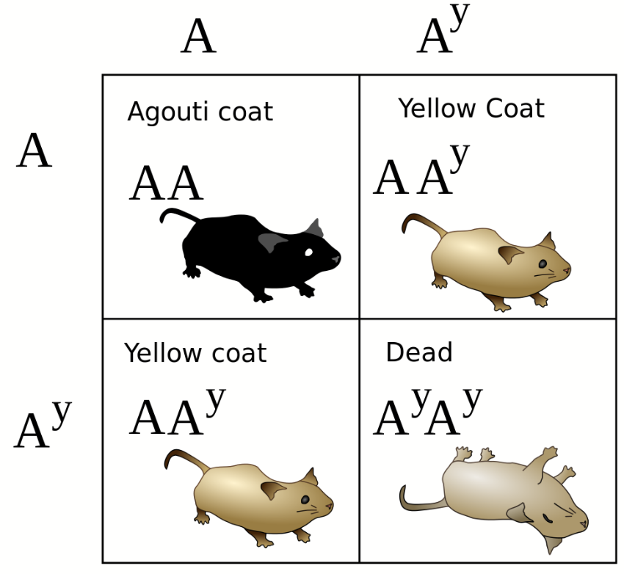
LETHAL GENES
Alleles that are lethal (cause an organism to die) only when present in homozygous condition are called lethal alleles.
The gene involved is considered an essential gene.

Slide 41
REVIEW
PATTERNS OF INHERITANCE
Pedigree
  What is it?
  What are the symbols used?

Slide 42
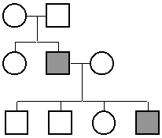
PEDIGREE
A pedigree is a diagram of family relationships that represents genetic relationships.
Pedigrees are often used to determine the inheritance of genetic diseases or traits.
Female
Male
Indicates a marriage
VIDEO: Pedigrees and Genetic Disorders

Slide 43
PEDIGREE
Fully shaded = has disease/disorder/trait
Half shaded = Carrier
No shading = no disease/disorder/trait
No disease
Has disease

Slide 44
REVIEW
PATTERNS OF INHERITANCE
Pedigree
  Examples – Autosomal Recessive
    PKU
    Cystic Fibrosis
    Tay-Sachs
    Sickle Cell

Slide 45
RECESSIVE TRAIT DISORDERS
Phenylketonuria (PKU)
PKU is caused by a defect in the gene that helps create the enzyme needed to break down phenylalanine. The person lacks the enzyme for normal metabolism. Phenylalanine builds up and causes brain damage. Changes in diet lead to normal life.
Babies in the United States and many other countries are screened for PKU soon after birth. Recognizing PKU right away can help prevent major health problems.

Slide 46
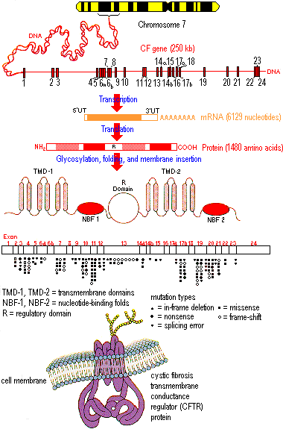
RECESSIVE TRAIT DISORDERS
Cystic fibrosis, which strikes one out of every 2,500 whites of European descent but is much rarer in other groups. One out of 25 Caucasians (4% ) is a carrier.
The normal allele for this gene codes for a membrane protein that functions in chloride ion transport between certain cells and the extracellular fluid. These chloride channels are defective or absent.
The result is an abnormally high concentration of extracellular chloride, which causes the mucus that coats certain cells to become thicker and stickier than normal which makes breathing difficult.

Slide 47
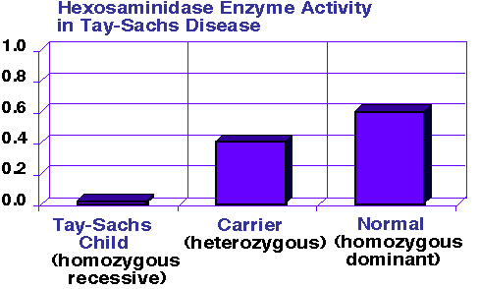
RECESSIVE TRAIT DISORDERS
Tay-Sachs disease is caused by a dysfunctional enzyme that fails to break down brain lipids of a certain class. Fat accumulates in brain destroying tissue and results in severe impairment and death. There is a proportionately high incidence of Tay-Sachs disease among Ashkenazic Jews, Jewish people whose ancestors lived in central Europe.

Slide 48
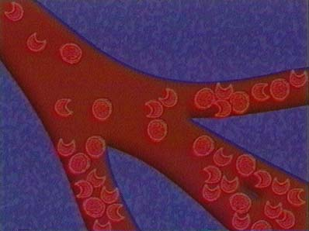
RECESSIVE TRAIT DISORDERS
Sickle-cell disease affects one out of 400 African Americans. Sickle-cell disease is caused by the substitution of a single amino acid in the hemoglobin protein of red blood cells and causes blood to be sickle shaped. This affects oxygen flow to the organs. Heterozygotes are resistant to malaria.

Slide 49
REVIEW
PATTERNS OF INHERITANCE
Pedigree
  Examples – Autosomal Dominant
    Huntington’s
    Achondroplasia

Slide 50
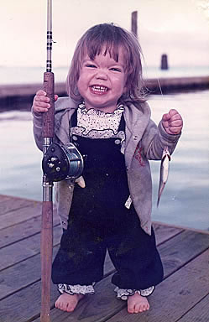
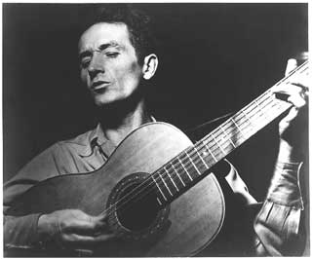
DOMINANT TRAIT DISORDERS
Huntington’s disease, a degenerative neurological disorder, is caused by a lethal dominant allele that has no obvious phenotypic effect until the individual is about 35 to 45 years old. Then there is progressive degeneration of the brain that leads to death at a early age.
Achondroplasia is a common form of dwarfism with an incidence of one case among every 10,000 people. Individuals have short arms and legs, and a normal torso. Heterozygous individuals have the dwarf phenotype. Homozygotes (AA) do not survive; it is a lethal gene.

Slide 51
SAT VOCABULARY
Attribute (v) to credit, assign (n) a facet or trait
Permeate (v) to spread throughout, saturate
Transmute (v) to change or alter in form
Reciprocate (v) to give in return

