Slide 1
MIDTERM REVIEW
Honors Biology

Slide 2
CELL UNIT
UNIT 1: CELLULAR STRUCTURES
SB1: Students will analyze the nature of relationships between structures and functions in living cells.
Explain the role of cell organelles for both prokaryotic and eukaryotic cells, including the cell membrane, in maintaining homeostasis and cell reproduction.
Explain how enzymes function as catalysts.
Identify the function of the four macromolecules.
Explain the impact of water on life processes.
SB3: Students will derive the relationship between single-celled and multi-celled organisms and the increasing complexity of systems.
Explain the cycling of energy through the process of photosynthesis and respiration.

Slide 3
CELL UNIT
Scientific Method –
1. What is a control group? What is its purpose?
2. What is the dependent variable?
3. What is the independent variable?
4. Define hypothesis.

Slide 4
CELL UNIT
5. You are conducting an experiment to determine if increased ultraviolet radiation from the decrease in the ozone layer is killing off frog tadpoles. Group one involves 100 tadpoles in a five gallon container of water that is covered by glass, which filters out the ultraviolet radiation. Group two will be set up exactly like group 1, except it isn’t covered with anything to filter out the ultraviolet radiation. You then place the groups outside for a period of a month, and observe the results. Identify the following:
control group = ____________________
independent variable = ____________________
dependent variable = _______________________

Slide 5
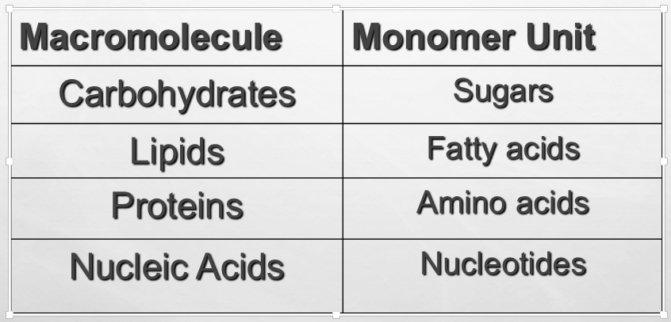
CELL UNIT

Slide 6
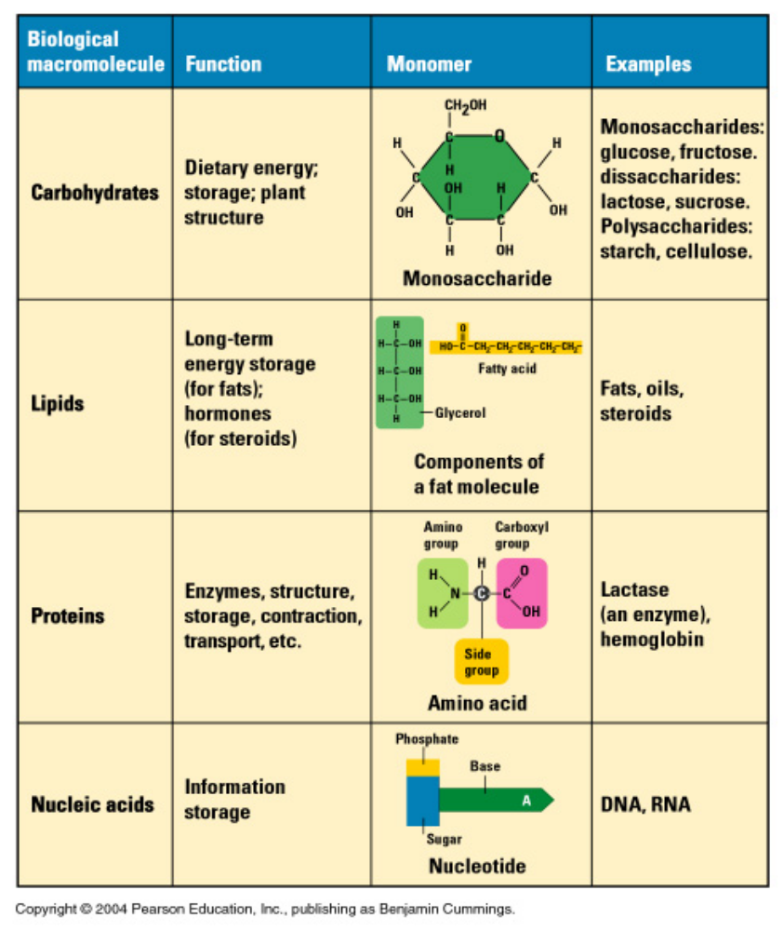
CELL UNIT

Slide 7
CELL UNIT
Identify the function of these polysaccharides.
    Cellulose – plant cell wall component, indigestible
    Starch – energy storage in plants
    Glycogen – energy storage in animals

Slide 8


CELL UNIT
What is the name of the bond between the monomer called?

Slide 9
CELL UNIT
Enzymes control the rate of chemical reactions by weakening bonds, thus lowering the amount of activation energy needed for the reaction.
The nature and arrangement of amino acids in the active site make it specific for only one type of substrate.

Slide 10
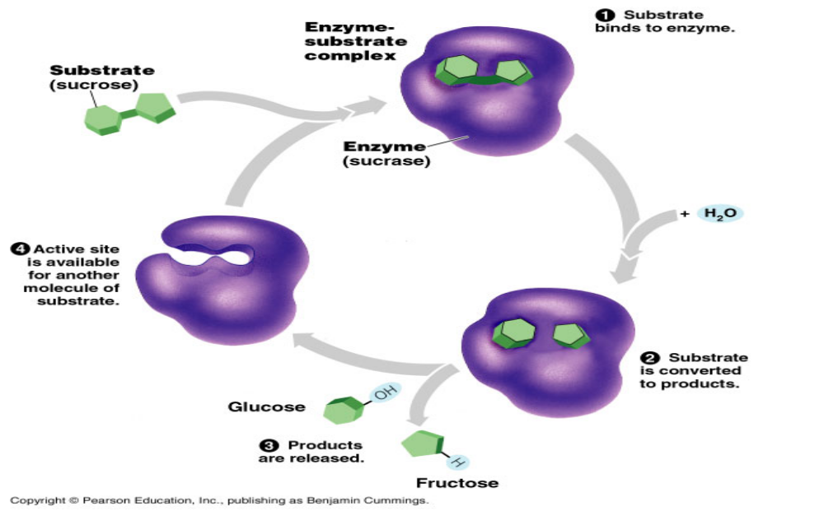
CELL UNIT

Slide 11
CELL UNIT
Enzymes work consistently until they become denatured.
When enzymes denature, they are no longer active and cannot function.
Extreme temperature and the wrong levels of pH can cause enzymes to become denatured.

Slide 12
CELL UNIT
How do enzymes affect the rate of a reaction?
How do enzymes affect the activation energy?
When an enzyme binds to a substrate, which substance is changed in the reaction? Which substance stays the same?
What is the name of the area on the enzyme where the enzyme attaches?
Enzymes are reusable. What does this mean?
Enzymes are highly selective. What does this mean?
What does denature mean? What environmental factors can denature an enzyme?

Slide 13
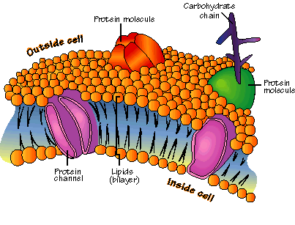
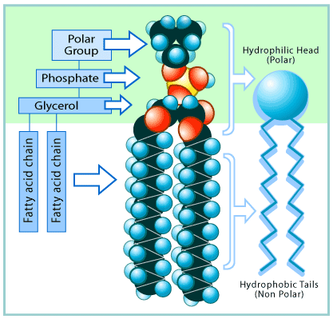
CELL UNIT
Plasma Membrane
Responsible for regulating materials that enter and exit the cell.
Fluid Mosaic model
Composed of
  Phospholipids
  Proteins – different types
  Cholesterol

Slide 14
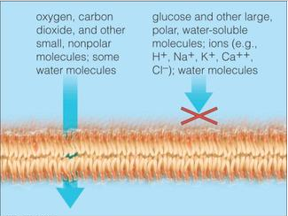
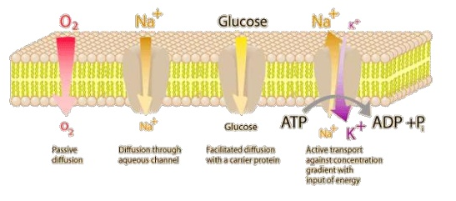
CELL UNIT
Selective Permeability
membrane’s ability to allow SOME molecules through and others out.
  Nonpolar versus polar molecules
  Large molecules pass through how?

Slide 15
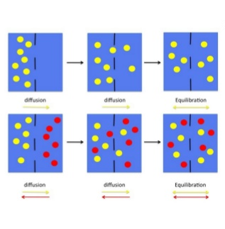
CELL UNIT
Equilibrium
When dynamic equilibrium is reached, the same amount of molecules will move into and out of the cell.
The rate depends on size of particle, temperature, composition of solution.
There is a concentration gradient

Slide 16
CELL UNIT
Passive Transport
Active Transport
Doesn’t require energy.
Solutes diffuse through a channel inside the protein’s interior.
Net movement is down concentration gradient (from high concentration to low concentration)
Diffusion, facilitate diffusion, osmosis
Requires ATP
Protein is an ATPase pump
Pumps solute against its concentration gradient (from low to high)
Endocytosis, Exocytosis, membrane transport proteins

Slide 17
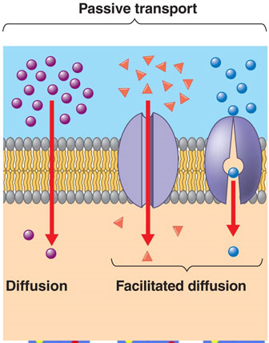
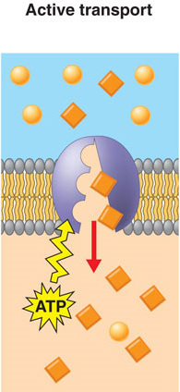
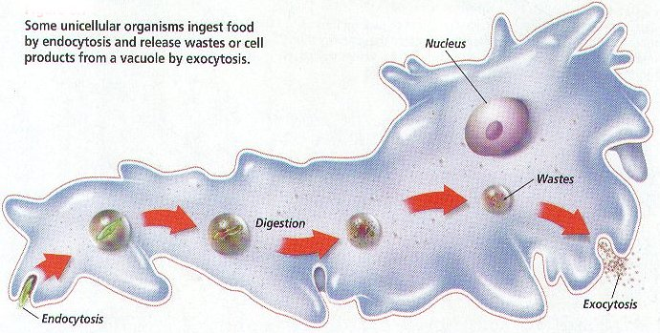
CELL UNIT

Slide 18
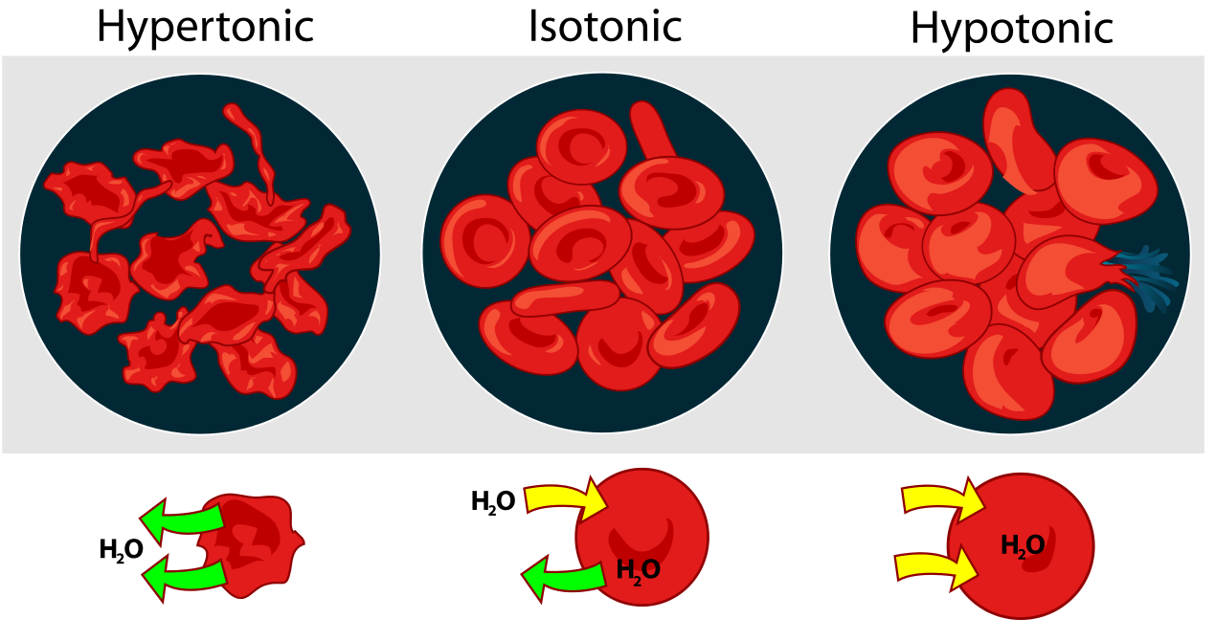
CELL UNIT
The concentration of water on each side of the membrane is determined by the concentration of solutes in solution.
Isotonic solution: concentration of solutes outside the cell is the same as the concentration inside the cell.
Hypertonic solution: the concentration of solute molecules is higher outside than inside the cell.
Hypotonic solution: the concentration of the solute molecules is lower outside the cell than inside the cell.

Slide 19
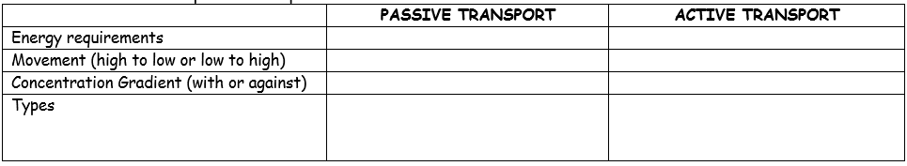
CELL UNIT
Why is the cell membrane considered selectively permeable? What is the cell membrane composed of?
Compare and contrast active and passive transport.

Slide 20
CELL UNIT
5. Identify the following types of transport: osmosis, facilitated diffusion, diffusion, endocytosis, exocytosis, membrane pumps
____________________ is the movement of water from an area of high to low concentration.
____________________ is the movement of particles from an area of high to low concentration.
____________________ is the movement of materials through a membrane channel requiring the use of energy.
____________________ is movement of particles with the assistance of protein channels from an area of high to low concentration.
____________________ is the movement of materials to the outside of the cell using energy.
____________________ is the movement of materials to the inside of the cell using energy.

Slide 21
CELL UNIT
There are 3 types of solutions – isotonic, hypertonic and hypotonic. Identify the solutions.
concentration of solute outside and inside the cell are equal ___________
concentration of solute is higher outside than inside the cell ____________
concentration of solute is lower outside than inside the cell ____________
water moves out of cell _______________
water moves in the cell ______________
no net movement of water ______________
causes the cell to shrink ________________
causes the cell to swell _________________
preferred solution for plant cells ___________________
preferred solution for animal cells ___________________

Slide 22
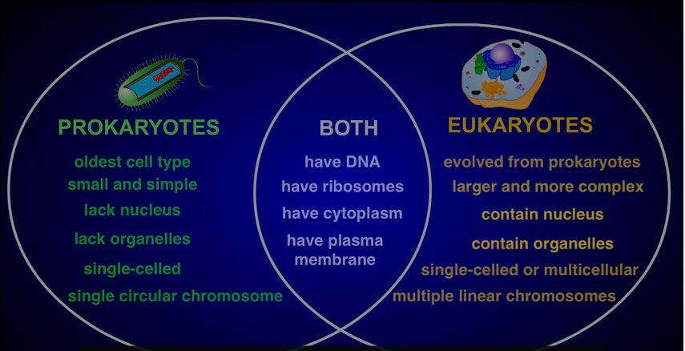
CELL UNIT

Slide 23
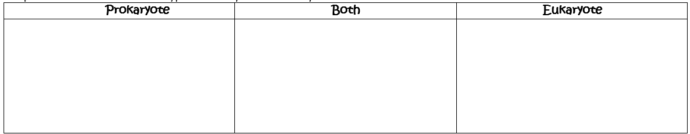
CELL UNIT
Compare and contrast the two cell types -- Prokaryotes and Eukaryotes.

Slide 24
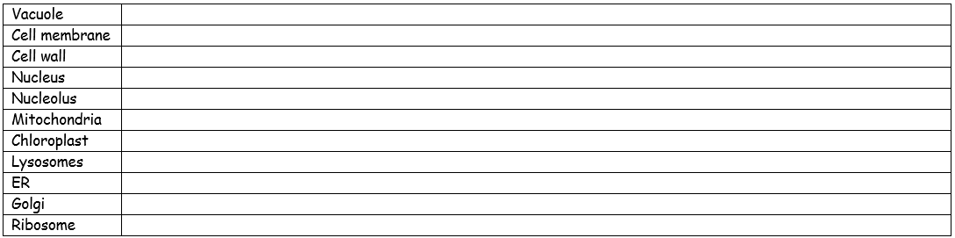
CELL UNIT
Identify the function of the following organelles.

Slide 25
CELL UNIT
Vacuole: Saclike structures (vesicle) that store amino acids, sugars, metabolic and toxic waste; stores water absorbed by the cell
Cell Membrane: Serves as a barrier between the cell and its environment. Controls the movement of materials in and out of the cell to maintain homeostasis.
Cell Wall: Thick, inflexible outer layer surrounding the cell membrane that provides support and protection.

Slide 26
CELL UNIT
Nucleus: Stores the genetic information in DNA.
Nucleolus: Non-membrane structure located in nucleus where ribosomes are produced.
Mitochondria: Site of aerobic cellular respiration - Uses energy from food to make ATP (adenosine triphosphate) that the cell can use to grow, develop and move; has own DNA and can self replicate

Slide 27
CELL UNIT
Chloroplast: Plastid only found in plants and algae; site of photosynthesis - transforming sunlight energy directly into food; contains green pigment called chlorophyll; has own DNA & can self replicate
Lysosome: Vesicle containing digestive enzymes that break down and recycle organic compounds. Stomach of the cell; destroys cell parts, the entire cell or pathogens
Endoplasmic Reticulum: Membrane system of channels and flatten sacs that is continuous with the nuclear membrane and extends through cytoplasm. Aids protein synthesis and transport of materials .

Slide 28
CELL UNIT
Golgi Apparatus: Flattened sacs that contain enzymes for modification of proteins produced in rough ER then packages proteins inside transport vesicles and sends them to their destination .
Ribosomes: Non-membrane structures that are attached to the Rough ER or free in the cytoplasm and synthesizes proteins.

Slide 29
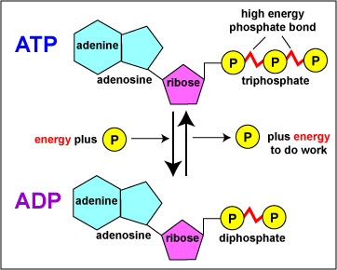
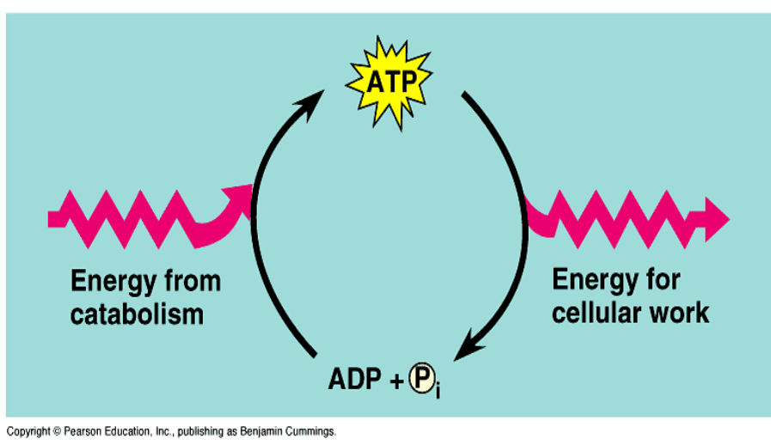
CELL UNIT

Slide 30
CELL UNIT
PHOTOSYNTHESIS
Anabolic (small molecules combined)
Endergonic (stores energy)
Carbon dioxide (CO₂) requiring process that uses light energy (photons) and water (H₂O) to produce organic macromolecules (glucose).

Slide 31
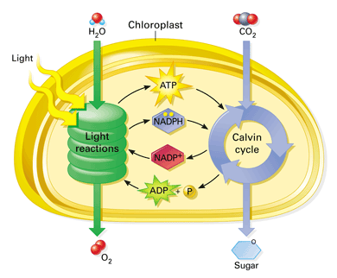
PHOTOSYNTHESIS OVERVIEW
CELL UNIT

Slide 32
CHLOROPLAST
CELL UNIT
Thylakoid Membrane – where Light reactions occur
STROMA– where Calvin Cycle occurs
Outer Membrane
Thylakoid
Granum
Inner Membrane

Slide 33
TWO PARTS OF PHOTOSYNTHESIS
CELL UNIT
SUN
1.Light Dependent Reaction -
Light energy is converted to chemical energy which is temporarily stored in the form of ATP and NADPH (chemical energy).

Slide 34
CELL UNIT
2. Light Independent Reaction (The Calvin Cycle)
CO₂ is used to make glucose molecules.
The chemical energy stored in ATP and NADPH powers to formation of glucose.
Also called Carbon Fixation or C₃ Fixation.

Slide 35
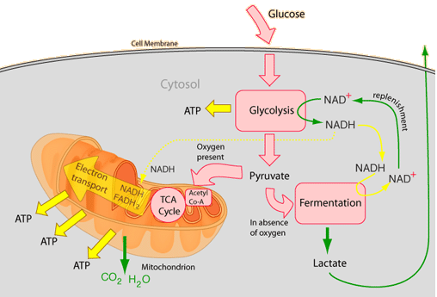
Cellular Respiration
CELL UNIT

Slide 36
Mitochondria
CELL UNIT
Organelle where cellular respiration takes place.
Inner
membrane space
Matrix
Cristae
Outer
membrane
Inner
membrane

Slide 37
CELL UNIT
CELLULAR RESPIRATION
Four main parts (reactions).
Glycolysis (splitting of sugar)
Grooming Phase
Krebs Cycle (Citric Acid Cycle)
4. Electron Transport Chain (ETC) and
Oxidative Phosphorylation

Slide 38
CELL UNIT
GLYCOLYSIS
Means “splitting glucose”.
Glucose is broken down into 2 pyruvate molecules.
Occurs in the cytoplasm (cytosol) just outside of mitochondria.
It is anaerobic which means it does NOT require oxygen.
YIELDS: 2 ATP, 2 NADPH, 2 pyruvate

Slide 39
CELL UNIT
KREBS CYCLE (CITRIC ACID CYCLE)
Aerobic which means it requires O₂.
Each Acetyl-CoA enters the Krebs Cycle resulting in two complete cycles to get yield.
Location: mitochondrial matrix.
It takes 2 turns of the Krebs cycle to oxidize 1 glucose molecule.
Total net yield (2 turns of krebs cycle)
2 - ATP (substrate-level phosphorylation)
8 – NADH
2 - FADH₂
4 - CO₂

Slide 40
CELL UNIT
Electron Transport Chain (ETC) and
Oxidative Phosphorylation (Chemiosmosis
Aerobic
Occurs in the cristae of the mitochondria.
Electron acceptors in the chain accept NADH/FADH₂ electrons. As electrons pass down a series of molecules to O₂ – the O₂ combines with H atoms to form H₂O and ATP.

Slide 41
CELL UNIT
FERMENTATION
Called anaerobic.
Occurs in cytoplasm when cells are deprived of oxygen.
Lactic acid forms during increased muscle activity. Cramps result from increased acidity level.
Alcohol fermentation occurs in fungi such as yeast and some bacteria produce ethanol and CO₂.

Slide 42
CELL UNIT
NET ATP YIELD
4 ATP - substrate-level phosphorylation
2 ATP – Krebs Cycle
32 ATP - ETC & oxidative phosphorylation
38 ATP – TOTAL
- 2 ATP used in glycolysis
36 ATP – NET TOTAL YIELD
ATP

Slide 43
CELL UNIT
Photosynthesis | Respiration
anabolic | catabolic
endergonic | exergonic
carbon dioxide requiring | oxygen requiring
forms glucose from carbon dioxide | forms carbon dioxide from glucose
forms oxygen from water | forms water from oxygen
store energy from the sun | stores energy in ATP
occurs in plants | occurs in plants and animals
in the mesophyll cells | in all cells
in the chloroplasts | in the cytoplasm and mitochondria
6CO₂ + 6H₂O → C₆H₁₂O₆ + 6O₂ C₆H₁₂O₆ + 6O₂ → C₆H₁₂O₆ + 6O₂

Slide 44
CELL UNIT
Explain how you form ATP and how you break it apart to form ADP.
2. Write the formula for photosynthesis. Circle the reactants and underline the products.
3. Define photosynthesis. Where does photosynthesis occur in the cell?
4. Briefly explain the 2 steps of photosynthesis.

Slide 45
CELL UNIT
Define respiration. Where does cell respiration occur in the cell?
Write the formula for cellular respiration. Circle the reactants and underline the products.
Briefly explain the 3 steps of cell respiration.
What happens if no O₂ is available after glycolysis?
9. Compare and contrast the respiration and photosynthesis.

