Slide 1
PERIODIC TABLE REVIEW

Slide 2
REVIEW
1. Know who Mendeleev and Mosely were and what they contributed to the development of the periodic table.
Father of the Periodic Table - DMITRI MENDELEEV
He discovered a basic chemistry principle - a pattern with the elements. There was a periodic relationship among the elements. He set up the periodic table by ATOMIC MASS and left blanks for undiscovered elements (three were later discovered).
Father of the Modern Periodic Table - HENRY MOSELEY
He saw some elements were out of place in Mendeleev’s table. He determined atomic numbers using x-rays. The elements were placed according to ATOMIC

Slide 3
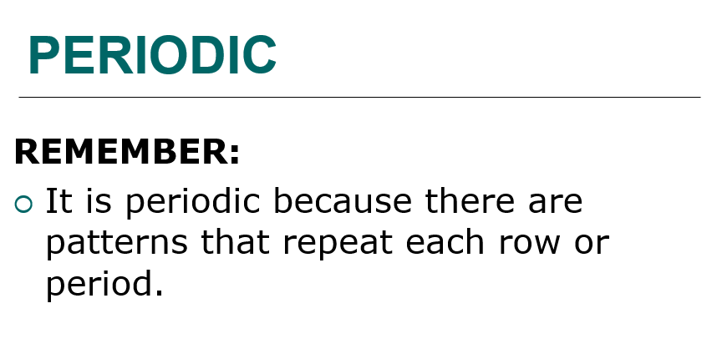
REVIEW
3. Know why it is called the “periodic” table.

Slide 4
REVIEW
2. Explain the composition of the periodic table.
COLUMNS
- vertical, called groups (numbers) or families (names); 18 total (8 main ones); elements in the same column are not identical, but similar in properties; have the same number of valence electrons.
ROWS
horizontal, called periods; 7 total (at this time); elements are not alike in any way
PATTERN:
- left side elements are active solids, far right side elements are inert (nonreactive) gases. Last two rows are rare earth elements. Atomic number increases from left to right.

Slide 5
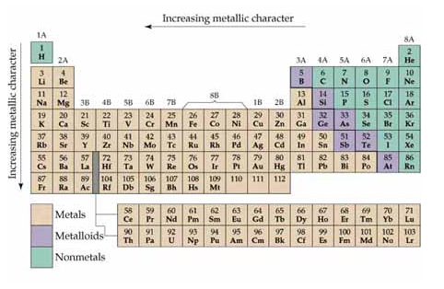
REVIEW
4. Describe characteristics of metals, nonmetals, and metalloids and be able to give examples from the periodic table.

Slide 6
REVIEW
PROPERTIES | METALS | METALLOIDS | NONMETALS
Appearance | Shiny | Shiny | dull
Hardness | Very hard or hard | Hard | brittle
Malleability | Malleable | Malleable | Not malleable
Ductility | Ductile | Ductile | Not ductile
Heat Conduction | Good conductor | Semi conductor | Poor conductor
Electrical Conduction | Good conductor | Semi conductor | Poor conductor
State | Solid, liquid | Solid | Solid, liquid, gas
Density | Highest | Higher | Lowest
Number of Elements | All but 24 | Seven | Seventeen

Slide 7
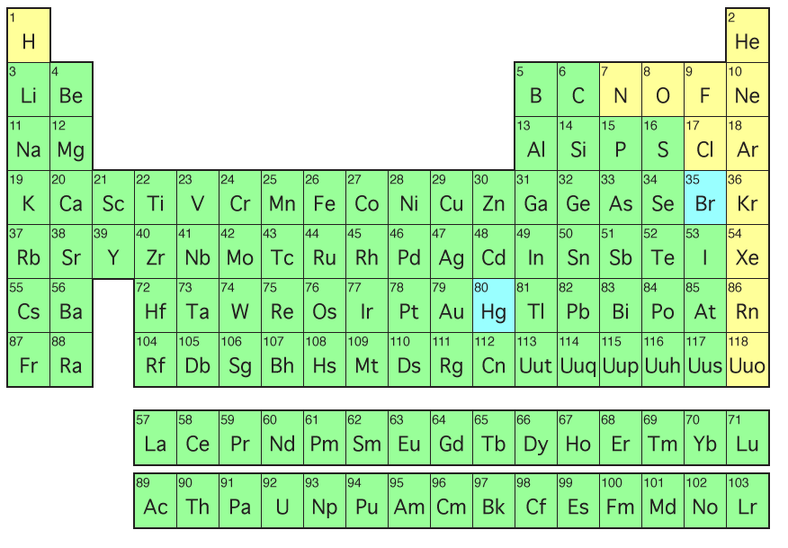
REVIEW
5. Know which elements are solids, liquids, and gases at room temperature.

Slide 8
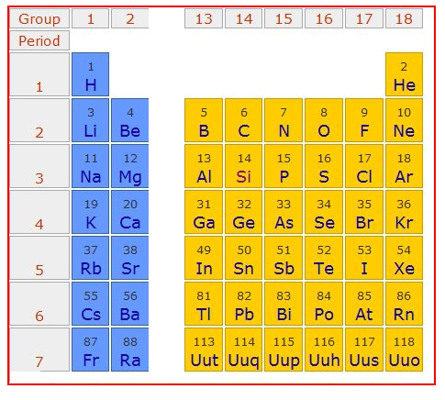
REVIEW
6. Be able to determine the period, group, family name, valence electrons, and electron dot diagram for any of the representative elements.
Element | Period | Group | Valence Electrons | Electron Dot Diagram
Silicon
Strontium
Selenium

Slide 9
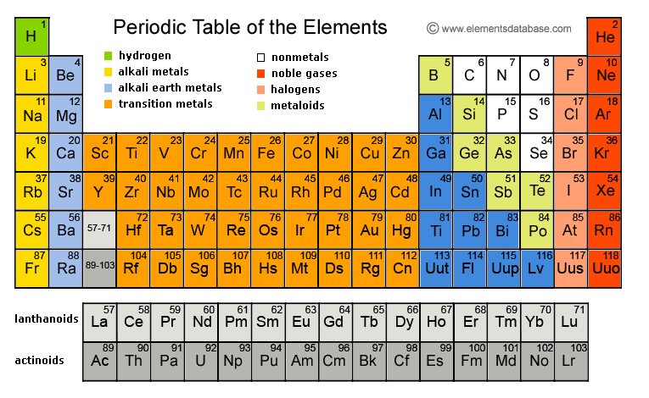
REVIEW
7. Be able to determine the period, group, and family name for any element on the periodic table.

Slide 10
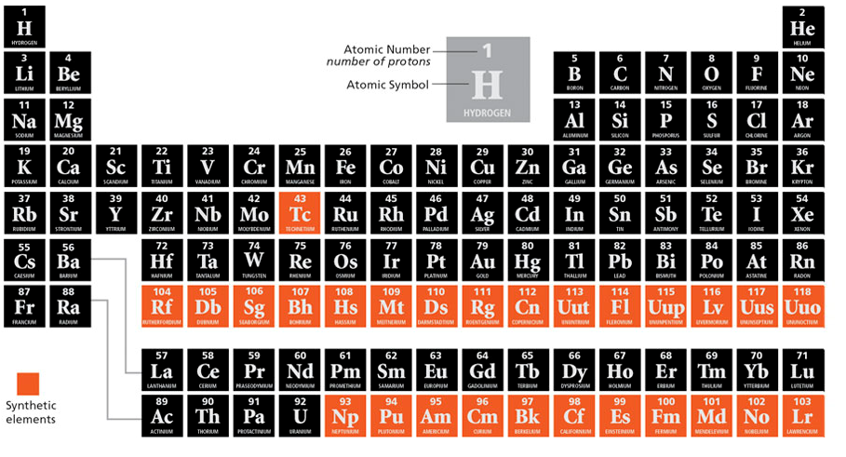
REVIEW
8. Know which elements are synthetic/artificial.

Slide 11
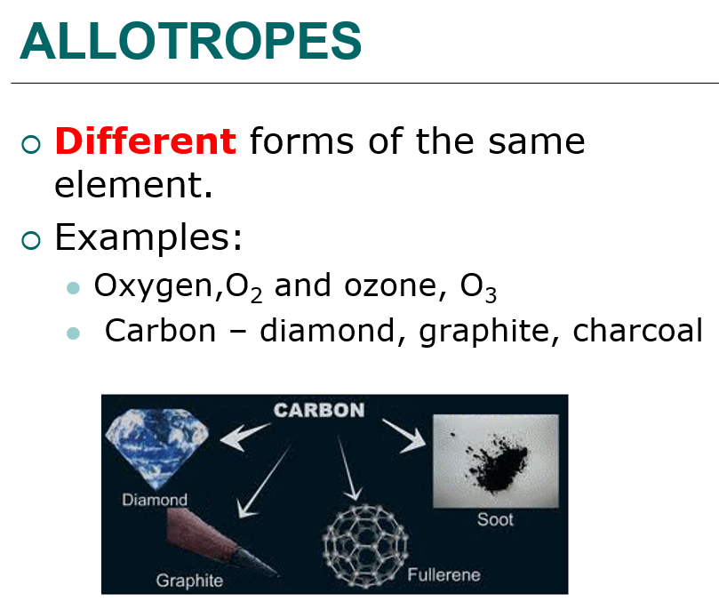
REVIEW
9. Be able to describe what an allotrope is and give examples.

Slide 12
REVIEW
10. Use the periodic table to predict properties for representative elements, especially Alkali metals, Alkaline Earth Metals, Halogens, and Noble gases: valence electrons, atomic radii, electron affinity

Slide 13
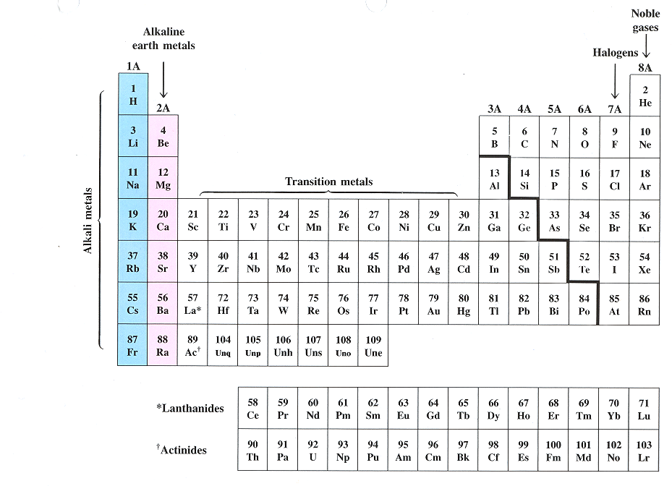
GROUP 1: ALKALI METALS

Slide 14
ALKALI METALS – group one
one valence electron;
very reactive
Most reactive is francium;
not found in nature by themselves;
low electron affinity
SODIUM and POTASSIUM important to body functions
FRANCIUM – most reactive metal, but extremely rare

Slide 15
GROUP TWO:
ALKALINE EARTH METALS

Slide 16
ALKALINE EARTH METALS – group two
two valence electrons;
less reactive, but similar to alkali metals;
low electron affinity,
CALCIUM – 5th most abundant element on earth (lime, calcium chloride, body functions)

Slide 17
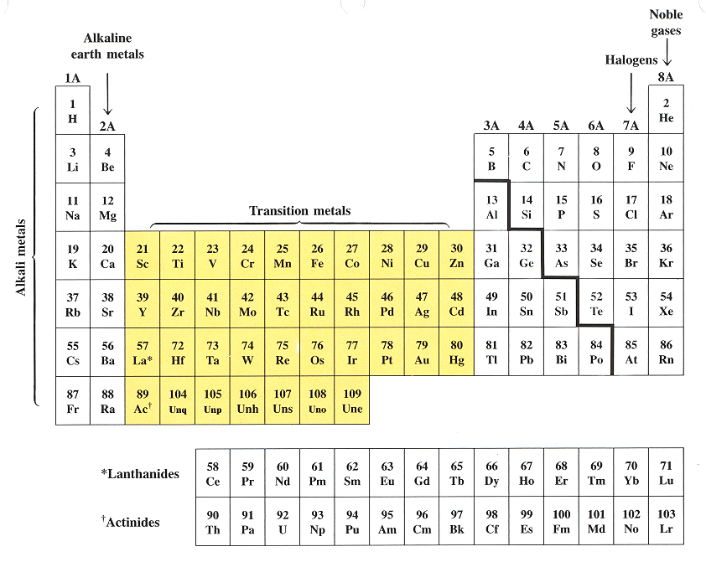
GROUPS 3-12:
TRANSITION ELEMENTS

Slide 18
TRANSITION ELEMENTS – groups 3-12
Two, three, or four valence e-;
They all have properties similar to one another and to other metals: resistant to corrosion, high melting points, brittle
These metals are less reactive than Group 1 or 2, and are harder.
Include IRON (steel), CADMIUM (batteries), COPPER (wiring), COBALT (magnets), SILVER (dental fillings), ZINC (paints), GOLD (jewelry)

Slide 19
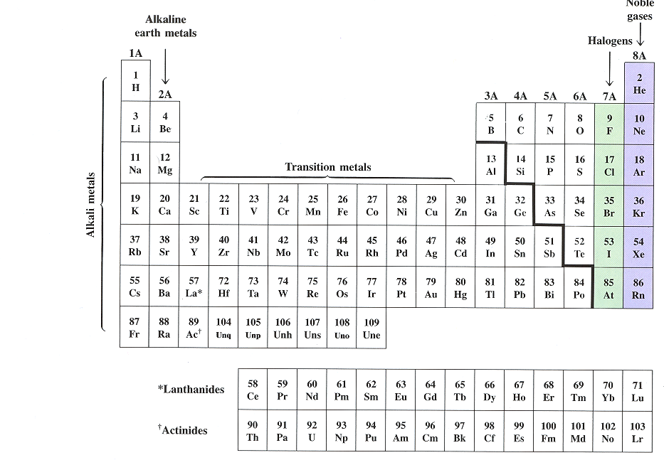
GROUP 13: Boron Family

Slide 20
Boron Family – group 13
three valence electrons
includes a metalloid and metals
BORON – metalloid;
ALUMINUM – most plentiful metal in the earth's crust, has the most practical uses
GALLIUM – low melting point, component of blue lasers.

Slide 21
GROUP 14: CARBON FAMILY

Slide 22
CARBON FAMILY – group 14
four valence electrons;
generally react by sharing electrons,
Consists of a nonmetal, metalloids, and metals;
CARBON – most versatile element can form millions of compounds; field of organic chemistry; has several allotropes: graphite, diamond, fullerene, carbon black
SILICON – second most plentiful element in the earth’s crust (quartz); many industrial uses.
LEAD – toxic; used to be in paint, plumbing, gasoline

Slide 23
GROUP 15: NITROGEN FAMILY also called Pnictogen Family

Slide 24
NITROGEN FAMILY – group 15
five valence electrons;
Consists of nonmetals, metalloids, and a metal
Sometimes will share its five electrons
NITROGEN – found in fertilizers, TNT, medicines, proteins
PHOSPHORUS – compounds found in laxatives, cheese, and baking powders

Slide 25
GROUP 16: OXYGEN FAMILY also called Chalcogens

Slide 26
OXYGEN FAMILY – group 16
six valence electrons;
Consists of nonmetals and metalloids
OXYGEN - very reactive; most plentiful element in the earth’s crust; forms compounds with practically every element (except neon, argon, and helium); has two allotropes, O₂ and O₃.

Slide 27
GROUP 17: HALOGEN FAMILY

Slide 28
HALOGEN FAMILY – group 17
seven valence electrons
high electron affinity,
FLUORINE - most reactive nonmetal (element) due to its size; most electronegative element; reacts with all elements but neon, helium, and argon.
CHLORINE – deadly gas; compounds act as bleaching agents and disinfectants
IODINE – used to disinfect water and wounds (tincture of iodine)

Slide 29
GROUP 18:
NOBLE GAS FAMILY

Slide 30
NOBLE GAS FAMILY – group 18
eight valence electrons (except Helium which has two)
has stable outer electron configurations and all electron energy levels are full;
low electron affinity
HELIUM – used in scuba diving; balloons
NEON, ARGON – lighting

Slide 31
INNER TRANSITION ELEMENTS – no group number

Slide 32
INNER TRANSITION ELEMENTS – no group number
LANTHANIDES:
silvery metals with high melting points
high luster and conductivity
Tend to be mixed together in the same geologic zones and are hard to separate since they are so similar;
used in making high quality glass, television screens, lasers, tinted sunglasses, LEDs

Slide 33
INNER TRANSITION ELEMENTS – no group number
ACTINIDES:
Have similar properties and are not easily purified. This is a problem for the nuclear industry as it requires purified samples of uranium and plutonium.
all are radioactive
93-103 are synthetic or manmade (transuranium elements)
Most common are URANIUM and PLUTONIUM - used as nuclear fuel.

Slide 34
REVIEW
11. Know the four SAT words: anesthesia, antiseptic, pathology, vestige
anesthesia (n.) a substance that causes loss of sensation
antiseptic (adj.) clean, sterile
pathology (n.) a deviation from the normal; study of disease
vestige (n.) a mark or trace of something lost or vanished

