Slide 1
PLANTS AND ANIMALS
REVIEW

Slide 2
WATCH
Animal’s Mechanisms to Survive in Hot and Cold Temperatures

Slide 3
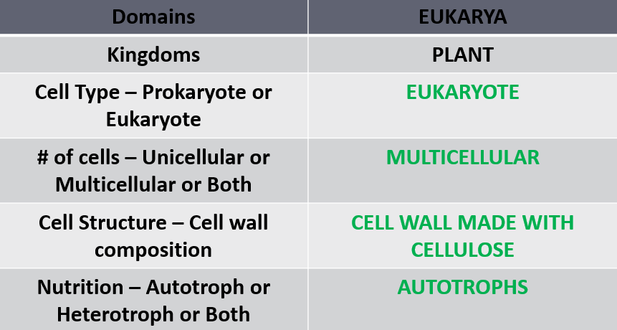
REVIEW
KINGDOM PLANTAE
Characteristics

Slide 4
REVIEW
KINGDOM PLANTAE
Survival Needs
  Sunlight
  Gas exchange
  Water and minerals
  Movement of water and nutrients

Slide 5
REVIEW
Adaptations
  Attainment of Resources
    Roots developed as a structure that allowed plants to obtain minerals and water from the soil.
Stems developed to store and transport water & nutrients.
    Some plants developed vascular tissue (xylem and phloem) that act as a transport system to bring water and other substances such as minerals up the plant body, allowing for increased plant size.

Slide 6
REVIEW
    Vascular tissue (xylem and phloem)
      Xylem – tissue that transports water and nutrients from the roots to the rest of the plant.
      Phloem – tissue that transports the products of photosynthesis to the rest of the plant.
    Leaves are modified to maximize photosynthesis.
    All plants contain lignin which binds to cellulose fibers to harden and strengthen the cell walls of plants to support growth.

Slide 7
REVIEW
  Reduction of Water Loss
To prevent desiccation, many plants developed a cuticle (a thick, waxy, watertight barrier) that covers the plant and prevents loss of moisture to the air.
The stomata are openings in the cuticle that allow for gas exchange and transpiration of water as the plant photosynthesis.

Slide 8
REVIEW
  Reproduction
    The seed allowed safe dispersal of plant embryos by supplying it with nutrition and protection against hostile conditions.
Pollen grains containing the male gamete could be dispersed without water.
Flowers developed to attract pollinators and allow for greater dispersal of the pollen.
Fruits developed to protect the embryo and allow for greater dispersal of the plant.

Slide 9
REVIEW
Defense
Mechanical - incorporated into the physical structure of the organism. (thorns, spines and stiff hairs that repel a predator)
  Chemical - occurs when the plant produces stinging sensations, paralysis, poisoning, or just a bad taste.
  Camouflage - the organism blends into its environment or appear to be something they are not

Slide 10
REVIEW
Classification
  Origin - Green algae is believed to be the ancestors of plants.
  Bryophytes
    Characteristics
  nonvascular – instead uses rhizoids for movement of minerals and water via diffusion; need a moist environment.
  produces spores (reproductive cells) – sperm require water for fertilization
  Examples include hornworts, liverworts, and mosses.

Slide 11
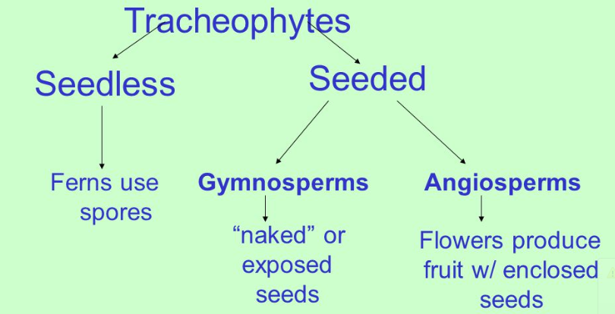
REVIEW
Classification
  Tracheophytes
    Characteristics
      Seedless Vascular
      Gymnosperms
      Angiosperms
    Examples

Slide 12
REVIEW
Classification
Vascular Plants: Tracheophytes
Seedless vascular – reproduce with spores
  Examples - ferns
Gymnosperms – produces seeds in cones
  Examples – pine, fir, spruce, cedar (evergreens)
Angiosperms – produces flowers and seeds in fruit
  Examples – all flowering plants

Slide 13
REVIEW
Growth Adjustment
Gravitropism or Geotropism– a growth response to gravitational forces.
Phototropism— when stems/leaves adjust the direction of growth in response to light
Thigmotropism— plants shift a direction of growth as they contact objects

Slide 14
REVIEW
Hormones
  Auxin - hormone responsible for regulating phototropism in a plant by stimulating the elongation of cells and helps promote the growth of fruit.
  Abscisic Acid - inhibits plant growth during times of stress such as cold temperature or drought.
  Gibberellins - growth hormones that cause plants to grow taller and increase the rate of seed germination and bud development.

Slide 15
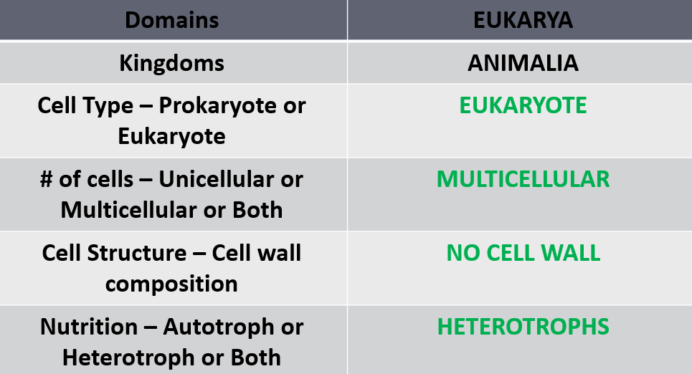
REVIEW
KINGDOM ANIMALIA
      Characteristics

Slide 16
REVIEW
MAJOR ANIMAL GROUPS
Phylum Porifera - sponges
Phylum Cnidarian – hydras, jellyfish
Phylum Platyhelminthes (flatworms) – flukes, tapeworms
Phylum Nematoda (roundworms) – pinworms, hookworm
Phylum Annelida (segmented worms) – leeches, earthworms
Phylum Arthropoda – crustaceans, spiders, insects
Phylum Mollusca – snails, slugs, clams, squids, octopi
Phylum Echinoderms – starfish, sea urchins
Phylum Chordata
Invertebrate chordates – tunicates, lancelets
Vertebrate chordates – fish, amphibians, reptiles, birds, mammals

Slide 17
REVIEW
        Behavior – anything an organism does in response to a stimulus in its environment.
        Behavior is ADAPTIVE – adapting allows animals to survive!!!
        Innate - Inherited or inborn behavior
Something an animal is born knowing how to do; includes both automatic and instinctive behaviors.
Reflexes
Automatic response that requires no thinking at all.
Reflexes help animals respond quickly to a stimulus, thus protecting them from harm.

Slide 18
REVIEW
Instincts - something which is engrained into that animal when it is still developing and hasn't even been born yet; thought to be hereditary, passed on from the parents.
          Instincts – territoriality: Animals that have territories will defend their space against others in their species or (sometimes) against other species.
Instincts – aggression: A threatening behavior that one animal uses to gain control over another; Used to fend off predators and competitors; Used to protect young and food sources.
Instincts – submission: The weaker animal, involves an individual indicating by an act or posture that it will not challenge a dominant individual in a social group.

Slide 19
REVIEW
Instincts – courtship: To find a mate; Courtship behavior helps many animals identify healthy mates; Animal sends out stimuli in order to attract a member of the opposite sex.
          Instincts – behavioral cycles: Many animals respond to periodic changes in the environment with daily or seasonal cycles of behavior.
            Circadian rhythm – occur in daily patterns; uses external cues; important in the feeding and sleeping patterns of all animals

Slide 20
REVIEW
Migration - periodic movement from one place to another and then back again.
Hibernation - dormancy during winter; characterized by low body temperature, slow breathing and heart rate, and low metabolic rate; reduces the need for food
Estivation - dormancy during summer; animals slow their activity for the hot, dry summer months.

Slide 21
REVIEW
Learned Behaviors: these behaviors are acquired or learned over time; Organisms can alter their behaviors as a result of experience; A result of previous experiences.
          Habituation: organism decreases or stops its response to a repetitive stimulus that neither rewards nor harms the animal
          Imprinting: when an organism forms an attachment to an object or other organism after birth and copies it.

Slide 22
REVIEW
      Defense Adaptations
Mechanical - occurs when an animal uses its physical structures such as claws, tusks, stingers and shells; Is incorporated into the physical structure of the organism; Other examples of mechanical defense include camouflage, cryptic coloration, disruptive coloration, counter shading, etc.
        - Chemical - occurs when the animal produces stinging sensations, paralysis, poisoning, or just a bad taste

Slide 23
SAT VOCABULARY
arboreal (adj.) of or relating to trees
aquatic (adj.) relating to water
potable (adj.) suitable for drinking
conduit (n.) a pipe or channel through which something passes
reservoir a. (n.) reserves, large supply; b. (n.) a body of stored water

Slide 24
WATCH
25 Animals with Insane Survival Adaptations

