Slide 1
POPULATIONS AND COMMUNITIES
REVIEW

Slide 2
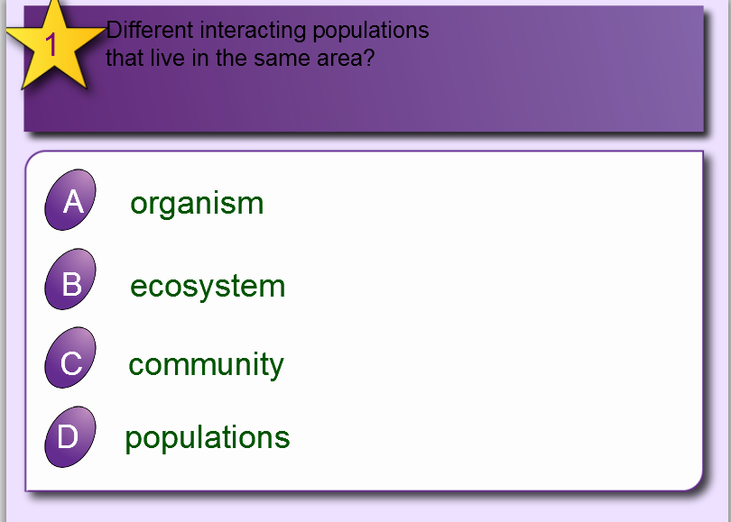
VOCAB
PRACTICE

Slide 3
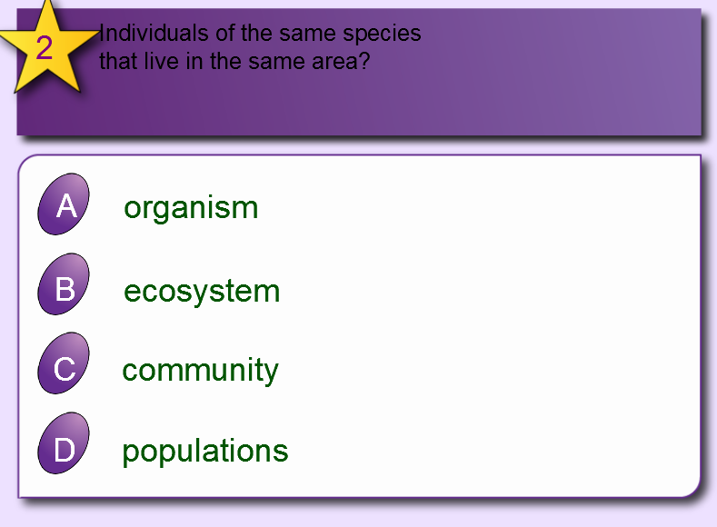
VOCAB
PRACTICE

Slide 4
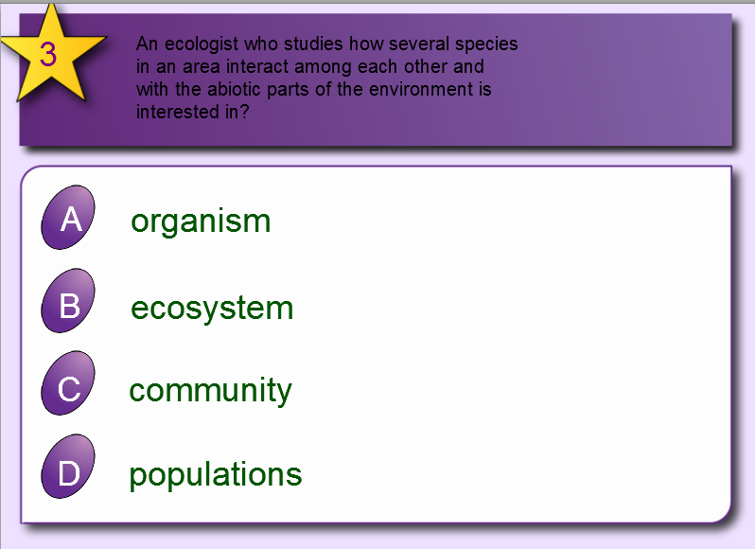
VOCAB
PRACTICE

Slide 5
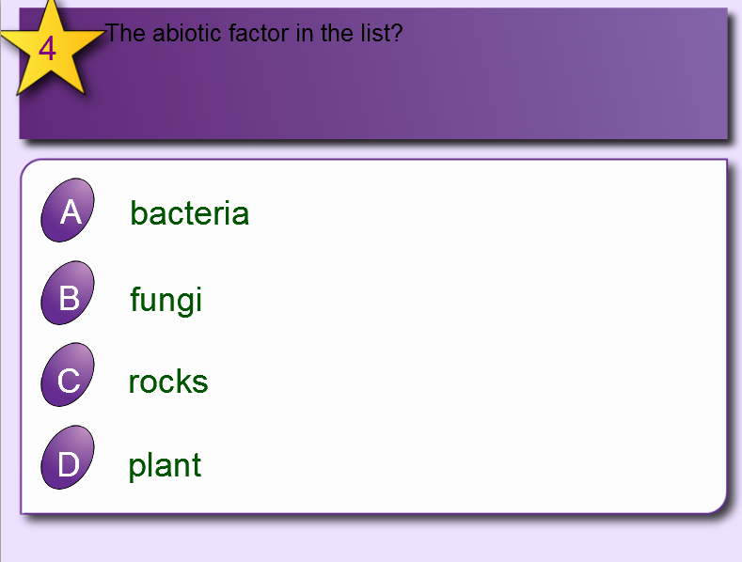
VOCAB
PRACTICE

Slide 6
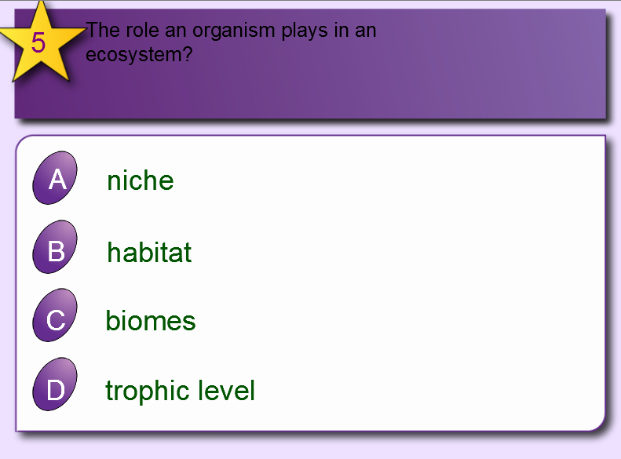
VOCAB
PRACTICE

Slide 7
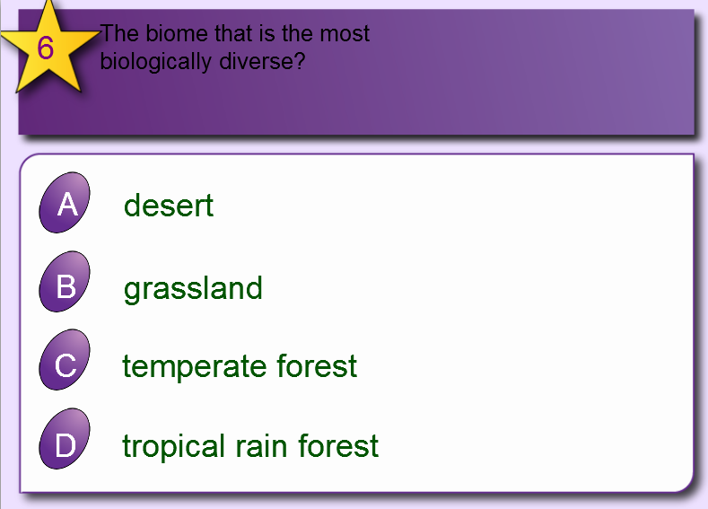
VOCAB
PRACTICE

Slide 8
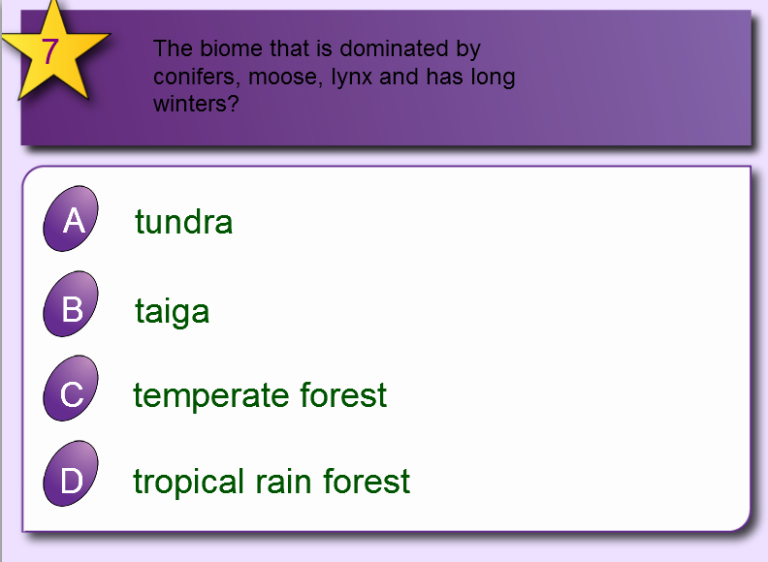
VOCAB
PRACTICE

Slide 9
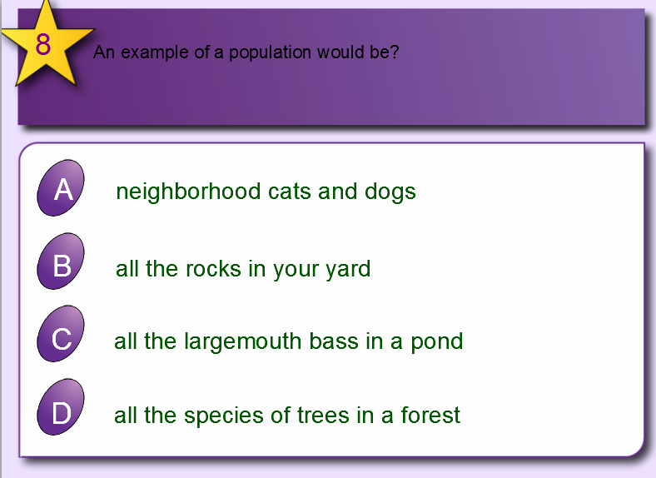
VOCAB
PRACTICE

Slide 10
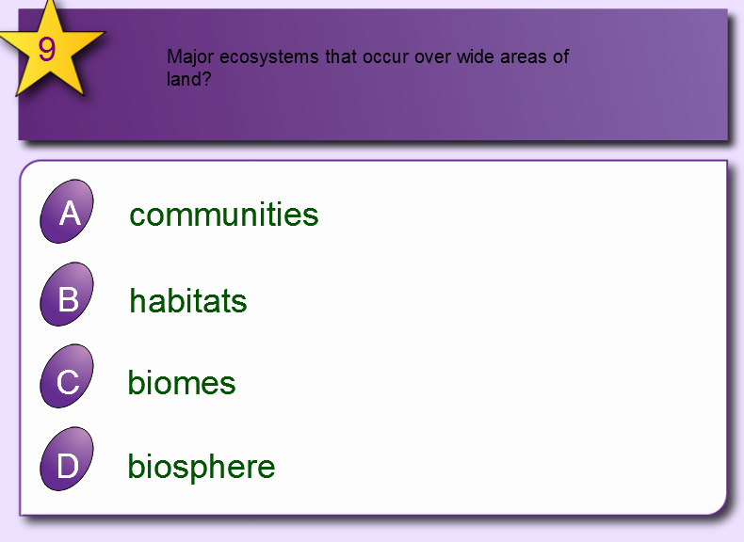
VOCAB
PRACTICE

Slide 11
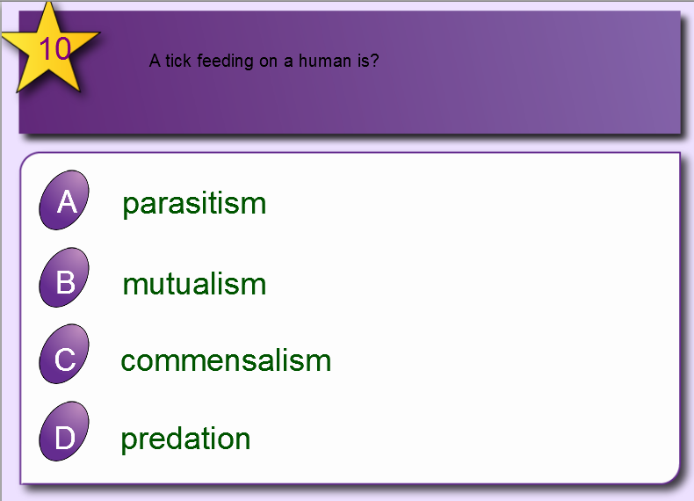
VOCAB
PRACTICE

Slide 12
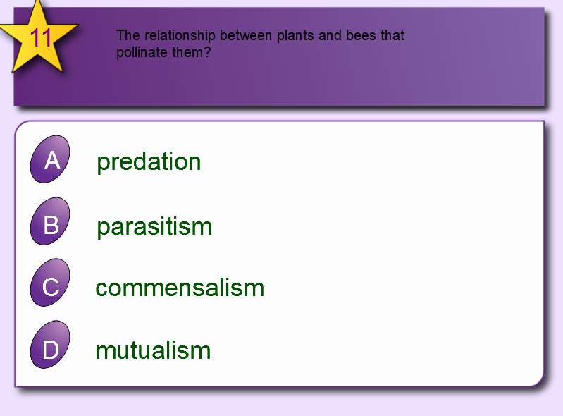
VOCAB
PRACTICE

Slide 13
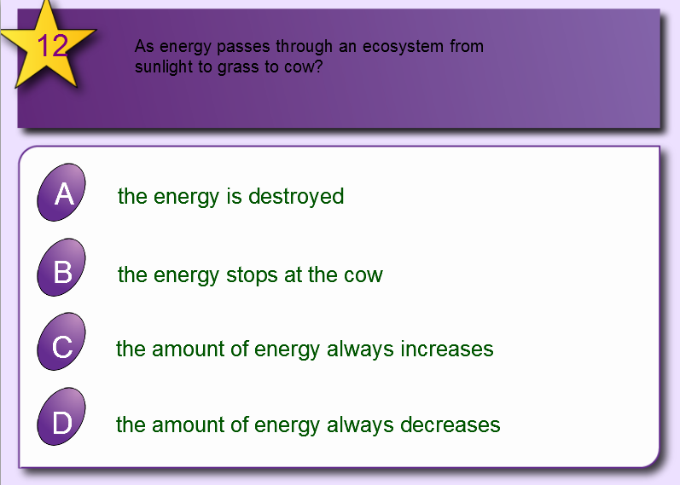
VOCAB
PRACTICE

Slide 14
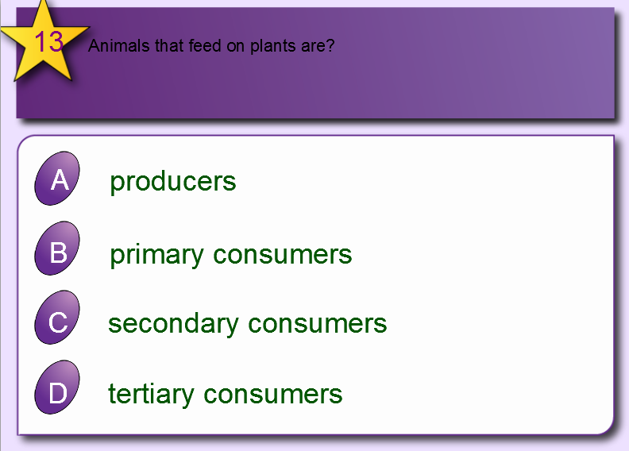
VOCAB
PRACTICE

Slide 15
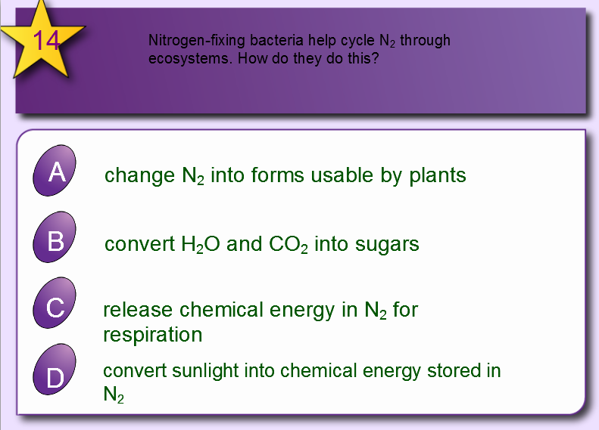
VOCAB
PRACTICE

Slide 16
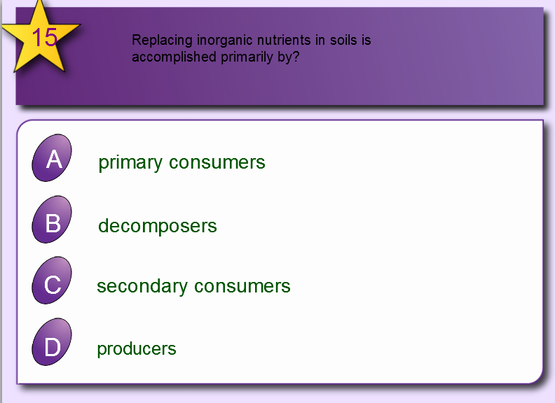
VOCAB
PRACTICE

Slide 17
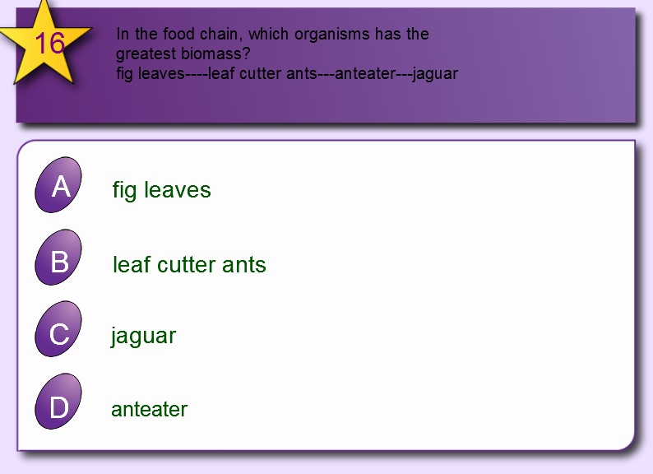
VOCAB
PRACTICE

Slide 18
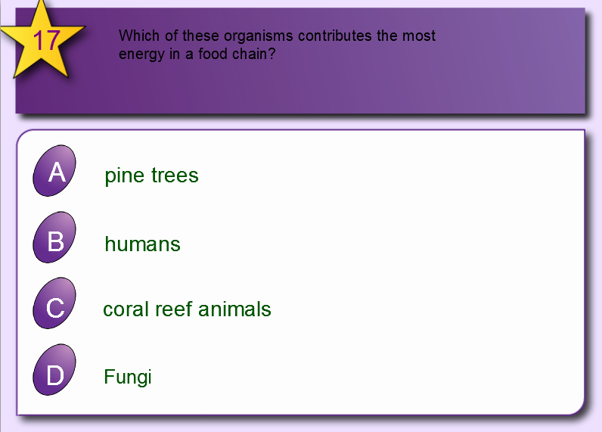
VOCAB
PRACTICE

Slide 19
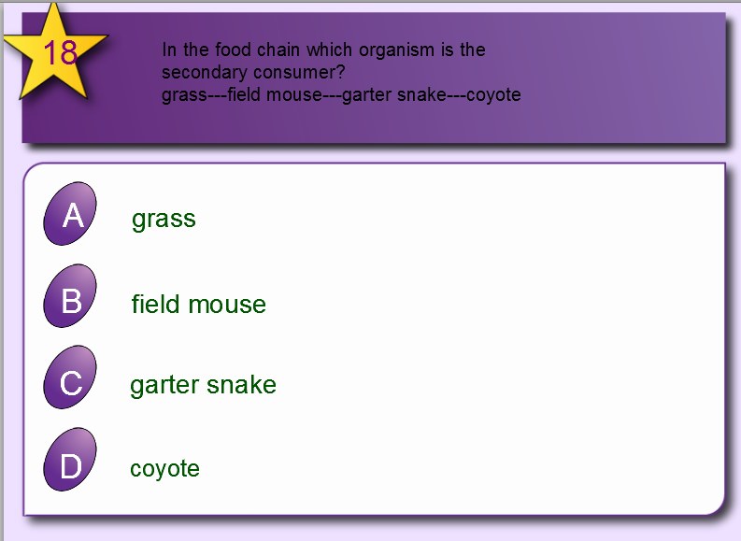
VOCAB
PRACTICE

Slide 20
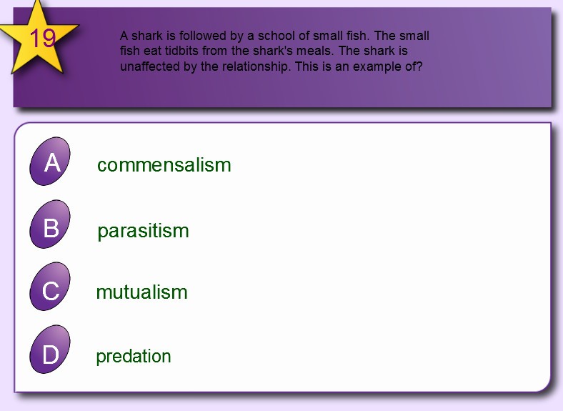
VOCAB
PRACTICE

Slide 21
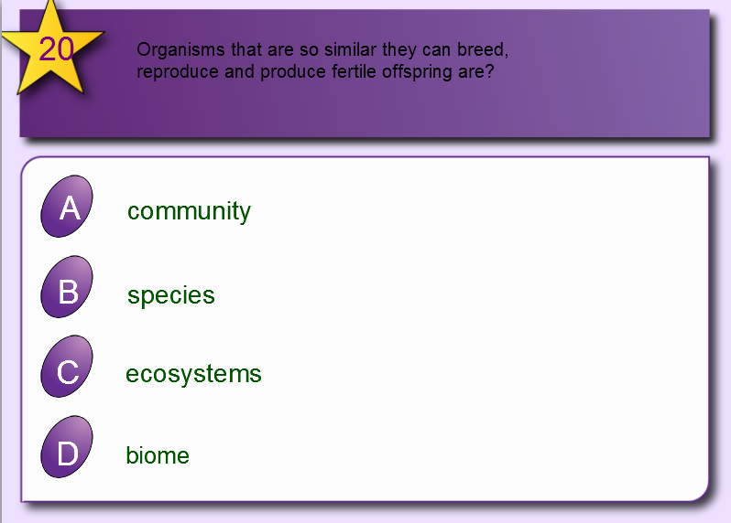
VOCAB
PRACTICE

Slide 22
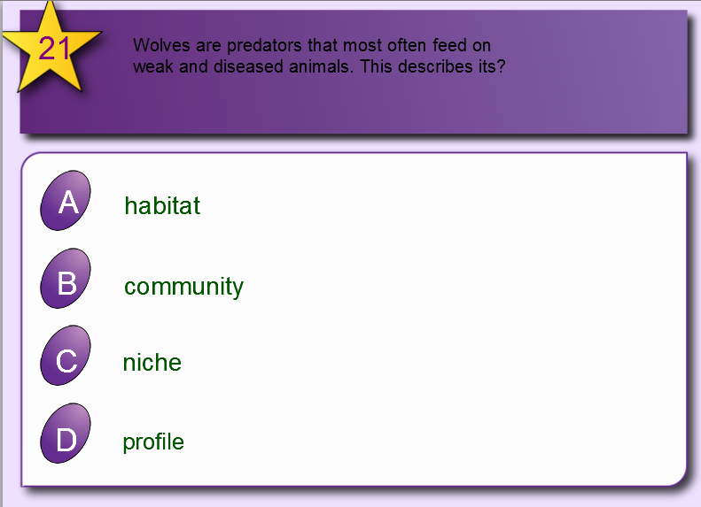
VOCAB
PRACTICE

Slide 23
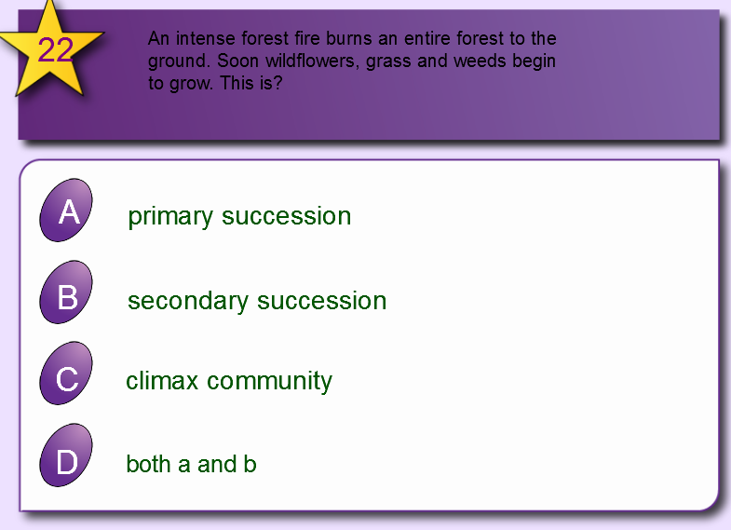
VOCAB
PRACTICE

Slide 24
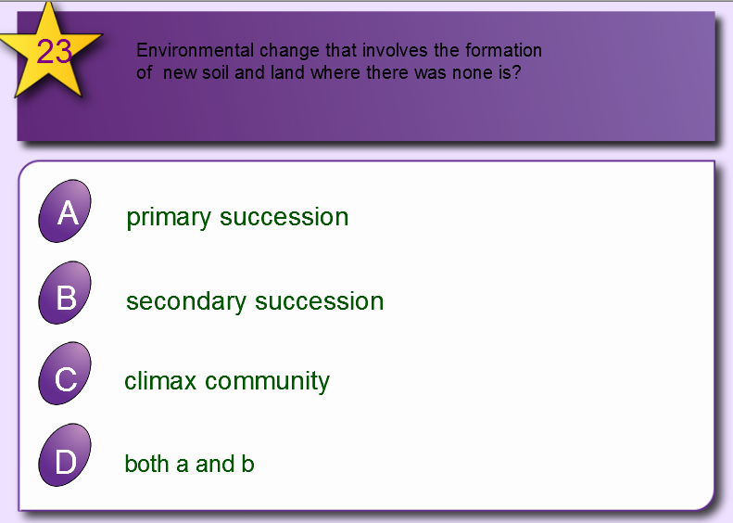
VOCAB
PRACTICE

Slide 25
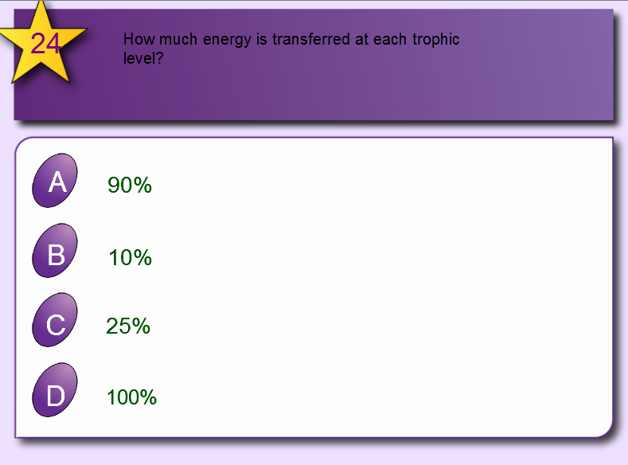
VOCAB
PRACTICE

Slide 26
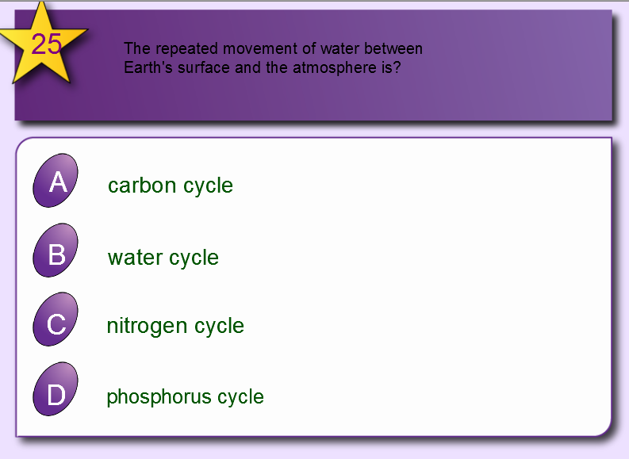
VOCAB
PRACTICE

Slide 27
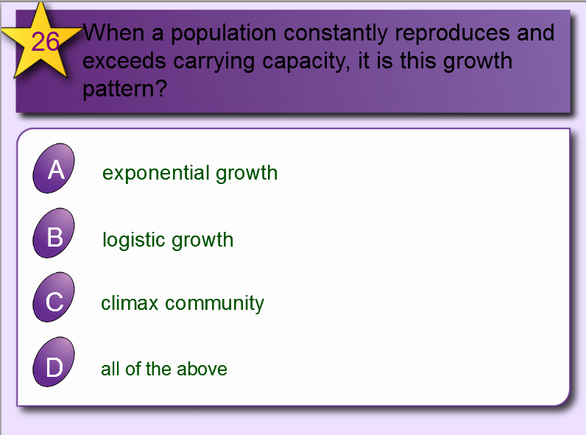
VOCAB
PRACTICE

Slide 28
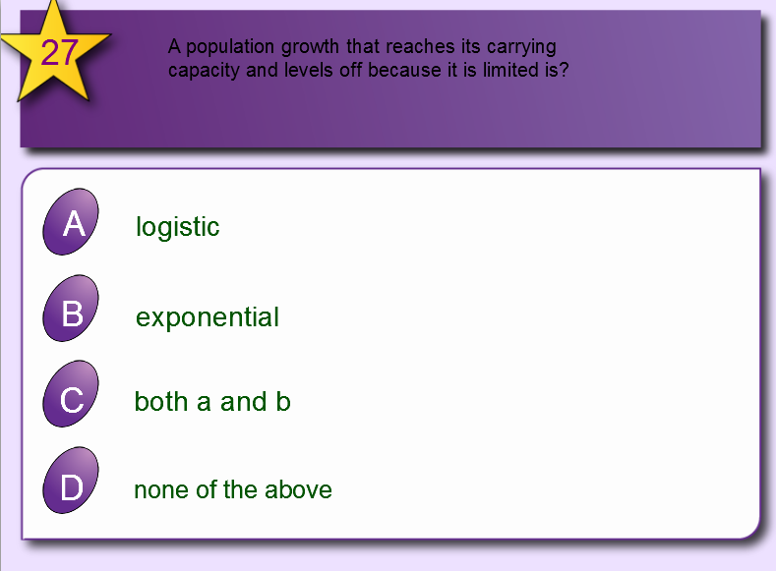
VOCAB
PRACTICE

Slide 29
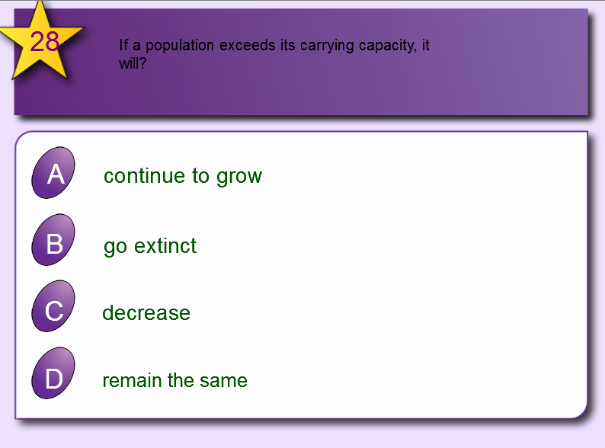
VOCAB
PRACTICE

Slide 30
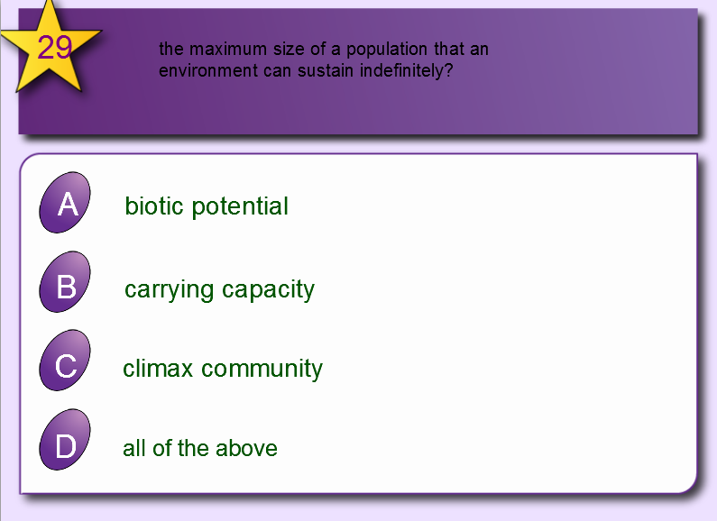
VOCAB
PRACTICE

Slide 31
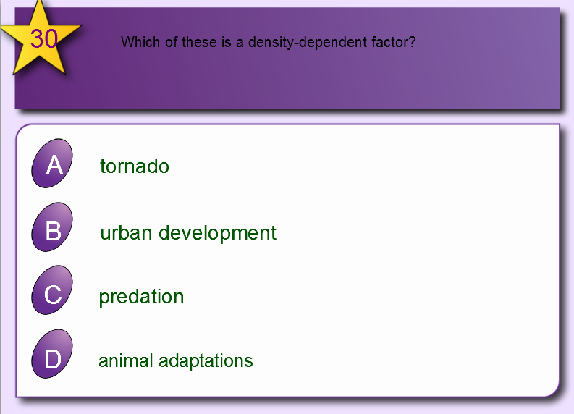
VOCAB
PRACTICE

Slide 32
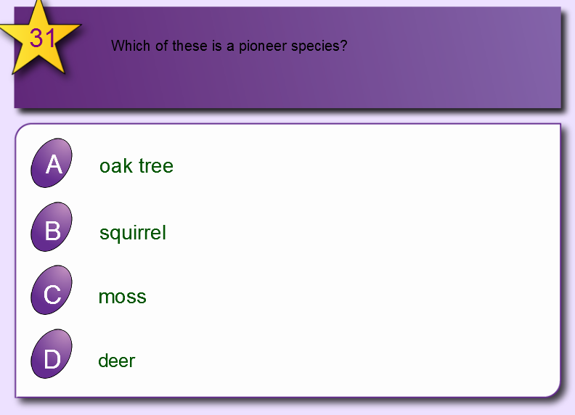
VOCAB
PRACTICE

Slide 33
REVIEW
ECOLOGY
Definition
Ecology- the scientific study of interactions between organisms with one another and with their environments. Ecology is a science of relationships.

Slide 34
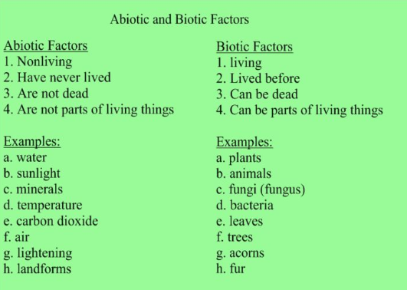
REVIEW
ECOLOGY
Biotic factors
Abiotic factors

Slide 35
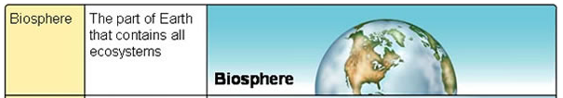
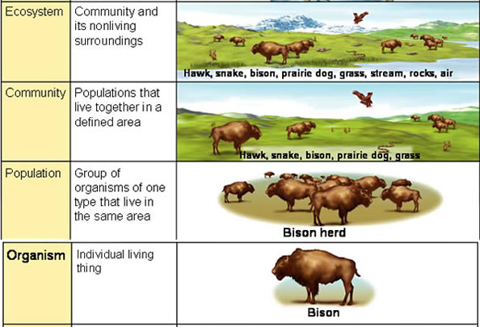
REVIEW
ECOLOGY
Organization
  Organism
  Population
  Community
  Ecosystem
  Biome
  Biosphere
  BIOME: large climatic regions that contain a number of smaller ecosystems.

Slide 36
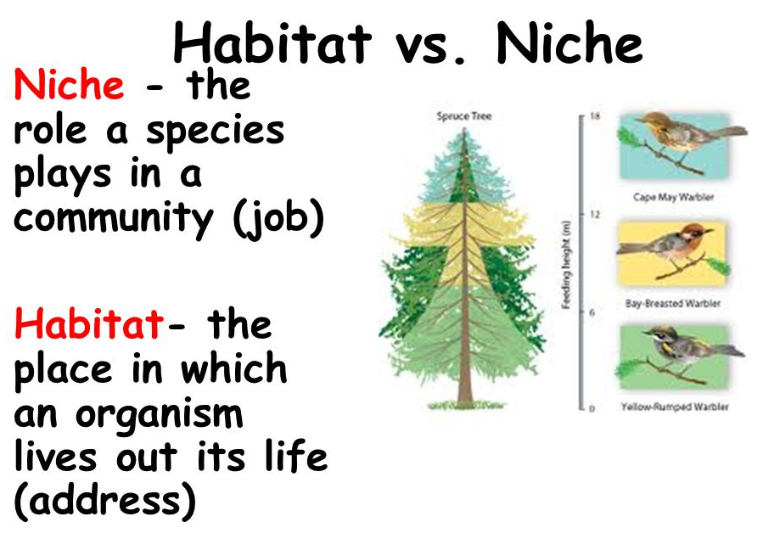
REVIEW
ECOLOGY
Habitat
  Define
  Examples
Niche
  Define
  Examples

Slide 37
REVIEW
POPULATION
All members of the same species that LIVE in the same place at the same time.
Produce fertile offspring
Compete with each other for resources (food, mates, shelter, etc.)
POPULATION
Define
Population rate calculation
Four variables influence/govern population size:
1. Births
2. Deaths
3. Immigration
4. Emigration.
rate = (b - d) + (i - e)

Slide 38

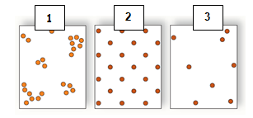
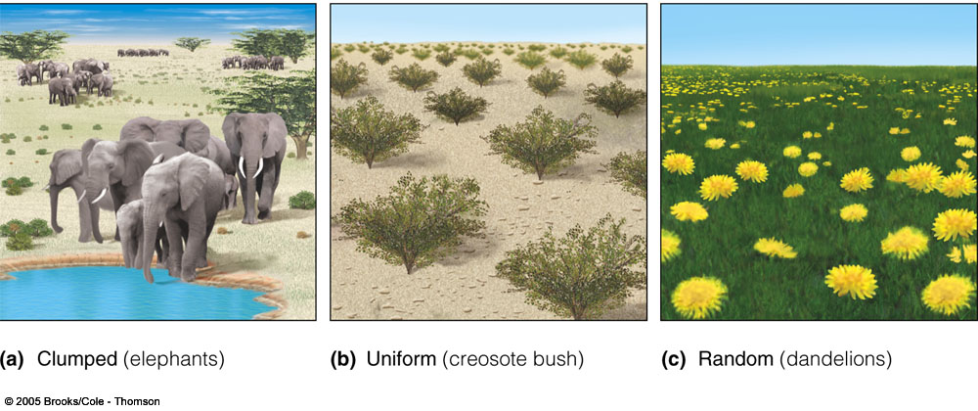
REVIEW
POPULATION
Population Density
  Clumped
  Uniform
  Random

Slide 39
REVIEW
POPULATION
Biotic Potential
Reproductive Potential
Populations usually stay about the same size from year to year because various factors kill many individuals before they can reproduce.
A species’ biotic potential is the fastest rate at which its population can reproduce.
This rate is limited by an organism’s reproductive potential which is the maximum number of offspring that each member of the population can produce.

Slide 40
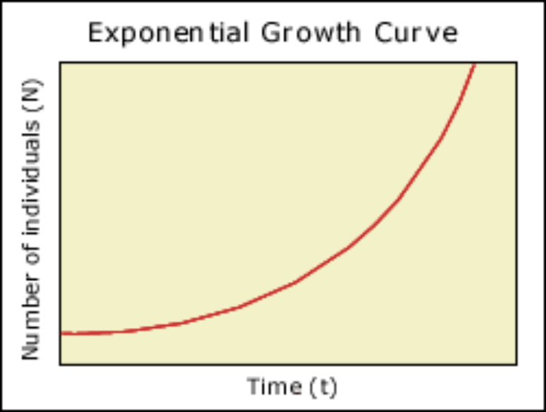
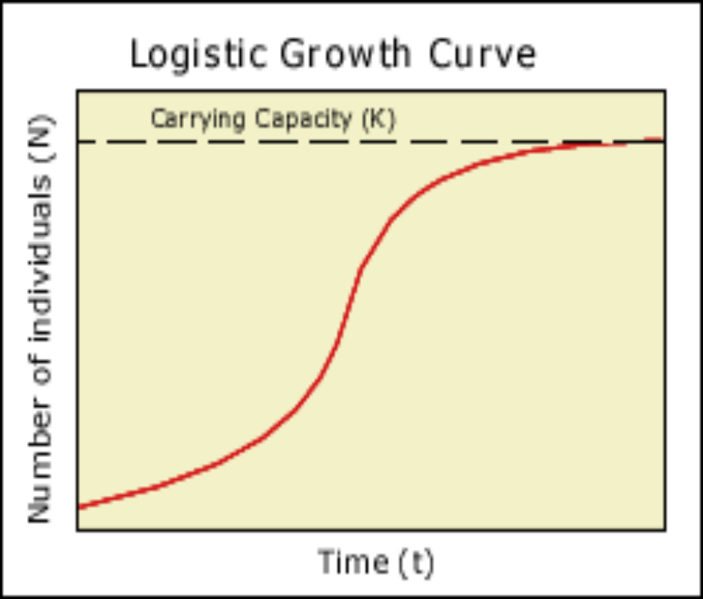
REVIEW
POPULATION
Population Growth Patterns
  Exponential Growth
    Define - Populations rapidly increase due to an abundance of resources.
    There are UNLIMITED resources.
    Graph
  Logistic Growth
    Define - populations are limited by environmental factors and tend to attain equilibrium in size which is determined by available resources.
    Graph

Slide 41
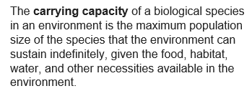
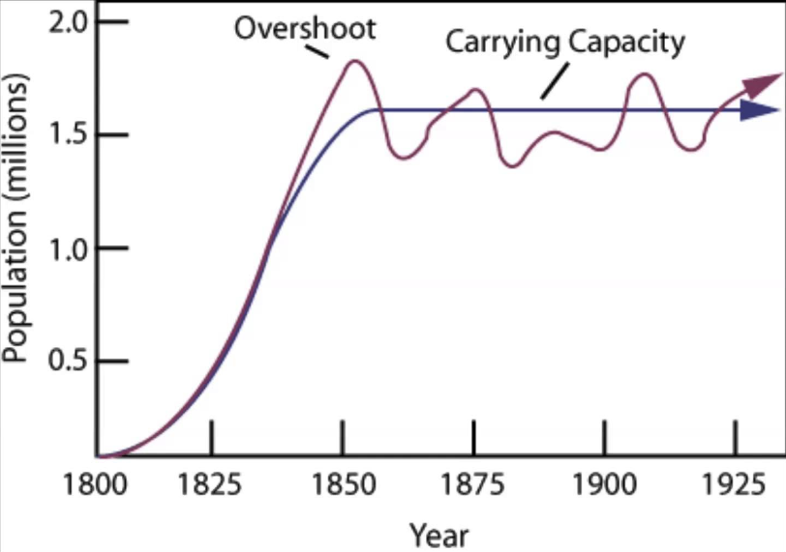
REVIEW
POPULATION
Carrying Capacity

Slide 42
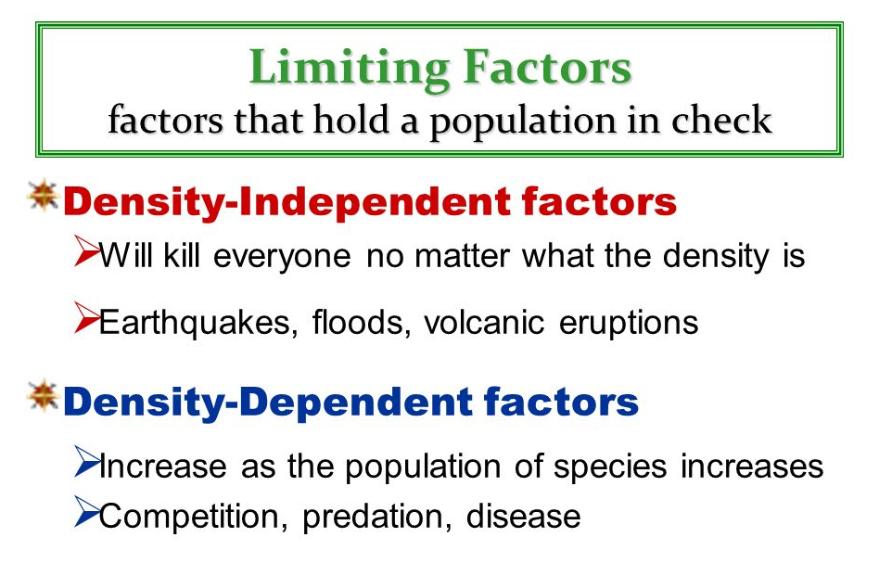
REVIEW
POPULATION
Limiting factors
  Density-dependent factors
  Density-independent factors

Slide 43
REVIEW
COMMUNITY
Define
COMMUNITY
A group of various species that live in the same place and interact with each other.
Several interacting populations that inhabit a common environment and are interdependent.
It is only made of biotic components.

Slide 44
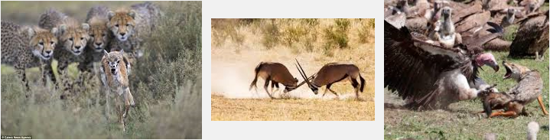
REVIEW
COMMUNITY
Competition
  Define
  Why it happens
  Competitive Exclusive Principle
  Indirect Competition
Competition
A relationship in which different individuals or populations attempt to use the same limited resources.
Each individual has less access to the resource and is harmed by the competition.
Competitive Exclusive Principle - Two species that have exactly the same requirements cannot coexist in exactly the same habitat. Otherwise, competition will occur.
Indirect competition – Species compete even if they never come into direct contact with each other. (i.e. Insects feeding on same plant at different times.)

Slide 45
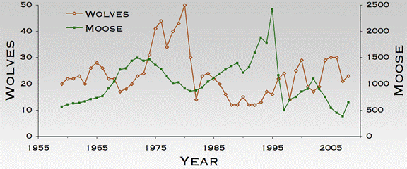
REVIEW
Predation
The act of one organism (predator) feeding on another organism (prey).
Most organisms are vulnerable to predation, so there are strong selective pressures for adaptations that serve as defenses against predators.
COMMUNITY
Predation
  Define
  Adaptations
  Specific predator-prey relationships

Slide 46
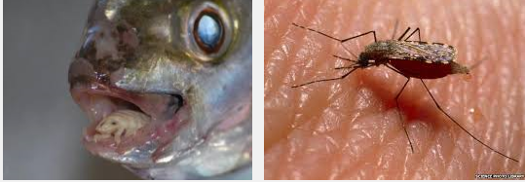
REVIEW
Symbiosis
A relationship in which two species live in close association.
These species may evolve adaptations that reduce the harm or improve the benefit of the relationship.
COMMUNITY
Symbiosis
  Define
  Parasitism
Parasitism – An organism that lives in or on another organism (host) and feeds on it. Parasites usually do not kill their hosts, but weakens or develops a disease.

Slide 47
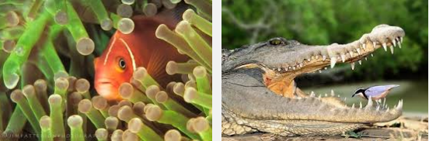
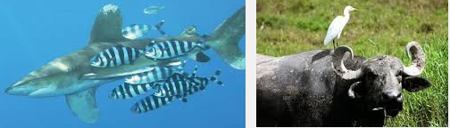
REVIEW
Mutualism – Two species provide a benefit and depend on each other for survival.
COMMUNITY
Symbiosis
  Mutualism
  Commensalism
Commensalism – A relationship in which one species benefits and the other species is neither harmed nor helped.

Slide 48
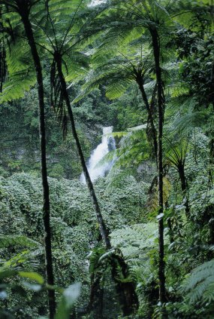
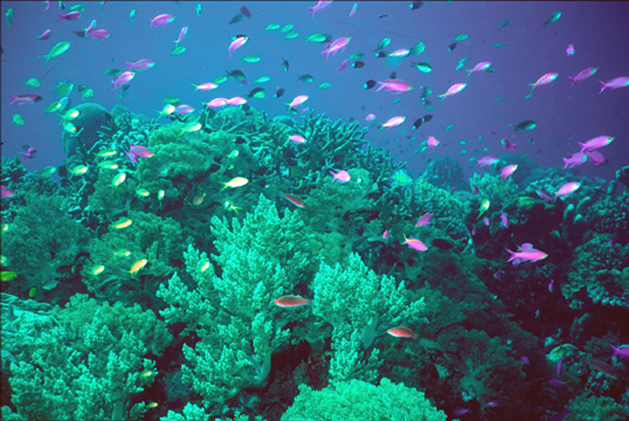
REVIEW
ECOSYSTEM
– all the organisms living in an area together with their physical environment.
ECOSYSTEMS

Slide 49
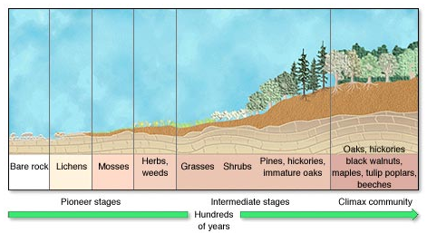
REVIEW
ECOSYSTEMS
Changes in ecosystems
  Primary Succession
    Pioneer Species
    Order

Slide 50

REVIEW
ECOSYSTEMS
Changes in ecosystems
  Secondary Succession
    How is it different from primary succession? – starts with soil
    Order

Slide 51

REVIEW
ECOSYSTEMS
Energy Flow in Ecosystems
  Autotroph/Producer
Autotrophs / Producers: organisms that make their own food.
A producer is an organism that can make carbohydrates (organic compounds) from the sun’s energy or inorganic compounds. (i.e. Bacteria in deep-ocean vents use hydrogen sulfide, an inorganic compound, as the energy source to perform chemosynthesis).

Slide 52

REVIEW
ECOSYSTEMS
Energy Flow in Ecosystems
  Heterotroph/Consumer
    Primary
    Secondary
    Tertiary
A heterotroph or consumer is an organism that eats other organisms or organic matter instead of producing its own nutrients.
Consumers get their energy indirectly by eating producers or other consumers.

Slide 53

REVIEW
ECOSYSTEMS
Energy Flow in Ecosystems
  Food Chain
    Define - A food chain is a sequence in which energy is transferred from one organism to the next as each organism eats another organism.
    Examples

Slide 54

REVIEW
ECOSYSTEMS
Energy Flow in Ecosystems
  Food Web
    Define
    Examples
    Trophic Level
Food web includes multiple food chains linked together to show many feeding relationships in an ecosystem.
Each step in the transfer of energy through a food chain or food web is known as a trophic level.

Slide 55

REVIEW
ECOSYSTEMS
Energy Flow in Ecosystems
  Energy Pyramid
    90%
    10%
    Biomass
    Direction of energy transfer
Amount of available energy decreases for higher consumers.
Amount of available energy decreases down the food chain.
It takes a large number of producers to support a small number of primary consumers.
It takes a large number of primary consumers to support a small number of secondary consumers.

Slide 56

REVIEW
ECOSYSTEMS
Matter Cycles in Ecosystems
  Water Cycle
    Define
    Parts
    Diagram
    Human Effect
How Have Humans Affected the Water Cycle?
Quantitative: by using large parts of the water available through generating hydroelectricity, irrigation, etc.
Qualitatively: by changing the quality of water (e.g. pollution).
.

Slide 57

REVIEW
ECOSYSTEMS
Matter Cycles in Ecosystems
  Carbon Cycle
    Define
    Parts
    Diagram
    Human Effect
How humans affect the Carbon Cycle?
Cars, factories and power plants rely on fossil fuels to operate.
Each year, about 6 billion metric tons of carbon is released into the atmosphere as CO₂ by the burning of fossil fuels and the burning of wood in forest fires.
As a result, the amount of CO₂ levels in the atmosphere has steadily increased.
Increased levels of CO₂ may contribute to global warming, which is an overall increase in temperature of the Earth.

Slide 58

REVIEW
ECOSYSTEMS
Matter Cycles in Ecosystems
  Nitrogen Cycle
    Define
    Parts
    Diagram
    Human Effect
How humans affect the Nitrogen Cycle?
Humans have impacted this cycle due to agricultural fertilization, burning of fossil fuels, wastewater etc.
Excessive nitrogen contributes to acid precipitation, contamination of water, removal of nitrogen from topsoil, and destruction of plant through the release of excess nitrogen.

Slide 59

REVIEW
ECOSYSTEMS
Matter Cycles in Ecosystems
  Phosphorus Cycle
    Define
    Parts
    Diagram
    Human Effect
How humans affect the Phosphorus Cycle?
Humans remove large amounts of phosphate from the earth through mining to make fertilizers, reduce phosphorus in tropical soils by clearing forests and then we add excess phosphates into aquatic systems. Phosphorus disrupts aquatic systems through runoff of animal wastes, fertilizers and discharges from sewage treatment systems.

Slide 60
REVIEW
SAT VOCABULARY LIST #10
compound a. (v.) to combine parts; b. (n.) a combination of different parts
consumption (n.) the act of consuming
disperse (v.) to scatter, cause to scatter
pliable (adj.) flexible

Slide 61
REVIEW
Websites where you can get practice with quizzes:
http://www.sciencegeek.net/Biology/review/U7BasicEcology.htm
http://www.sciencegeek.net/Biology/review/U7Cycles.htm
http://www.sciencegeek.net/Biology/review/U7Populations.htm
http://www.sciencegeek.net/Biology/review/U7Change.htm
http://www.sciencegeek.net/Biology/review/U7Review.htm
http://edhsgreensea.net/Biology/taters/populations_mc.htm
http://edhsgreensea.net/Biology/taters/basic_ecology_mc.htm
http://edhsgreensea.net/Biology/taters/nutrient_cycles.htm
http://edhsgreensea.net/Biology/taters/ecosytem_changes_mc.htm

