Slide 1
DO NOW
Turn in Solubility Curves and Solutions handout
Get out your Saccharine-y Sweet Solutions lab
Get out EOC sheet, notes, and review packet

Slide 2
PHYSICAL SCIENCE PS52
Match the following elements with the category or series to which they belong:
C, N, O, P, S, Se
B, Si, Ge, As, Sb, Te, Po
He, Ne, Ar, Kr, Xe, Rn
All other elements
Noble gases
Metals
Metalloids
Nonmetals

Slide 3
PHYSICAL SCIENCE PS52
Nonmetals
Metalloids
Noble gases
Metals

Slide 4
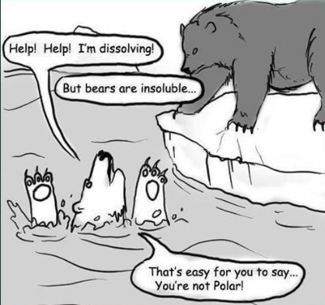
SOLUTIONS
Test Review

Slide 5
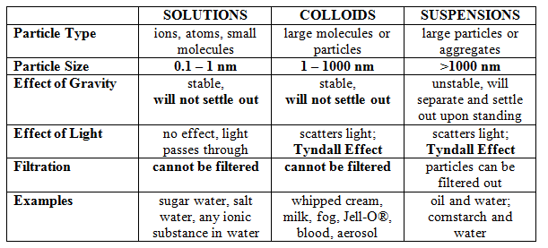
REVIEW
1. Differentiate between colloids, solutions, and suspensions.

Slide 6
REVIEW
1. Differentiate between colloids, solutions, and suspensions.
SOLUTION: smallest particle size, cannot be filtered, will not settle out, does not scatter light.
COLLOID: next largest particle size, cannot be filtered, will not settle out, does scatter light (Tyndall Effect).
SUSPENSION: largest particle size, can be filtered, will settle out, does scatter light (Tyndall Effect)

Slide 7
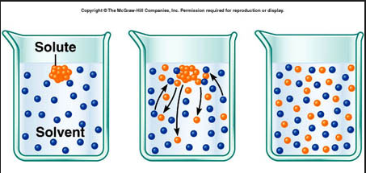
REVIEW
2. Define solvent and solute and be able to identify them in a solution.

Slide 8
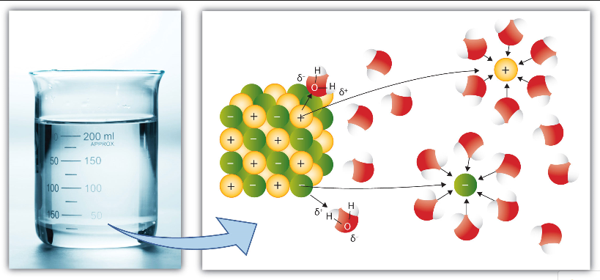
REVIEW
3. Describe the process of dissolving, dissociation, and ionization.
DISSOLVING - occurs when the solute is pulled apart by the solvent. This takes place at the surface of the solute. The solvent surrounds the solute.

Slide 9
REVIEW
3. Describe the process of dissolving, dissociation, and ionization.
DISSOCIATION – the breakdown of a compound into its ions.
IONIZATION – the formation of a charged particle by the gain or loss of an electron.

Slide 10
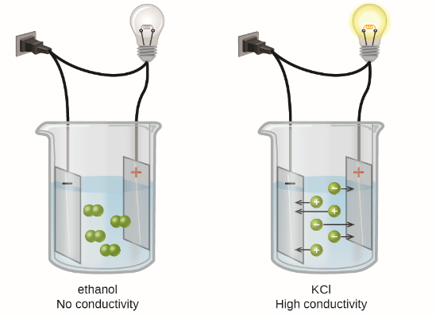
REVIEW
4. Describe the conductivity of solutions in terms of ions, ionization, electrolyte, and nonelectrolyte.
ELECTROLYTE
NONELECTROLYTE

Slide 11
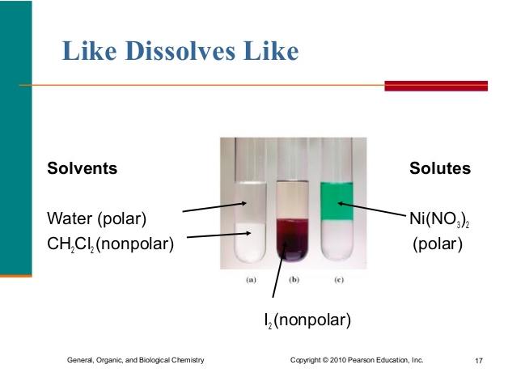
REVIEW
5. Be sure to study polarity of compounds to be able to predict solubility.
Need to know:
POLAR: Water , Ionic compounds
NONPOLAR: Oil, wax

Slide 12
REVIEW
5. Be sure to study polarity of compounds to be able to predict solubility.
Polar Solvent – Polar Solute:
The polar solvent is attracted to the polar solute. The solvent gradually surrounds the solute. The particles attach themselves due to polar attraction. Dissolving occurs. Like dissolves like. Example: Salt in water
Polar Solvent – Nonpolar Solute:
Polar solvent particles are attracted to each other and not the solute. Dissolving does not occur and a solution is unlikely. Example: oil in water.

Slide 13
REVIEW
5. Be sure to study polarity of compounds to be able to predict solubility.
Nonpolar Solvent – Polar Solute:
Nonpolar solvent particles have little attraction to the polar solute. Dissolving does not occur and a solution is unlikely. Example: Salt in oil.
Nonpolar solvent – Nonpolar solute:
Random motion of solute particles causes them to leave the surface of the solute and become evenly dispersed in the nonpolar solvent. Dissolving occurs. Like dissolves like. Example: Styrofoam® in acetone.

Slide 14

REVIEW
6. Be able to distinguish between a concentrated solution and a dilute solution.
CONCENTRATED: lots of solute in some solvent
DILUTE: little solute in some solvent
Most Concentrated
Most Dilute

Slide 15
REVIEW
7. Be able to calculate percentage by volume.
% volume = amount of solute (mL) x 100
amount of soln (mL)
PRACTICE: 200mL of Powerade® with 800mL of water to make a 1000mL solution. What is the percentage by volume?

Slide 16
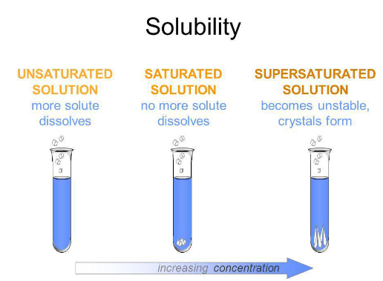
REVIEW
8. Differentiate between saturated, unsaturated, and supersaturated.

Slide 17
REVIEW
8. Differentiate between saturated, unsaturated, and supersaturated.
Unsaturated
There is more available space for solute to dissolve in the solvent.
Saturated
When there is enough solute in the solvent and you begin to see some crystals
Supersaturated
When there is an excess of solute in the solvent. The solution is unstable and the excess solute with crystallize out if given the chance.

Slide 18
REVIEW
9. State and discuss the factors affecting the rate of solubility.
Agitation – stirring or shaking puts the solute in contact with the solvent more often.
Temperature – raising the temperature makes the particles move faster which puts the solute in contact with the solvent more often.
Particle Size – smaller particles means more surface area which puts the solute in contact with the solvent more often.

Slide 19
REVIEW
10. State and discuss the factors that affect solubility.
Nature of the solvent and solute - “like dissolves like”.
Temperature - increase the temperature and solubility increases.
Pressure - increase the pressure and you increase solubility. (only gases)
How much is already dissolved?

Slide 20
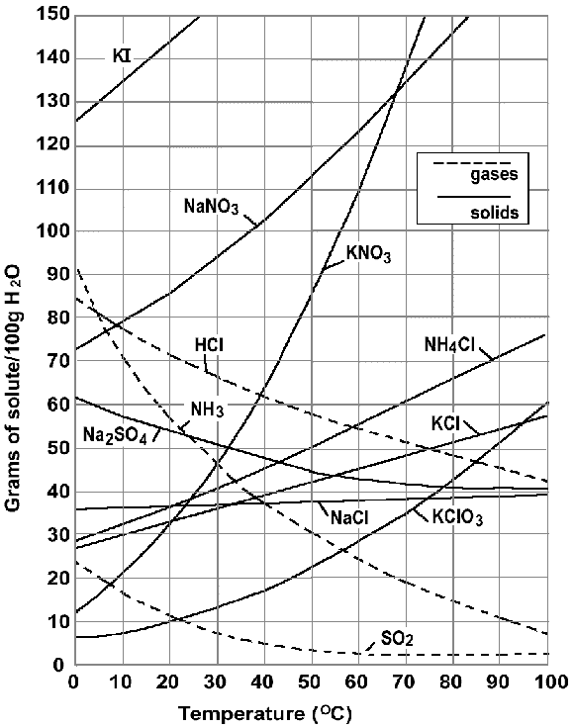
REVIEW
11. Be able to read a solubility curve graph.
Be able to tell how much is dissolved.
Be able to tell at what temperature it dissolved

Slide 21
REVIEW
11. Be able to read a solubility curve graph.
Be able to tell saturated, unsaturated, and supersaturated.
Know what types of compounds show a decrease in solubility

Slide 22
REVIEW
12. Know the chapter vocabulary words and the SAT words from list #10.
diffuse a. (v.) to scatter, thin out, break up; b. (adj.) not concentrated, scattered or disorganized
saccharine (adj.) sickeningly sweet.
soluble (adj.) able to dissolve
solvent a. (n.) substances that dissolve other substances; b. (adj.) able to pay debts
viscous (adj.) not free flowing, syrupy

Slide 23
SACCHARINE-Y SWEET SOLUTIONS LAB
When graphing, you were to convert your sample masses in 20mL of solvent to match the graph which is per 100mL solvent.
30g = xg
20mL 100mL
Substitute in 35g, 40g, and 45g for 30g to get your three numbers.

Slide 24
TO DO
Complete lab and turn it in by the end of the period today.
Work on Review packet – due tomorrow for test redo credit.

