Slide 1
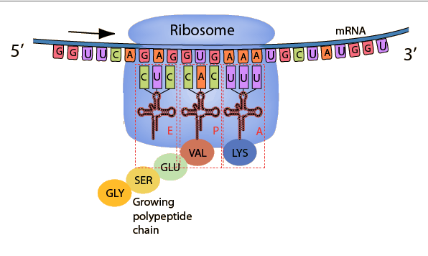
RNA - TRANSLATION

Slide 2
PROTEIN SYNTHESIS
GENERAL INFORMATION
Proteins are formed from amino acids.
Formed by using the information coded on DNA and carried out by mRNA.
Protein synthesis takes place in the cytoplasm on structures called ribosomes.
Protein synthesis involves both DNA & RNA.
Protein synthesis involves both transcription & translation.

Slide 3
TRANSLATION
Information on the mRNA is used to make proteins:
1. After leaving the nucleus, the mRNA enters the cytoplasm and attaches to a ribosome. The ribosome moves along the mRNA until it finds a START CODON (AUG) – (3 nitrogen bases on mRNA = codon).

Slide 4
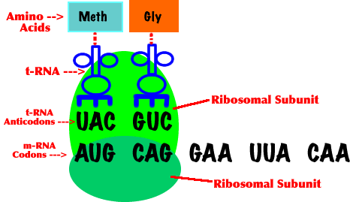
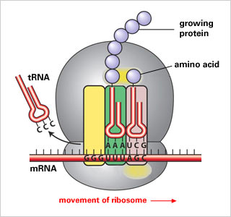
TRANSLATION

Slide 5
TRANSLATION
2. tRNA binds to the mRNA strand at the start codon. tRNA transfers the amino acids to the ribosome. tRNA also carries the ANTICODON – (3 complementary nitrogen bases on tRNA = anticodon).
3. rRNA is found in ribosomes and helps in the attachment of tRNA to mRNA and in the assembly of proteins.

Slide 6
TRANSLATION
4. Another tRNA anticodon binds to the mRNA codon, and drops off the amino acid. The amino acids form a peptide bond and the tRNA detaches from mRNA.
5. The binding of tRNA and mRNA continue until the ribosome reaches a STOP CODON. The amino acid chain is released and folds to form a globular protein.

Slide 7
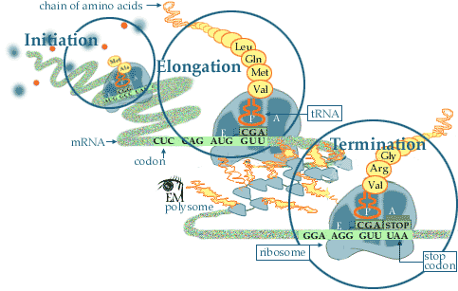
TRANSLATION
Translation and Translation

Slide 8
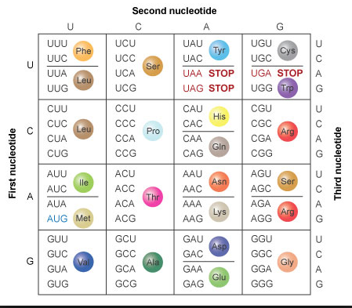
CODONS = AMINO ACIDS

Slide 9
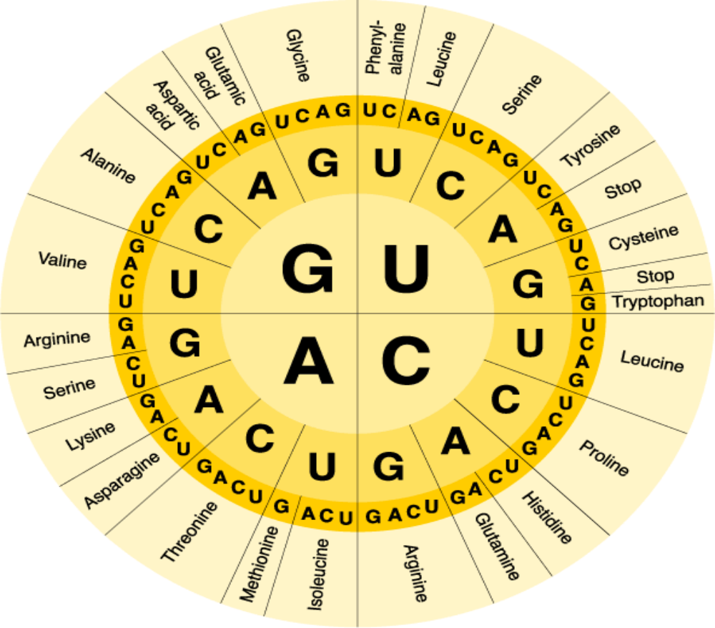
CODONS = AMINO ACIDS

Slide 10
