Slide 1
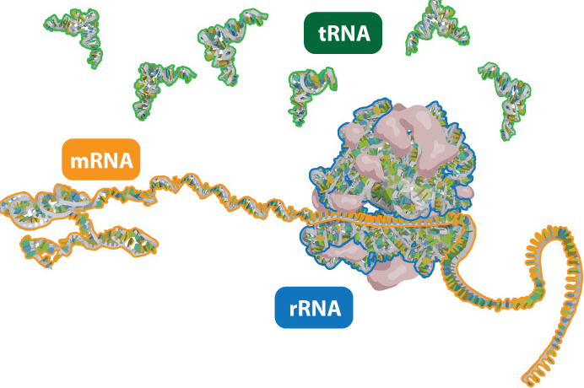
RNA and TRANSCRIPTION

Slide 2
DNA REPLICATION REVIEW
GCTCAG Original Strand
CGAGTC Complimentary Strand
DNA helicase unzips (unwinds)
Replication forks: two areas on either area of the DNA where the double helix separates .
DNA polymerase adds nucleotides & “proofreads”
Two DNA molecules form that are identical to the original DNA molecules.
GCTCAG GCTCAG
CGAGTC CGAGTC

Slide 3
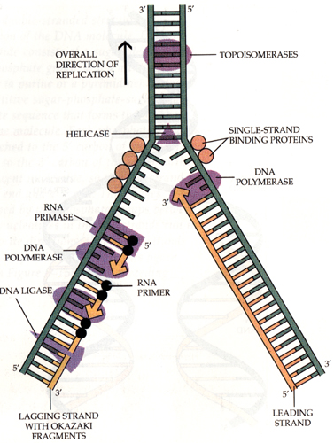

Slide 4
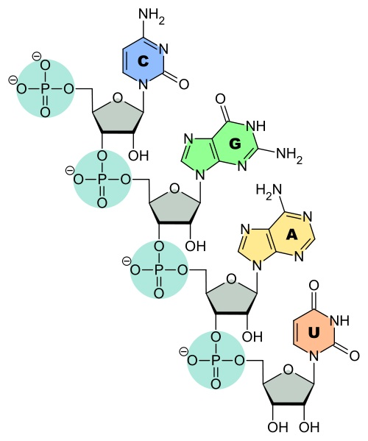
RNA
RNA is composed of monomers called nucleotides. Each nucleotide consists of:
a phosphate
a sugar (ribose)
nitrogenous base (adenine, uracil, guanine, cytosine)

Slide 5
RNA
  How RNA differs from DNA:
  RNA is single strand of nucleotides.
  RNA is a copy of DNA used for protein synthesis.
  RNA nucleotides have a uracil base instead of thymine.
  Otherwise, DNA and RNA are the same. Their phosphates, sugars, and bases show the same bonding patterns to form nucleotides and their nucleotides bind to form nucleic acids in the same way.

Slide 6
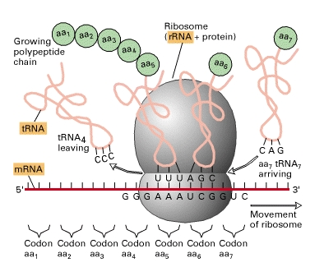
RNA
    There are three types of RNA:
    Messenger RNA (mRNA)
carries a sequence of nucleotides that code for a protein from nucleus to cytoplasm.
    Transfer RNA (tRNA)
picks up amino acids in the cytoplasm and carries them to the ribosome.
    Ribosomal RNA (rRNA)
    found in ribosome, helps to bind mRNA to tRNA.

Slide 7
IMPORTANCE OF PROTEINS
From the Greek word “prota,” meaning of primary importance.
Large, organic molecule made up of amino acids.
Traits, such as eye color, are determined by proteins, built according to the DNA.
Example
The condition of albinism is the result of a genetic defect of the enzyme tyrosinase.
This enzyme helps the body change the amino acid tyrosine into pigment (melanin).

Slide 8
PROTEINS
Proteins are the tools of the living organism.
Proteins are composed of amino acids and have a defined three-dimensional structure. This form dictates the function.
Proteins are responsible for all the reactions and activities of the cell.
The structure of the individual proteins is encoded in DNA in the cell nucleus.
Cytoskeletal proteins control the shape and movement of the cell.

Slide 9
FUNCTION OF PROTEINS
Proteins have many functions
Enzymes
transport molecules (hemoglobin & O₂)
storage molecules (Fe in liver)
movement (muscles)
mechanical support (skin & bone made up of collagen a fibrous protein)
mediate cell responses (rhodopsin, a protein in the eye used for vision)

Slide 10
FUNCTION OF PROTEINS
Proteins have many functions
antibody proteins are needed for immune protection
control of growth & cell differentiation uses proteins (hormones), cytoskeleton, etc.

Slide 11
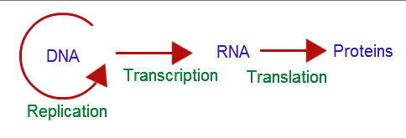
THE CENTRAL DOGMA
The Central Dogma, developed by Frances Crick, says:

Slide 12
TRANSCRIPTION
mRNA copies a segment of DNA.
RNA polymerase attaches to DNA in the nucleus and initiates transcription at the promoter. A promoter is a sequence of DNA where enzyme attaches and initiates transcription.
RNA polymerase unwinds DNA and starts transcription. As it moves along the DNA strand from 3’ to 5’, complementary bases of RNA nucleotides are added.

Slide 13
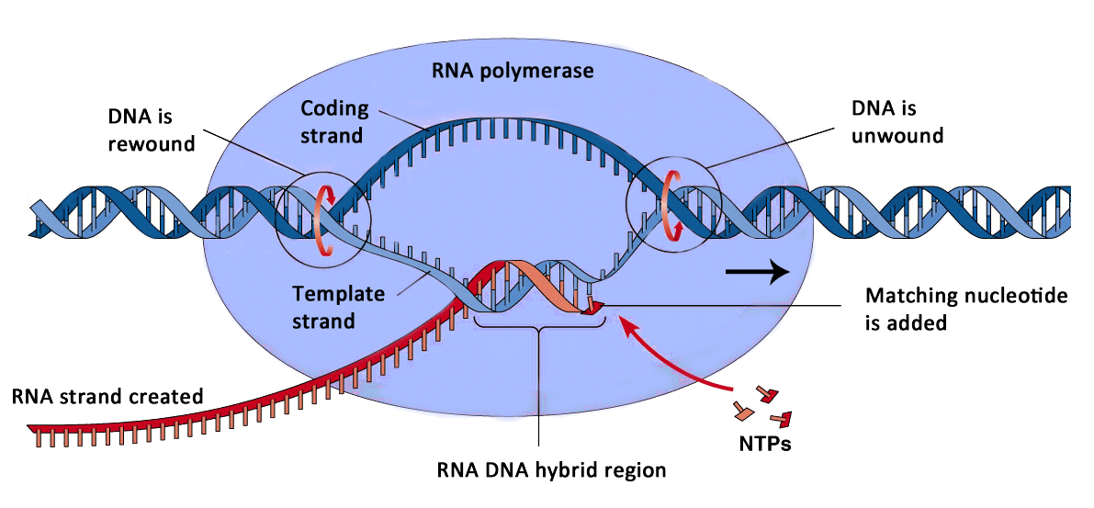
TRANSCRIPTION

Slide 14
TRANSCRIPTION
3. When the RNA polymerase reaches a terminator sequence on the DNA, transcription stops. The mRNA strand disconnects from DNA.
4. Before leaving the nucleus, each new mRNA transcript undergoes modification. Introns, which are non-coding regions (junk DNA), are cut out of the mRNA strand. The strand is spliced back together leaving only exons. Exons are the coding regions (genes).
5. The mRNA strand leaves the nucleus and travels to the ribosome.

Slide 15
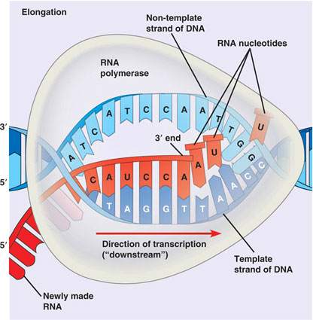
TRANSCRIPTION
Transcription and Transcription

