Slide 1
SOLUTIONS
If you are not part of the SOLUTION, you’re part of the PRECIPITATE!

Slide 2
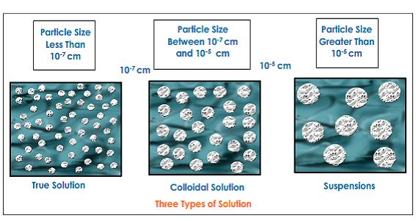
THREE TYPES OF MIXTURES
SOLUTIONS COLLOIDS SUSPENSIONS
The particle size determines the type of mixture.
Solutions and Colloids are homogeneous;
suspensions are heterogeneous.

Slide 3
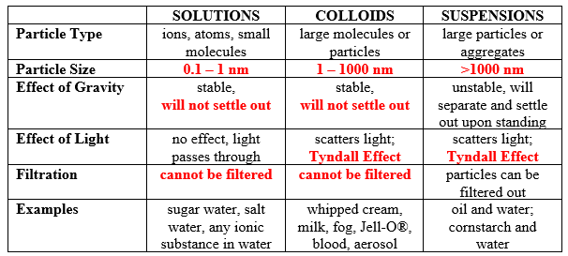
MIXTURES

Slide 4

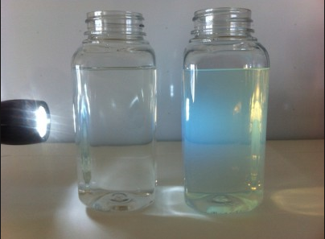
MIXTURES
TYNDALL EFFECT: particles dispersed in mixture are big enough to scatter light.

Slide 5
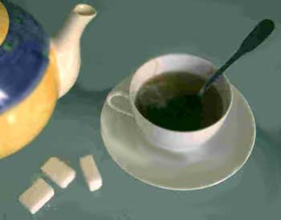
SOLUTIONS
A solution is a mixture that has the same composition, color, and density throughout.
It is homogeneous.
Solutions form when particles of solute are interspersed evenly throughout the solvent.

Slide 6
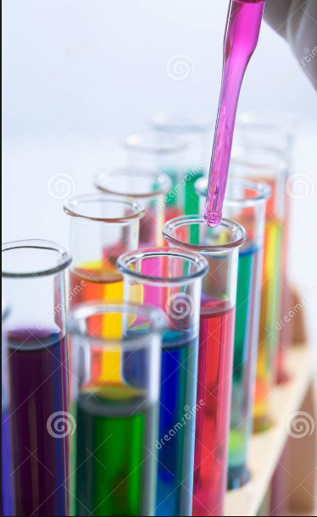
SOLUTIONS
It has two parts:
SOLUTE: the substance being dissolved; in smaller abundant.
SOLVENT: the substance doing the dissolving; the greater amount.

Slide 7
SOLUTIONS
Solutions can be one of nine basic types:
Liquid Solutions:
solid in liquid (salt water)
liquid in liquid (vinegar)
gas in liquid (carbonated drink)
Gaseous Solutions (All gaseous mixtures are solutions):
solid in gas (soot in air)
liquid in gas (humid air)
gas in gas (air)

Slide 8
SOLUTIONS
Solid Solutions - usually made from liquid solutions that have been mixed and then solidified (frozen):
solid in solid (alloys – brass, bronze)
liquid in solid (dental fillings)
gas in solid (charcoal gas mask)

Slide 9
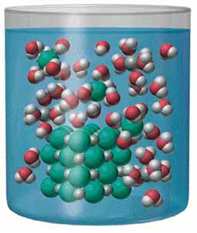
THE DISSOLVING PROCESS
Dissolving occurs when the solute is pulled apart by the solvent.
This takes place at the surface of the solute.
The solvent surrounds the solute.
When ionic compounds separate into their ions in a solvent, dissociation occurs.

Slide 10
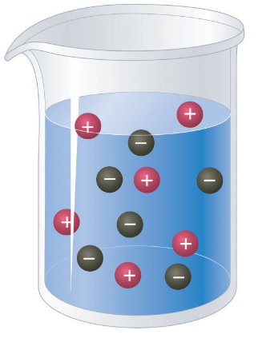
THE DISSOLVING PROCESS
Remember that opposites attract. So when a positive ion comes near a negative ion, there is an attraction.
Polar molecules have a negative end and a positive end. Polar molecules are attracted to each other.

Slide 11
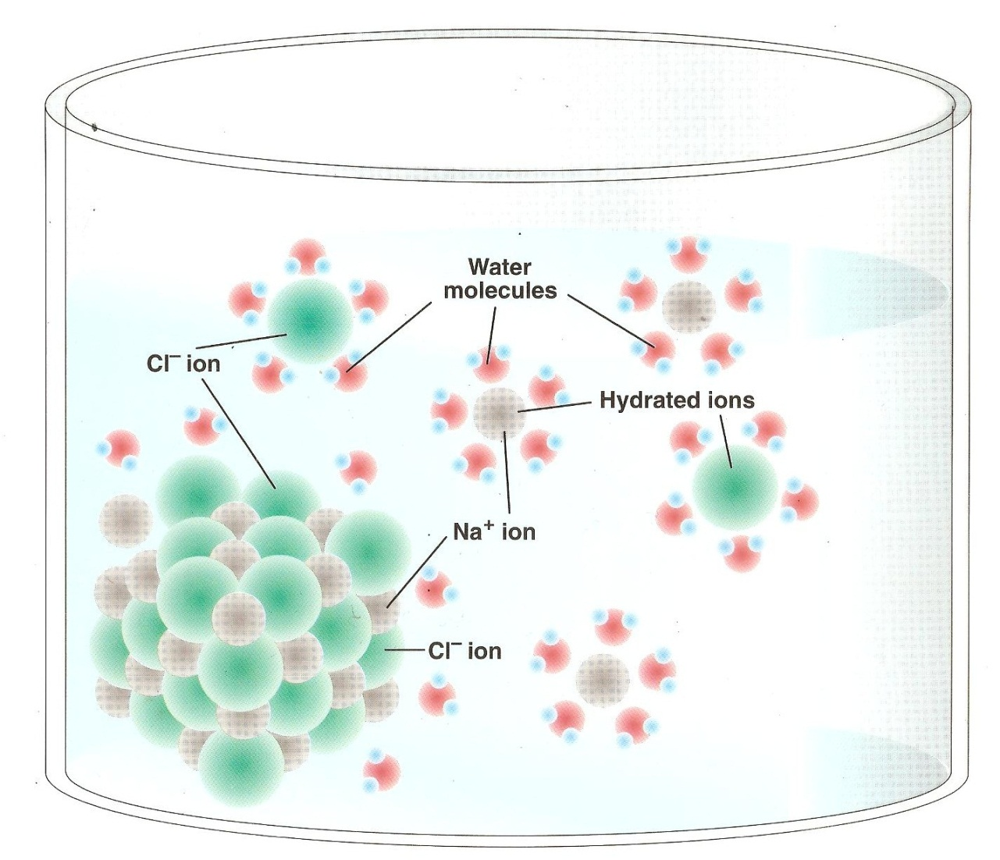
DISSOCIATION OF NaCl

Slide 12
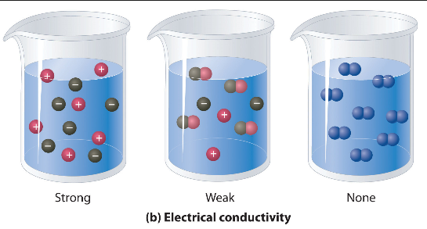
THE DISSOLVING PROCESS
Electrolytes are compounds that break apart in water forming ions that conduct electricity. Ions are polar.
Ionization is when electrolytes dissolve in water and separate into ions. So a solution with ions conducts electricity.

Slide 13
THE DISSOLVING PROCESS
Nonpolar molecules are not attracted to each other or to polar molecules.
Nonelectrolytes are substance that do not ionize in water and cannot conduct electricity. They may still dissolve in water. A solution with nonelectrolytes does not conduct electricity.

Slide 14
Solute-Solvent Combinations
Combinations to solute and solvent are based on properties of each.
There are FOUR main types.

Slide 15
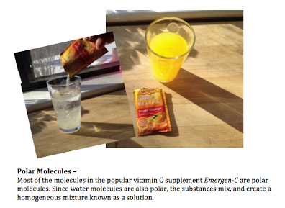
Solute-Solvent Combinations
1. Polar Solvent – Polar Solute:
The polar solvent is attracted to the polar solute. The solvent gradually surrounds the solute. The particles attach themselves due to polar attraction. Dissolving occurs. Like dissolves like. Example: Salt in water

Slide 16
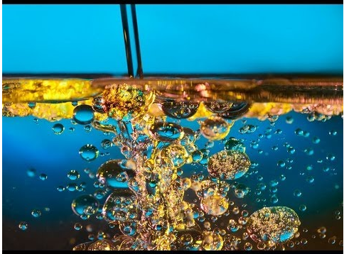
Solute-Solvent Combinations
2. Polar Solvent – Nonpolar Solute:
Polar solvent particles are attracted to each other and not the solute. Dissolving does not occur and a solution is unlikely. Example: oil in water.

Slide 17
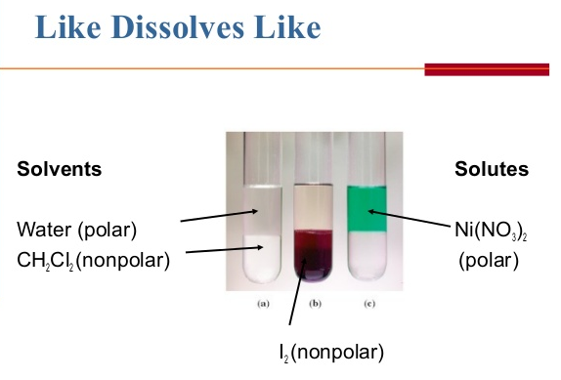
Solute-Solvent Combinations
3. Nonpolar Solvent – Polar Solute:
Nonpolar solvent particles have little attraction to the polar solute. Solvation does not occur and a solution is unlikely. Example: Salt in oil.

Slide 18
Solute-Solvent Combinations
4. Nonpolar solvent – nonpolar solute:
Random motion of solute particles causes them to leave the surface of the solute and become evenly dispersed in the nonpolar solvent. Solvation occurs. Like dissolves like. Example: Styrofoam® in acetone.

Slide 19
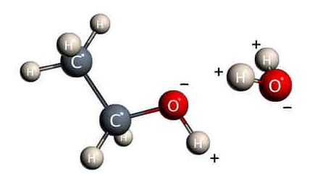
REAL-WORLD SOLUTIONS
Alcohol has a polar end and a nonpolar end so it will work with polar and nonpolar solvents

Slide 20
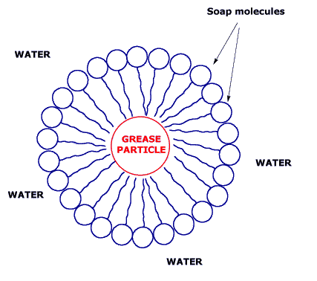
REAL-WORLD SOLUTIONS
Soap is another molecule with a nonpolar end and a polar end that is good at lifting oils and other nonpolar solutes in water which is polar.

Slide 21
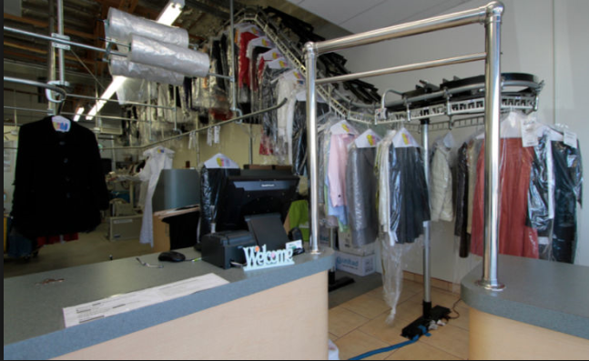
REAL-WORLD SOLUTIONS
Many nonpolar solvents are flammable or toxic. Dry cleaners use nonpolar solvents. Turpentine is a nonpolar solvent that can dissolve oil-based paints.

Slide 22
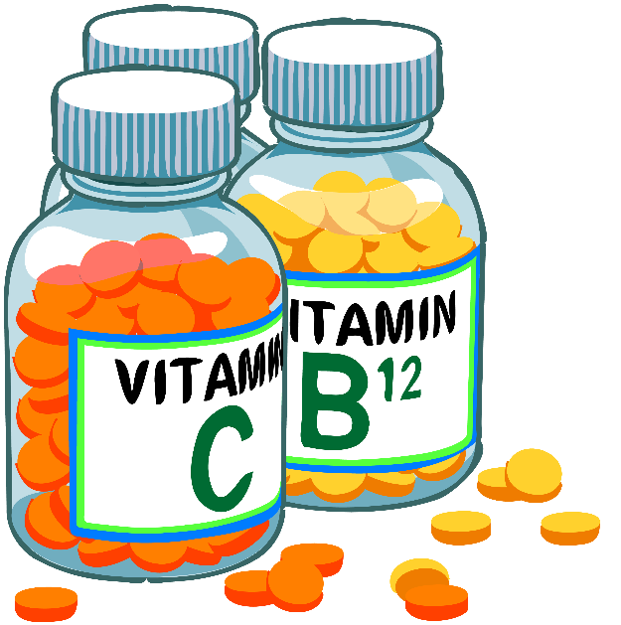
REAL-WORLD SOLUTIONS
Vitamins – some vitamins are polar (B vitamins and Vitamin C) so they dissolve in water and other are nonpolar (Vitamins A, D, E, and K).
You have to make sure you do not overdose on the nonpolar ones because they are not easily eliminated by the body.

