Slide 1
SOLUTIONS
If you are not part of the SOLUTION, you’re part of the PRECIPITATE!

Slide 2
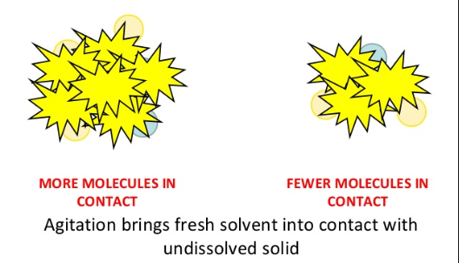
FACTORS AFFECTING RATE OF DISSOLVING
Agitation (shaking, stirring) - more solvent to come in contact with the solute faster.

Slide 3
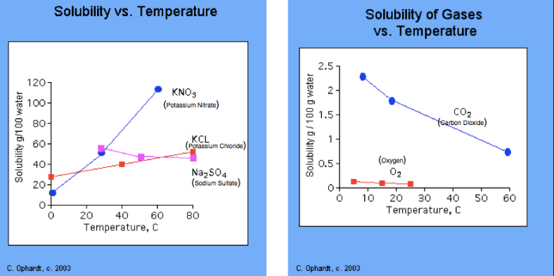
FACTORS AFFECTING RATE OF DISSOLVING
Increased temperature (except gases)- more solvent to come in contact with the solute faster.

Slide 4
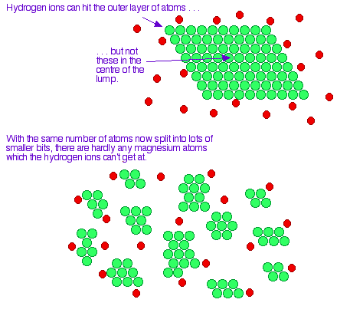
FACTORS AFFECTING RATE OF DISSOLVING
Smaller Particle size - more surface area in solutions means more solvent to come in contact with the solute faster.

Slide 5
FACTORS AFFECTING DISSOLVING
Nature of the solvent and solute - “like dissolves like”. This means that polar solvent dissolves a polar solute and nonpolar solvent dissolves nonpolar solute. But polar does not dissolve nonpolar.
In other words – will it even dissolve?

Slide 6
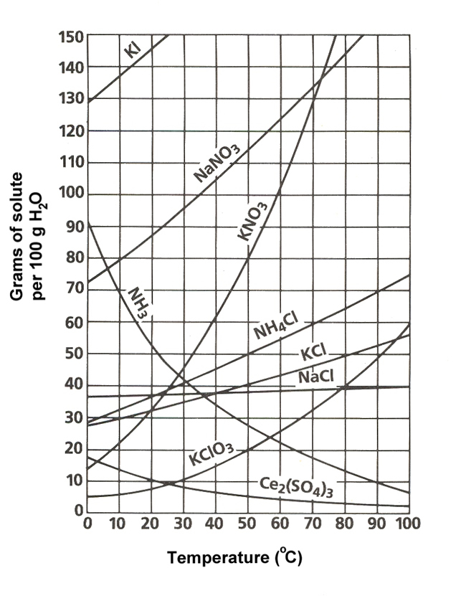
FACTORS AFFECTING DISSOLVING
Temperature - increase the temperature and solubility increases. The exception is gases. When you increase the temperature of a gas, less gas will dissolve.

Slide 7
FACTORS AFFECTING DISSOLVING
Pressure - increase the pressure and you increase solubility. This only works with gases.
How much is already dissolved?

Slide 8
SOLUBILITY
Solubility is the maximum amount of a solute that can dissolved in a given amount of solvent at a given temperature.
It is usually measured in grams of solute per 100 grams of solvent.

Slide 9
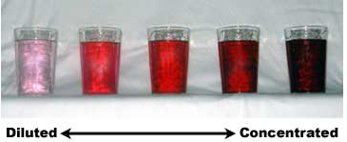
SOLUBILITY
A CONCENTRATED solution is said to have a high ratio of solute to solvent.
A DILUTE solution is the opposite of this.
Neither of these is a precise way to measure concentration.

Slide 10
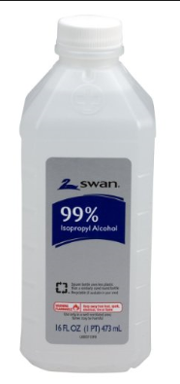
SOLUBILITY
One way to describe concentration is to state the percentage by volume.
Adding 10mL of juice to 90mL of water makes 100mL and a 10% juice solution.
(10mL / 100mL) x 100 = 10%

Slide 11
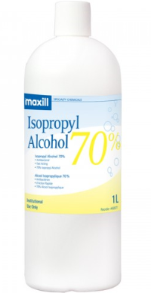
SOLUBILITY
PRACTICE
Calculate the percentage volume of the alcohol in the rubbing alcohol id there is 70mL of alcohol in 100mL solution

Slide 12
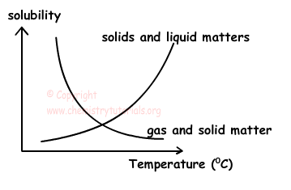
SOLUBILITY
Solubility curves have temperature and solubility on their axes.
For solids: solubility usually increases with increased temperature.
For gases: solubility usually decreases with increased temperature.

Slide 13
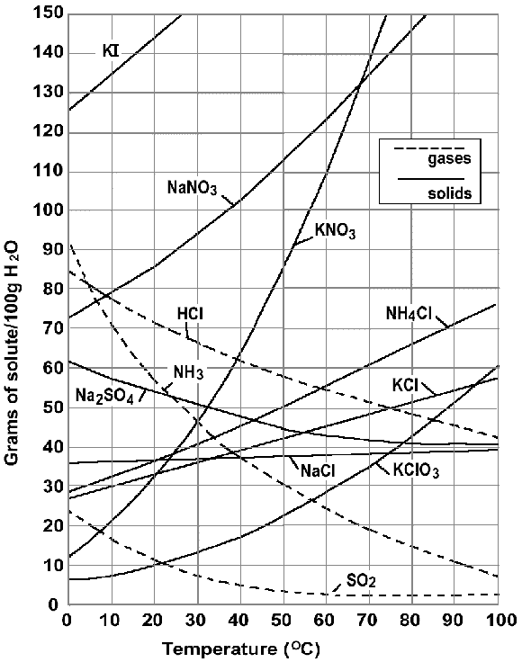
SOLUBILITY
Each line is a saturation line for that substance indicating temperature and amount dissolved.

Slide 14
TO WATCH
Supersaturation, Chapter 36
A large supersaturation:
Rapid Crystallization

Slide 15
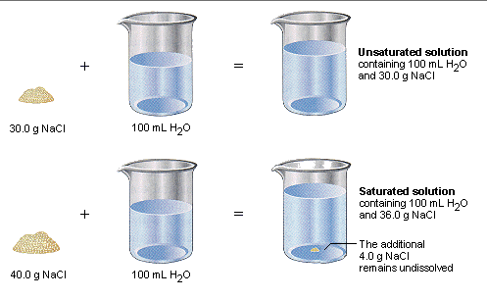
TYPES OF SOLUTIONS
A saturated solution is a solution that contains all the solute is can hold at a given temperature.
An unsaturated solution is a solution that can dissolve more solute at a given temperature.

Slide 16
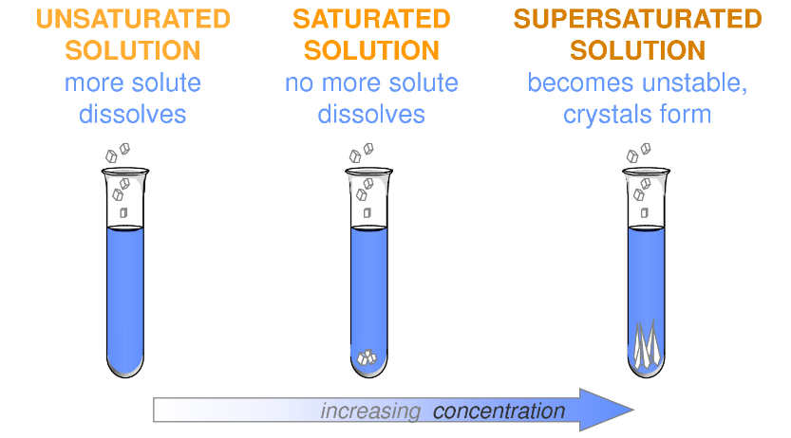
TYPES OF SOLUTIONS
A supersaturated solution is one that contains more solute than a saturated one at the same temperature.
An unstable condition results because the solution holds more solute that it normally does at a given temperature.

Slide 17
SEIZURE
Art Installation by Roger Hiorns

Slide 18
SEIZURE
Hiorns began by reinforcing the walls and ceiling, and tanking the flat (apartment)with plastic sheeting.
Then 70-80,000 liters of hot copper sulfate solution was pumped in through a hole in the ceiling from the flat above.
Weeks went by, until the temperature of the solution dropped, and the crystals began to precipitate.
Finally, any remaining liquid was pumped back out, to be recycled by the chemical industry.

Slide 19
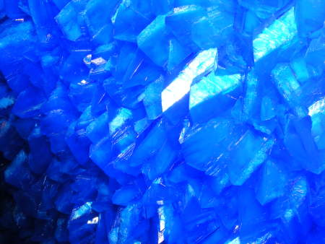

Slide 20
PRACTICE
Looking at the solubility curve above, answer the following:
At what temperature 85g of NaNO₃ dissolved? ____________
How many grams will dissolve at 60°C of NH₄Cl? ____________
Name one compound that has a decreasing solubility as temperature increases. _________

Slide 21
PRACTICE
4. If you have 35g of KNO₃ at a temperature of 60°C, is it saturated, unsaturated, or supersaturated?
____________________________
5. If you have 40g of KClO₃ at a temperature of 20°C, is it is it saturated, unsaturated, or supersaturated? ____________________________

Slide 22
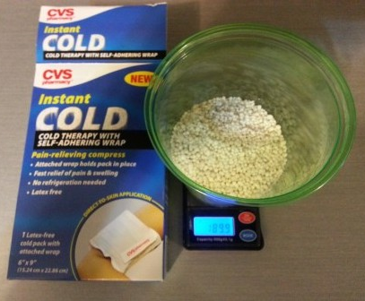
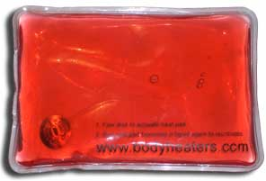
SOLUTION ENERGY
When making a solution, it can be exothermic or endothermic.
When sodium acetate is crystallizing (coming out of a supersaturated solution), it gives off heat.
When ammonium nitrate is dissolving in water, it needs energy to dissolve and thus the solution gets cold.

