Slide 1
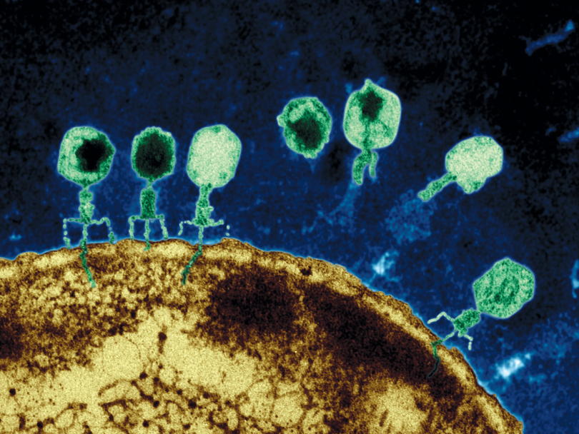
VIRUSES
Introduction to Viruses video

Slide 2
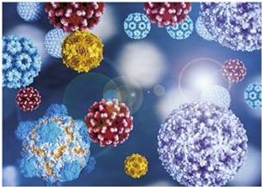
VIRUSES
The Beginnings of Life?

Slide 3
VIRUSES
Viruses are nonliving particles that can only reproduce within a HOST CELL (living cell).
CANNOT carry out life-sustaining functions.
Most biologists do not consider them as living.

Slide 4
VIRUSES
Smaller than bacteria, most can only be seen with an electron microscope.
Incapable of reproducing independently.
Do not grow.
Do not have homeostasis.
Do not metabolize.
Can crystallize.

Slide 5
DISCOVERY OF VIRUSES
Viruses can cause disease in plants and animals.
Pathogens are disease-causing microorganisms.
Scientists were looking for the cause for the disease in tobacco plants.
1892, Dmitri Iwanowski, squeezed fluid from a diseased plant, passed it through a filter, and gave it to a healthy plant. The fluid caused disease in a healthy plant.
1898, Martinus Beijerinck, repeated Iwanowski’s experiment and concluded fluid contained “unknown factor,” he called a virus, Latin for “poison.”
1935, Wendell Stanley isolated the Tobacco Mosaic Virus (TMV), crystallized it, placed it back in solution, rubbed fluid on a healthy plant which became diseased.

Slide 6
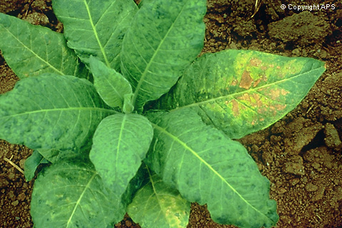
TOBACCO MOSAIC VIRUS

Slide 7
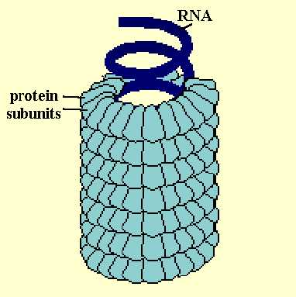
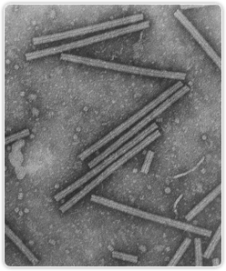
TOBACCO MOSAIC VIRUS
Electron micrograph and explanation of shape due to arrangement of proteins.

Slide 8
VIRAL STRUCTURES
Nucleic Acid – DNA or RNA
  encodes for the synthesis of proteins and making new viruses
Capsid – protein coat surrounding nucleic acid; arrangement determines shape
  protects the nucleic acid from digestive enzymes
  contains special sites on its protein surface that allow the virus to attach and penetrate the host cell membrane

Slide 9
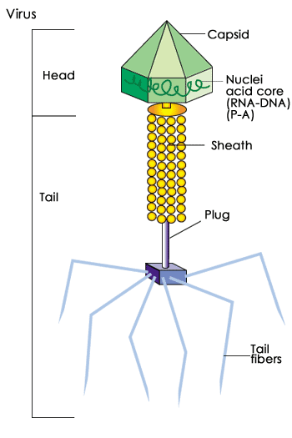
VIRAL STRUCTURES

Slide 10
VIRAL STRUCTURES
DIFFERENT MORPHOLOGICAL TYPES
Envelope: membrane surrounding the capsid; not found in all viruses; helps the virus enter cells. Made up of proteins, lipids, and glycoproteins. Some also have enzymes. Example: influenza
Helical: rod-like with capsid proteins winding around the core in a spiral. Example – Tobacco Mosaic Virus

Slide 11
VIRAL STRUCTURES
DIFFERENT MORPHOLOGICAL TYPES
Polyhedral: many sides (20 triangular faces & 12 corners) and roughly spherical. Example: Adenovirus, causes several human infections such as chest & stomach flu.
Bacteriophage: Viruses that infect bacteria. Polyhedron capsid attached to a helical tail.

Slide 12
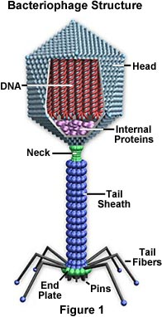
BACTERIOPHAGE

Slide 13
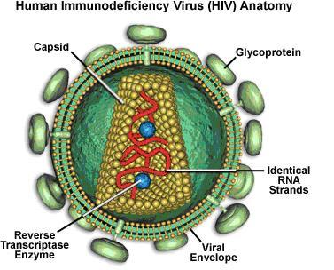
VIRAL STRUCTURES
The viral envelope, the outer coat of the virus, consists of two layers of lipids; different proteins are embedded in the viral envelope, forming "spikes" consisting of the outer glycoprotein and the transmembrane .
The HIV matrix proteins lie between the envelope and core.
-The viral core, contains the viral capsule protein which surrounds two single strands of HIV RNA and the enzymes needed for HIV replication, such as reverse transcriptase, protease, ribonuclease, and integrase.

Slide 14
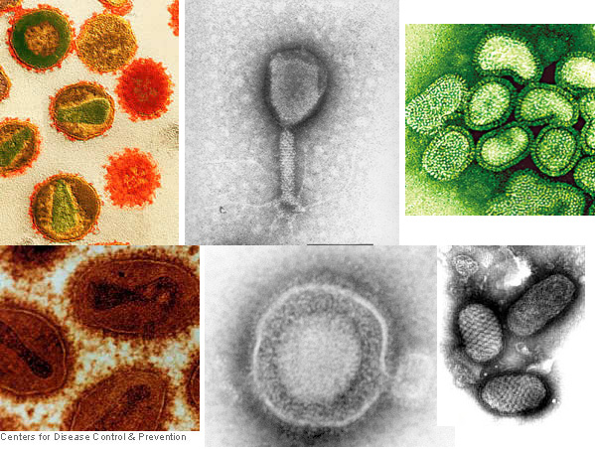
Virus Shape is due to the arrangement of proteins

Slide 15
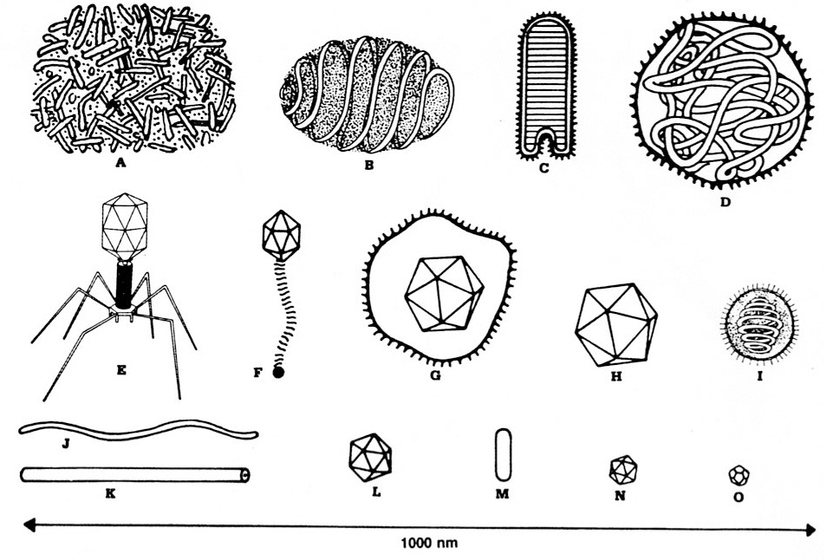
VIRUS SHAPES

Slide 16
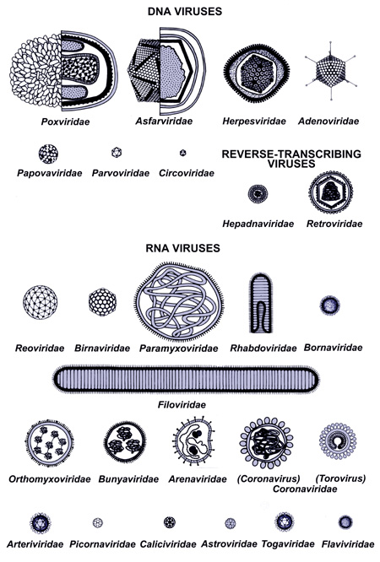
VIRUS SHAPES

Slide 17
CLASSIFICATION OF VIRUSES
Group I: double-stranded DNA viruses
Group II: single-stranded DNA viruses
Group III: double-stranded RNA viruses
Group IV: positive-sense single-stranded RNA viruses
Group V: negative-sense single-stranded RNA viruses
Group VI: reverse transcribing Diploid single-stranded RNA viruses
Group VII: reverse transcribing Circular double-stranded DNA viruses

Slide 18
DNA VIRUSES
Virus Family | Virus Genus | Virion- naked/ enveloped | Capsid Symmetry | Type of nucleic acid
1.Adenoviridae | Adenovirus | Naked | Icosahedral | ds
2.Papovaviridae | Papillomavirus | Naked | Icosahedral | ds circular
3.Parvoviridae | B 19 virus | Naked | Icosahedral | ss
4.Herpesviridae | Herpes Simplex Virus, Varicella zoster virus, Cytomegalovirus, Epstein Barr virus | Enveloped | Icosahedral | ds
5.Poxviridae | Small pox virus, Vaccinia virus | Complex coats | Complex | ds
6.Hepadnaviridae | Hepatitis B virus | Enveloped | Icosahedral | ds circular

Slide 19
RNA VIRUSES
“RETROVIRUSES”
Virus Family | Virus Genus | Virion- naked/ enveloped | Capsid Symmetry | Type of nucleic acid
1.Reoviridae | Reovirus, Rotavirus | Naked | Icosahedral | ds
2.Picornaviridae | Poliovirus, Rhinovirus, Hepatitis Avirus | Naked | Icosahedral | ss
3.Caliciviridae | Norwalk virus, Hepatitis E virus | Naked | Icosahedral | ss
4.Togaviridae | Rubella virus | Enveloped | Icosagedral | ss
5.Arenaviridae | Lymphocytic choriomeningitis virus | Enveloped | Complex | ss
6.Retroviridae | HIV, Human T cell leukemia | Enveloped | Complex | ss

Slide 20
RNA VIRUSES
“RETROVIRUSES”
7.Flaviviridae | Dengue virus, Hepatitis C virus, Yellow fever virus | Enveloped | Complex | ss
8.Orthomyxoviridae | Influenza virus | Enveloped | Helical | ss
9.Paramyxoviridae | Measles virus, Mumps virus, Respiratory syncytial virus | Enveloped | Helical | ss
10.Bunyaviridae | California encephalitis virus, Hantavirus | Enveloped | Helical | ss
11.Rabdoviridae | Rabies virus | Enveloped | Helical | ss
12.Filoviridae | Ebola virus, Marburg virus | Enveloped | Helical | ss
13.Coronaviridae | Corona virus | Enveloped | Complex | ss
14.Astroviridae | Astro virus | Naked | Icosahedral | ss
15.Bornaviridae | Borna disease virus | Enveloped | Helical | ss

Slide 21
COMMON VIRUSES
RNA Viruses include: HIV (AIDS), cancer, influenza A, B, & C, rabies, poliomyelitis, and hepatitis.
DNA Viruses include: warts, cancer, respiratory and intestinal infections, herpes simplex, chicken pox, shingles, infectious mononucleosis, smallpox, and cowpox.

Slide 22
TO DO
Cell versus Virus
Do Section C #1-5 using the “Viruses: The Ultimate Parasites” handout

Slide 23
DO NOW
Get out your notes, worksheet, and a new EOC sheet.

Slide 24
EOC BIOLOGY BIO21
Put the steps of DNA replication in the correct order.
Parent DNA double helix unwinds, and the two strands separate.
Two identical daughter molecules become twisted again in the form of a double helix.
Free nucleotide bases join with their matching bases along separate parent DNA strands.
Parent DNA is a double helix consisting of two strands of paired nucleotides.

Slide 25
EOC BIOLOGY BIO21
4. Parent DNA is a double helix consisting of two strands of paired nucleotides.
1. Parent DNA double helix unwinds, and the two strands separate.
3. Free nucleotide bases join with their matching bases along separate parent DNA strands.
2. Two identical daughter molecules become twisted again in the form of a double helix.

Slide 26
TO DO
Go over Section C #1-5
Watch “How Viruses Work”

Slide 27
THE LYTIC CYCLE
Virulent Bacteriophages and the Lytic Cycle
Viruses that kill their infected host cell are called virulent.
The DNA in these type of viruses reproduces through the lytic cycle.
When these viruses reproduce, they break open, or lyse, their host cells, resulting in the destruction of the host.
The whole cycle can be complete in 20 - 30 minutes depending on a variety of factors such as temperature.
Phage reproduction is much faster than typical bacterial reproduction, so entire colonies can be destroyed very quickly.

Slide 28
THE LYTIC CYCLE
Virus attaches to host cell and injects viral DNA
Viral DNA uses host cell to create new viruses
New viruses assemble –destroying host

Slide 29
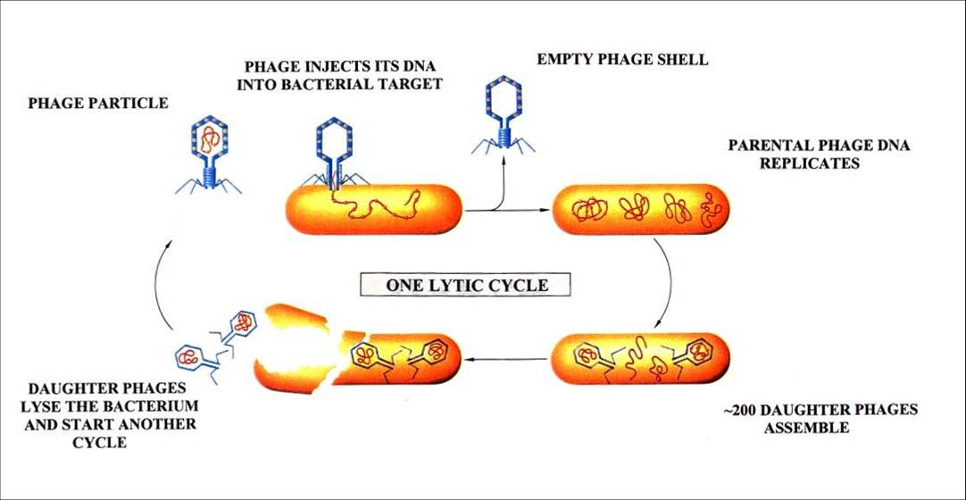
THE LYTIC CYCLE

Slide 30
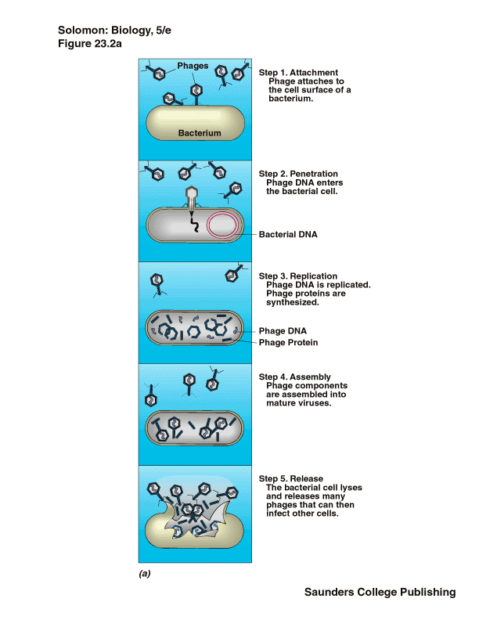
THE LYTIC CYCLE
Adsorption
Entry
Replication
Assembly
Release

Slide 31
WATCH
The Lytic Cycle

Slide 32
THE LYSOGENIC CYCLE
Temperate Viruses and the Lysogenic Cycle
Temperate viruses are those that reproduce without killing their host cell. Typically they reproduce in two ways: through the lytic cycle and the lysogenic cycle.
In the lysogenic cycle, the phage's DNA recombines with the bacterial chromosome.
Once it has inserted itself, it is known as a provirus.
A host cell that carries a prophage has the potential to lyse, thus it is called a lysogenic cell.
Transduction: Viruses also have the ability to transfer genetic material from one host to another, altering the genetic code of a cell.

Slide 33
THE LYSOGENIC CYCLE
Virus attaches to host cell and injects viral DNA.
Viral DNA integrates with host DNA creates provirus.
Provirus is replicated along with host cell’s DNA.
Virus may become active, switching to the lytic cycle, destroying host.

Slide 34
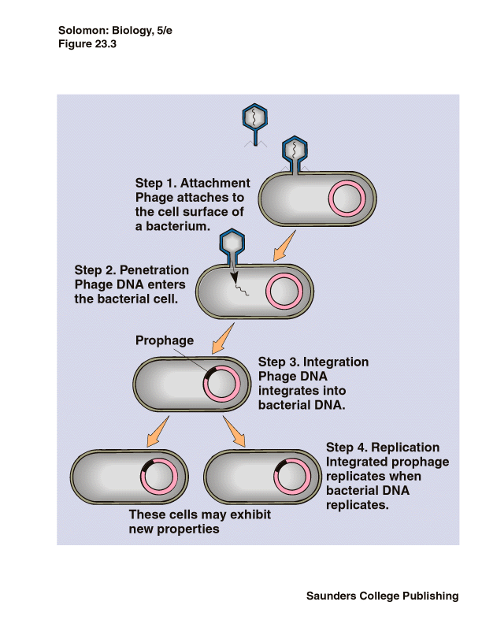
THE LYSOGENIC CYCLE
Attachment
Replication
Activation
A change in the environment, stress, exhaustion, etc., can cause the provirus to begin the lytic cycle.

Slide 35
WATCH
The Lysogenic Cycle

Slide 36
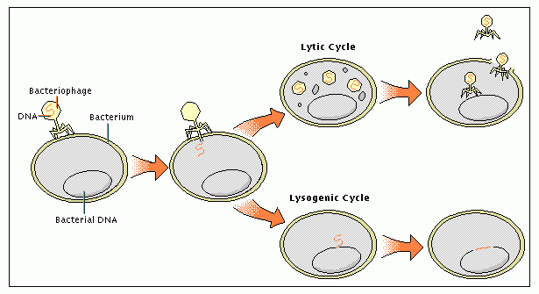
THE LYSOGENIC & LYTIC CYCLES

Slide 37
TO DO
Do Section C #6-12 using the “Viruses: The Ultimate Parasites” handout and your notes.

Slide 38
DO NOW
Get out notes, worksheet and EOC Daily sheet.

Slide 39
EOC BIOLOGY BIO22
A team of scientists at the University of California Irvine has recently placed foreign DNA in mosquitoes. The World Health Organization helped fund the project. What might the team be trying to accomplish?

Slide 40
EOC BIOLOGY BIO22
The team could be trying to eradicate diseases, such as malaria, caused by mosquitoes by causing permanent genetic mutations.

Slide 41
TO DO
Go over Section C #6-12
Watch Flu Attack

Slide 42
VIRUSES ARE HOST SPECIFIC
Viruses tend to attack particular species of animals and plants and specific cells in the organism.
Cold viruses attack cells from the respiratory system while polio attacks the nervous system.
Many viruses can attack more than one species, for example, rabies can be transmitted from dogs and raccoons to humans.
Cowpox can be transmitted from cows to humans.
Psittacosis can be transmitted from birds to humans.

Slide 43
VIRUSES CAUSE MANY DISEASES
The most lethal virus in history: The Spanish Flu (1918-1919).
Approximately 25 million people died, more people than died in battle in WWI.
More than the number that died in a four year time period (1347-1351) from the plague (bacterium).
Many viruses cause cancer: Hepatitis B (liver cancer), Epstein-Barr (Burkitt’s Lymphoma), & human papilloma virus (cervical cancer).

Slide 44
VIRAL DISEASES
VIRAL DISEASES
Mumps | Rabies
Influenza | Herpes
Smallpox | Chickenpox
Measles | AIDS
Polio | Hepatitis

Slide 45
VIRULENCE
The ability of a virus to cause disease:
1. response of the host cell.
2. speed the virus multiplies.
3. presence or activity of receptor sites on the cell surface.
Emerging Viruses: Viruses that evolve in geographically isolated areas and are pathogenic to humans. Ex: Hantavirus (U.S) , Ebola (Africa), Lassa (Africa), Machupo (S.A.)

Slide 46
TREATMENTS
Antiviral drugs – treat symptoms or suppress the virus
Your immune system has to kill the virus
Vaccine – preparation of weakened or killed virus/viral particle.
  stimulates immune system to prevent infection by “teaching” it to recognize virus
  Edward Jenner created smallpox vaccine
  Jonas Salk created polio vaccine

Slide 47
DEFENSE AGAINST VIRAL INFECTIONS
The body provides its own best natural defense against viral disease.
The first line of defense: skin, mucous membranes. Once the virus enters, the body attacks directly with white blood cells (phagocytes).
The second method of defense involves the production of protein molecules (antibodies).
The third method of defense is the production of interferon, a protein which interferes with viral replication. Successful with cancer treatments. Now readily produced through Recombinant DNA technology.

Slide 48
IMMUNITY: THE BODY’S NATURAL RESISTANCE TO DISEASE
Active Immunity: Body produces antibodies in response to a pathogen (natural) or a vaccine (artificial).
  Example: exposure to measles (natural active immunity)
  Example: chicken pox vaccine (artificial active immunity)
Passive immunity: Person receives antibodies already produced.
  Example: shot of gamma globulin (artificial passive immunity)
  Example: mother unborn child (natural passive immunity)
  Passive immunity is temporary.

Slide 49
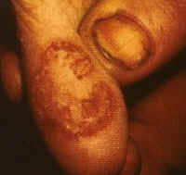
COWPOX

Slide 50
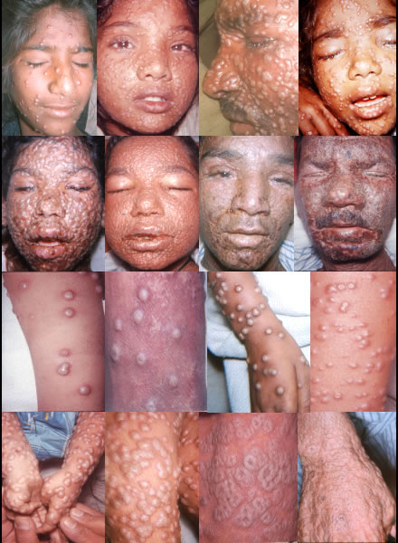
SMALLPOX

Slide 51
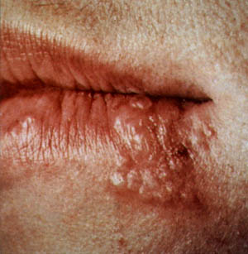
HERPES SIMPLEX I:
COLD SORES

Slide 52
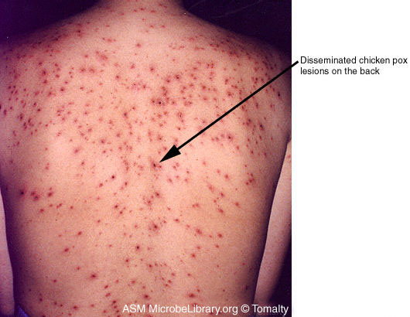
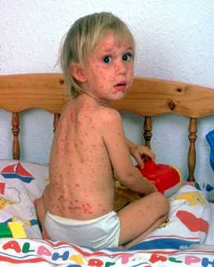
CHICKEN POX

Slide 53
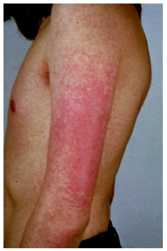
RUBELLA
Rubella, also called German measles or three-day measles, is a highly contagious viral disease that in most children and adults causes mild symptoms of low fever, swollen glands, joint pain, and a fine red rash. Although rubella causes only mild symptoms in child and adult sufferers, the infection can have severe complications for the fetus of a woman who becomes infected with the virus during the first trimester of pregnancy. These complications include severe birth defects or death of the fetus.

Slide 54
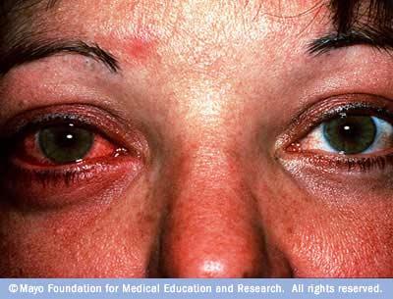
CONJUCTIVITIS (PINK EYE)

Slide 55
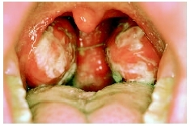
INFECTIOUS MONONUCLEOLUS

Slide 56
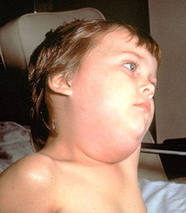
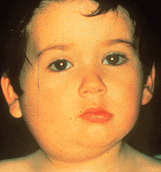
MUMPS

Slide 57
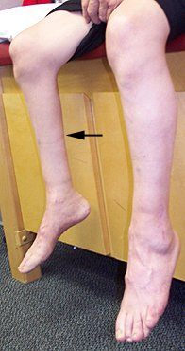
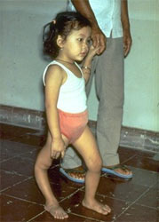
POLIOMYELITIS

Slide 58
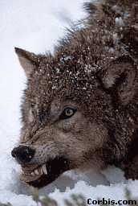
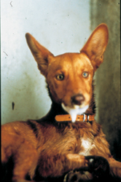
RABIES

Slide 59
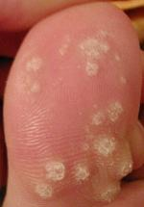
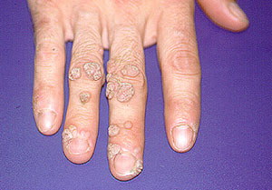
WARTS

Slide 60
EXTRAS
Oncogenic viruses – cause cancer; genes disrupt cell cycle.
Retrovirus – contains RNA; produces a DNA copy of the viral RNA and inserts viral DNA into host cell.
Prion – protein particle with no nucleic acid; accumulation of proteins in an area and kills cells.
Viroid - small naked single-stranded RNA molecules that cause plant diseases.

